Slide 1

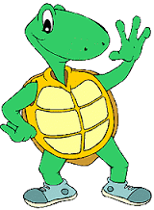
Python basic tutorial
Turtle
Design by : Abdullah Saremi Naeini

Slide 2
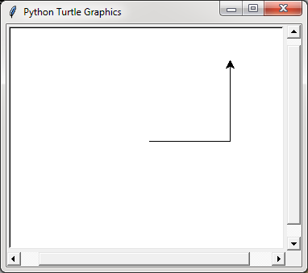
First
import turtle
wn=turtle.Screen()
pat=turtle.Turtle()
pat.forward(100)
pat.left(90)
pat.fd(100)
wn.mainloop()

Slide 3
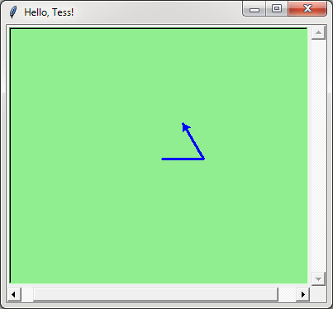
Second
import turtle
wn = turtle.Screen()
wn.bgcolor("lightgreen") # Set the window background color
wn.title("Hello, Tess!") # Set the window title
mat= turtle.Turtle()
mat.color("blue") # Tell mat to change her color
mat.pensize(3) # Tell mat to set her pen width
mat.forward(50)
mat.left(120)
mat.forward(50)
wn.exitonclick()

Slide 4
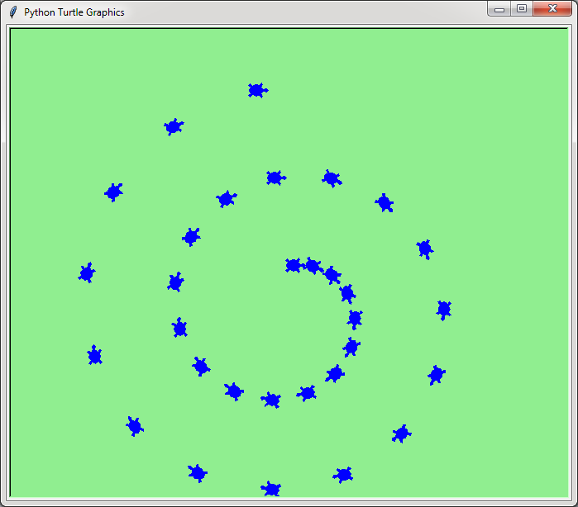
Third
import turtle
wn = turtle.Screen()
wn.bgcolor("lightgreen")
mat= turtle.Turtle()
mat.shape("turtle")
mat.color("blue")
mat.penup() # This is new
size = 20
for i in range(30):
mat.stamp() # Leave an impression on the canvas
size = size + 3 # Increase the size on every iteration
mat.forward(size) # Move mat along
mat.right(24) # ... and turn her
wn.mainloop()

Slide 5
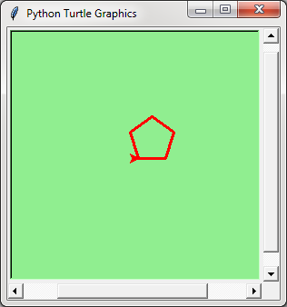
Fourth
import turtle
wn = turtle.Screen()
wn.bgcolor("lightgreen")
wn.setup(300,300)
pat=turtle.Turtle()
pat.color("red")
pat.pensize(3)
for i in [0,1,2,3,4]:
pat.forward(30)
pat.left(72)
wn.mainloop()

Slide 6
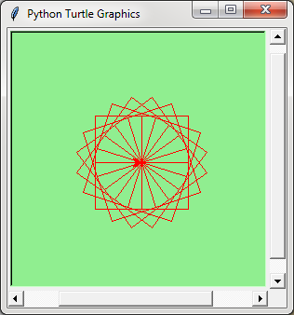
Last
import turtle
wn = turtle.Screen()
wn.bgcolor("lightgreen")
wn.setup(300,300)
pat=turtle.Turtle()
def square(x):
for i in range(4):
pat.forward(x)
pat.left(90)
pat.color("red")
for i in range(20):
square(50)
pat.left(18)
wn.mainloop()

Slide 7
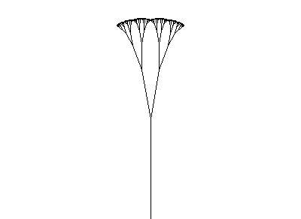
fractal

Slide 8
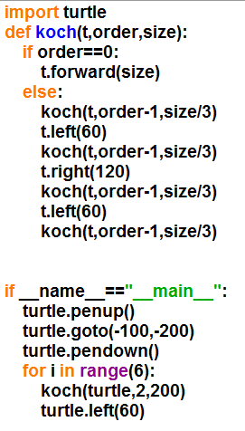
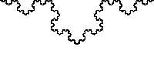
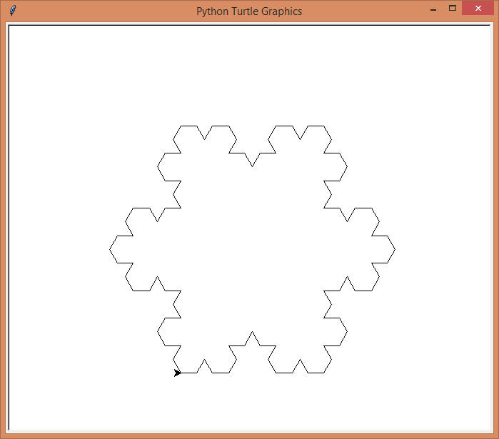
frACTAL

Slide 9
END

