Slide 1
Lesson 4
Conversation and practices

Slide 2
خدمات
Services

Slide 3
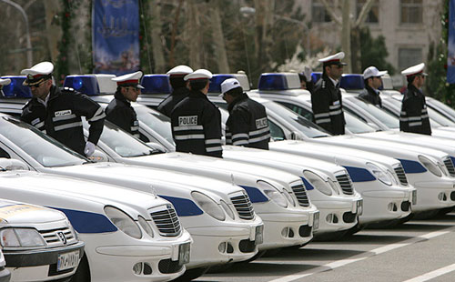
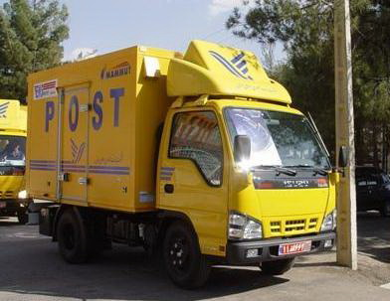
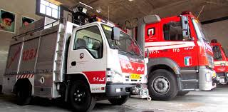
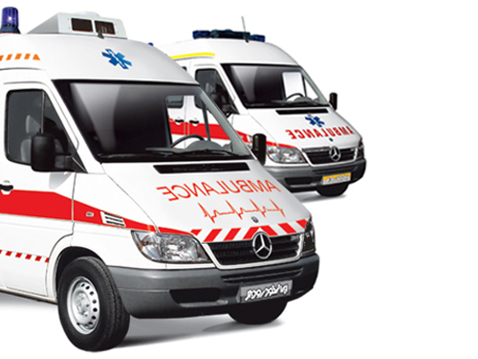
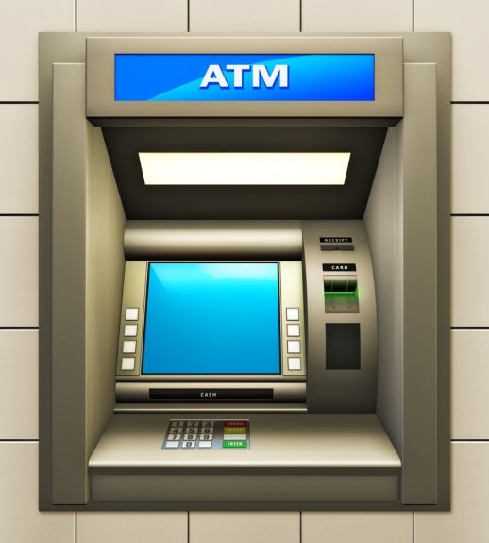
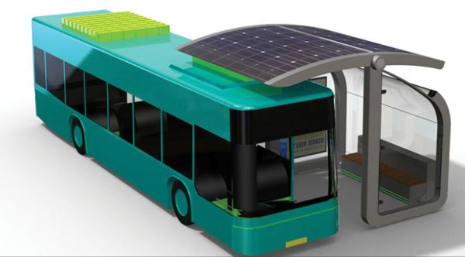

Slide 4
How can get the following services?
police
firefighters
emergency

Slide 5
Many people work to give services to us in big cities. Workers keep the city clean. Policemen keep the city safe. Bus drivers get people to work. Doctors and nurses help sick people in the hospitals. We know all these people are important for our city. We thank them all.

Slide 6
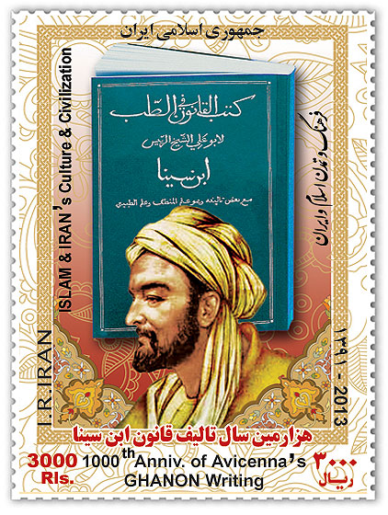
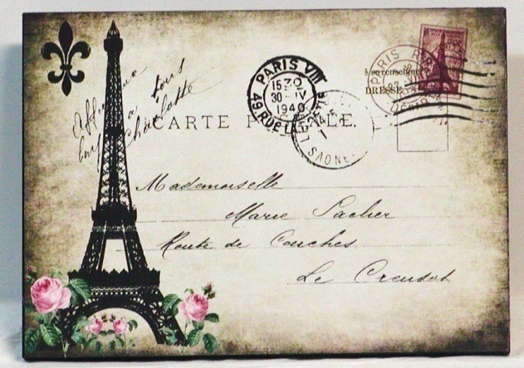
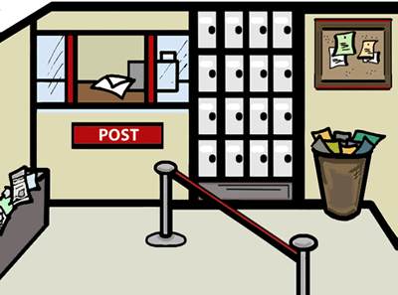
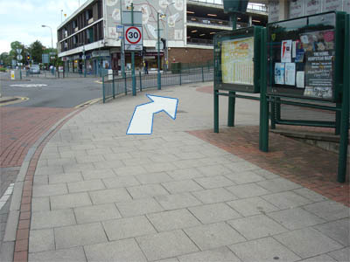
postcard
envelope
stamp
Post office
Round the corner

Slide 7
Is the man a tourist?
Does Pedram speak English?
Is there a post office near your house?

Slide 8
practices
What’s her job?
She’s an employee.

Slide 9
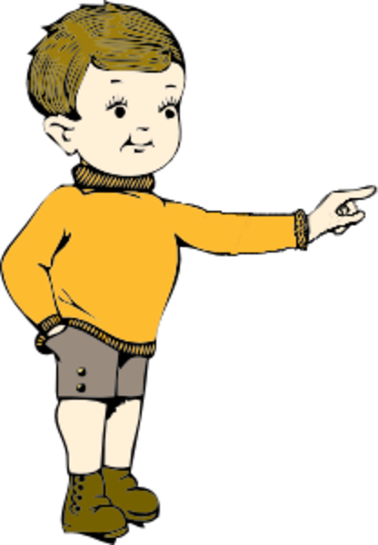
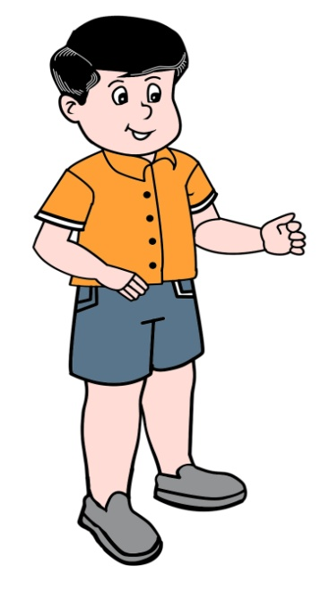
Where is the post Office?
It’s over there.

Slide 10
Who’s that man?
He is a postman.

Slide 11
When is the break?
It’s at 9:30.

Slide 12
What time does it open?
It opens at 8 in the morning.

Slide 13
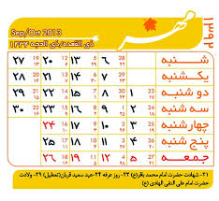
When do they work?
They work from Saturday to Wednesday.

Slide 14
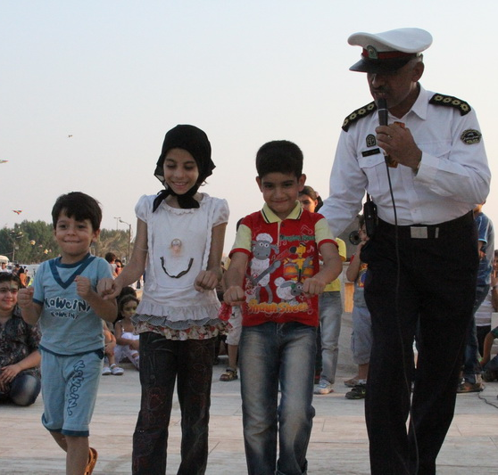
Who helps the children?
Police helps the children.

Slide 15
Where does she buy stamps?
She buys them from post office.

Slide 16
Why does she go by bus?
Because it’s fast and cheap.

Slide 17
How do you go to school?
I take a bus.

Slide 18
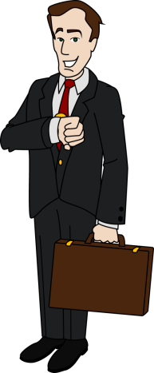
Look at the pictures ask and answer orally.
Who …………………………………… ? …………………………………………….. .
What ………………………………….. ? …………………………………………….. .
When …………………………………. ? …………………………………………….. .
Where …………………………………. ? …………………………………………….. .
How …………………………………….. ? …………………………………………….. .
Why ……………………………………..? ………………………………………………. .
Mr. Jackson

Slide 19
Grammar

Slide 20
Who is that man? He is Mr. Jackson.
What’s his job? He’s an employee.
Where does he work? He works in a bank?
When does he go to work? He goes to work at 7:45.
How does he go to work? He goes to work by car.
Why does he go to work by car? Because it’s fast.
Mr. Jackson

Slide 21
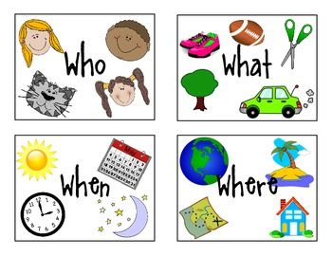

Slide 22
Wh questions
What Where | is | that | ?
 | are | those
Wh questions
When Where Why How | do | I You We they | go | ?
 | does | he she

Slide 23
What – Where – When – Why – How - Who
………………. do you live? I live in Sari.
………………. do you go to school? I go to school by bus.
………………… does she go to work? She goes at 8:00.
……………….. do go by bus? Because it’s cheap.
……………… helps your mother at home? I help my mother.
……………… do you study at school? I study English.

Slide 24
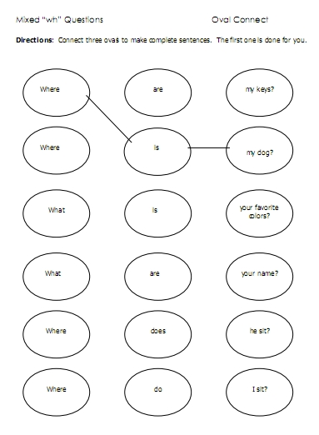

Slide 25
