Slide 1
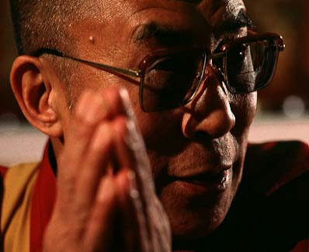
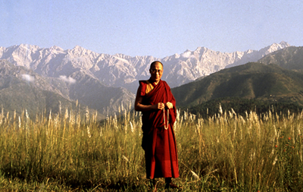
Is he powerful?
Which power he has?
What type of authority he possesses?
Dalai Lama

Slide 2
High
Consensus
Shared interest
Shared Power
Conflict
Low
Over-ideal
Pluralism
Elitism

Slide 3
Elitism
… unequal as natural and inevitable

Slide 4
Society is divided into ruling minority – the elites and the ruled – the mass

Slide 5
Classical elitist theorists …
Vilfredo Pareto (1848 – 1923)
Gaetano Mosca (1858 - 1911)
Background:
1. Italian
2. Threat from Marxism – in politics & in ruling
3. Against the propositions that the mass (proletariat)
can overthrow the ruling elites and gain power
Elites gain power by their personal quality

Slide 6
Gaetano Mosca … the ruling class
…. in all societies in human history, … two classes of people appear … a class that rules and a class that is ruled
…. Elites are distinguished from the mass of the governed that give them a certain material, intellectual or even moral superiority, which are the result of their social background

Slide 7
Vilfredo Pareto
Two types of elites: Fox and Lion
Fox – rule by cunning, manipulation (democracy in early 20th century in Europe) …
Lion – rule by force, direct and incisive action (e.g. military dictatorship) …
Circulation of elites: elites decay as lion lacks of cunning and fox lack of incisive action
Power circulated from one elite to another and not proletarian revolution

Slide 8
Robert Michels (1876 – 1936)
Study of socialist party in Europe in early 20th C and found that bureaucracy grew in this organisations
Iron laws of oligarchy (rule by a small elite)
Man’s inherent nature to crave power, and to perpetuate it, and majority are apathetic
Direct involvement to politics is impossible and therefore division of labour
Leaders never give up their power to the mass but only to other new leaders
Organisations excluded participation, elite rule!!!

Slide 9
Pluralism
… politics is a free market

Slide 10
Basic assumption
Power is dispersed among many competing interest groups
Equal, but not necessarily absolutely equal, in power
Everyone has say and can influence decision!
Government act in the interest of the society and according to the members’wishes

Slide 11
Notions ….
A plurality of groups maintaining a balance of power
Pluralism safeguard against authoritarian, best model of democracy?
Decision by different mutually exclusive groups
Interest groups represent different interests and put forward their claims
No single group dominate society

Slide 12
But ….
Shared power =/= shared common interest or value, no consensus
One person can have different positions in different issues (no rigid class interest)
Government = honest broker, compromise

Slide 13
Typology ….
 |  | Recruitment Principle
 |  | Aristocratic | Democratic
Authority Principle | Autocratic | Hereditary Monarchy | Merit System
 | Liberal | Elected Aristocracy | Representative Democracy

