Slide 1
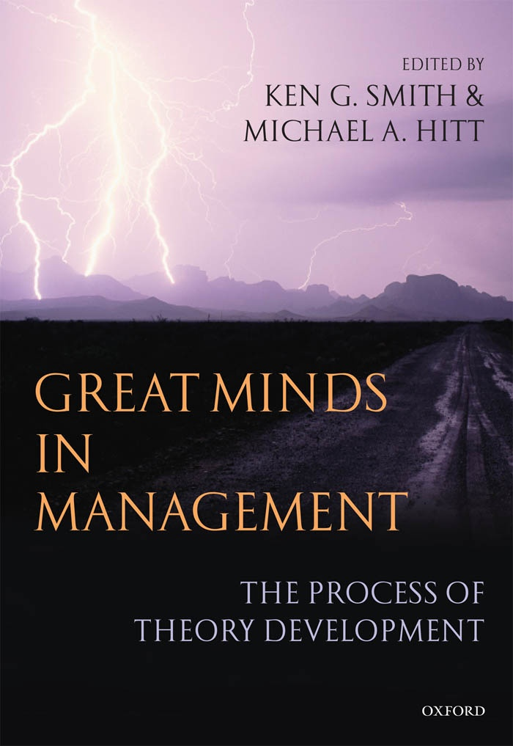

Slide 2
c h a p t e r 5 GRAND THEORIES AND MID-RANGE THEORIES CULTURAL EFFECTS ON THEORIZING AND THE ATTEMPT TO UNDERSTAND ACTIVE APPROACHES TO WORK
Written By: MICHAEL FRESE
Dr.Rezaeeian
Presented by: ZAINAB ABOUTALEBI
Spring 2013

Slide 3
Agenda
Introduction
Definitions
The method of Frese’s Theorization
The Study of Errors: Error Management
Error Management Training
The Function of Error Culture in Organizations
Personal Initiative by Employees and active Planning in Entrepreneurship
The Concept of Personal Initiative (PI)
The Three Aspects of PI: Self-Starting, Proactive, and Persistent
Facets of PI
Antecedents and Consequences of PI
The Effects of PI on the Environment
PI and Individual and Organizational Performance
Entrepreneurship: Elaborate and Active Planning
Changing Personal Initiative: Developing a Training Program
Conclusion

Slide 4
Grand Theory
Grand Theory refers to the form of highly abstract theorizing in which the formal organization and arrangement of concepts takes priority over understanding the social world. Grand Theory is more or less separated from the concrete concerns of everyday life and its variety in time and space. "grand theory" integrates not only sociological concepts, but also psychological, economic, political, and religious or philosophical components.

Slide 5
Mid-Range Theory
Middle-range theory is an approach to sociological theorizing aimed at integrating theory and empirical research. Middle-range theory starts with an empirical phenomenon (as opposed to a broad abstract entity like the social system) and abstracts from it to create general statements that can be verified by data.

Slide 6
Theory Building is based on
Environmental forces
Person factors

Slide 7
Person Factors
Frese’s Overactive nature
To be active
Active Approach
Rotter’s cognitive behaviorist theory
Themes of an active approach
PI(Personal Initiative)
Error Management
Seligman’s learned helplessness theory
Hacker’s action (regulation) theory
To be in control of things

Slide 8
Person Factors(cont.): Cognitive Behaviorism Theory
Cognitive-Behaviorism is a blended theory that incorporates both cognitive theory and behaviorism. According to cognitive-behaviorism, our responses are based on a complex interaction between thoughts and behaviors.

Slide 9
Person Factors(cont.): Learned helplessness Theory
Learned helplessness is the condition of a human or animal that has learned to behave helplessly, failing to respond even though there are opportunities for it to help itself by avoiding unpleasant circumstances or by gaining positive rewards.

Slide 10
Person Factors(cont.):Action Theory
Action theory defines a task-oriented view of human behaviors. The main purpose is to describe how a person completes a task. There are certain repeated patterns during completion of each task.

Slide 11
Person Factors(Cont.)
All Frese’s research centered around the themes of an active approach to work-life (the opposite of helplessness):
He became interested in personal initiative as one such instance of an active approach.
Since an active approach means to explore, he also became interested in errors and how one can learn from errors(Error Management).

Slide 12
Environmental Forces
Frese had a good Fortune to experience two different environments:
Germany
Doing his Ph.D. (in 1978) with Walter Volpert at the Technical University of Berlin who proposed a combination of Marx and action theory to understand ‘‘work actions’’.
U.S.
First important job (as associate professor at the University of Pennsylvania)

Slide 13
Environmental Forces(Cont.)
Whenever people move from one culture to the other, they become much more conscious of how they are doing things—routines are no longer effective and need to be (re-)intellectualized.

Slide 14
Environmental Forces(Cont.) Germans:
Like to think of themselves to be theoretically driven
Are more interested in developing large, all encompassing theories (often excessively complex).
Have a culture with high uncertainty avoidance.
one way how cultures cope with high uncertainty avoidance is to develop ‘‘grand’’ theories because understanding the ‘‘complete’’ picture is uncertainty reducing.
This may be one of the factors that makes German scientific culture skeptical towards simplicity

Slide 15
Germans:
Are fiercely independent up to the point of attempting to constantly differentiate themselves from other scientists.German professors tend to build little kingdoms around them and there is little cooperation between them.

Slide 16
Americans
Do quickly empirical work
Are interested in specific phenomena
Are interested in developing middle-range theorizing
Are interested in precise experimentation

Slide 17
The differences between Mid-range & Grand Theory
Mid range theory
limited number of variables
limited assumptions
high problem specification
Weick argued that for effective problem solving science needs to move towards mid-range theories.
Grand Theory
all-encompassing
more variables
low precise relationship
low falsifiability
Examples of grand theories in this German tradition are Freud’s psychoanalysis; Marx’s theory of history, society, and organizations; Lewin’s Weld theory; or Gestalt theory.

Slide 18
Frese’s Research Approach & Research Path(Cont.)
Frese tried to synthesize the two approaches
Take a grand theory as a general guideline: action theory(this was his German heritage)
combine this with a keen interest to develop theories of middle range that have a phenomenological approach(these were the lessons learnt from colleagues such as Martin Seligman, John Sabini, Henry Gleitman, Rob DeRubeis,and Paul Rozin at the University of Pennsylvania)

Slide 19
Frese’s Research Approach & Research Path(Cont.)
He started his research in each case by first studying a specific phenomenon in real life through observation, qualitative approaches, thinking about the phenomenon, and introspecting.

Slide 20
Frese’s Research Approach & Research Path(Cont.)
The common path in research:
read the literature
come to one particularly important issue that has been neglected in the literature
examine it for contradictions between theories and evidence.
The Frese’s path
He often started his research with little knowledge of the literature but with a general idea of what he wanted to study.
he does not usually read the literature and then comes to one particularly important issue that has been neglected in the literature; nor does he read the literature and examine it for contradictions between theories and evidence.
This approach gave him a chance to make contributions to the literature and, in some cases, to start new trends

Slide 21
Frese’s Research Approach & Research Path(Cont.)
Observing something of general interest
Doing empirical research to understand the specific phenomenon
Producing a middle-range theory as a building block for his general approach to a theory of work actions
Grand Theory

Slide 22
Frese’s Research Approach & Research Path(Cont.)
Thus this is his approach:
Using German approach to keep a grand theory alive
Using American approach(Phenomenological Approach) to produce a well-developed middle-range theory

Slide 23
The Study of Errors Error management

Slide 24
The Study of Errors Error management

Slide 25
Frese’s Research Approach & Research Path(Cont.)
He observed Germans were afraid of new technology &how difficult it was for them to deal with errors.(only Singapore has a higher intolerance for errors among the sixty-one GLOBE countries.)
He was set to explore the phenomenon of errors with a number of researchers
Error Management
Action Theory emphasizes the importance of negative feedback: an error is a special form of negative feedback

Slide 26
What is Error Management?
A new kind of training that produces an active error orientation and promotes use of errors actively.

Slide 27
Error Management Training
A new kind of training that produces an active error orientation and promotes use of errors actively.
‘‘Errors are a natural part of the learning processes!’’ ‘‘I have made an error, great! Because now I can learn!’’
Encouraging to make errors
Performing better after training

Slide 28
Error Management Training
The issue of error management :
what can be done after an error has occurred.
Error management training uses errors to achieve goals
Negative feedback (ERROR) presents information on what we have not yet achieved (GOAL)
e.g., a person wants to travel to Rome and acknowledges that he or she is 500 miles away

Slide 29
Error Management approach attempts to ensure:
Errors are reported and detected quickly
Negative error consequences are effectively handled and minimized
Errors are discussed and communicated and learning occurs
Error are prevented

Slide 30
Error management(Cont.)
Error Management
Error Prevention
focuses on reducing the negative consequences of error and on increasing the potentially positive consequences
aims at avoiding negative consequences of error by avoiding the error altogether

Slide 31
Error management(Cont.)
“Error management” training proved to be more effective than ‘‘Error-avoidant ’’ training across :
diverse groups of participants (university students as well as employees)
training contents (e.g., computer training, driving simulator training)
training durations (1-hour training to 3-day training sessions)
Different effect sizes(with medium to large effect sizes) .

Slide 32
Error management(Cont.)
This is not so that
The more errors, the more chances to learn.
So Trainee should use the error management instructions
(Action Theory does not suggest that any feedback has positive value—rather, only feedback that leads to new understanding; and this occurs only when participants use a systematic approach to dealing with errors)

Slide 33
The Function of Error Culture in Organizations
Organization
Higher profitability
Higher task orientation
Effective and coordinated error handling
Quick error detection
Higher innovativeness
More improving product or service quality
Any organization should use both error prevention and error management to optimize the chance to reduce the negative consequences of errors.

Slide 34
Personal Initiative

Slide 35
Personal Initiative(PI)
people behave actively
Traditional performance models (Reactive Models)
People just react
often changing the environment instead of just reacting to it
people perform well when they go beyond what they are told to do (add tasks).
a ‘‘redefinition’’ process takes place that often modifies what the employee perceives to be his or her task
People change their jobs via PI
people perform well, when they do what they were told to do (‘‘do a task well’’)
the pathway from an outside task to the acceptance of the task is direct and not problematic
the influence of the employee on the work situation is minimal

Slide 36
In East Germany
Bureaucratic socialism in East Germany had given the employees incentives, not to show initiative and to become reactive.
work was organized tightly with a high degree of supervision and little control.
There were Taylorized jobs to a larger extent than capitalist countries—at least more than in West Germany

Slide 37
The Three Aspects of PI
Proactivity
Self Starting
Persistent
PI

Slide 38
Self-Starting
a person does something
without being told
Without getting an explicit instruction
without an explicit role requirement
Thus, PI is: the pursuit of self-set goals in contrast to assigned goals

Slide 39
Proactive
Proactive(#reactive)
a person anticipate things (new demands, new or recurring problems, emerging opportunities) and to do something proactively about them by a long-term focus on work(opportunities and problems)

Slide 40
Persistent
Persistent(overcoming barriers)
When taking initiative, things get changed. So there are difficulties to overcome because
one does not possess all the required skills and knowledge
moreover other people (supervisors and colleagues) may not like the changes and develop resistance

Slide 41
The three aspects of PI reinforce each other:
Self-Starting
proactive
persistent
Self-starting makes it often necessary to think of future issues, and, therefore, there is a higher degree of proactivity
Self-started goals lead to the need to overcome barriers
(persistent) because of the changes inherent in their implementation
a proactive orientation toward the future makes it more likely to develop goals that go beyond what one is expected to do

Slide 42
PI versus Reactive Approach
Personal initiative (PI)
Reactive approach
Self-starting work behavior
Proactive
Overcomes difficulties
doing what one is told to do
giving up in the face of difficulties
not developing plans to deal with future difficulties
reacting to environmental demands

Slide 43
In the short run, PI is not always appreciated, although in the long run, it is crucial for organizational health and survival.
Every initiative ‘‘rocks the boat’’ and makes changes. Since people tend not to like changes, they often greet initiatives with skepticism.

Slide 44
The facets of PI can be described using the action sequence perspective of action theory.
Facets of PI
Goal development
Collecting information
planning
monitoring
feedback

Slide 45
Facets of Personal Initiative (PI)
Action sequence | Self-starting | Proactive | Overcome barriers
Goals / redefinition of tasks | Active goal, redefinition | Anticipate future problems and opportunities and convert into a goal | Protect goals when frustrated or taxed by complexity
Information collection and prognosis | Active search, i.e., exploration, active scanning | – Consider potential problem areas and opportunities before they occur – Develop knowledge on alternatives routes of action | Maintain search in spite of complexity and negative emotions
Plan and execution | Active plan | – Back-up plans – Have action plans for opportunities ready | – Overcome barriers – Return to plan quickly when disturbed
Monitoring & feedback | Self-developed feedback and active search for feedback | Develop pre-signals for potential problems and opportunities | – Protect feedback search

Slide 46
Antecedents and Consequences of PI
First, PI is conceptualized as behavior.
PI was a behavioral concept and not a personality dimension(we measured it with an interview that carefully looked at self-starting behaviors, proactive behaviors, and behaviors to overcome barriers)
Second, we differentiate between proximal and distal causes
distal causes: Personality along with knowledge, skills, and abilities (KSA)
proximal causes: orientations
environmental supports are a mixture of distal and proximal causes
Third, environmental support, knowledge, skills and abilities, and personality variables influence orientations, which, in turn, influence PI

Slide 47
Environmental Supports
- Control at work
- Complexity
- Stressors
- Support for personal initiative
Knowledge, Skills, Abilities
- Job qualification
- Cognitive ability
Orientations
- Control appraisals
- Self-efficacy
- Control and responsibility
aspirations
- Change orientation
- Handling errors
- Active coping
Personal Initiative
- Self-starting
- Pro-active
- Persistent
- Pro-company
High Performance
- Individual level
- Organizational level
Personality
- Achievement motive
- Action orientation
- Proactive personality
- Psychological
conservatism

Slide 48
The Effects of PI on the Environment
PI should eventually exert an influence on work characteristics by two mechanisms:
First, people with high PI may generate some added complexity and control in given jobs.
A second mechanism involves job change.
Each of the above mechanisms requires a certain amount of time to unfold.

Slide 49
PI and Individual and Organizational Performance
Personal initiative is also related to individual performance through clear career plan
A widespread use of PI in an organization improves its ability to deal with challenges.

Slide 50
Entrepreneurship: Elaborate and Active Planning
Action theory argues that very good employees (from blue collar worker to software developers) show higher performance if they produce active and elaborate plans (Hacker, 1992).

Slide 51
Entrepreneurship: Elaborate and Active Planning
an active and planning approach to the firm by the firm owners was related to a higher degree of success for the firm—in Europe and in Africa.
Success
Planning
Failure
Reactive approach

Slide 52
Changing Personal Initiative: Developing a Training Program
Their training to improve PI for business owners based on the following facets:
Understanding PI situations
proactive planning To improve both goal setting and planning, we utilized the concept of personal project
proactive goal setting focuses on maximizing the positive effect of goals by developing
Specific goals
time-bound goals
challenging goals
innovating as a training module was to convince the participants to invest more time and effort into producing innovative solutions and to teach them methods and techniques to be more creative and innovative.
emotion regulation was based on Ellis’s (1962) approach to dealing with one’s emotions in a difficult environment
time management is related to one aspect of planning—planning of time and coping with lack of time.

Slide 53
Conclusion

Slide 54
Frese’s Advisements for Theorization
To have an open mind to the quirks and difficulties
To have beautiful coping strategies
Being able to wonder and be surprised
To become involved in concrete phenomena not necessarily in your own society
To cultivate contacts across cultures

Slide 55
Indeed:
varied experiences
the process of being surprised
stumbling across interesting phenomena
developing theoretical ideas & methodological approaches

Slide 56
In the other word:
wonderment and surprise
understanding experiences and phenomena theoretically
Concrete Phenomenon & Good research questions
apply theories like a 2-year-old takes a hammer
Understanding the limits of the usefulness of these theories & starting to understand the theories better

Slide 57
Developing Competencies By:
Thinking clearly
Choosing a proper methodology
Going back and forth between the concrete phenomenon to the abstract concepts
Abstract Concepts
Concrete Phenomenon

Slide 58
A Grand Theory
Gives a starting point
Structures our approach to theorizing
however
Does not always suggest the right questions
Does not always provide the right answers

Slide 59
The Advantages of having Grand Theory for Frese
First, a grand theory makes it easier to accumulate knowledge in various areas of research. Plucking the middle-range theories into the grand theory, makes it possible to combine knowledge.
Second, Frese chose action theory because he is convinced that one basic category of humans is that they act (and interact).
Third, whenever, Frese was approaching a new area, his general grand theory gives him a first set of hypotheses.

Slide 60
Methodology
structured interviews
they showed excellent validity in meta-analytic research
They gave Frese a chance to probe owners’ answers and to understand precisely what they mean.

Slide 61
Perceptual Error
Stereotyping
Halo Effect
Perceptual Defense
Selective Perception
Implicit Personality Theory
Projection
First Impression

Slide 62
خطاهای ادراکی
خطاي كليشه‌اي: ناشي از دسته‌بندي افراد بر اساس يك يا دو صفت خاص (سياه و سفيد ديدن)
خطاي هاله‌اي: تحت تأثير يك صفت خاص فرد قرار گرفتن (ارتباط دادن خوش‌برخورد بودن فرد با صادق بودن وي)
خطاي دفاع ادراكي: ناديده انگاشتن برخي محرك‌هاي و ادراكهاي گيج‌كننده يا غيرقابل تصور (رد يا ناديده انگاشتن تهديدات بين‌المللي)
خطاي ادراك انتخابي: تصور راجع به افراد طبق تجربيات گذشته و مطلوبيت‌هاي فردي (از خود ممنون بودن معلم و ناديده انگاشتن نقد دانش‌آموز)

Slide 63
خطاهای ادراکی
خطاي نظريه‌هاي ضمني شخصيت: تصور راجع به افراد طبق نظريه‌هاي شخصي (تصور خجالتي، غيرمدعي و صادق و مطيع بودن يك فرد خدمتكار)
خطاي فرافكني: تمايل آدمي به انتساب احساسات و ويژگي‌هايش به ديگران (شكست را به گردن شرايط و محيط انداختن)
خطاي اثر اولين برخوردها: پيش‌بيني رفتار افراد بر اساس اولين برخورد با آنها (تصور اوليه مصاحبه‌كننده از برخورد دقايق نخست فرد مصاحبه‌شونده با وي)

Slide 64
Thanks for your attention

