Slide 1
Attention
Peyman Hassani Abharian-MD/PHD in Cognitive Neuroscience
Institute for Cognitive Sciences Studies (ICSS)
MAR. 2016

Slide 2
Review of Last Session
Cognitive neuroscience
Frontal lobe
Prefrontal cortex

Slide 3
Cognitive Neuroscience
Cognitive neuroscience is the knowledge of investigating brain and its functions.
This area is one field in cognitive sciences, which investigates the relationship between cognitive and mental functions with brain and its activity.
Goal of cognitive neuroscience is understanding the nature and structure of mental activities.
Cognitive neuroscience has developed intensively, during last two decades.

Slide 4
FRONTAL LOBE
Right frontal lobe: Five functional areas
Left frontal lobe: Six functional areas
- motor area
- supplementary motor area
- premotor area
- frontal eye fields
- prefrontal cortex
- Broca’s area (left)

Slide 5
Prefrontal Cortex (left, right)
Dorsolateral
Ventrolateral
Ventromedial
Orbitofrontal

Slide 6

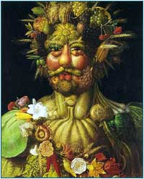
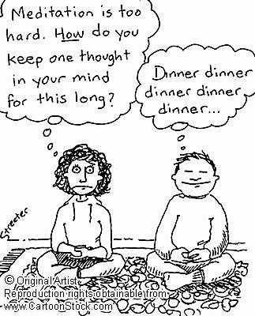
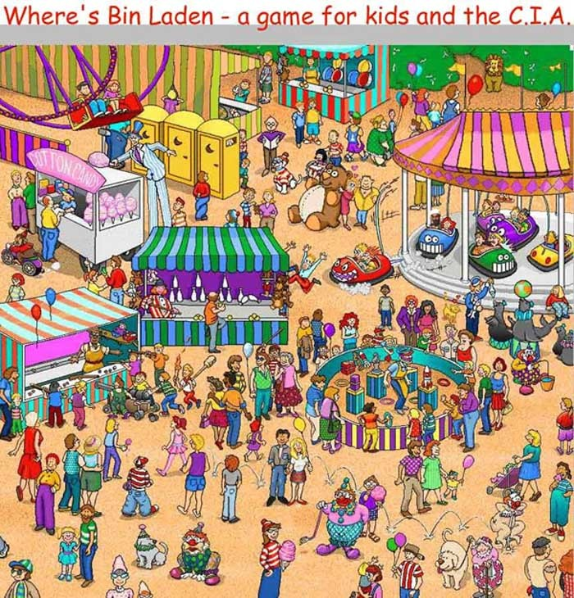
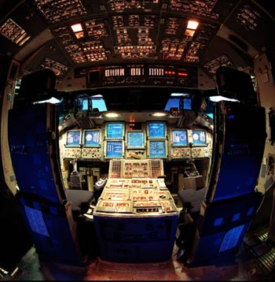


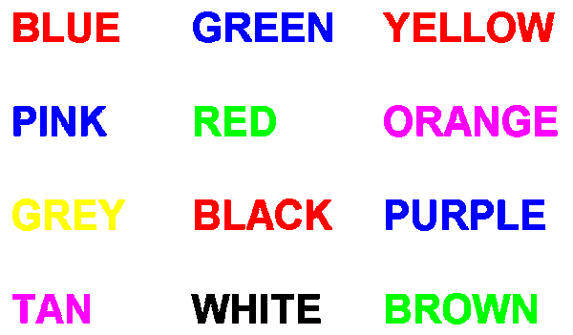

Slide 7

How Many Persons Do You See?

Slide 8
How Many Persons Do You See?

Slide 9
How Many Persons Do You See?

Slide 10
How Many Persons Do You See?

Slide 11
How Many Persons Do You See?

Slide 12
Attention
Terminology and definitions
Theories and models
Neural bases of attention
Neural circuits of attention
Neurotransmission in attentional system
Neuropsychology of attention
Clinical complications of attention
Cognitive rehabilitation of attentional deficits

Slide 13
Attention
Terminology and definitions
Theories and models
Neural bases of attention
Neural circuits of attention
Neurotransmission in attentional system
Neuropsychology of attention
Clinical complications of attention
Cognitive rehabilitation of attentional deficits

Slide 14
Attention
Attention is a filtering job, which occurs for all interring data to the cognitive system.
In other words, attention is the processing of the more important information, and prevention of the entrance of the other information to the higher level information processing.
Attention is a cognitive construction, which is necessary for the adjustment behaviors, because attention is necessary for selection, and selection is necessary for thinking, answering and adjustment behaviors.

Slide 15
What is Attention?
It is more than just sensation and perception
Attention and arousal are not synonymous
There can be attentional deficits in perfectly awake individuals
Extreme arousal (as in pain) may impair the flexibility of attention

Slide 16
Different aspects of Attention
Voluntary or in voluntary
With motion or without it

Slide 17
Dimensions of attention
Top down (voluntary) attention
Bottom up (involuntary) attention

Slide 18
One other aspect of attention
Overt (explicit) attention
Covert (implicit) attention

Slide 19
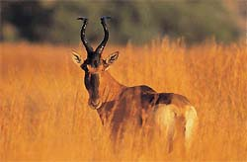

Overt attention
Movements of the eyes allow selective aquisition of visual signals.
Other sensory organs equally allow selective capturing of environmental signals.

Slide 20
Covert attention

Slide 21
Types of Attention
Alertness and arousal – the basic aspects of attention that enable a person to extract information from the environment or to select a particular response (coma → full alertness)
Vigilance (sustained attention) – the ability to sustain alertness (monitor an event or stimulus) continuously (impairs in ADHD subjects)
Selective attention – ability to scan events/stimuli and pick out the ones that are relevant

Slide 22
Selective Attention
Ability to focus on one message and ignore all others
  Research method: dichotic listening
    One message is presented to the left ear and another to the right ear
    Participant “shadows” one message to ensure he is attending to that message

Slide 23
Selective Attention
Results of dichotic listening
  Participants could not report the content of the message in unattended ear

Slide 24
Mode of attention
Shifting attention
Sustain or transient attention
Focused or divided attention
Conflictual attention

Slide 25
Modality of attention
Visuspacial attention
Verbal attention

Slide 26
Bases of selection and filtering
Location
Feature
Object
Attentional set (wcst)
Time (novelty)

Slide 27
Attention
Terminology and definitions
Theories and models
Neural bases of attention
Neural circuits of attention
Neurotransmission in attentional system
Neuropsychology of attention
Clinical complications of attention
Cognitive rehabilitation of attentional deficits

Slide 28
Models of Attention
Selection Models: Bottlenecks
  Early Selection: Filter
  Early Selection: Attenuation
  Late Selection
Capacity Models: Pools of Resources
  Also applicable to complex tasks
Feature Integration Theory: Glue

Slide 29
Broadbent’s Filter Model
Early-selection model
  Filters message before incoming information is analyzed for meaning

Slide 30
Early Selection:
Broadbent’s Filter Model
Sensory Channels assumed to have unlimited capacity
There is a bottleneck limiting the information that can get into working memory
A selective filter (attention) allows information from only one channel at a time
Information in the unattended channel is completely blocked

Slide 31
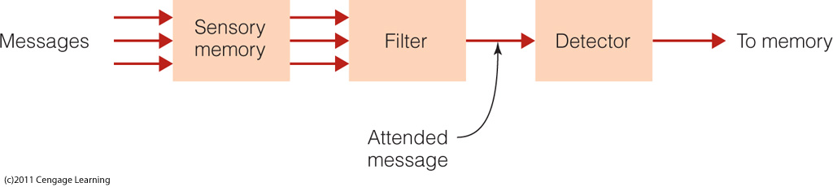
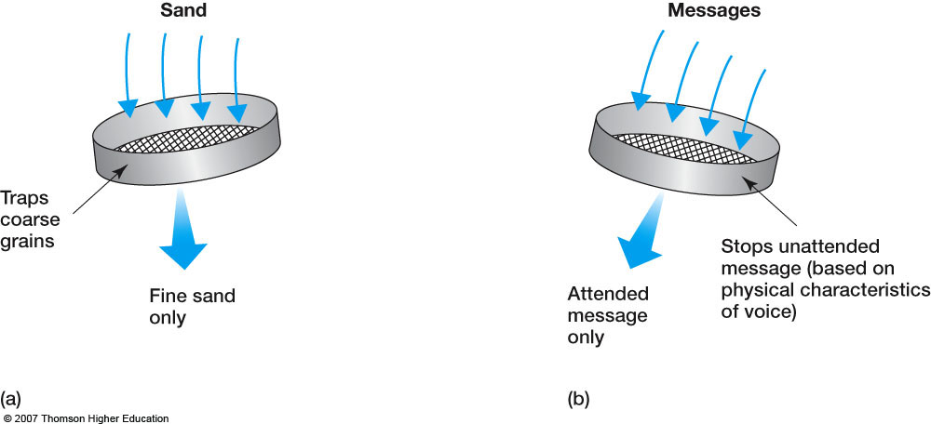
Broadbent’s filter model of attention

Slide 32
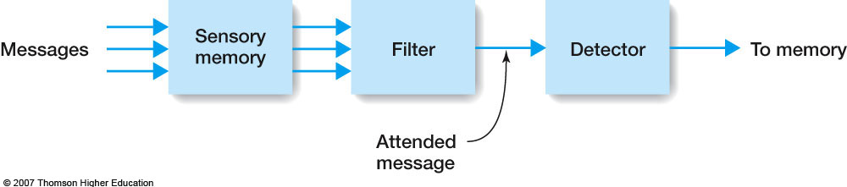
Sensory memory
  Holds all incoming information for a fraction of a second
  Transfers all information to next stage

Slide 33
Filter
  Identifies attended message based on physical characteristics
  Only attended message is passed on to the next stage

Slide 34
Detector
  Processes all information to determine higher-level characteristics of the message

Slide 35
Characteristics of Attention in Broadbent’s Filter Model
Filter selects information based on physical characteristics only
Filter is all or none
Switching is under conscious control
Selected information receives deeper perceptual processing and enters working memory

Slide 36
Evidence for the Filter Model
Explains the results of early shadowing studies: the unattended channel is blocked

Slide 37
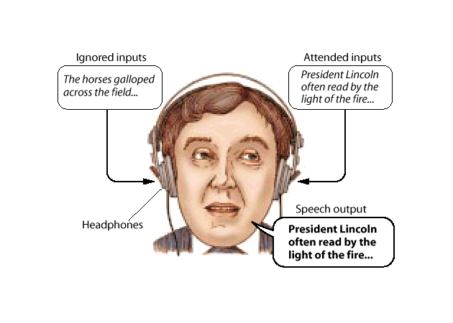
Dichotic Listening Task

Slide 38
Shadowing Results
Physical attributes of unattended channel are detected
  Male vs. female voice
  Human vs. musical instruments
Semantic attributes of unattended channel were missed
  Don’t notice foreign language
  Don’t notice repeated items

Slide 39
Evidence Against Filter Model
Cocktail Party phenomenon (Moray, 1959)
Errors in shadowing (Triesman, 1960)
Galvanic Skin Response to unattended channel

Slide 40
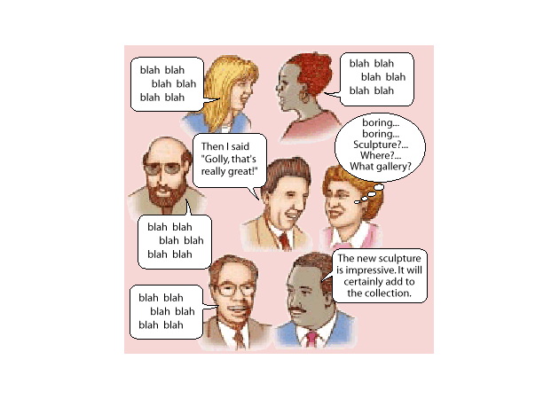
Cocktail Party Effect

Slide 41
Cocktail party phenomenon
  You are in a cocktail party.
  You are talking with someone intently.
  Somewhere, someone else mentions your name.
  You notice that even though your attention is fully committed to the person you were talking with.

Slide 42
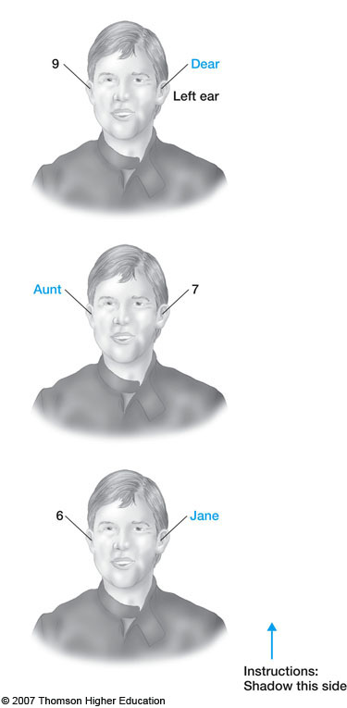
Errors in shadowing
Ss were asked to shadow the message received to the left ear only.
Left ear:
  Dear 7 Jane
Right ear:
  9 Aunt 6
Shadowing report
  Dear Aunt Jane

Slide 43
Attenuation Model (Treisman)
Present a story in dichotic listening task
  Story switches from attended ear to unattended ear
  Participant mistakenly shadows from attended ear to unattended ear
Attended Ear: Unattended Ear:
She had peanut butter freaking laser beams
You keep using that word and jelly sandwiches

Slide 44
Early Selection 2:
Triesman’s Attenuation Model
Messages differ in “subjective loudness”
Attention modulates subjective loudness: attended channel is louder
Individual words have different thresholds of subjective loudness to be noticed
Some concepts have a permanently low threshold (like your name)

Slide 45
Tresiman’s Attenuation Theory
Intermediate-selection model
  Attended message can be separated from unattended message early in the information-processing system
  Selection can also occur later

Slide 46
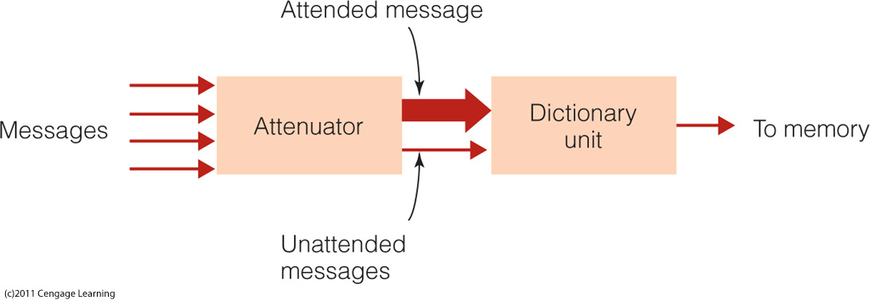
Treisman’s attenuation model of selective attention
Notes:
Figure 11.1 Specialties in psychology. Percentages are approximate. The percentages shown here are based on membership in the American Psychological Association. The APA welcomes both scientists and practitioners. However, some psychological researchers belong to other organizations, such as the American Psychological Society. As a result, the percentage of clinical and counseling psychologists working in the United States may be a little lower than shown in chart a. Nevertheless, it is accurate to say that most psychologists specialize in applied areas and work in applied settings.

Slide 47
Problems with Early Models
Memory for unattended channel may depend on familiarity or importance
  Cocktail party effect
There are effects of practice
There is implicit memory for the unattended channel even when there isn’t explicit memory
  Shock study
People can shadow meaningful message that switch from ear to ear
  Treisman
Memory for unattended channel affected by similarity to attended channel

Slide 48
Late Selection Models
(Deutch & Deutch, 1963; Norman, 1968)
Selection occurs late in processing (after information enters STM)
STM is the bottleneck
Attention keeps information from dropping out of STM

Slide 49
Evidence for Late Selection
Listeners can access the meaning of unattended information. Example (MacKay, 1973):
Attended ear:
  “They were standing near the bank”
Unattended ear:
  One of the following was presented
    “river”
    “money”
Participants interpreted “bank” as
  a riverbank if they heard “river”
  a financial bank if they heard “money”

Slide 50
Capacity Models:
Attention as Pools of Resources
Funnel vs. Spotlight
Attention = allocation of cognitive resources
Arousal: increases or decreases the pool of resources
Divided Attention Tasks: can attend to two things at once if neither demands too many resources

Slide 51
Task load and selective attention
Attention is more like resources
  Kahneman’s (1973) capacity theory
  When a particular task demands lots of processing resources, then other tasks get fewer resources.
No task
Hard task
Easy task
Attention capacity

Slide 52
Evidence for Resource Models
(Posner & Boies, 1971)
Two tasks
  Primary task: Letter Matching
  Secondary task: Tone Detection
Varied the time the tone was presented
RT to detect the tone was slower just before and just after the 2nd letter
Therefore resources were shifted from the tone detection task to the matching task

Slide 53
Feature Integration Theory:
Attention as Glue
Attention is required to put the pieces together (to combine features into objects)
“What” and “Where” may be separate systems in the brain; attention puts the two back together
Evidence: Conjunction Errors

Slide 54
Feature Integration Theory (FIT)
Preattentive stage
  Automatic
  No effort or attention
  Unaware of process
  Object analyzed into features
Focused attention stage
  Attention plays key role
  Features are combined

Slide 55
Attention
Terminology and definitions
Theories and models
Neural bases of attention
Neural circuits of attention
Neurotransmission in attentional system
Neuropsychology of attention
Clinical complications of attention
Cognitive rehabilitation of attentional deficits

Slide 56
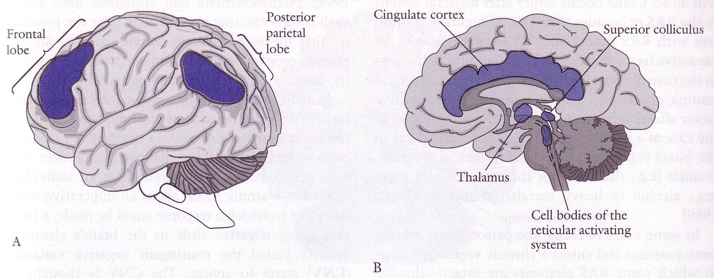
Neurophysiology of Attentional Matrix
Reticular activating system
The superior colliculus
The thalamus
The parietal lobe
The frontal lobe
The cingulate cortex

Slide 57
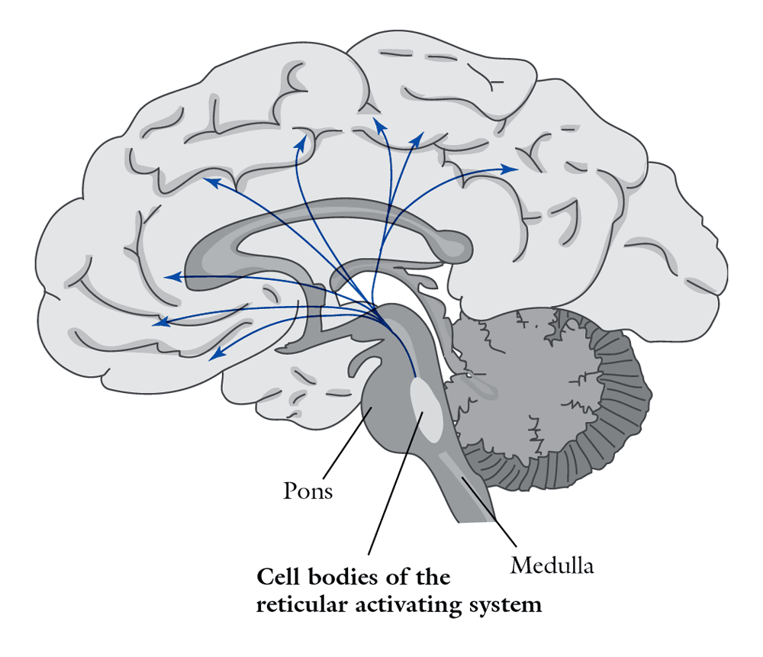
The Reticular Activating System (RAS)
Arousal and wakefulness
Sleep-wake cycle
Cells in the reticular formation can set the pace of activity of cells throughout the brain
Damage to the RAS can produce reduced attention – confusional state or coma
Stimulants and depressants have an effect on this system

Slide 58
RAS
The reticular activating system helps mediate transitions from relaxed wakefulness to periods of high attention.
There is increased regional blood flow (presumably indicating an increased measure of neuronal activity) in the midbrain reticular formation (MRF) and thalamic intralaminar nuclei during tasks requiring increased alertness and attention.

Slide 59
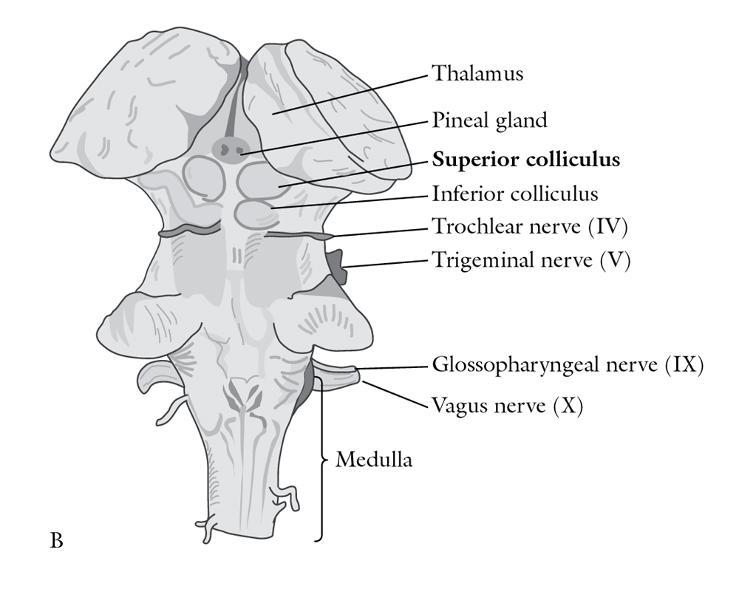
The Superior Coliculus
This structure is important for directing visual attention to ‘novel’ stimuli
Saccade – an eye movement in which the eyes jump from one position to the next (rather then moving smoothly)
Express saccade – fast and reflexive in response to novel visual stimuli (superior coliculi)
Regular saccade – voluntary eye movements (frontal eye fields)

Slide 60
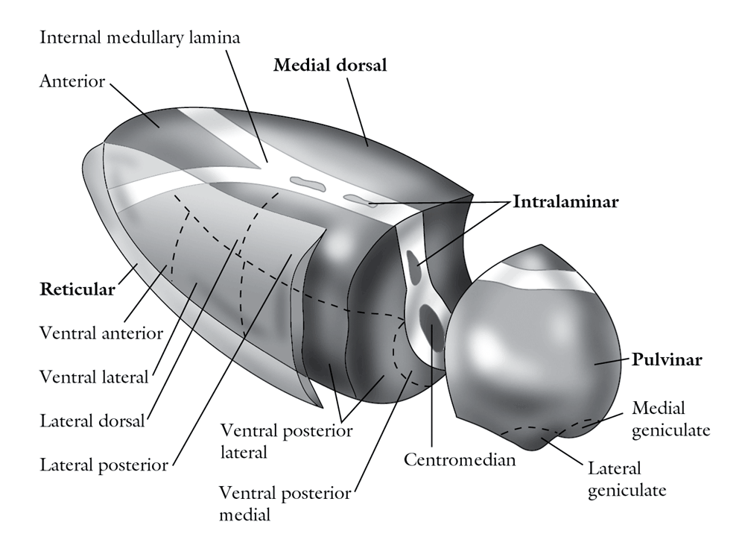
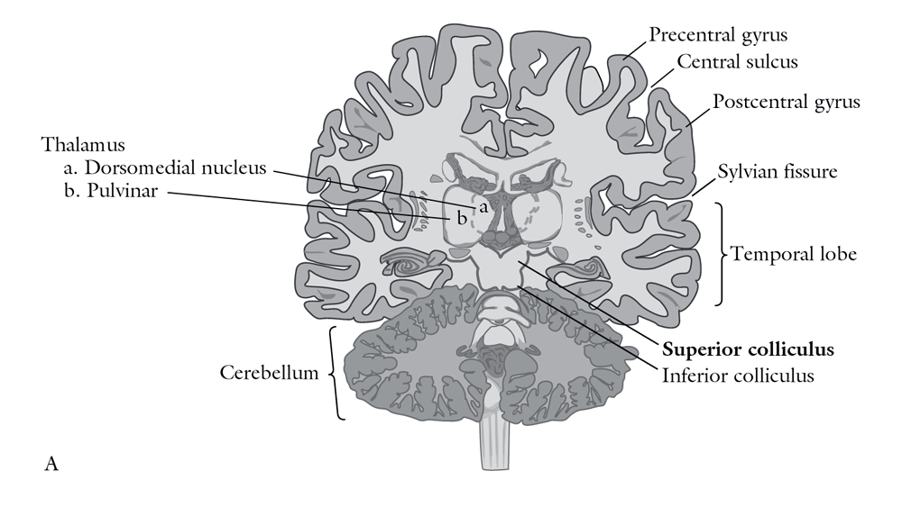
Thalamus
Medial dorsal, intralaminar and reticular nuclei are important for general arousal (connected to the RAS)
Pulvinar is involved in selective attention

Slide 61
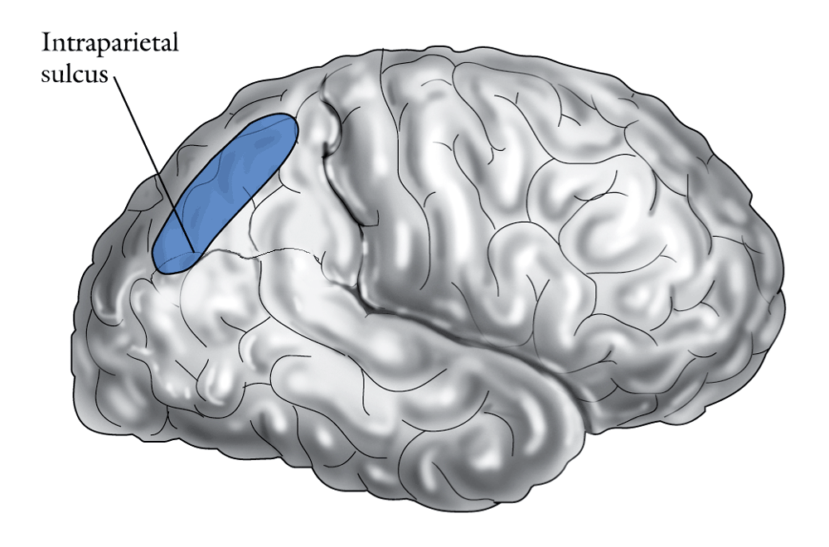
Parietal lobe
Important for visual and spatial aspects of attention (remember the “where” pathway) and general attentional resources
Domain-specific
Top-down processing
Hemineglect

Slide 62
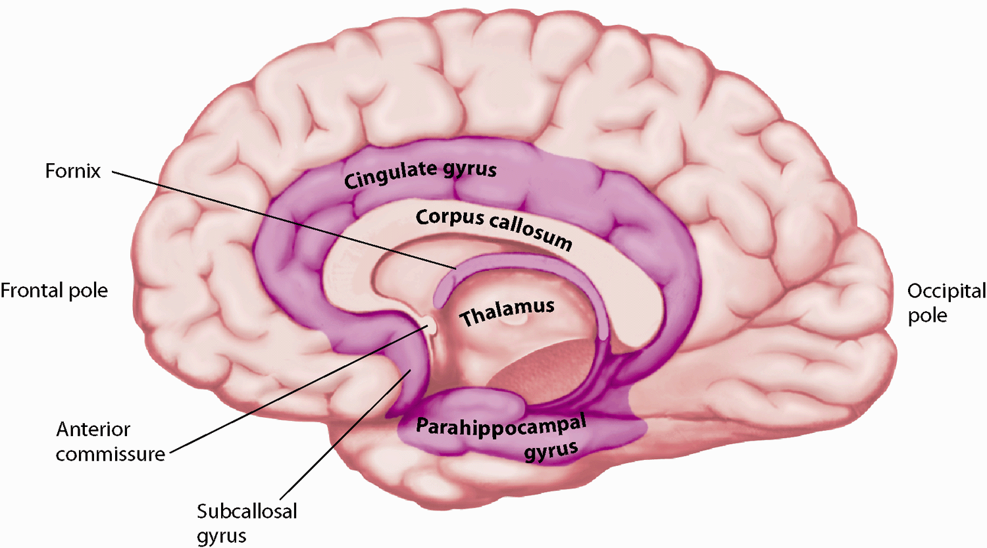
Anterior Cingulate Cortex
Important for attentional selection
red green blue yellow
blue yellow red green
red green blue yellow

Slide 63
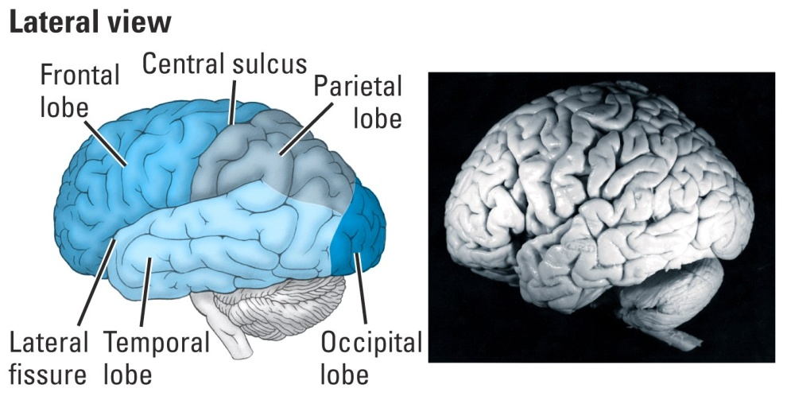
Frontal Lobe
Important for complex aspects of attention
Executive control of attention → can inhibit the more reflexive aspects of attention
Top-down processing
Domain non-specific
On-line holding of information

Slide 64
      Posner, M. I., Rothbart, M. K. (2007) Research on Attention networks as a model for the integration of psychological science. Annual Review of Psychology, 58, 1-23.

Slide 65
Attention
Terminology and definitions
Theories and models
Neural bases of attention
Neural circuits of attention
Neurotransmission in attentional system
Neuropsychology of attention
Clinical complications of attention
Cognitive rehabilitation of attentional deficits

Slide 66
Neurotransmission in attentional system
The RAS contains both cholinergic and
adrenergic components, which exhibit synergistic as well as competitive actions to regulate thalamocortical.
Cholinergic: Cholinergic projections descend throughout the reticular formation and ascend to the substantia nigra, basal forebrain, thalamus, and cerebellum.
Glutamate has also been suggested to play an important role in determining the firing patterns of the tegmental cholinergic neurons.

Slide 67
RAS
Adrenergic: The adrenergic component of the reticular activating system is closely associated with the noradrenergic neurons of the locus coeruleus.
More recent work has indicated that the neuronal messenger nitric oxide (NO) may also play an important role in modulating the activity of the noradrenergic neurons in the RAS.
It appears that hypocretin/orexin neurons of the hypothalamus activate both the adrenergic and cholinergic components of the RAS.

Slide 68
Neurotransmission in attentional system
Recent modelling studies suggest that the rhythmic synchronization in the gamma range (related to selective attention) may be mediated by a fine balance between N-methyl-D-aspartate (NMDA) and alpha-amino-3-hydroxy-5-methylisoxazole-4-propionate(AMPA) postsynaptic currents.
Whereas other studies have highlighted the possible contribution of the neuromodulator acetylcholine.

Slide 69
Your Seminars
Sensation
Perception
Information processing
Vision
Visual perception
Language
movement
Motor control
Emotion
Emotion regulation
Theory of mind
Consciousness
Cell firing
Synapses
Neuronal plasticity
Cell channels
Hebian theory of learning
36. Mirror neurons
18. Metacognition
19. Limbic system
20.
21. Brain organization
22. Cognitive layers
23. Artificial intelligence
24. Cog N. of addiction
25. Cog N. of music
26. Cog N. of aesthetics
27. Association cortical areas
28. Cortex layers
29.M.C Gurk effect
30. Cog N. of sleep
31. Brain development
32. Genetic & epigenetic
33. Molecular basis of cog N.
34. Neurotransmitters (1)
35. Neurotransmitters (2)

Slide 70

THANKS FOR YOUR ATTENTION

