Slide 1
آشنایی با Restful
گروه کامپیوتر دانشگاه صفاهان
@Safahan_IT
محمد صمدیه
Moh.Samadieh@gmail.com

Slide 2
معرفی Rest
REST stands for Representational State Transfer. (It is sometimes spelled "ReST".) It relies on a stateless, client-server, cacheable communications protocol -- and in virtually all cases, the HTTP protocol is used.

Slide 3
معرفی Rest
REST is an architecture style for designing networked applications. The idea is that, rather than using complex mechanisms such as CORBA, RPC or SOAP to connect between machines, simple HTTP is used to make calls between machines.

Slide 4
معرفی Rest
کل اینترنت را که بر اساس httpبنا شده را می توان به صورت معماری Rest دید.
Rest یک جایگزین ساده برای مکانیزم هایی مثل RPC و سرویسهای SOAP و WSDL و غیره است.
برخلاف سادگی Rest، تقریبا هر کاری که با Web Service ها می توان انجام داد را می توان با Rest انجام داد.

Slide 5
معرفی Rest
Platform-independent (you don't care if the server is Unix, the client is a Mac, or anything else),
Language-independent (C# can talk to Java, etc.),
Standards-based (runs on top of HTTP), and
Can easily be used in the presence of firewalls.

Slide 6
معرفی Rest
Like Web Services, REST offers no built-in security features, encryption, session management, QoS guarantees, etc. But also as with Web Services, these can be added by building on top of HTTP:
For security, username/password tokens are often used.
For encryption, REST can be used on top of HTTPS (secure sockets).
... etc.
One thing that is not part of a good REST design is cookies: The "ST" in "REST" stands for "State Transfer", and indeed, in a good REST design operations are self-contained, and each request carries with it (transfers) all the information (state) that the server needs in order to complete it.

Slide 7
معرفی Rest

Slide 8
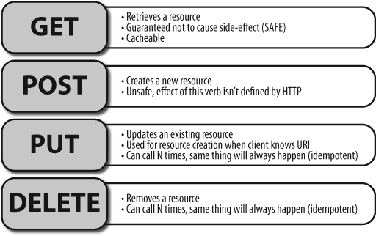
HTTP verbs

Slide 9
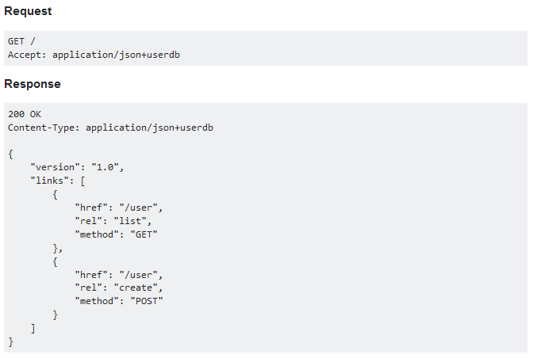
مثال

Slide 10
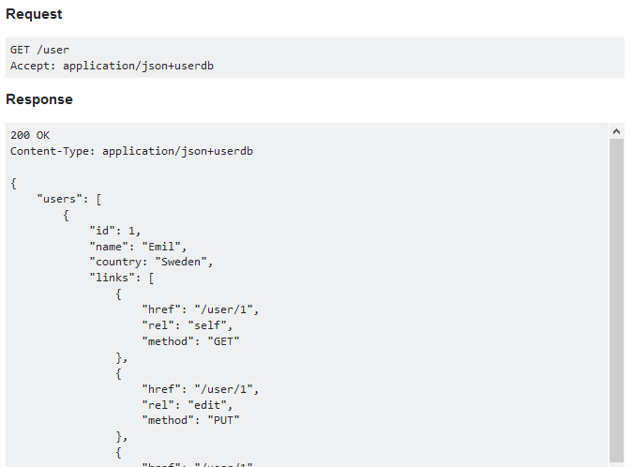
مثال
200 OK
Content-Type: application/json+userdb
{
"users": [
{
"id": 1,
"name": "Emil",
"country: "Sweden",
"links": [
{
"href": "/user/1",
"rel": "self",
"method": "GET"
},
{
"href": "/user/1",
"rel": "edit",
"method": "PUT"
},
{
"href": "/user/1",
"rel": "delete",
"method": "DELETE"
}
]
},
{
"id": 2,
"name": "Adam",
"country: "Scotland",
"links": [
{
"href": "/user/2",
"rel": "self",
"method": "GET"
},
{
"href": "/user/2",
"rel": "edit",
"method": "PUT"
},
{
"href": "/user/2",
"rel": "delete",
"method": "DELETE"
}
]
}
],
"links": [
{
"href": "/user",
"rel": "create",
"method": "POST"
}
]
}

Slide 11
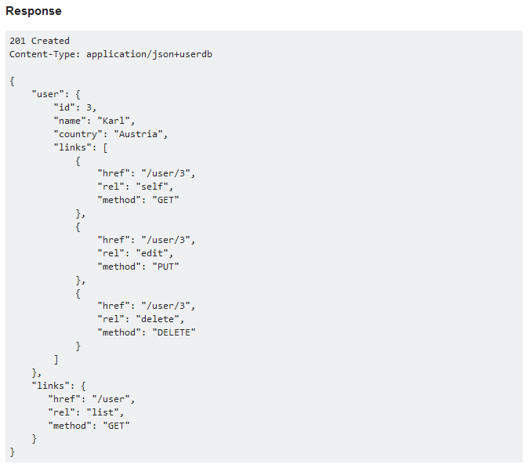
مثال

Slide 12
مثال

Slide 13
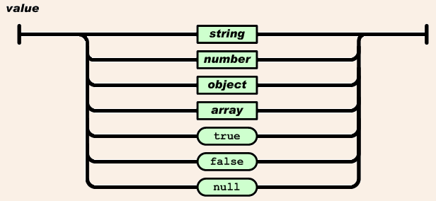
JSON

Slide 14
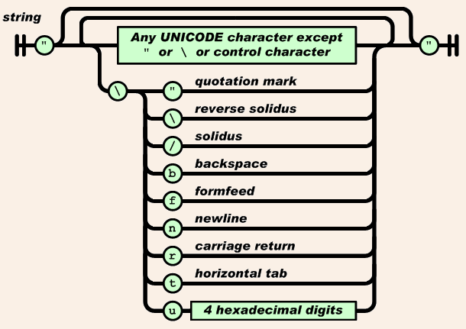
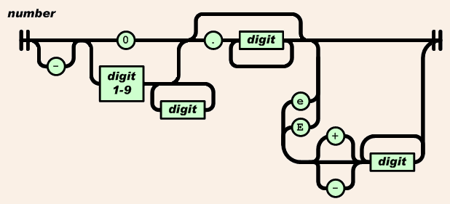
JSON

