Slide 1

What You Need to Know About Dental Filling

Slide 2

Dental Filling
  When you tooth suffers from decay, is extraction the only solution?
  If it can be repaired, then extraction is not necessary. Instead, your dentist may restore your damaged tooth with a filling.
  A filling helps bring back the normal shape and function of a tooth.

Slide 3

How Does Tooth Filling Works
  First, your dentist checks your teeth and sees whether you need to have a cavity filled.
  They examine your tooth surfaces using a small mirror. Depending on the extent of the damage, your dentist may suggest that you get a filling.
  If you’re amenable to it, the decay will have to be removed from your tooth first. The area is cleaned, and afterward, it is filled using a variety of materials.

Slide 4

  What are Different Filling Materials
  Choosing which type of filling to use depends on the extent of the repair necessary and your budget.
  Another factor to consider is if you are allergic to certain materials. In this case, no one type is recommended to everyone.
  In some cases, the filling can be a combination of different materials. Your dentist can help you decide which type best fits your needs.

Slide 5

Here are a few filling materials:

Slide 6
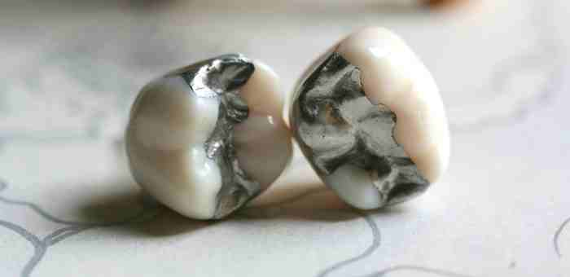
  Amalgam
Also known as silver fillings, amalgam is durable and relatively inexpensive.
Its dark color makes it more noticeable that’s why it is usually placed in areas that are not visible.

Slide 7
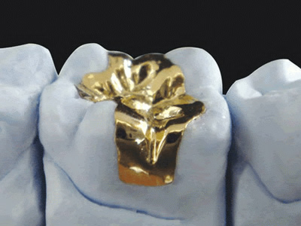
  Gold Fillings
Gold fillings, on the other hand, are made to order.
Their lifespan may reach over 20 years. Because they’re extremely durable, gold fillings are usually regarded by dental professionals as the best type of filling.
The downside is that it can be expensive.

Slide 8
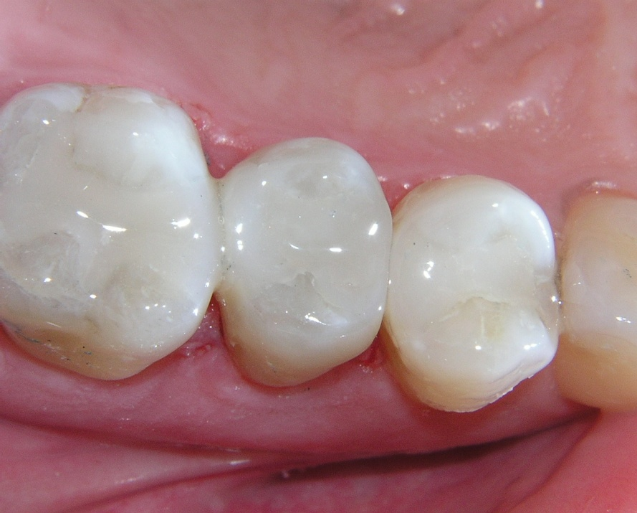
  Composite
Also called plastic resins, the composite type of filling is versatile.
It can be adjusted to match your teeth color. If you would like a filling that looks natural, then a composite resin may be the perfect choice.
However, if the tooth damage requires large fillings, composite may not be the best choice as they can wear overtime. They’re also not immune to stains.

Slide 9

  What You Should Expect from a Tooth Filling Procedure
  During a filling procedure, you will be given anesthesia.
  Afterward, the tooth decay will have to be removed to prepare the space for the filling.
  Your dentist will as well etch the tooth first before finally placing the filling.
  Resin will then be applied to make the filling stronger. Last step is the polishing.

Slide 10

  Don’t be afraid!
  Your dentist will make sure that the procedure turns out painless for you.
  Just be honest how you feel so your dentist would be able to assist you properly.
  Share this post to your friends who are also curious about dental filling.

Slide 11

  Check These Out!
  Check Out This Info on What You Need to Know About Dental Filling. Brought to you by West Airdrie Dental.
  West Airdrie Dental treats their clients with the utmost respect, as they work hard to provide their dental patients with the exceptional care. They offer a wide range of dental services from general dentistry to dental implants.
  For more info, visit site: http://www.westairdriedental.com

