Slide 1
SPSS Class
Dr Nader Sadigh

Slide 2
1- Introduction to the SPSS Environment
three main windows that you will need to use to perform essential functions.
a) Data View : like an Excel spreadsheet

Slide 3
b) Variable View: you can view various components of your variables;
Name, Label, Values and Measure.
names:
They can be up to 64 characters long.
not case sensitive for variable names however it displays the case as you enter it.
The first character must be a letter.
Spaces between charcters are not allowed but the underscore _ is.

Slide 4
Measure column is often overlooked but is important for certain analysis in SPSS and will help orient you to the type of analyses that are possible.
Nominal: variables that have no intrinsic rating (e.g., gender, ethnicity)
Ordinal: variables that have categories with an intrinsic ordering (e.g., Likert scales,Olympic medals)
Scale: variables that are continuous with intrinsic ordering and meaningful metric (e.g., blood pressure, income)

Slide 5
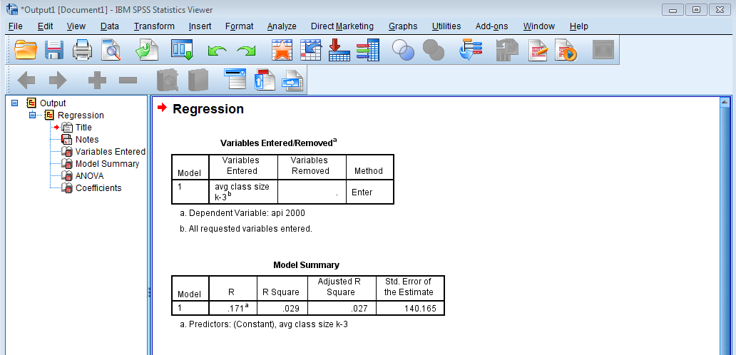
C) Viewer (Output) Window

Slide 6
Entering Data
Reading in an Excel file
File
Open
Data
from "Files of type", select Excel .xls, xlsx., xlsm format
select File: c:\temp\hs0.xls
Open
check "Read variable names from the first row of the data"
click on OK

Slide 8
Opening an SPSS data file
File
Open
Data
select File: c:\temp\hs0.sav
Open

Slide 9
Exploring Data
Analyze
Descriptive Statistics
Descriptives...
select gender read write math science

Slide 11
organize the output by the levels of a categorical variable by sorting on that variable and then splitting the file
Data
Sort Cases
select ses
Data
Split file
Click on Organize output by groups
select ses
Analyze
Descriptive Statistics
Descriptives...
select gender read write math science
Data
Split file
Analyze all cases, do not create groups

Slide 12
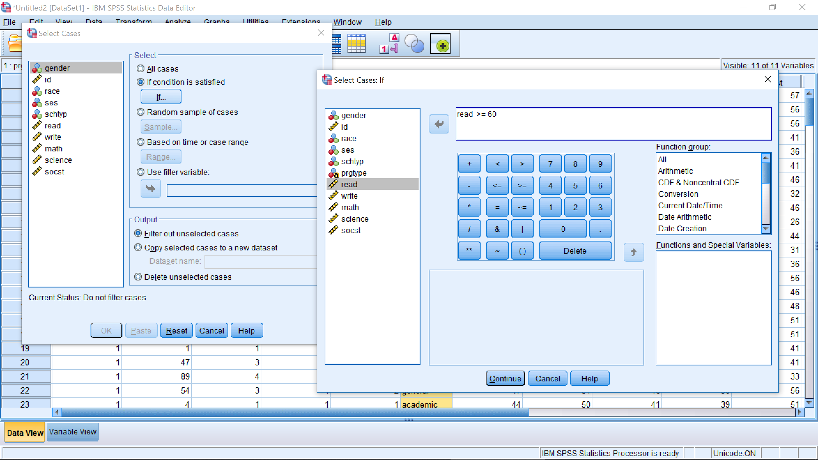
look at that the records for students who earned reading scores of 60 or above
Data
Select Cases...
select "if condition is satisfied"
if read >= 60
Analyze
Descriptive Statistics
Descriptives...
select gender read write math science

Slide 13
provide the selection criteria
select the first 40 cases
Data
Select Cases...
select "all cases"
Data
Select Cases...
select "if condition is satisfied"
if prgtype = "academic"
Analyze
Descriptive Statistics
Descriptives...
select gender read write math science

Slide 14
compare the means of the variables read, write, math and science broken down by
prgtype
Data
Select Cases...
select "all cases"
Analyze
Compare Means
Means...
select read write math science as the dependent variable
select prgtype as the independent variable

Slide 15
crosstabulations and correlations.
Analyze
Descriptive Statistics
Crosstabs...
select prgtype for the rows and ses for the columns
OK
Analyze
Correlate
Bivariate...
select read write math science
Analyze
Correlate
Bivariate...
select read write math science
click on "Options..."
click to "Exclude cases listwise"

Slide 16
Chi-square
The chi-square test is used to determine if there is a relationship between two categorical variables
Analyze
Descriptive Statistics
Crosstabs...
select prgtype for the rows and ses for the columns
click on "Statistics"
check the chi-square box

Slide 17
t-tests
This is the one-sample t-test, testing whether the sample of writing scores was drawn from a population with a mean of 50
Analyze
Compare Means
One Sample t-test
select write and compare it to 50

Slide 18
2-sample independent t-test
Analyze
Compare Means
Independent Samples t-test
select write as the dependent variable and female as the independent
variable

Slide 19
Any question?

