Slide 1
Nouns
In the name of God
Vision1-lesson1
All nouns are words naming
people, animals, places, things, and
abstract (ideas).

Slide 2
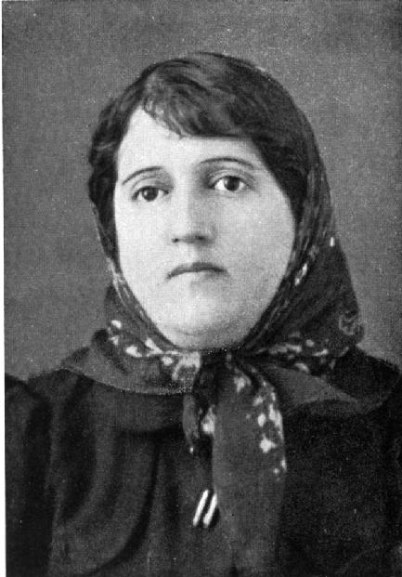
What are their names ?
Her name is Parvin Etesami.
His name is Saadi.
As you see everybody has a name.

Slide 3
What do you see in these pictures?
a tiger
a lion
an elephant
a cow
a dog
a cat
As you see every animal has a name.

Slide 4
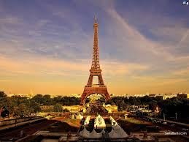
What do you see in these pictures?
Paris
sea jungle
As you see every place has a name.

Slide 5
What do you see in this picture?
Colored paper
Ruler
markers
Notebook
Pen
pencil
As you see everything has a name.

Slide 6
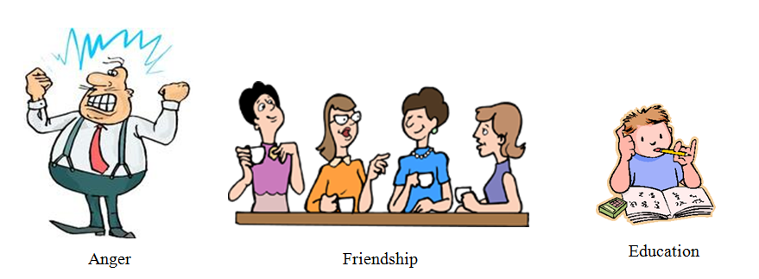
What are abstract (idea) nouns?
Abstract nouns can not be
heard , seen , tasted , touched or smelled.
Some examples are:
ability, anger, belief, beauty, bravery,
culture, energy, fear, goal, happiness, humor,
hate, hope, joy, love, life, lie, luck, music, pain, peace,
power, sleep, skill, truth, trust, worry, wisdom, warmth...

Slide 7
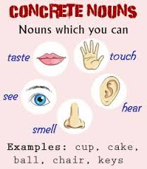
Practice 1:
How many groups of nouns did you see in previous slides?
5 groups
Can you call them ?
People, animals, things, places, abstract(idea)
Do you know the first 4 groups are also called Concrete nouns.
The nouns that can be
heard ,
seen ,
touched ,
tasted ,
smelled.

Slide 8
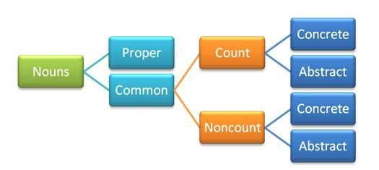
Other classifications for nouns
Nouns can also be classified to the following groups:

Slide 9
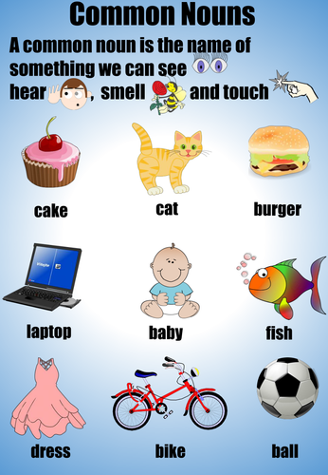
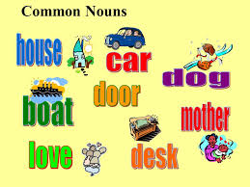
Common nouns
common nouns are
more general.
They do not begin with
a capital letter.

Slide 10
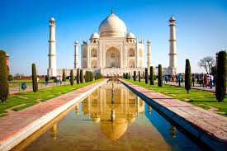
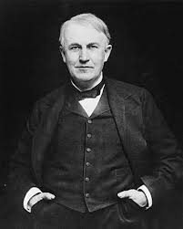
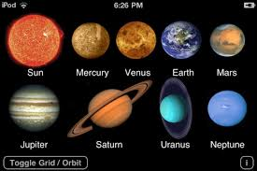
Proper nouns
Proper nouns are the names of
specific people , places , things.
They always begin with a capital letter.
Tajmahal
Edison
Sun - Earth

Slide 11
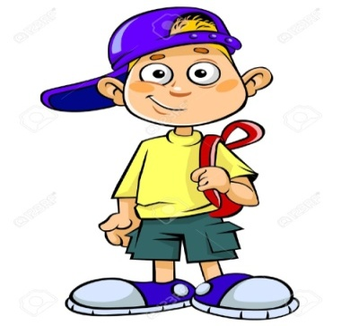
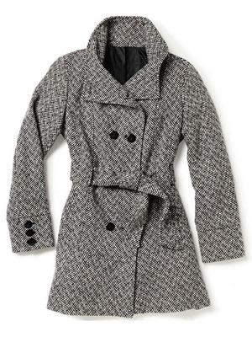
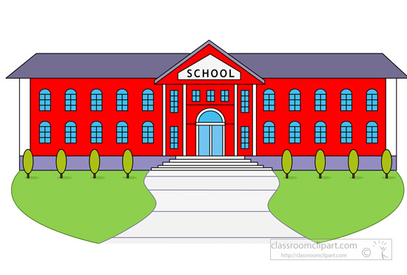
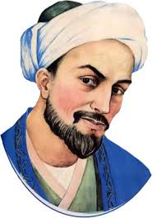
Practice 2:
Which one is common ?
a boy
a coat
a boy
food
Paris
a school
Saadi

Slide 12
Practice 3:

Slide 13
Countable and uncountable nouns

Slide 14
Countable nouns
Countable nouns are nouns that we can count them.
For example we can say
one apple two apples
Countable nouns can be singular or plural

Slide 15
singular or plural nouns

Slide 16
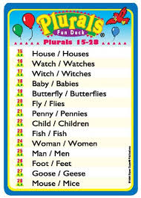
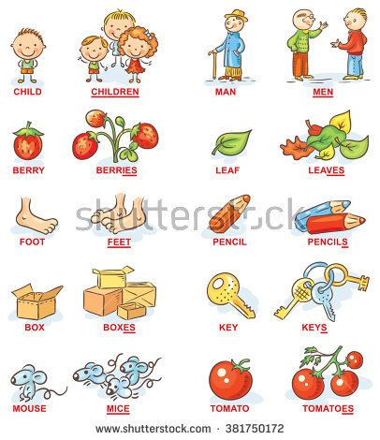
Plural nouns are regular and irregular
As you see some nouns are added s /es at the end (regular)
but some are not added s /es at the end (irregular).

Slide 17
How to make regular and irregular nouns?

Slide 18
Some examples of Irregular plural nouns

Slide 19
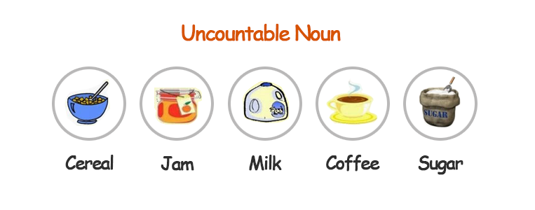
uncountable nouns
Uncountable nouns are nouns that we
can not count them.
Some examples are :
They are always singular.

Slide 20
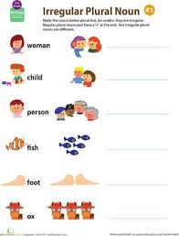
Practice 4:
What are
plural forms of
the front pictures ?
Women
Children
People
Fish
Feet
oxen

Slide 21
Prepared by:
Thank you
Mehrnaz Hosseini Fard

