Slide 1
What Is Next for Policy Design and Social Construction Theory?
Anne Schneider and Mara Sidney
The Policy Studies Journal,2009
Presented by: Zainab Aboutalebi
Spring 2014

Slide 2
About Writers
Anne Schneider is professor of political science at Arizona State University.
Danielle M. Varda is associate professor of political science at Rutgers University

Slide 3
Agenda
The centrality of policy design
The attention to social constructions
The attention policy consequences(or feed forward effects)
The integration of normative and empirical research and theory
Policy design as a complement to policy Theories
Research methods and epistemology: expanding the range in policy studies
Next step for policy design research and theory building

Slide 4
The next generation of policy design theory should
expand investigation into the social constructions that are ubiquitous in the policy field, especially the social construction of knowledge;
Further develop, empirically and theoretically, the relationship between policy design components and target populations;
empirically investigate and theorize about the impact that policy designs have on subsequent political voice, social movements, and other aspects of political processes;
integrate empirical research and normative democratic theory; and
integrate policy design more fully with other policy theories.

Slide 5
What Are Policy Designs?
Policy design = content of policy
1950
Recognizing that policies contain sets of fundamental elements, or
designs, is akin to stating that policies contain an architecture:
practice
practice
text
practice

Slide 6
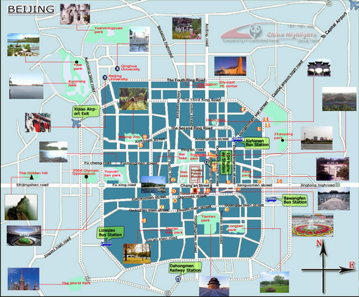

Slide 7
Dimensions for evaluating policy designs
Dahl and Lindblom(1953) did discuss a set of normative dimensions for evaluating policy designs such as
freedom,
rationality,
efficiency,
political equality,
and subjective equality.

Slide 8
The fundamental empirical elements of public policy Schneider and Ingram (1997)
1. problem definition and goals to be pursued;
2. benefits and burdens to be distributed;
3. target populations (the “players” in the policy arena who receive, or may receive, benefits or burdens);
4. rules (policy directives stating who is to do what, when, with what resources, who is eligible, etc.);
5. tools (incentives or disincentives for agencies and target groups to act in accord with policy directives);

Slide 9
The fundamental empirical elements of public policy Schneider and Ingram (1997)(Cont.)
6. Implementation structure (the entire implementation plan, including the incentives for agency compliance and resources);
7. social constructions (the “world making,” the images of reality, the stereotypes people use to make sense of the reality as they see it);
8. rationales (the explicit or implicit justifications and legitimations for the policy
including those used in debates about the policy); and
9. underlying assumptions (explicit or implicit assumptions about causal logics or about the capacity of people or of organizations).

Slide 10
Element of the policy design include:
Target groups or target populations are the groups designated to receive benefits or burdens
the stated goals of the policy or the problem to be solved,
the means by which the goals are to achieved (the tools),
the rules for inclusion or exclusion of individuals in target groups,
the rationales that state the cause and effect logic of the policy design (the theory of action), and
the implementation structure.

Slide 11
Before
Now
instrumental components
rational components
studies of policies
rationales
social constructions
studies of policies
underlying assumptions

Slide 12
While some dimensions of policy designs are clearly normative (such as rationales and goals), others are not so obviously normative (such as tools or implementation structure).
a variety of dimensions to evaluate of design:
whether the design is clear or opaque;
deceptive or straightforward;
inclusive or exclusive;
top-down or bottom-up;
participatory or closed;
filled with mandates or enabling discretion; and
whether it incorporates consistent or competing problem definitions and social constructions.

Slide 13
Policy design theory posits that:
Political and social process
The characteristic of design
Subsequent political process
Policy design helps us to understand how, and why, we get certain kinds of design elements instead of others,
and to understand the full range of consequences
that stem from differences in designs.(e.g. school failures)

Slide 14
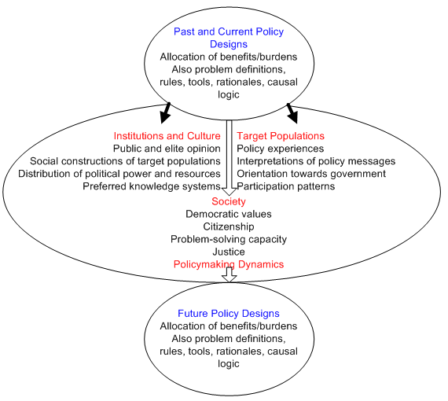
past and current policy designs impact on institutions and culture (see the left-hand side of the central ellipse) both by instrumental means (e.g., by creating new rules) and by symbolic means (different interpretations).
Past and current policy also impacts on society directly by setting democratic values, what it means to be a citizen, the problem-solving capacity of society, and the understanding of justice.
The dynamics of policymaking include, for instance, interest groups, social movements, agencies, and elected officials and their staff, in addition to those who are formally determining future policy designs.

Slide 15
Accounting for, and Considering, the Impact of the Social Construction of Reality(Cont.)
The idea is that target populations have varying levels of political power, and that actors characterize them in positive or negative terms.
Schneider and Ingram (1993) suggest a set of four “ideal types” of constructions:
Advantaged (powerful groups with positive images),
contenders (powerful groups with negative
images), dependents (powerless groups with positive images), and deviants (powerless
groups with negative images).

Slide 16
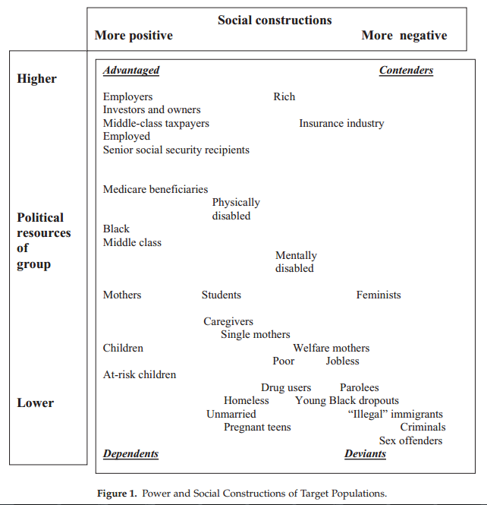

Slide 17
Accounting for, and Considering, the Impact of the Social Construction of Reality(Cont.)
The importance of accounting for social constructions of target groups goes beyond a focus on the policymaking process and the content of public policies to the impacts of policies.
as with the social construction of target populations, the construction of knowledge that drove the policymaking process may become embodied in the policy design.

Slide 18
Policy Design and the Feed(back)-Forward Process
Policy design is not only a critical dependent variable that needs to be incorporated more explicitly into theories of the policy process, but is also an independent variable in that it has multiple consequences for society.
feed-forward instead of policy feedback
Some scholars have developed typologies showing how different kinds of policy shape subsequent politics, for example Lowi (1964,1979), Wilson (1973), and Steinberger (1980)

Slide 19
Policy Design and the Feed(back)-Forward Process(Cont.)
Schneider and Ingram (1997, 2005; Ingram & Schneider, 2006) suggest that policy design’s impacts on four aspects of democracy should be emphasized:
justice(e.g., fairness, quality of life),
citizenship (political voice, participation, orientation toward government, identity),
democratic institutions (scope, depth, authenticity),and
problem solving (effectiveness, efficiency, relevance).

Slide 20
The next generation of policy research should include systematic analysis of the effects of public policy designs on the most critical issues of our time, including:
The vastly unequal levels of political participation across socioeconomic groups,
The cynicism people demonstrate toward government,
The growing inequality in income and education,

Slide 21
Integrating Normative and Empirical Analysis Using Policy Design Theory
key element of policy design theory is the integration of normative and empirical analysis.
Policy design theory pushes scholars to think about:
the technical aspects of a policy
Its implicit ideas, values, and broader meaning within society
feed-forward effects as policy outcomes

Slide 22
Policy Design as a Complement to Policy Theories
to look backward
study how and why a particular design emerged, and look
forward to its effects on society
The analyst is encouraged

Slide 23
Research Methods and Epistemology: Expanding the Range in Policy Studies
accounting for social construction processes in policymaking, policy designs, and policy impacts requires interpretive research methods.
As explicated by Yanow and many others, interpretivist researchers conceptualize theory and its role, data and interpretation, and evaluative criteria, even the goal of social science research and the role of researchers themselves, quite differently from positivist researchers.
As articulated by Schneider and Ingram (1997), policy design theory seems to straddle these worldviews and ways of knowing rather than choosing between them.

Slide 24
Next Steps for Policy Design Research and Theory Building
Public policy scholarship needs to be relevant to the most important issues of a democratic society, and that means going beyond simply explaining political processes or explaining policy change.
We need to ask how processes shape designs and how designs affect justice, problem solving, citizenship, and subsequent democratic institutions.

Slide 25
Next Steps for Policy Design Research and Theory Building(cont.)
We need to understand how negative and divisive social constructions of social groups, of types
of knowledge, and of events are used to manipulate opinion, and how these become
embedded in policy designs. We need to ask whether political processes produce
policy designs that serve democratic ends. We need to ask who political change
serves. Who benefits and who loses? Are the changes positive influences on subsequent
democracy? We need to ask about policy windows—who gains and who loses
from different kinds of windows? We need policy scholars to tackle the difficult
question of a policymaking culture that has become increasingly negative, divisive,
and more intent on “winning” and permanently damaging one’s “enemies” than on
solving problems or producing a more just society. We need studies that include
policy design as causal factors that, if changed, could enable public policy to become
a more democratic tool

Slide 26
Conclusion
Policy design Theory with its focus on
The content of public policies
The roles of social construction in policy making and implementation
The feed- forward effects of policies
The integration of empirical and normative goals
Is well positioned to move policy studies significantly forward.

Slide 27
اللهم وفقنا لما تحب و ترضی

Slide 28
buildings
efficiency
streets
esthetics
houses
equality of
park
airports
sports arenas
access
sustainability
friendliness
adaptability
safety

Slide 29
Accounting for, and Considering, the Impact of the Social Construction of Reality
A key strength and contribution of policy design theory has been its incorporation of social construction processes into its model of the policymaking process, policy design, and policy impacts
Constructivist approaches to social inquiry, such as policy design theory, emphasize that human agency means that constructions

Slide 30
Policy designs need to
Be transparent rather than opaque,
Be straightforward rather than deceptive,
contain positive constructions of all social groups and points of view even of those who are “losing,”
Contain logical connections between means and ends, implementation processes that grant equal access to information and subsequent points of contestation, and arenas for discourse that engage multiple “ways of knowing” the issue.

Slide 31
Policy design theory, with its focus on the content of public policies, the roles of social construction in policymaking and implementation, the feed-forward effects of policies, and the integration of empirical and normative goals, is well positioned to move policy studies significantly forward.

