Slide 1
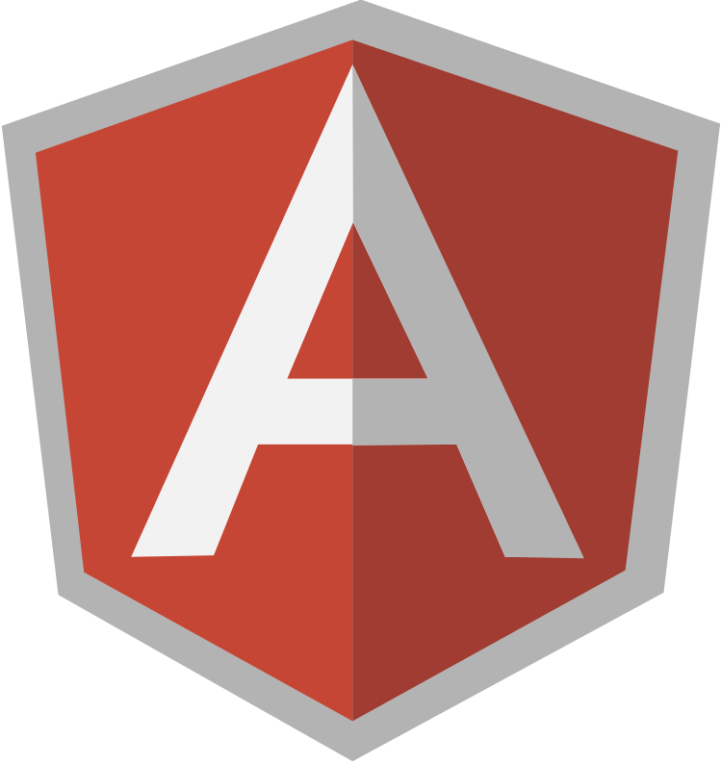
Intro to AngularJS
Masoud AliJafari

Slide 2
What is AngularJS?
A Javascript (client-side) library that allows you to build web applications and single-page applications using the MVW design pattern
MVW – Model, View, Whatever!
Angular started as an MVC library
Angular has morphed to be more flexible, supporting MVVM now as well. Hence MV*
Angular does with HTML what HTML was never designed to do: support dynamic documents
Provides two-way databinding between your model and your view
With POJO’s! (no observable models necessary)

Slide 3
What AngularJS is Not
Difficult to learn
Unawesome Another jQuery Library
To be used with jQuery
Angular has its own implementation of jQuery called ‘jq-lite’
While Angular will play nicely with jQuery(even replacing jq-lite with it automatically), jQuery has a different mindset (i.e. “thinking in Angular” versus “thinking in jQuery”)
A jQuery developer might say: “what selector do I use to manipulate the DOM here?”
An AngularJS developer might say: “what business problem am I trying to solve, and is what I’m building now achieving good separation of concerns?”

Slide 4
The History
Misko Hevery

Slide 5
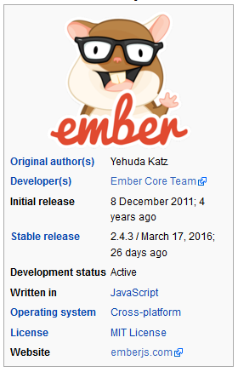
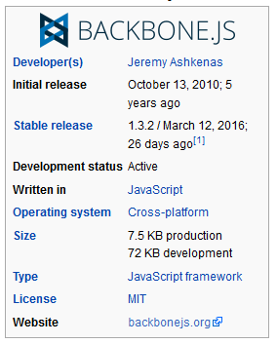
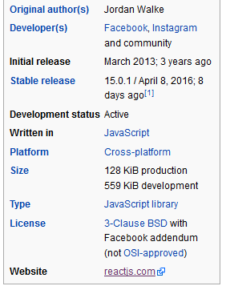
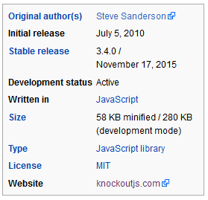
Others

Slide 6
MVC Pattern in Angular
Model – the POJO/JSON you receive. Angular provides the ability to take this data and plug it right into views in an observable/databound fashion (sweeeet)
View – the HTML markup:
View templates (when using routing and SPA approach)
Directives that aid in manipulating (or directly manipulate) the DOM
Controller – functions (objects for OO developers) that provide functionality for the application
Things that manipulate scope
Things that perform business logic
Things that make you go hmm
But never, ever ever things that manipulate the DOM or any kind of UI element!
Because, SoC!

Slide 7
Any sufficiently advanced technology is indistinguishable from magic.
Arthur C. Clarke

Slide 8
The Model
Any kind of regular JSON or POJO!
$scope.person = {
name: 'Carlos‘,
IsCool: true,
hasTopLevelSecurityClearance: true
};
Can be bound to any UI element
<input type=‘text’ ng-model=‘person.name’/>
<input type=‘check’ ng-model=‘person.IsCool’/>

Slide 9
The View
Just a basic HTML page!
Views are comprised of the base HTML page (the one containing the <body> tag) and zero or more HTML snippets
HTML snippets are used when building a SPA app with the ngRoute plugin
In order to “turn on” (initialize) Angular, you add an ngModule attribute to the target element, usually body:
HTML: <body ng-module=“myModule>
JS: angular.module(‘myModule’, []); //the square brackets can list dependencies

Slide 10
The Controller – Pulling it All Together
With ngController, attaches a controller class to the view.
Key aspect of how angular supports the principles behind the Model-View-Controller
Contains main bit of business logic used to implement functionality
Use controllers to:
Set up the initial state of the $scope object
For example, loading a Person and attaching them to scope for later databinding:
$scope.person = myService.load();
Add behavior to the $scope object
$scope.add = function(a, b){return a + b;}

Slide 11
The Controller – Should Never
Manipulate the DOM
Cannot stress this enough – this will led to massive amounts of spaghetti code that is very hard to test and debug. Any guess on how this should be done?
Call external services directly
Use services and delegate!
Do more than it should
If building a Person entry form, should there be functionality in the controller to copy files?
Any other “Should Nevers” I missed? Don’t be shy!

Slide 12
Controller Sample
HTML:
<div ng-controller=“myController”>
<span>{{greeting}}</span> (could also do <span ng-model=“greeting”></span>
<button type=“button” ng-click=“showAlert()”>Show Alert</button>
</div>
angular.module(‘myModule’).controller(‘myController’, function($scope){
$scope.greeting = ‘hi!’;
$scope.showAlert = function(){
alert($scope.greetin);
}
});

Slide 13
Directives
Why wait for HTML 6? You can create new elements right now!
Or add crazy new behaviour to existing elements
Attach via: element, attribute, class (and comment)
Not the easiest thing to understand
Notes:
Let’s say you wanted your buttons to Quack every time you hovered over them. Directive
You want to replace all <strong> tags with your new, custom blink tag, yep. Directive

Slide 14
Directives all the way down
<div class="tree-dir"> <div class="tree-filename" ng-bind="treeDir.node.filename" ng-style="{paddingLeft: treeDir.depth * 20 + 'px'}"> </div> <div class="tree-children"> <tree-node node="node" depth="treeDir.depth" ng-repeat="node in treeDir.node.children"> </tree-node> </div> </div>
Notes:
This is a simplified example from a file tree directive I made. This is the template for a directory node.

Slide 15
The dreaded directive definition object (DDO)
var directiveDefinitionObject = { template: '<div></div>', restrict: 'A', scope: false, controller: "ControllerName", controllerAs: 'ctl', bindToController: false, require: 'siblingDirectiveName', link: function ($scope, $element, $attrs) { } };
Notes:
Or templateUrl
Restrict tells Angular how this directive can be identified (element, attribute, class, etc)
Scope, controllerAs ad bindToController are all related to binding DOM to the directive code.
Scope will trigger the creation of a new scope or isolate scope if non-falsy
Controller is an injectable function to add logic to the directive… similar to link
Link is called as soon as the directive is compiled, added to the dom and controller has run. Here is where you do any DOM manipulation you need
This is all changing dramatically in Angular 2 and will likely have a transition api in 1.5
Require lets you get a hold of the instantiated Controller of another directive on the same DOM element or higher up in the DOM tree

Slide 16
Directive Example
angular.module(‘myModule’).directive(‘helloWorld’, function(){
return {
restrict: ‘AE’,
replace: ‘true’,
template: ‘<h3>Hello, world!</h3>’
}
});
<hello-world/> or <span hello-world></span>

Slide 17
ngRepeat – Directive for Collections
var m = [
"India",
"England",
"Brazil"
];
function MyCtrl($scope) {
$scope.items = m;
}
<div ng-app ng-controller="MyCtrl">
<ul>
<li ng-repeat=“item in items">{{item}}</li>
</ul>
</div>

Slide 18
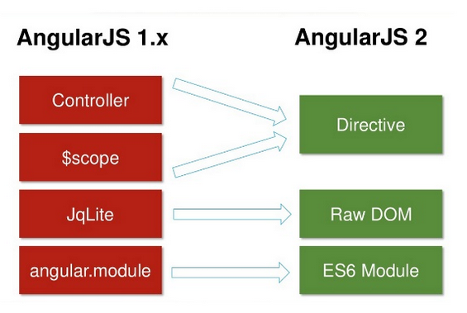
Angular 2

Slide 19
Angular 2
Angular 2 is written in TypeScript

Slide 20
Let’s clarify

Slide 21
Code Comparison

Slide 22
Code Comparison

Slide 23
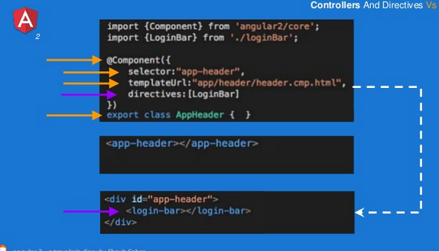
Code Comparison

Slide 24
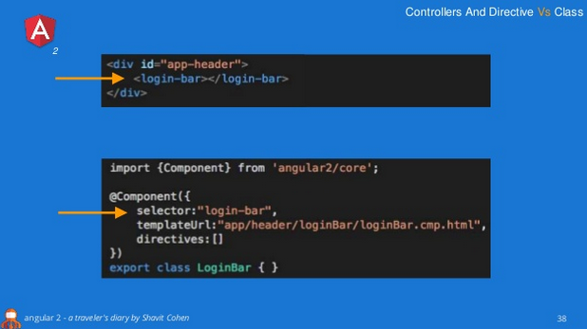
Code Comparison

Slide 25
The Service
Generally speaking, are used to encapsulate consuming external services
The proper place for use of $http
Are DI’ed for dependencies (e.g. $http) and are also DI’ed into your controller
Can be used for communication between controllers
Are singletons (whereas I’m a simpleton #lol #ngRhyme)

Slide 26
Service Example
angular.module(‘myModule’).service(‘myService’, function($http){
var self = this;
self.getPeople = function(){
return $http.get(‘/theUrl’); //Any guess what this returns?
};
});
A promise!
Controller:
Angular.module(‘myModule’).controller(‘myController’, function(myService){
myService.getPeople.success(function(data){
//do stuff
});
});

Slide 27
The Factory
Factories are basically services!
Some key differences which we’ll discuss in shortly

Slide 28
Factory Example
angular.module(‘myModule’).factory(‘myFactory’, function($http){
var factory = {};
factory.getPeople = function(){
return $http.get(‘/theUrl’); //Any guess what this returns?
};
return factory;
});
A promise!
Controller:
Angular.module(‘myModule’).controller(‘myController’, function(myService){
myService.getPeople.success(function(data){
//do stuff
});
});

Slide 29
Services vs Factories: ngTruth
Services are essentially Factories, however:
Services return a new (singleton) instance of your Service declaration
For example: return new myservice()
Factories return the result of your Factory declaration (i.e. the return value of the Factory function)
For example: return myService()

Slide 30
First – Single Page Apps
Do you prefer native Windows apps to web apps?
Do you prefer native mobile apps to mobile web sites?
The goal of Single Page Apps is to deliver an experience that looks and feels like a native app
Data is loaded in one call for most of the pages that the user will interact with, or is loaded dynamically as the user moves through the page using AJAX requests
The page is designed to look like the user is browsing through the app, but responds instantly and quickly and fluidly moves through to the next page in the site
No more clicking links and waiting for the page to load. That experience stinks anyway!
Single page apps deliver a user experience that is unmatched by classic round-trip based web applications

Slide 31
ngRoute – the ng approach to SPA
ngRoute is an Angular plugin that provides site browsing using a classic URL hashing approach
Classic URL: http://mysite.com/people/addresses.aspx?personID=1
ngRoute/Hashing: http://mysite.com/people.cshtml?personID=1#addresses
Hashes are tied to Angular view templates
#addresses loads the Address view (e.g. addresses.html) which contains an HTML snippet for the view
View templates have controllers associated with them
View templates can be role-based and have full permissions

Slide 32
ngView
ngRoute is used in conjunction with ngView
<div ng-view>
Elements containing ngView are replaced by the view template loaded by ngRoute

Slide 33
ngRoute Example
angular.module(‘myModule’, [‘ngRoute’])
.config(function($routeProvider){
$routeProvider.when(‘/addresses’, {
templateUrl: ‘addresses.html’,
controller: ‘addressesController’
});
});
when ‘mysite.com/main.html#addresses’ then show that view

Slide 34
Final Notes on AngularJS
AngularJS is great for building rich applications that run in a browser
The closer you get to SPA architecture, the more you should use AngularJS
And the better AngularJS will perform
jQuery is a fantastic tool, but does not grow well with large web apps, and does not lend itself to good test coverage via unit testing
When building a round-trip centric app, favor a combination of jQuery and KnockoutJS with limited Razor
When building a SPA, favor AngularJS. It has more up front time than jQuery and Knockout, but the payoff will be well worth it

Slide 35
The Slide Deck Is Done, Maaaaan
We discussed:
AngularJS in depth:
Controllers
Views
Models
Directives
Services
Routes

Slide 36
Questions?
Ask ‘em if you got ‘em

Slide 37
Angular 2 a traveler's diary
http://www.slideshare.net/ShavitCohen/angular-2-a-travelers-diary-60442038
The evolution of Angular 2 @ AngularJS Munich Meetup #5
www.slideshare.net/johannes-weber/the-evolution-of-angular-2-angularjs-munich-meetup
Intro to AngularJs
http://www.slideshare.net/soltechatlanta/intro-to-angularjs-40917242

