Slide 1
پروژه ترجمه زبان انگلیسی
Active 3 - Unit 1 - Chapter 1
Successful Dieting
مترجمان: نیکزاد ترکمن– کوشا حیدرنژادیان
1401-1402

Slide 2
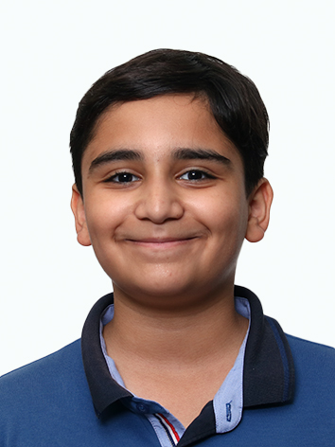
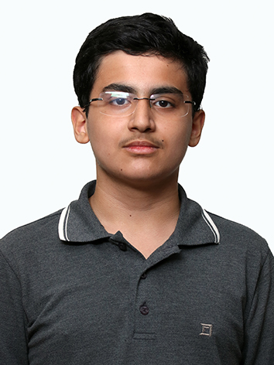
فهرست
مطالب
نیکزاد ترکمن– کوشا حیدرنژادیان

Slide 3
Hi everyone, A question for all you veteran dieters out there: What's the best way to lose weight and keep it off? I've tried all kinds of fad diets: low fat, low carbohydrate, grapefruit, cabbage soup—you name it, I've tried it! I do lose some weight, but have never been able to keep it off. Plus, eating the same food day after day can be so boring! How do you do it?
JudyGirl, Spokane, Washington
ترجمه خود را جایگزین این متن کنید.

Slide 4
Hi JudyGirl, Fad diets haven't done the trick for me, either. The problem is that you either eat too much of one kind of food and get fed up with it, or you don't get enough of the foods that your body needs. So when you stop, you eat too much of the foods that weren't on the diet and the weight comes back. For me the solution has been portion control. I have to be aware of serving sizes for each meal and make sure everything is in moderate amounts. For example, for dinner, I'll fix a nice, attractive meal of a piece of meat, some rice, and a salad, and I put everything in front of me. I eat slowly and stop when it's finished—no seconds! And no eating between meals! I eat less but appreciate the food more. This method has really worked for me.
Drew T., Chicago
ترجمه خود را جایگزین این متن کنید.

Slide 5
JudyGirl, My secret to weight control has been "no white foods." You know, no white bread, pasta, potatoes, or desserts made with white flour and refined sugar. These foods are loaded with calories but don't contain much nutrition. You can still eat foods made with whole grains like whole wheat bread, crackers, and oatmeal. These foods are better for you, and they fill you up because they contain a lot of fiber. So think brown foods, not white!
ترجمه خود را جایگزین این متن کنید.

Slide 6
Hi JudyGirl, I notice you didn't say anything about exercise. As I'm sure you're aware, food is only part of the problem for overweight people. Many of us just don't exercise enough. That was my problem, anyway. I always had a pretty good diet, but I never exercised. Then I went to a weight-loss clinic, and a counselor there said I should start exercising regularly, both for my weight and general health. So I joined a gym and started lifting weights several times a week. Now I alternate lifting weights, swimming, and jogging. Exercise has made a huge difference in my life. I was able to lose 10 kilograms without changing my diet very much (though I eat fewer desserts). Also, I've kept off the weight for three years now. You don't need to go overboard; getting a few sessions of exercise a week should be enough.
JimGym, Sydney
ترجمه خود را جایگزین این متن کنید.

Slide 7
JudyGirl, Have you thought about becoming a vegetarian? I used to follow a typical American diet—lots of meat, lots of junk food, and I especially loved fast-food hamburgers! I wasn't terribly overweight—maybe five to seven kilograms—but I felt slow and tired all the time. Then a friend told me about the health benefits of a vegetarian diet, and I decided to try it. I didn't lose a lot of weight right away, but I kept losing over time, maybe a couple of pounds a month. What's more important is that I have more energy and feel healthier than ever! It can be a struggle to be a vegetarian, though. Sometimes it's difficult to find restaurants with good vegetarian options, and you have to plan your meals more carefully. But, it's been worth it for me—I look better and feel great!
Minjoo, San Francisco
ترجمه خود را جایگزین این متن کنید.

Slide 8
Hi everybody, Many thanks to all of you for your great ideas. Drew T. and QueenMother, I'm definitely going to try portion control and cut down on white foods. And a special appreciation to you, JimGym. You've reminded me that I really need to exercise more. Sorry, Minjoo, while I see how becoming vegetarian could work, I'm not ready to give up meat! Well, everyone, wish me luck.
JudyGirl
ترجمه خود را جایگزین این متن کنید.

