Slide 1
Intranet, Extranet, Firewall

Slide 2
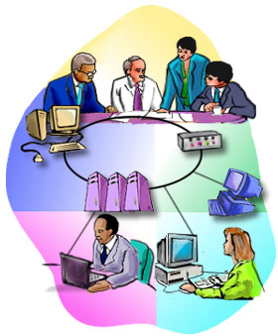
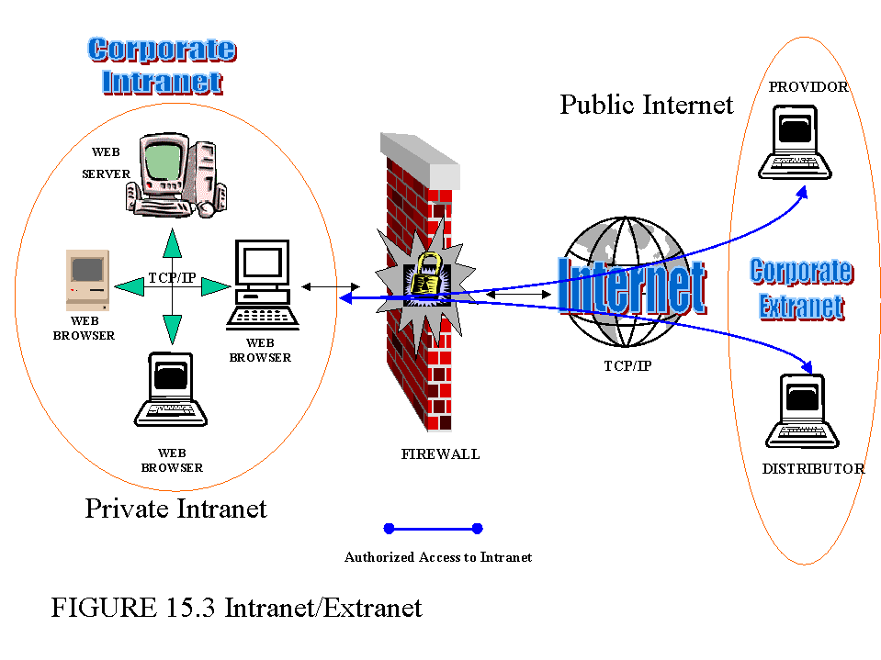
Intranet and Extranet

Slide 3
What is Intranet
Definition:
An Intranet is a private computer network that uses Internet protocols, network connectivity, and possibly the public telecommunication system to securely share part of an organization’s information or operations with its employee.

Slide 4
Basically
It uses the same concepts and technologies of the internet (clients and servers) running on the TCP/IP protocol suite.
HTTP, FTP and SMTP and very commonly used.
Access to information is typically through browsers.
Platform independent.
No need to install special software on clients.

Slide 5
Advantage:
Intranet help employees to quickly locate information and applications relevant to their roles and responsibilities.
Standard interface, allowing “access from anywhere”.
Can serve as a powerful tool for communication within an organization.
Both vertically and horizontally
Permits information to be published.

Slide 6
What is Extranet
Definition
An Extranet is private network that uses internet protocols, network connectivity, and possibly the public communication system to securely share part of an organization’s information or operations with suppliers, partners, customers, or other businesses.
Can be viewed as part of a company’s Intranet that is extended to users outside the company.

Slide 7
Basically
It is “a private internet over the Internet”.
Used to designate “private parts” of a website.
Only registered users can navigate.
It requires security and privacy.
Firewall server management.
Issuance and use of digital certificates or similar means of authentication.
Encryption of messages.
Use of Virtual Private Network (VPN) that tunnel through the public network.

Slide 8
Advantages:
Can improve organization productivity.
Allows information to be viewed at times convenient for external users.
Cut down on meeting times.
Information can be updated instantly.
Authorized users have immediate access to latest information
Can improve relationships with customers.

Slide 9
Firewall

Slide 10
Why Firewalls
Firewall are effective to:
Protect local systems.
Protect network-based security threats.
Provide secured and controlled access to Internet
Provide restricted and controlled access from the Internet to local servers.

Slide 11
Firewall Characteristics
Design goals:
All traffic from inside to outside must pass through the firewall.
Only authorized traffic will be allowed to pass.
Defined by local security policy.
The firewall itself is immune to penetration.
Use of trusted system with a secure operating system.

Slide 12
Types of Firewalls
Packet filters.
Application-level gateways
Circuit-level gateways.

Slide 13
Packet Filtering Firewall
Internet
Private network
Packet
Filtering
router
Some of the attacks that can be made on packet filtering routers:
IP address spooling
Source Routing attacks

Slide 14
Packet Filtering Firewall
Applies a set of rules to each incoming IP packet and then forwards or discards the packet.
Typically based on IP addresses and port numbers.
Filter packets going in both directions.
The packet filter is typically set up as a list of rules based on matches to fields in the IP or TCP header.
Two default policies (discard or forward).

Slide 15
Packet Filtering Firewall
Advantages:
Simplicity
Transparency to users
High speed
Disadvantages:
Difficulty of setting up packet filter rules
Lack of authentication

Slide 16
Application-Level gateway
Outside
Connection
FTP
Inside
Connection
HTTP
SMTP
Outside
Host
Inside
Host
Application-Level
Gateway
Also called a Proxy Server; acts as relay of application level traffic.
It is service specific.

Slide 17
Application-level Gateway
Application-level Gateway
Also called proxy server
Acts as a relay of application-level traffic
Advantages:
Higher security than packet filters
Only need to scrutinize a few allowable applications
Easy to log and audit all incoming traffic
Disadvantages:
Additional processing overhead on each connection (gateway as splice point)

Slide 18
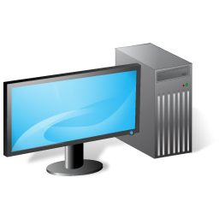
Circuit-level gateway
Outside
Connection
Out
In
Outside
Host
Out
In
Inside
Connection
Out
In
Inside
Host
Circuit-level gateway

Slide 19
Circuit-level Gateway
Stand-alone system, or specialized function performed by an Application-level Gateway.
Does not permit end-to-end TCP connection; rather the gateway sets up two TCP connections:
The gateway typically relays TCP segments from one connection to the other without examining the contents.
The security function consists of determining which connections will be allowed.

Slide 20
Bastion Host
It is a system identified by the firewall administrator as a critical point in the network’s security.
It executes a secure version of its OS and is trusted
It consists of services which are essential.
Requires additional authentication before access is allowed

Slide 21
Firewall Configurations
In addition to the use of simple configuration of a single system, more complex configurations are possible.
Three common configurations are in popular use.
Single-homed host.
Dual-homed host
Screened subnet.

Slide 22
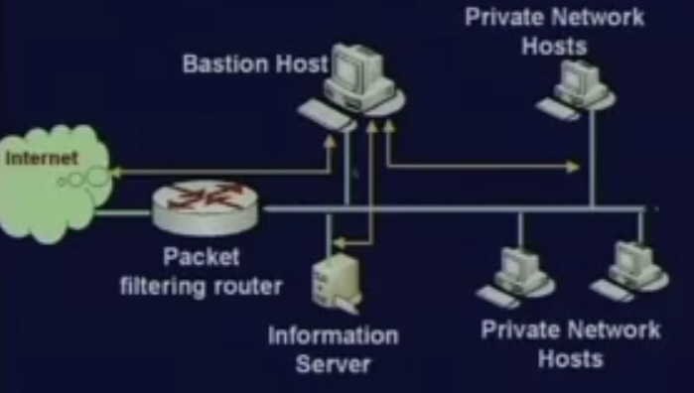
Single-homed Host

Slide 23
Firewall consists of two system:
A packet-filtering router
A bastion host
Configuration for the packet-filtering router:
Only packets from and to the bastion host are allowed to pass through the router.
The bastion host performs authentication and proxy functions.

Slide 24
Greater security than single configurations because of two reasons:
Implements both packet-level and application-level filtering (allowing for flexibility in defining security policy).
An intruder must generally penetrate two separate systems.

Slide 25
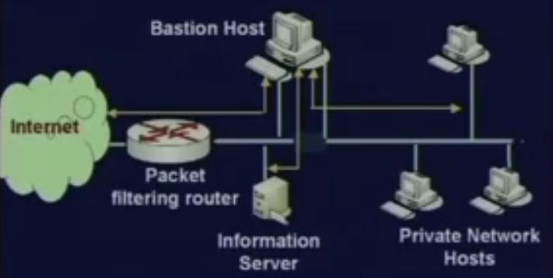
Dual-homed host

Slide 26
The packet-filtering router is not completely compromised.
Traffic between the Internet and other hosts on the private network has to flow through the bastion host.

Slide 27
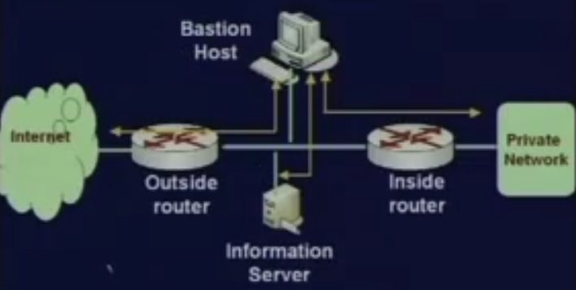
Screened Subnet

Slide 28
Most secure configuration of the three.
Two packet-filtering routers are used.
Creation of an isolated sub-network.

Slide 29
Advantages:
Three levels of defense to thwart intruders.
The outside router advertises only the existence of the screened subnet to the Internet.
Internal network is invisible to the Internet.
The inside router advertises only the existence of the screened subnet to the internal network.
The systems one the inside network cannot construct direct routes to the Internet.

Slide 30
Intranet/Extranet Design Issues

Slide 31
For Intranet:
Analysis of the organization flow.
Identify various cress-sections of employees, and their access privileges.
Enforce authentication mechanism.
For Extranet:
Security is the major concern.
Combination of firewalls, authentication, VPN, etc. must be used.

