Slide 1
Noun Markers
In The Name Of Allah

Slide 2
Start
To know about noun markers, first we should know exactly that is a noun?
a word used to identify any of a class of people, places, or things common noun, or to name a particular one of these proper noun ( Special nouns ).
And a pronoun is a usually short word that it is connected to the major noun and we use it instead of them. Like he, she, it …
So, Noun Markers are some words that precede and modify nouns. Like “the, that, a, an …”
Ok . Now the question is that how we make a noun? when we use “the, an, that or this, …). We will discuss on next pages.
precede (v):
Come before STH.
modify (v):
To make some changes that it can make it more clear and better or make it worse.

Slide 3
“A” vs “An”
USE 1
The article A is used before singular, countable nouns which begin with consonant sounds.
Examples:
* He is a teacher.
* She doesn't own a car.
* I saw a bear at the zoo.
Consonant: it is a speech sound that is not a vowel (I,e,u,h,a,o)

Slide 4
A vs An
USE 2
The article AN is used before singular, countable nouns which begin with vowel sounds.
Examples:
* He is an actor.
* an industry, must be active.
* I saw an eagle at the zoo.
Vowel sounds:
i, o, u, e, a, h

Slide 5
A vs An
USE 3
Remember that A(AN) means "one" or "a single". You cannot use A(AN) with plural nouns.
Examples:
I saw a bears in Yellowstone National Park. Not Correct
I saw bears in Yellowstone National Park. Correct

Slide 6
A vs An
USE 4
If there is an adjective or an adverb-adjective come before the noun, A(AN) should agree with the first sound in the adjective or the adverb-adjective combination.
Examples:
He is an excellent teacher.
I saw a really beautiful eagle at the zoo.

Slide 7
A vs An
USE 5
Use A before words such as "European" or "university" which sound like they start with a consonant even if the first letter is a vowel. Also use A before letters and numbers which sound like they begin with a consonant, such as "U", "J", "1" or "9". Remember, it is the sound not the spelling which is important. For example, "1" is spelled O-N-E; however, it is pronounced "won" like it starts with a "W".
Examples:
She has a euro. Sounds like "yu-ro".
That number is a "1". Sounds like "won".

Slide 8
A vs An
USE 6
In English, some nouns are considered uncountable such as: information, air, advice, salt and fun. We do not use A(AN) with these uncountable nouns. (Learn more about countable and uncountable nouns.)
Examples:
She gives a good advice. Not Correct
She gives good advice. Correct
Consider (v):
think carefully about (something), typically before making a decision.

Slide 9
Some questions
Choose correct one.
A/An /(nothing) Internet conference.
A/An /(nothing) extremely large dog.
A/An /(nothing) fantastic answer.
A/An /(nothing) people.
A/An /(nothing) hard lessons.
A/An /(nothing) old letter.
A/An /(nothing) computers.
A/An /(nothing) European cars.
Choose correct one.
A/An /(nothing) huge rainstorm.
A/An /(nothing) angry passengers.
A/An /(nothing) European football team.
It starts with A/An /(nothing) “R”.
It starts with A/An /(nothing) “F”.
A/An /(nothing) police.
A/An /(nothing) milk.
A/An /(nothing) advise.

Slide 10
When we use “the”?
Resource:
owl.english.purdue.edu
With some editing.
The definite article is used before singular and plural nouns when the noun is specific or particular. The shows that the noun is definite, that it refers to a particular member of a group. For example:
"The dog that bit me ran away." Here, we're talking about a specific dog, the dog that bit me.
I was happy to see the policeman who saved my cat!
I saw the elephant at the zoo. Probably there is only one elephant at the zoo.
Particular: special
Bit:
Use the teeth to cut into something in order to eat it.

Slide 11
Usage of “the” (Continue)
Count and uncountable Nouns
“The” can be used with noncount nouns, or the article can be omitted completely.
“I love to sail over the water” (some specific body of water) or "I love to sail over water" (any water).
"He spilled the milk all over the floor" (some specific milk, perhaps the milk you bought earlier that day) or "He spilled milk all over the floor" (any milk).
Omitted:
Can be deleted

Slide 12
Usage of “the” (Continue)
Geographical use of the
There are some specific rules for using the with geographical nouns.
Do not use the before:
names of most countries/territories: Italy, Mexico, Bolivia; however, the Netherlands, the Dominican Republic, the Philippines, the United States
names of cities, towns, or states: Seoul, Manitoba, Miami
names of streets: Washington Blvd., Main St.
names of lakes and bays: Lake Titicaca, Lake Erie except with a group of lakes like the Great Lakes
names of continents (Asia, Europe)

Slide 13
Usage of “the” (Continue)
Do use the before:
names of rivers, oceans and seas: the Nile, the Pacific
points on the globe: the Equator, the North Pole
geographical areas: the Middle East, the West
deserts, forests, … : the Sahara, the Persian Gulf, the Black Forest, the Iberian Peninsula
Globe:
earth

Slide 14
This, that, these, those
We use this, that, these and those to point to people and things. This and that are singular. These and those are plural. We use them as determiners and pronouns.
Determiner:
a word that is used before a noun to show which particular example of the noun you are referring to

Slide 15
Usage of this, that, these, those
Resource:
Cambridge.com
Demonstrative adj:
showing which
person or thing is being referred to

Slide 16
Usage of this, that, these, those (Continue)
Pointing to things
We use this and that with singular and uncountable nouns:
Try to repeat this exercise every morning and evening. (this + singular countable noun)
What does this music make you think of?
Referring to things or ideas
We normally use this, that, these and those as pronouns to refer to things or ideas:
We’re going to eat first and then go to the film. Are you happy with that?
Can you turn that off if you’re not watching it?

Slide 17
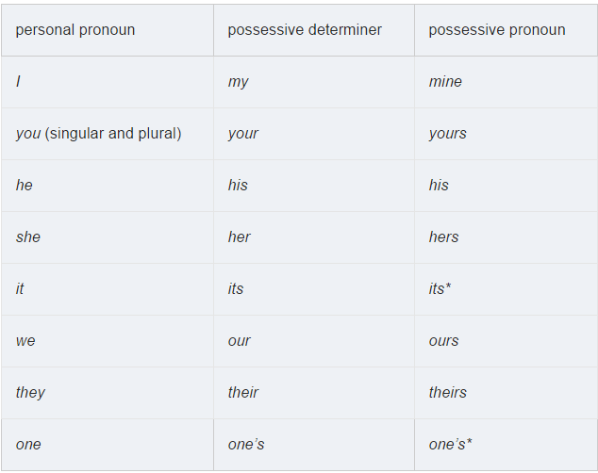
Pronouns: possessive (my, mine, your, yours, etc.)
We use pronouns to refer to possession and ‘belonging’. There are two types: possessive pronouns and possessive determiners. We use possessive determiners before a noun. We use possessive pronouns in place of a noun.

Slide 18
Some typical errors and problems
We don’t use another determiner with a possessive determiner:
I’m going to get my hair cut this afternoon.
… get the my hair cut … (wrong)
We don’t use ’s after possessive pronouns:
Are those gloves hers?
Are those gloves her’s? (Wrong)
We don’t use possessive pronouns before nouns:
Lots of our friends were at the party.
Lots of ours friends … (Wrong)

Slide 19
End
Collector: Ali Bazrafshan
Related teacher: Mr. Mokhtarzadeh
Some resources:
http://dictionary.cambridge.org/
http://www.grammar.cl/
http://englishpage.com
…

