Slide 1
بسم الله الرحمن الرحیم

Slide 2
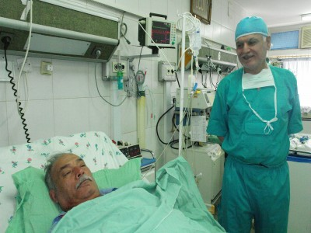
doctor

Slide 3
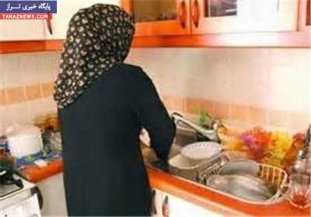
housewife

Slide 4
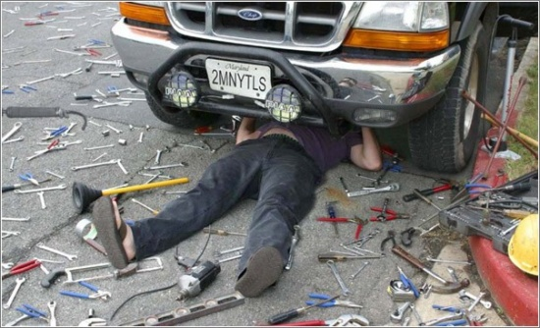
mechanic

Slide 5
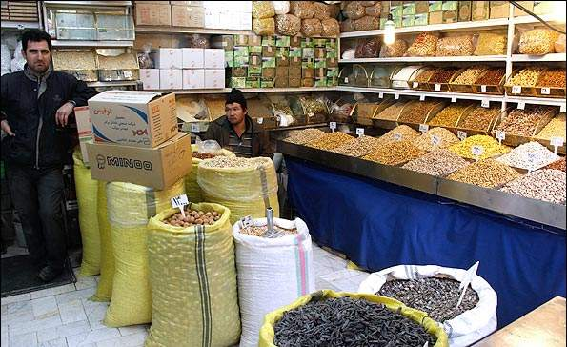
shopkeeper

Slide 6
nurse

Slide 7
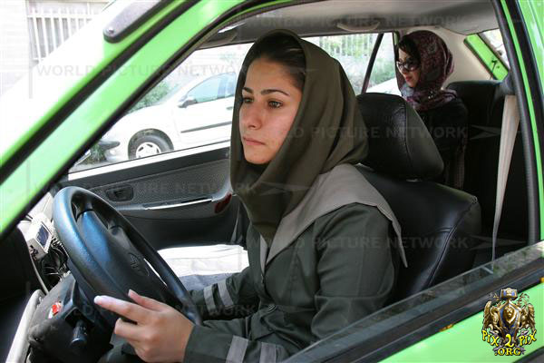
driver

Slide 8
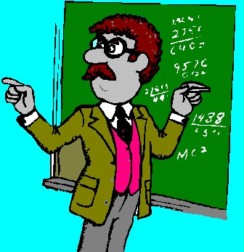
teacher

Slide 9
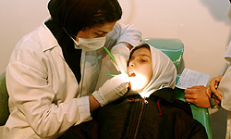
dentist

Slide 10
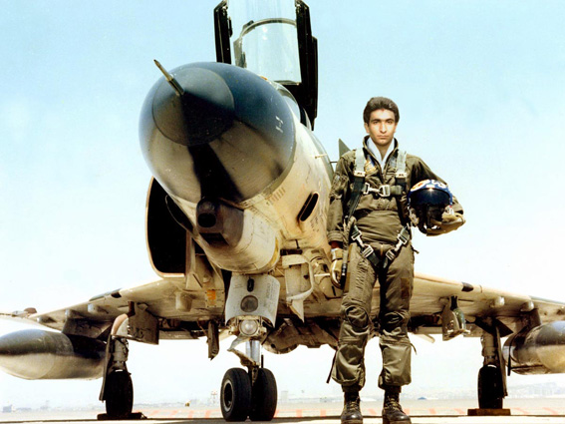
pilot

Slide 11
تصویر مناسب را در هر مورد انتخاب کنید.

Slide 12
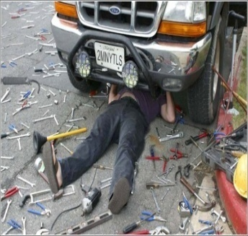
dentist

Slide 13
dentist

Slide 14
driver

Slide 15
driver

Slide 16
mechanic

Slide 17
mechanic

Slide 18
pilot

Slide 19
pilot

Slide 20
teacher

Slide 21
teacher

Slide 22
doctor

Slide 23
doctor

Slide 24
nurse

Slide 25
nurse

Slide 26
housewife

Slide 27
housewife

Slide 28
shopkeeper

Slide 29
shopkeeper

Slide 30
END

