Slide 1
ساخت ربات تلگرام با زبان برنامه نویسی C#
گروه کامپیوتر دانشگاه صفاهان
@Safahan_IT
محمد صمدیه
Moh.Samadieh@gmail.com

Slide 2
معرفی تلگرام
Telegram
Telegram is a cloud-based mobile and desktop messaging app with a focus on security and speed.

Slide 3
معرفی تلگرام
Telegram for iOS was launched on August 14, 2013. The alpha version of Telegram for Android officially launched on October 20, 2013. More and more Telegram clients appear, built by independent developers using Telegram's open platform.
iOS: چهارشنبه، ۲۳ مرداد ۱۳۹۲ ۱۳۹۲/۰۵/۲۳
Android: یکشنبه، ۲۸ مهر ۱۳۹۲ ۱۳۹۲/۰۷/۲۸

Slide 4
معرفی تلگرام
Telegram is supported by Pavel and Nikolai Durov. Pavel supports Telegram financially and ideologically while Nikolai's input is technological.
To make Telegram possible, Nikolai developed a unique custom data protocol, which is open, secure and optimized for work with multiple data-centers. As a result, Telegram combines security, reliability and speed on any network.
While the Durov brothers were born in Russia, as were some of the key developers, Telegram is not connected to Russia – legally or physically. Telegram's HQ is in Berlin.

Slide 5
معرفی تلگرام
With Telegram,
You can send messages, photos, videos and files of any type (doc, zip, mp3, etc)
Create groups for up to 10,000 people
Create channels for broadcasting to unlimited audiences.
You can write to your phone contacts and find people by their usernames. As a result, Telegram is like SMS and email combined. And can take care of all your personal or business messaging needs.

Slide 6
روبات تلگرام
Telegram Bot API
The Bot API is an HTTP-based interface created for developers keen on building bots for Telegram.
https://core.telegram.org/bots/api

Slide 7
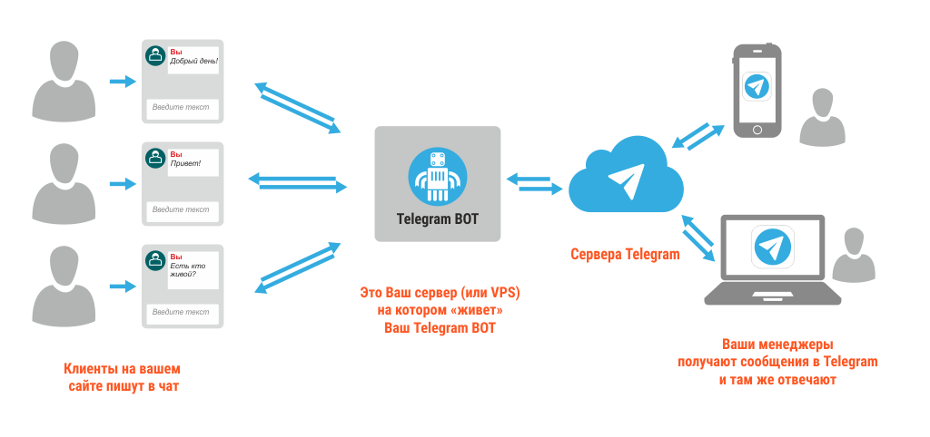
روبات تلگرام

Slide 8
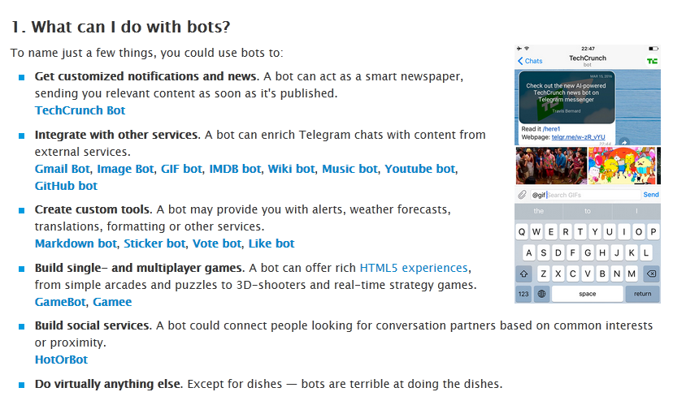

Slide 9
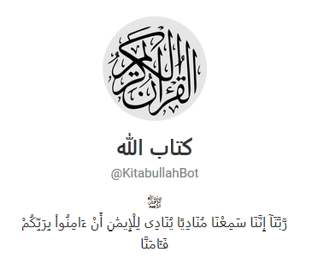
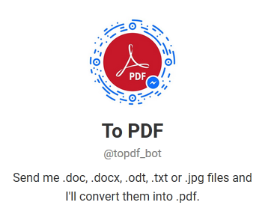
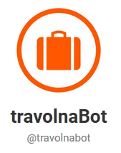
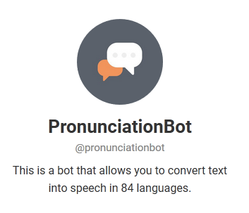
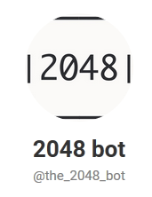
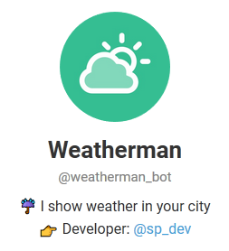
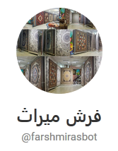
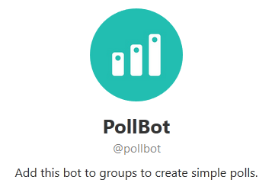
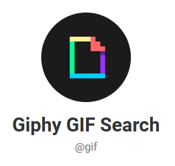
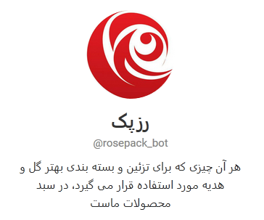
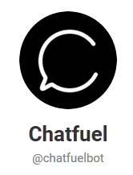
چند نمونه

Slide 10
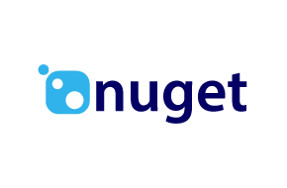
مواد لازم

Slide 11
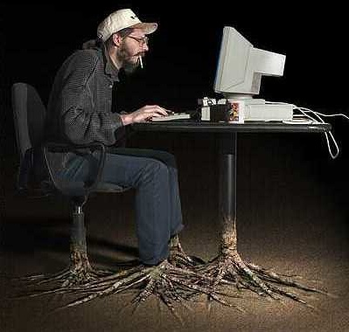
برنامه نویس

Slide 13
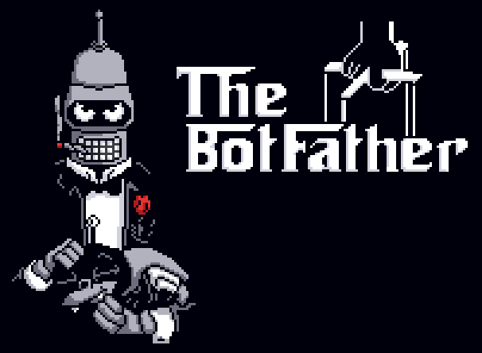

Slide 15
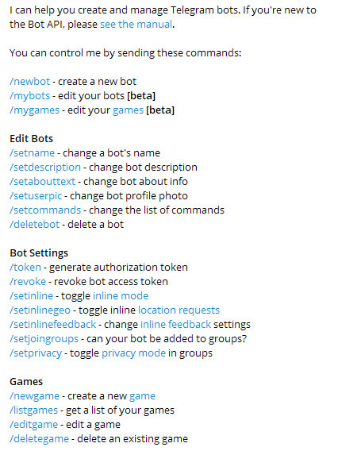
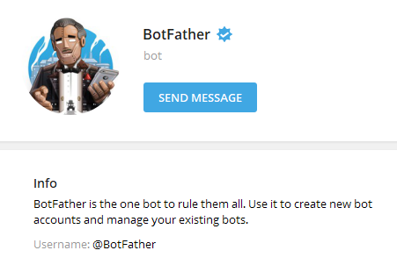
ربات پدر

Slide 16
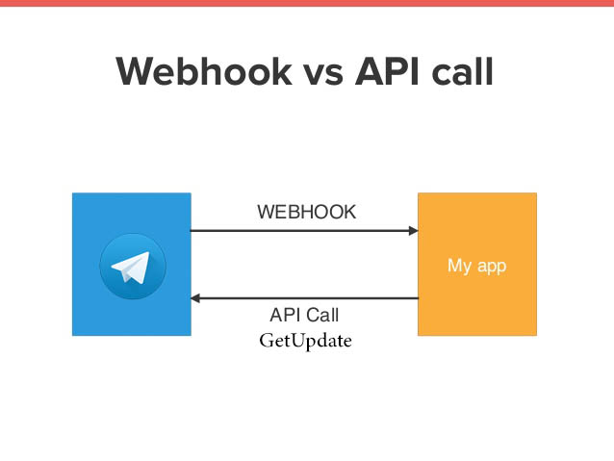
انتخاب روش

Slide 17
برنامه نویسی
https://www.nuget.org/packages/Telegram.Bot/

