Slide 1
My classmates Grade 7 Lesson 2
By kuchakzadeh
More at t.me/kuchakzadeh
1398

Slide 2
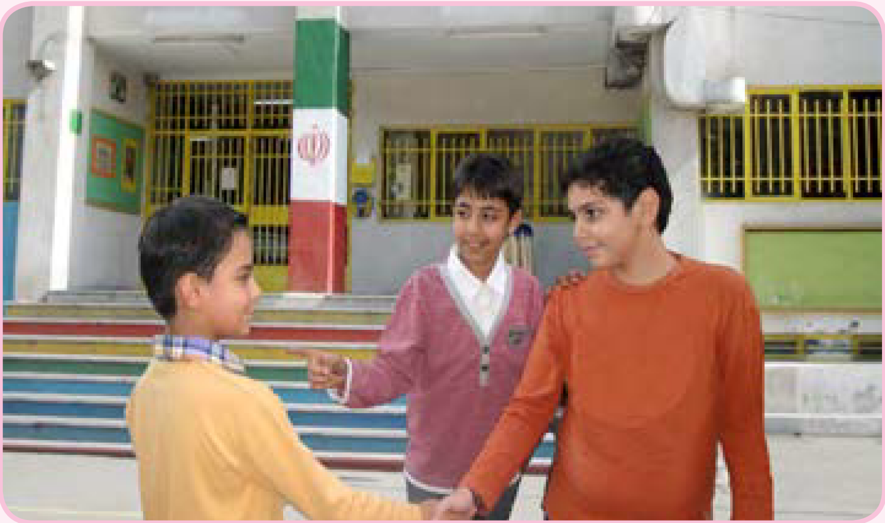
Who is that boy?
This is my classmate, Erfan
Nice to meet you, too.
Nice to meet you.

Slide 3
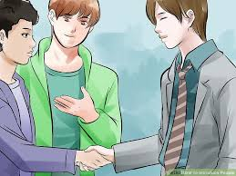
Who is that boy?
He is my friend, Hitachi
Nice to meet you, too.
Nice to meet you.

Slide 4
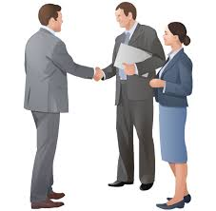
Who is that man?
He is my teacher, Mr. Jackson
Nice to meet you, too.
Nice to meet you.

Slide 5
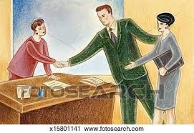
Who is that woman?
She is my teacher, Mrs. Smith
Nice to meet you, too.
Nice to meet you.

Slide 6
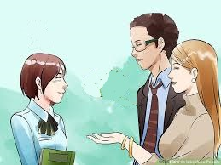
Who is that girl?
She is my classmate, Hakiko
Nice to meet you, too.
Nice to meet you.

Slide 7
Monolog

Slide 8
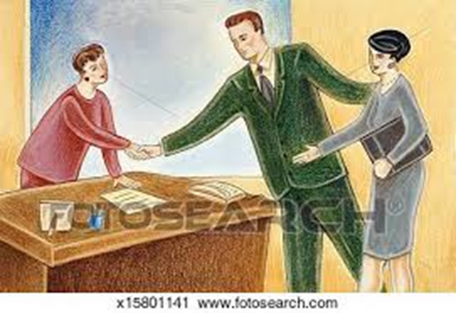
Who is he?
Who is she?
classmate
teacher
Erfan is that boy’s classmate.
teacher
Mr. Jackson is that woman’s ……………..
Mrs. Smith is that ………… …………………..
classmate
friend
Hitachi is ………. ……….. ……………….
Hakiko .… …… ……….. ……………….

Slide 9
Write about yourself
Mr./Mrs. ……………………. is my English teacher.
………………………… is my friend.
………………………… …… ……. classmate.

