Slide 1
LESSON 5
MY APPEARANCE
Identifying People by their Appearance
150 mins in 3 sessions
Letters:d , l , r words and expressions
(tall , short , young , old , suit , shirt , jacket , trousers , manteau , scarf , chador , shoes , gloves , wear and coulors )

Slide 2

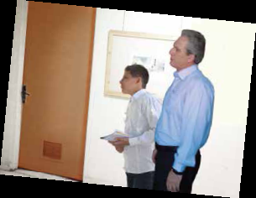
Page28
My Appearance

Slide 3
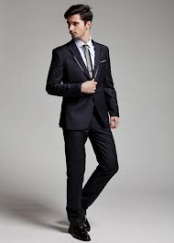
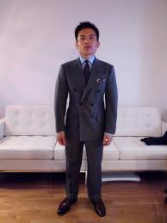
a tall man
a short man

Slide 4



a yellow shirt
chador
a brown manteau

Slide 5



a red T- shirt
a green scarf
jacket

Slide 6



trousers
a black suit
a grey coat

Slide 7
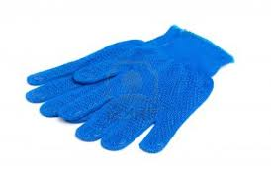
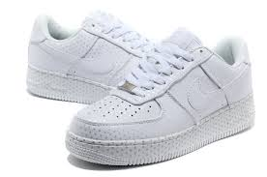
The blue gloves
The white shoes

Slide 8
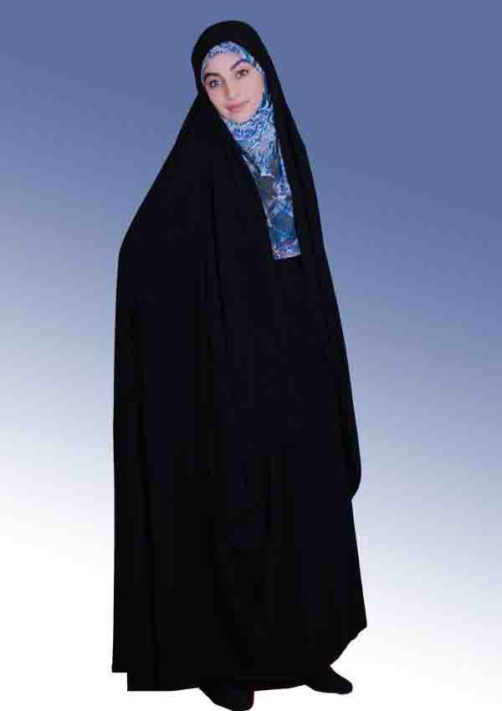
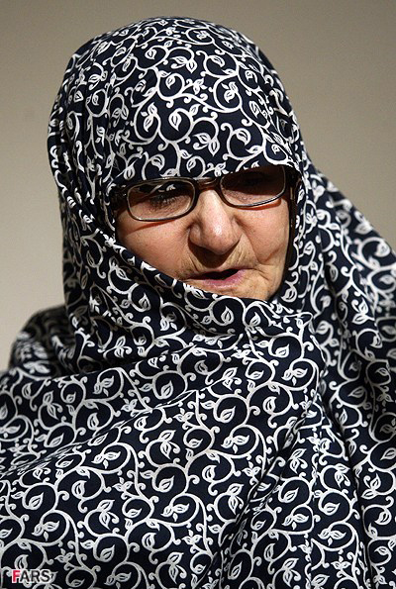
a young woman
An old woman

Slide 9
Sounds and Letters
Aa , Bb , Cc , Dd , Ee , Ff , Gg , Hh , Ii , Jj , Kk , Ll , Mm , Nn ,Oo ,Pp , Qq , Rr, Ss , Tt , Uu , Vv , Ww , Xx , Yy , Zz

Slide 10
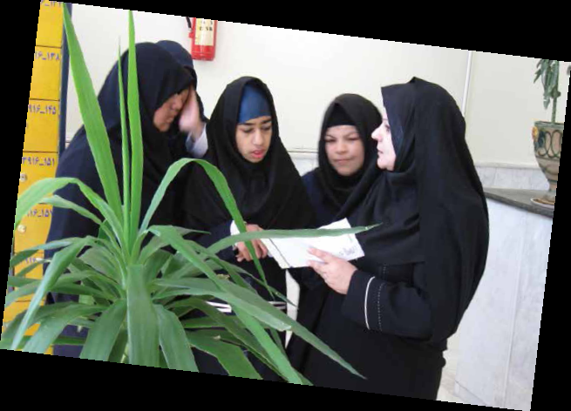

Page 30

Slide 11
chador
chador

Slide 12
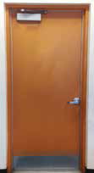
D d
desk
Dorna
-

Slide 13
example
, driver
dentist
, doctor
, birthday
red ,
old ,
friend
, Dabiran
, Darab

Slide 14

gloves
gloves

Slide 15
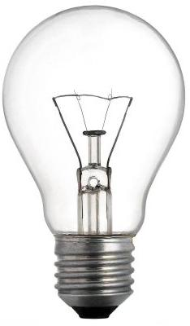
L l
bulb
Laleh
-

Slide 16
example
hello
,welcome
, football
, yellow
, black
, Lar
, spell
, please
, class

Slide 17
chador
chador

Slide 18
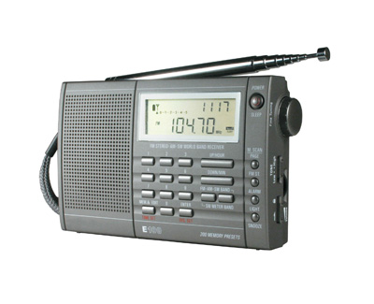
R r
Ramin
-
radio

Slide 19
example
, red
, green
, orange
grey
, brown
, are
, your
, scarf
,trousers
shirt
, friend
, Reza

Slide 20
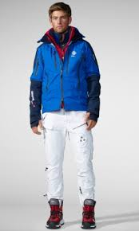
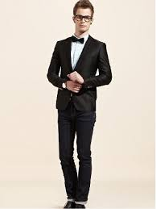
1) Tom is a tall man . He is wearig a blue jacket. Which one is he?
a)
b)

Slide 21
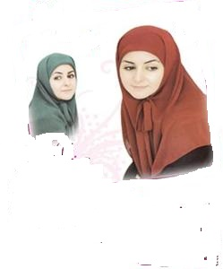
2)My aunt is a young girl . She is wearing a brown scarf . Which one is she?
a)
b)

Slide 22
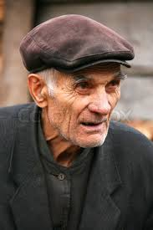
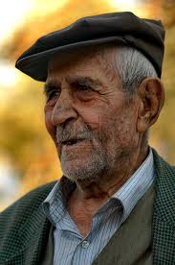
3)Mr Dabestani is an old man . He is wearing a grey shirt . Who is Mr Dabestani?
b)
a)

Slide 23
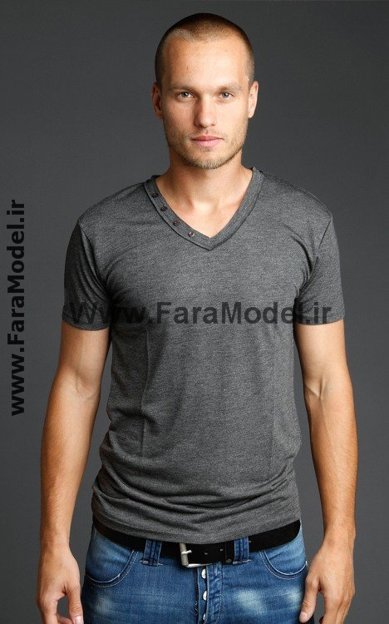
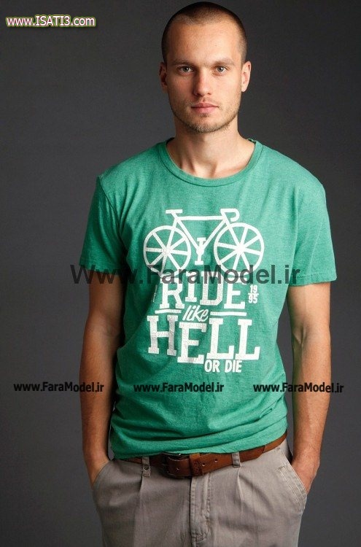
4)My brother is a short boy . He is wearing a green T- shirt. Which one is he?
b)
a)

Slide 24
5)What is کفش in English?
a) suit
b)shoes
c)belt
6)What is عینک in English?
a)glasses
b) dress
c)socks
7)What is کمربند in English?
a)shirt
c)belt
b)trousers

Slide 25
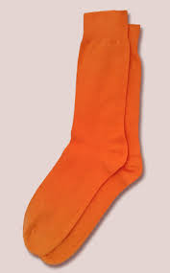
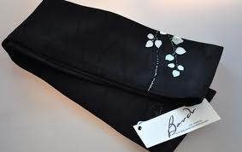
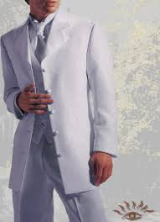
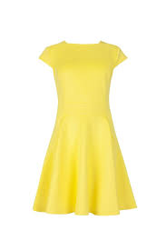
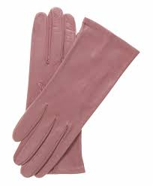
1)orange
2)pink
3)white
4)black
5)yellow
a)gloves
b)dress
c)scarf
d)suit
e)socks

Slide 26
1)
She is wearing a pink dress.
2)
And which one is your sister?
3)
Which girl is your classmate?
4)
She is tall . She is wearing a green scarf.
Dorna:
Ladan:
Dorna:
Ladan:

Slide 27
The End

