Slide 1

بسم الله الرحمن الرحیم

Slide 2
Colors
Colors

Slide 3
yellow

Slide 4
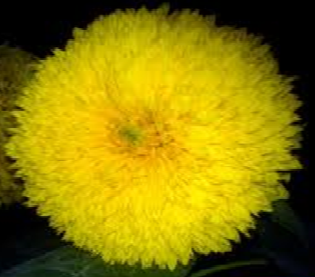

Slide 5
  red

Slide 6
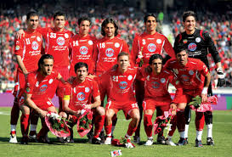

Slide 7
blue

Slide 8
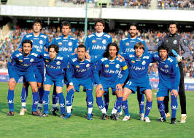

Slide 9
orange

Slide 10
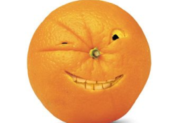
orange

Slide 11
pink

Slide 12
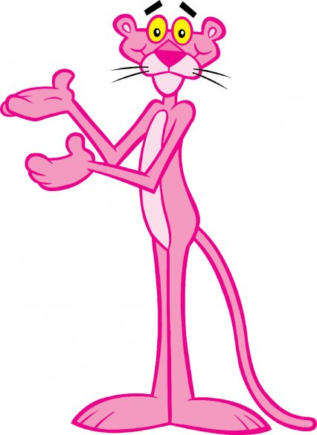

pink

Slide 13
green

Slide 14

green

Slide 15

brown

Slide 16
brown

Slide 17
grey

Slide 18
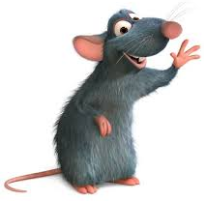

Slide 19
black

Slide 20
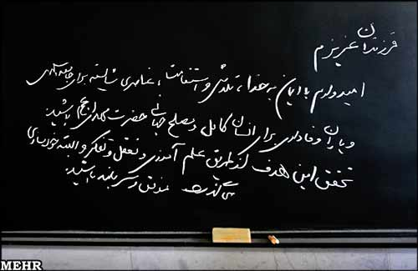

Slide 21
white

Slide 22

گزینه صحیح را انتخاب کنید.

Slide 23
blue – red – white - brown
blue

Slide 24
blue – red – pink - brown
brown

Slide 25
blue – red – white - brown
red

Slide 26
pink – green – white - brown
white

Slide 27
black – red – pink - brown
pink

Slide 28
blue – green – white - brown
green

Slide 29
blue – grey – white - black
black

Slide 30
yellow – grey – green - black
grey

Slide 31
blue – red – white - orange
orange

Slide 32
yellow – grey – orange - black
yellow

Slide 33
clothes

Slide 34


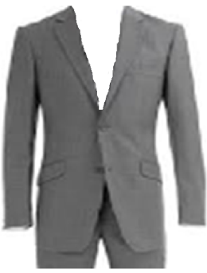
suit

Slide 35


shirt

Slide 36

T-shirt

Slide 37

chador

Slide 38

jacket

Slide 39

shoes

Slide 40

scarf

Slide 41

trousers

Slide 42

manteau

Slide 43
adjective

Slide 44
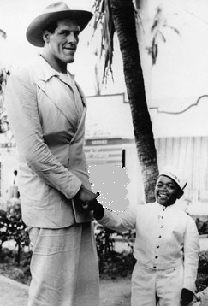
tall---
--short

Slide 45
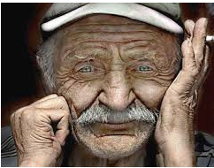
old

Slide 46
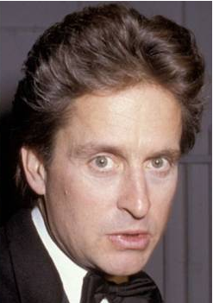
young

Slide 47
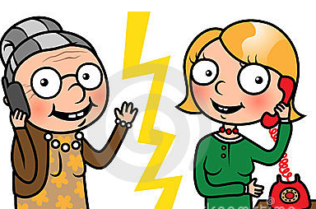
old
young

Slide 48
گزینه صحیح را انتخاب کنید.

Slide 49

shoes manteau suit
suit

Slide 50
shoes manteau scarf
scarf

Slide 51
trousers T-shirt scarf
trousers

Slide 52
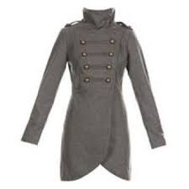
T-shirt manteau trousers
manteau

Slide 53
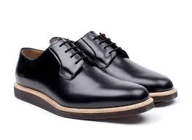
T-shirt shoes trousers
shoes

Slide 54
T-shirt manteau trousers
T-shirt

Slide 55
manteau trousers jacket
jacket

Slide 56
shirt jacket chador
chador

Slide 57
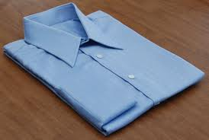
suit shirt jacket
shirt

Slide 58
Repeat after me .

Slide 59
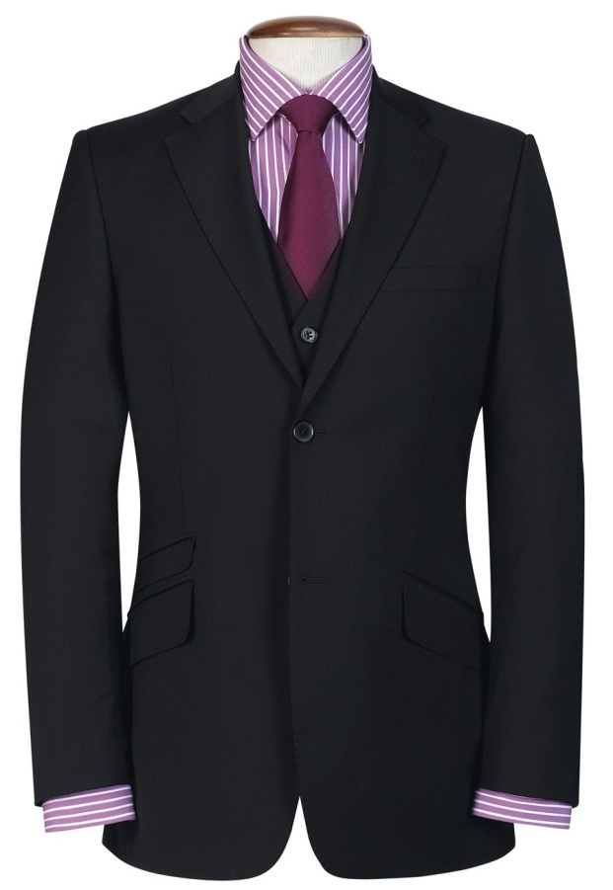
black suit

Slide 60
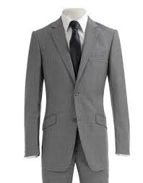
gray suit

Slide 61
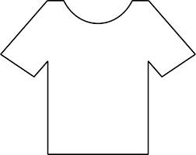
white T-shirt

Slide 62
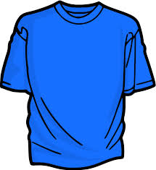
blue T-shirt

Slide 63
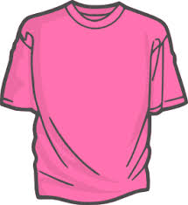
pink T-shirt

Slide 64
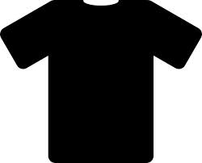
black T-shirt

Slide 65
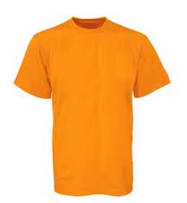
orange T-shirt

Slide 66
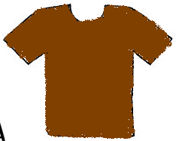
brown T-shirt

Slide 67

green T-shirt

Slide 68
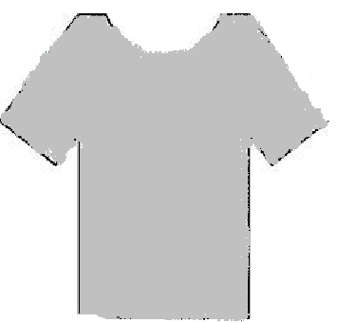
grey T-shirt

Slide 69
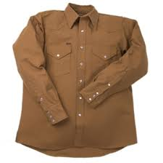
brown shirt

Slide 70
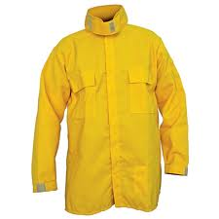
Yellow shirt

Slide 71
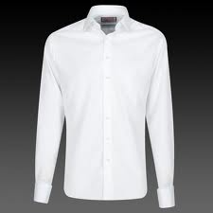
white shirt

Slide 72
blue shirt

Slide 73
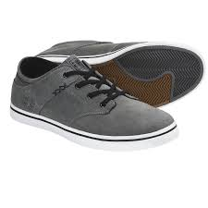
gray shoes

Slide 74
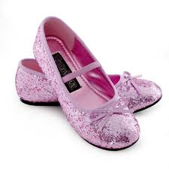
pink shoes

Slide 75
black shoes

Slide 76
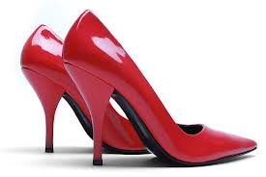
red shoes

Slide 77
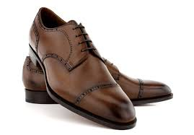
brown shoes

Slide 78
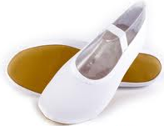
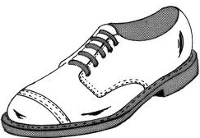
white shoes

Slide 79
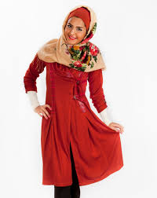
red manteau

Slide 80
grey manteau

Slide 81
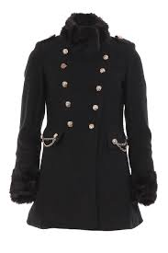
black manteau

Slide 82
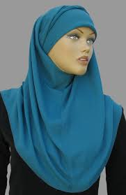
blue scarf

Slide 83
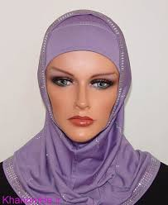
pink scarf

Slide 84
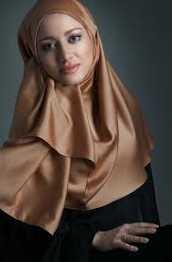
brown scarf

Slide 85
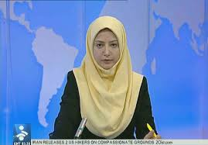
yellow scarf

Slide 86
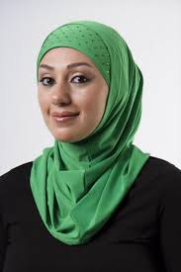
green scarf

Slide 87
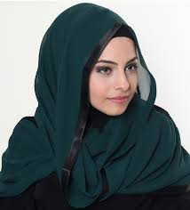
black scarf

Slide 88
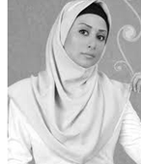
white scarf

Slide 89
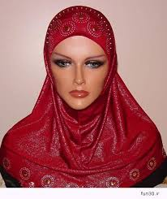
red scarf

Slide 90
تهیه کننده : محبوبه کرمانی
مدرسه : شهید یوسفلو
عنوان :لغات جدید درس پنجم
پایه: هفتم( متوسطه یک)

Slide 91

END

