Slide 1
My Appearance grade 7 lesson 5
By Kuchakzadeh
More at t.me/kuchakzadeh
Prospectpowerpoints.blog.ir
1398

Slide 2
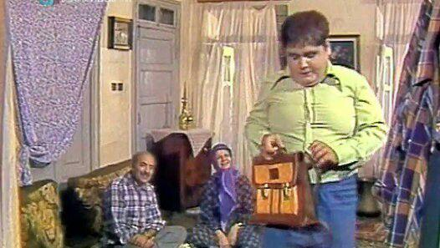
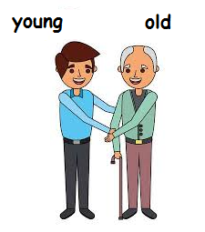
Akbar Abdi is this young boy

Slide 3
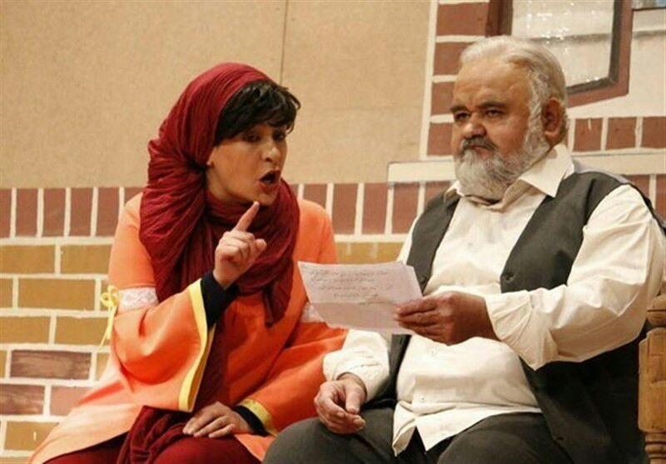
Akbar Abdi is this old man.

Slide 4
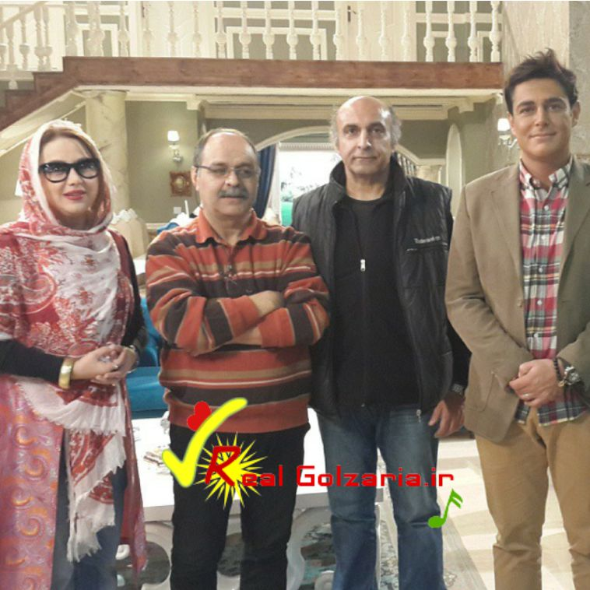
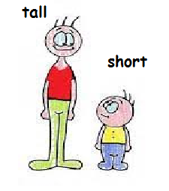
Mohammad Reza Golzar is this tall man.

Slide 5
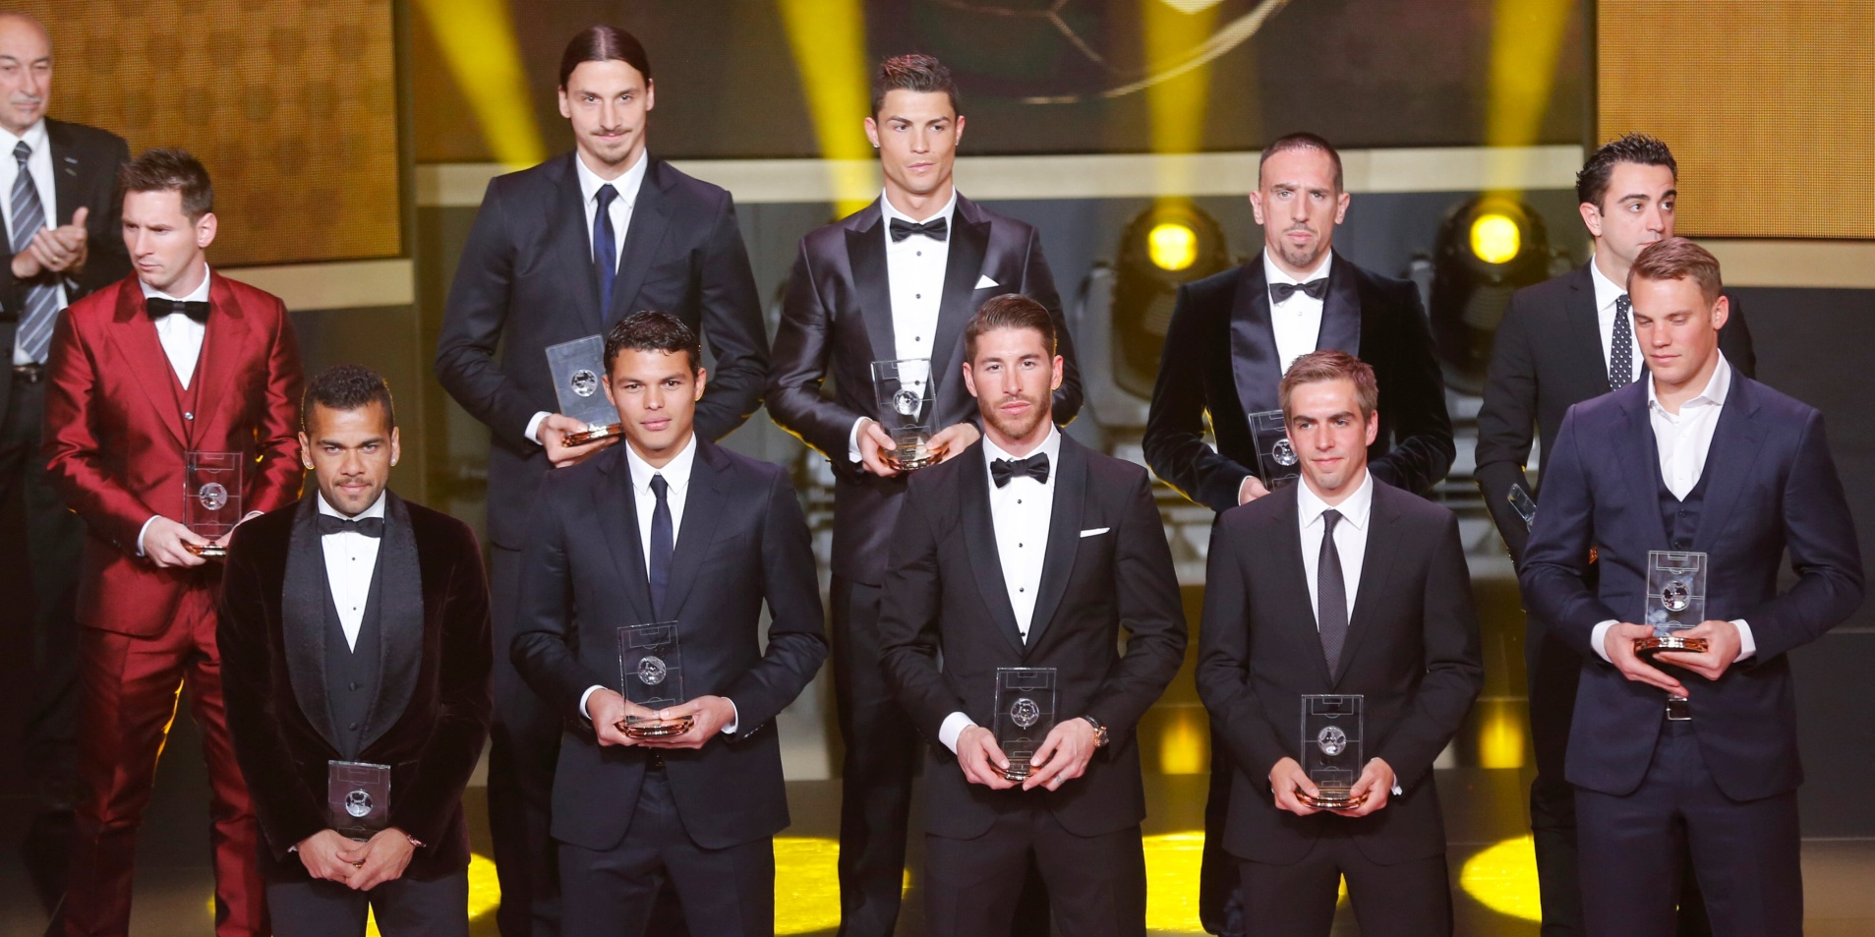
Lionel Messi is this short man.

Slide 6
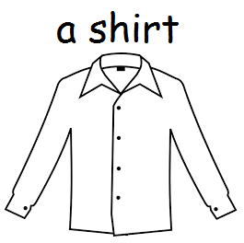
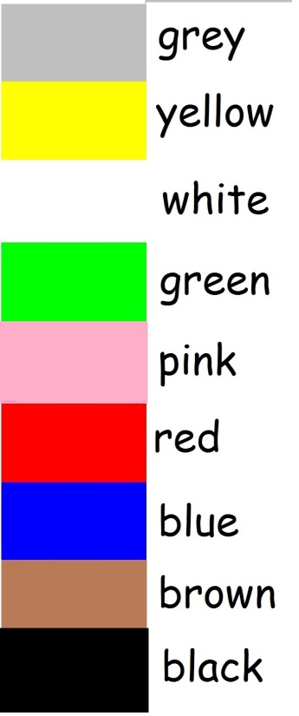
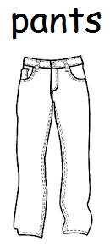
Akbar Abdi is wearing a green shirt and blue pants.

Slide 7
Akbar Abdi is wearing a white shirt and gray pants.

Slide 8
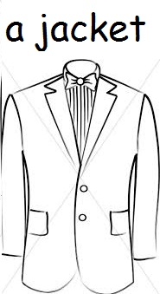
Mohammad Reza Golzar is wearing a brown jacket and brown pants.

Slide 9
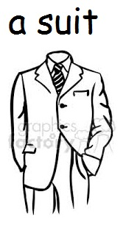
Lionel Messi is wearing a red suit.

Slide 10
Who is Akbar Abdi?
He’s the young boy.
He’s wearing a green shirt and blue pants.

Slide 11
Which one is Akbar Abdi?
He’s the old man.
He’s wearing a white shirt and gray pants.

Slide 12
Who is Mohammad Reza Golzar?
He is the tall man.
He is wearing a brown jacket and brown pants.

Slide 13

Which one is Lionel Messi?
He is the short man.
He is wearing a red suit.

Slide 14
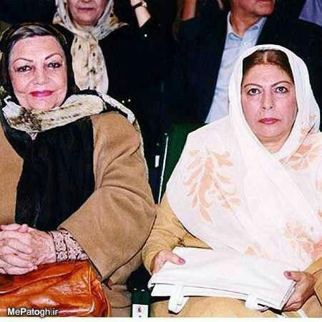
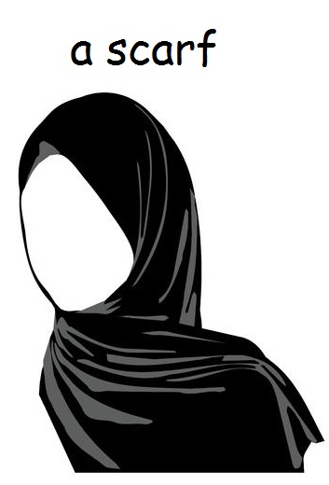
Who is Sorayya Qassemi?
She is the young woman.
She’s wearing a white scarf.

Slide 15
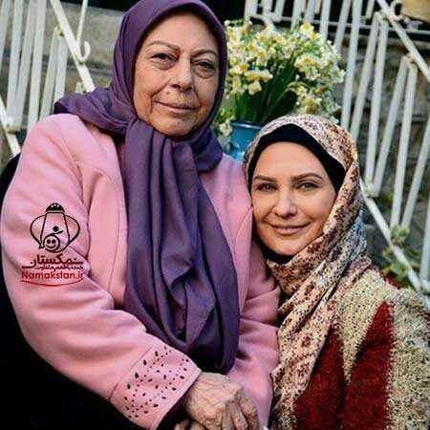
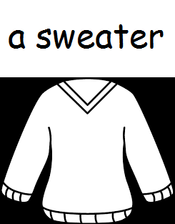
Which one is Sorayya Qassemi?
She’s the old woman.
She’s wearing a pink sweater.

Slide 16
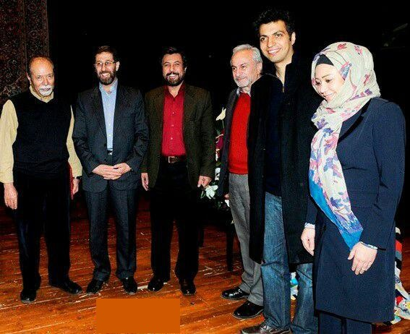
Which one is Ferdosipur?
He’s the tall man.
He’s wearing a black coat and blue pants and black shoes.

Slide 17
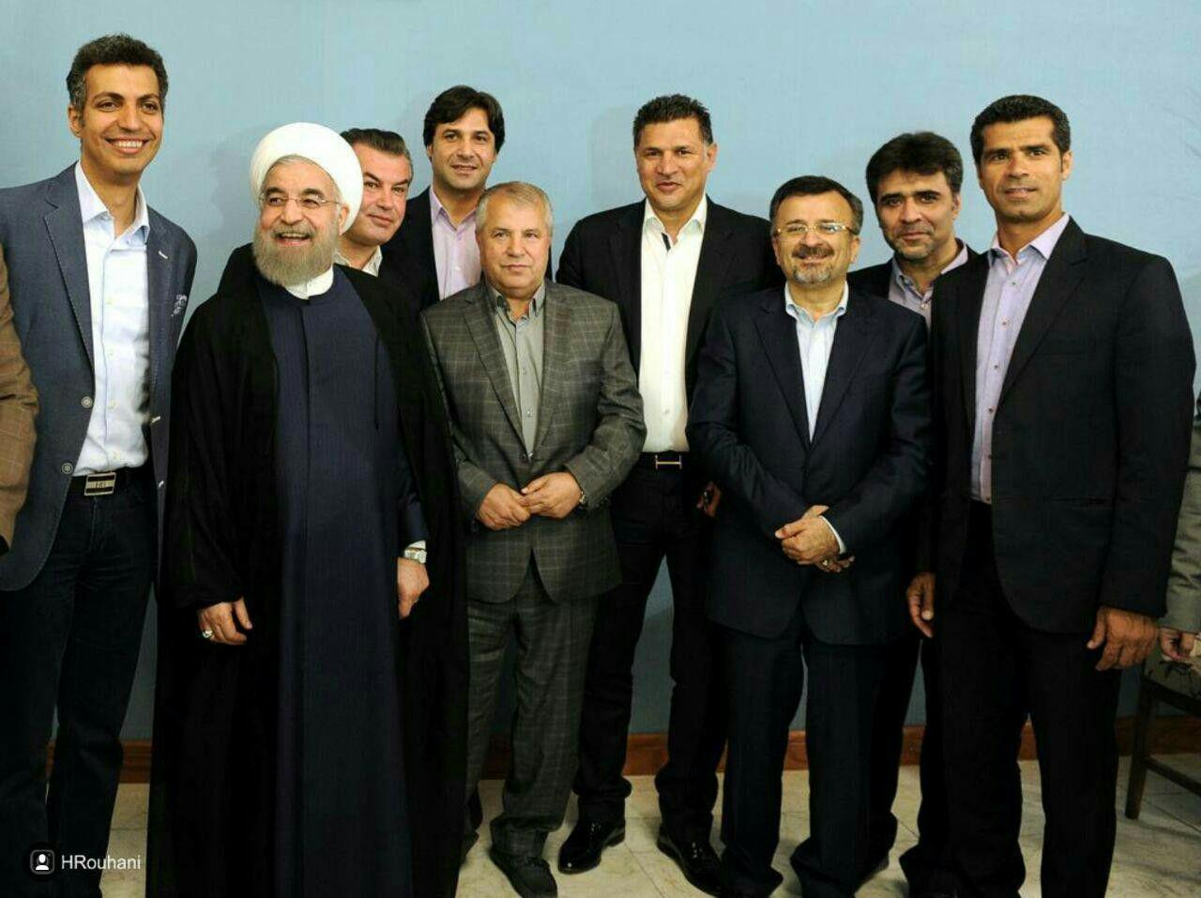
Which one is Ali Parvin?
He’s the short man.
He’s wearing a grey shirt, grey suit and black shoes.

Slide 18
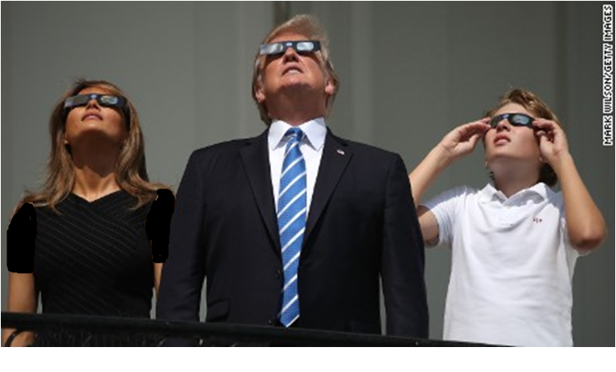
Which one is Donald Trump?
He’s the old man.
He’s wearing a white shirt, black suit and glasses.

Slide 19
Role Plays

Slide 20
You are Akbar Abdi!
Your friend: What are you wearing in this picture?
You: I’m that …………………………….
I’m wearing ……………………………….

Slide 21
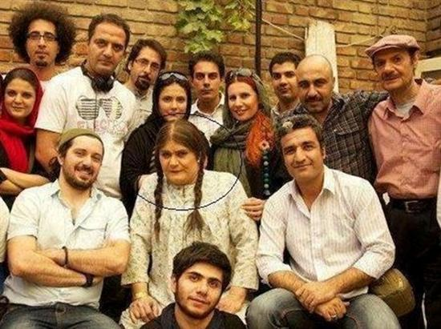

Slide 22
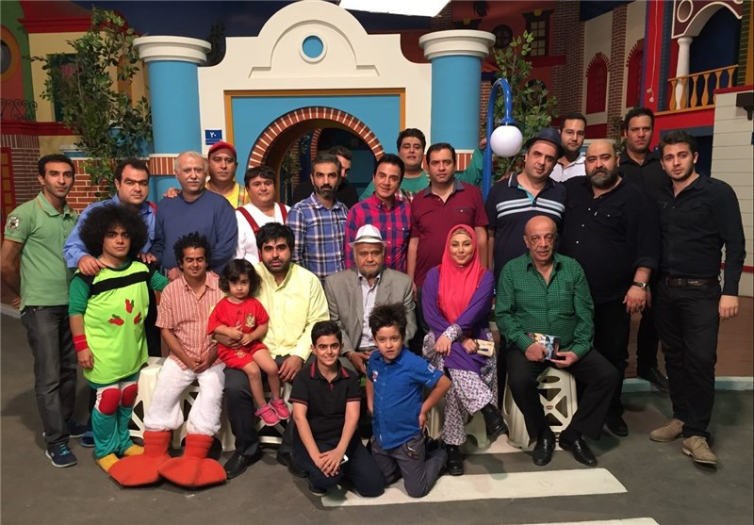

Slide 23
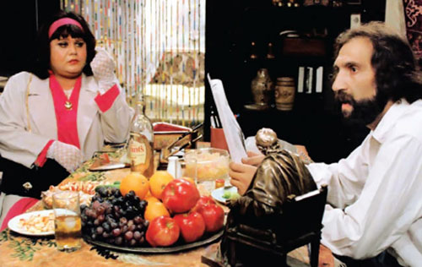

Slide 24
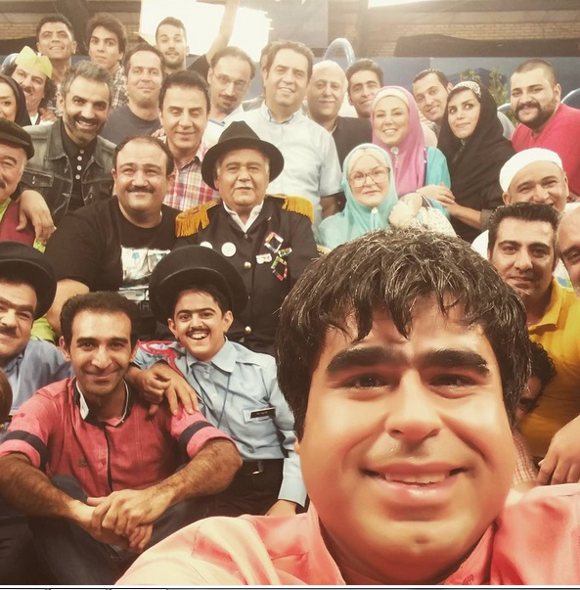

Slide 25
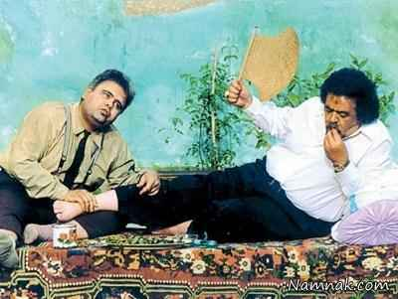

Slide 26
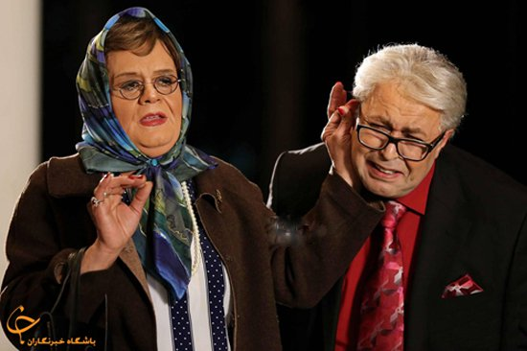

Slide 27
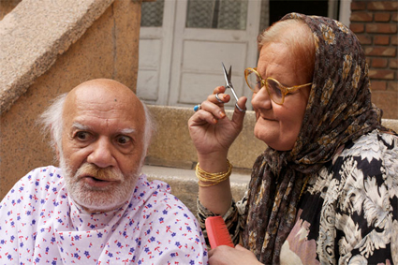

Slide 28
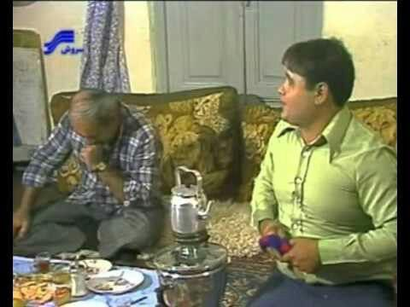

Slide 29
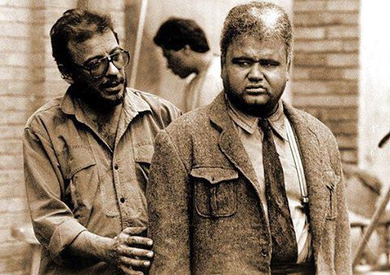

Slide 30
Monolog

Slide 31
Hello, I’m Akbar Abdi again! I am an actor. Here, I am a young girl, I’m wearing a white dress.
Here, I am an old man, I’m wearing a white shirt and a grey suit and a white hat.
Here I am a young boy and I’m wearing a light green shirt and a dark blue pants.
But here I’m a young woman. I’m wearing a brown manteau and a green and blue scarf and glasses.

Slide 32
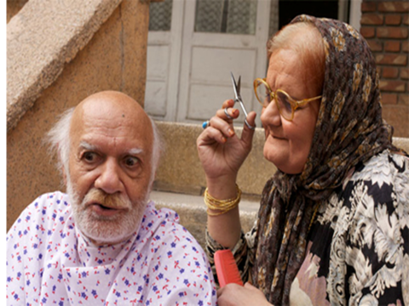

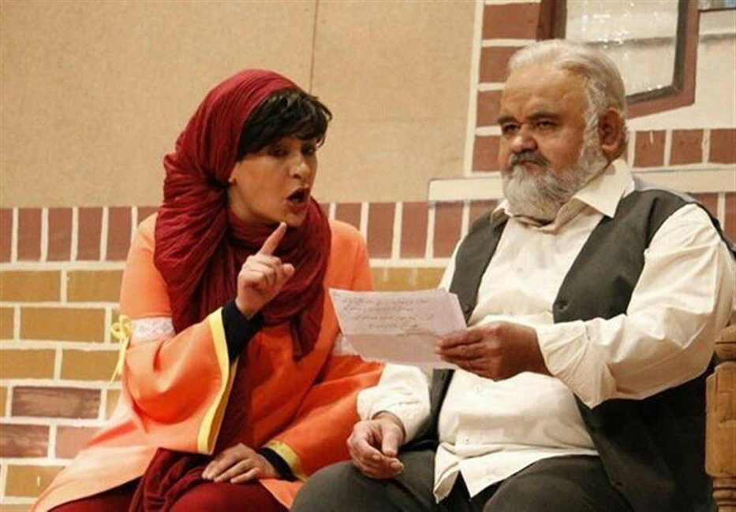
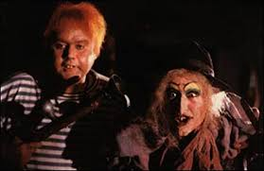
Akbar Abdi is that old woman, He’s wearing ...............
………………………………………………………………………………….
Akbar Abdi is that ………………, He’s ……………. ...............
………………………………………………………………………………….
Akbar Abdi ……………………………, …………………...............
………………………………………………………………………………….
……………………………………………., ………………….................
………………………………………………………………………………….

