Slide 1
به نام خدا
معرفی توزیع های مختلف لینوکس برای اهداف مختلف
Introducing Various Linux Distributions for Various Purposes
سید مصطفی سیدی

Slide 2
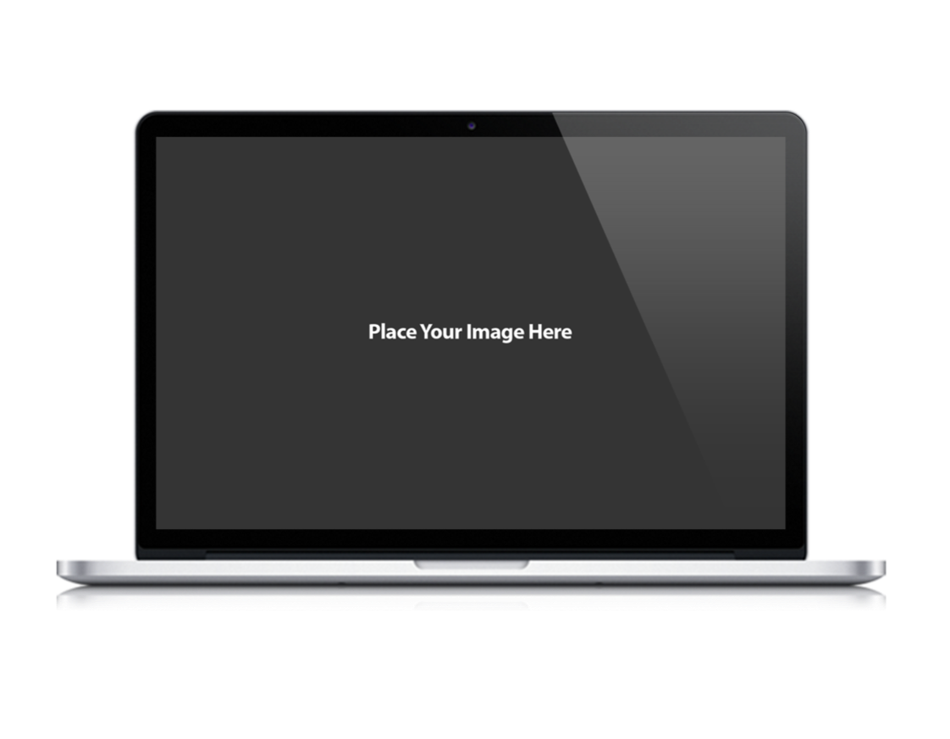
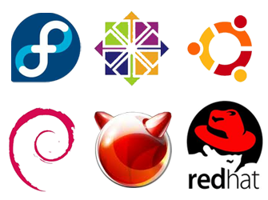
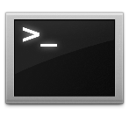
Headlines
Short History
About Linux Kernel and TimeLine
Devices and Architect
Linux on Different Devices With Different Architectures
Linux Distros and Purpose
See Category and Purpose for Using Linux

Slide 3
Short History about Linux
Notes:
Drag and drop the image in the placeholder
Send to back the image (Right click/Arrange/Send to back )

Slide 4
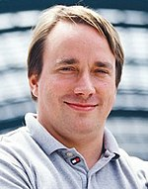
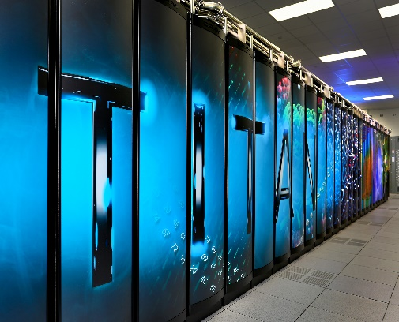
1991
1992
2008
2014
2017
The Linux kernel is publicly announced on 25 August by the 21-year-old Finnish student Linus Benedict Torvalds
The Linux kernel is relicensed under the GNU GPL. The first Linux distributions are created.
Google's Linux-based Android claims 75% of the smartphone market share, in terms of the number of phones shipped
Ubuntu claims 22,000,000 users
Linux totally dominates supercomputers

Slide 6
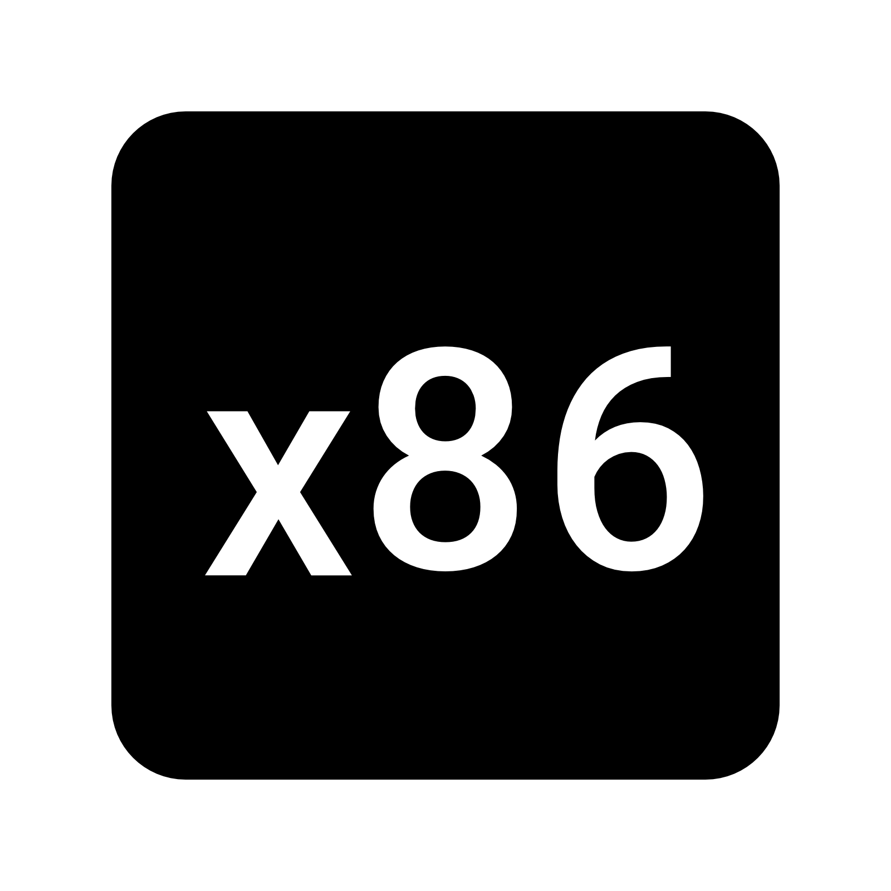
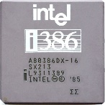
Devices and Architect:
Our Process

Slide 8
Linux for Devices….
Embedded Device
04
Mobile Device
05
03
Robotic
06
02
Space Station
Thin Client
07
01
TV
Old Device

Slide 9
Different Linux Distributions for Different Purposes

Slide 10
Beginners
Clusters
Data Rescue
Desktop
Gaming
Free Software
Firewall
Forensics
Disk Management
Docker
Education
High Performance Computing
Live Medium
Multimedia
Myth TV
NAS
Netbooks
Old Computers
Privacy
Raspberry Pi
Scientific
Sever
Source Based
Specialist
Telephony
Thin Client
Security
10

Slide 11
Desktop
Debian
Mint
Antergos
Manjaro

Slide 12
Education
Nix OS
Debian Edu
Trisquel Linux

Slide 13
Gaming

Slide 14
Multimedia
Ubuntu Studio

Slide 15
Old Computers
Puppy Linux
LXLE

Slide 16
Servers
Ubuntu
Fedora

Slide 17
Security
Kali Linux
Parrot Security
BlackArch Linux

Slide 18
Telephony
Alpine Linux
3CX Phone System
AsteriskNow
Elastix

Slide 19
Resources:
19

Distrowatch
❍
LinuxMag

MakeUseof
·
LinuxGizmos
●
Ubuntu insight
◉
Linuceum

Slide 20
Use and Share this Slide for Free:

