Slide 1
Convolutional Neural Networks
Shahrood University of Technology
Hossein Khosravi
Slides Provided by Brohrer http://brohrer.github.io/how_convolutional_neural_networks_work.html

Slide 2
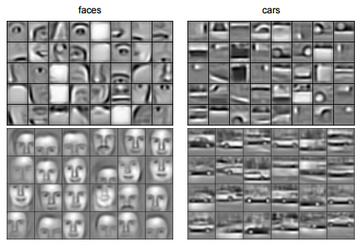
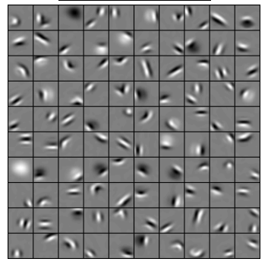
Convolutional Deep Belief Networks for Scalable Unsupervised Learning of Hierarchical Representations
Honglak Lee, Roger Grosse, Rajesh Ranganath, Andrew Y. Ng

Slide 3
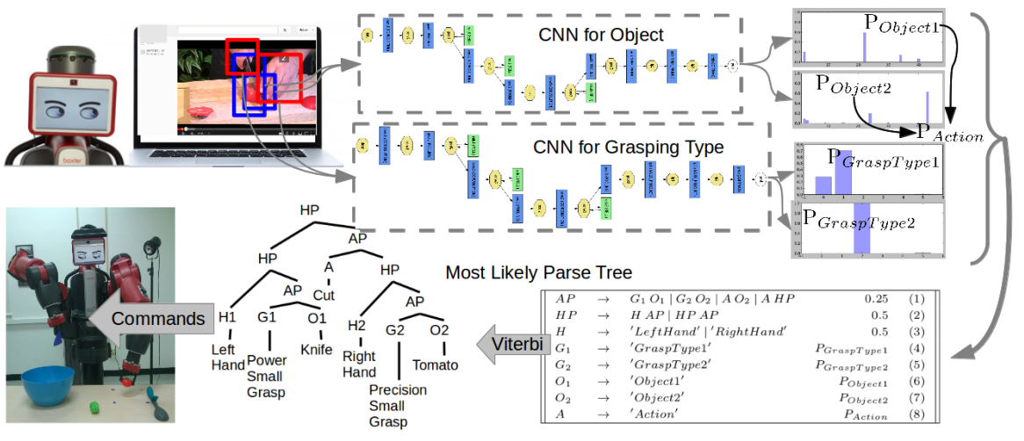
Robot Learning ManipulationAction Plans by “Watching” Unconstrained Videos from the World Wide Web.
Yezhou Yang, Cornelia Fermuller, Yiannis Aloimonos

Slide 4
A toy ConvNet: X’s and O’s
Says whether a picture is of an X or an O
A two-dimensional
array of pixels
CNN
X or O

Slide 5
For example
CNN
X
CNN
O

Slide 6
Trickier cases
CNN
X
translation
scaling
rotation
weight
CNN
O

Slide 7
Deciding is hard
?
=

Slide 8
What computers see
?
=

Slide 9
What computers see

Slide 10
Computers are literal
=
x
Notes:
Literal: precise

Slide 11
ConvNets match pieces of the image
=
=
=

Slide 12
Features match pieces of the image

Slide 18
Filtering: The math behind the match

Slide 19
Filtering: The math behind the match
Line up the feature and the image patch.
Multiply each image pixel by the corresponding feature pixel.
Add them up.
Divide by the total number of pixels in the feature.

Slide 20
Filtering: The math behind the match
1 x 1 = 1

Slide 21
Filtering: The math behind the match
1 x 1 = 1

Slide 22
Filtering: The math behind the match
-1 x -1 = 1

Slide 23
Filtering: The math behind the match
-1 x -1 = 1

Slide 24
Filtering: The math behind the match
-1 x -1 = 1

Slide 25
Filtering: The math behind the match
1 x 1 = 1

Slide 26
Filtering: The math behind the match
-1 x -1 = 1

Slide 27
Filtering: The math behind the match
-1 x -1 = 1

Slide 28
Filtering: The math behind the match
-1 x -1 = 1

Slide 29
Filtering: The math behind the match
1 x 1 = 1

Slide 30

Filtering: The math behind the match
$$\frac{1+1+1+1+1+1+1+1+1}{9}=1$$

Slide 31
Filtering: The math behind the match
1 x 1 = 1

Slide 32
Filtering: The math behind the match
-1 x 1 = -1

Slide 33
Filtering: The math behind the match

Slide 34

Filtering: The math behind the match
$$\frac{1+1−1+1+1+1−1+1+1}{9}=.55$$
.55

Slide 35
Convolution: Trying every possible match

Slide 36
Convolution: Trying every possible match
=

Slide 37
=
=
=

Slide 38
Convolution layer
One image becomes a stack of filtered images

Slide 39
Convolution layer
One image becomes a stack of filtered images

Slide 40
Pooling: Shrinking the image stack
Pick a window size (usually 2 or 3).
Pick a stride (usually 2).
Walk your window across your filtered images.
From each window, take the maximum value.

Slide 41
Pooling
maximum

Slide 42
Pooling
maximum

Slide 43
Pooling
maximum

Slide 44
Pooling
maximum

Slide 45
Pooling
maximum

Slide 46
Pooling
max pooling

Slide 48
Pooling layer
A stack of images becomes a stack of smaller images.

Slide 49
Normalization
Keep the math from blowing up by tweaking each of the values just a bit.
Change everything negative to zero.
Notes:
Blow up: منفجر شدن (مقادیر بزرگ گرفتن)

Slide 50
Rectified Linear Units (ReLUs)

Slide 51
Rectified Linear Units (ReLUs)

Slide 52
Rectified Linear Units (ReLUs)

Slide 53
Rectified Linear Units (ReLUs)

Slide 54
ReLU layer
A stack of images becomes a stack of images with no negative values.

Slide 55
Layers get stacked
The output of one becomes the input of the next.
Convolution
ReLU
Pooling

Slide 56
Deep stacking
Layers can be repeated several (or many) times.
Convolution
ReLU
Convolution
ReLU
Pooling
Convolution
ReLU
Pooling

Slide 57
Fully connected layer
Every value gets a vote

Slide 58
Fully connected layer
Vote depends on how strongly a value predicts X or O
X
O

Slide 59
Fully connected layer
Vote depends on how strongly a value predicts X or O
X
O

Slide 60
Fully connected layer
Future values vote on X or O
X
O

Slide 61
Fully connected layer
Future values vote on X or O
X
O

Slide 62
Fully connected layer
Future values vote on X or O
X
.92
O

Slide 63
Fully connected layer
Future values vote on X or O
X
.92
O

Slide 64
Fully connected layer
Future values vote on X or O
X
.92
O
.51

Slide 65
Fully connected layer
Future values vote on X or O
X
.92
O
.51

Slide 66
Fully connected layer
A list of feature values becomes a list of votes.
X
O

Slide 67
Fully connected layer
These can also be stacked.
X
O

Slide 68
Putting it all together
A set of pixels becomes a set of votes.
.92
X
Convolution
ReLU
Fully
connected
Fully
connected
Convolution
ReLU
Convolution
ReLU
Pooling
Pooling
O
.51

Slide 69
Learning
Q: Where do all the magic numbers come from?
Features in convolutional layers
Voting weights in fully connected layers
A: Backpropagation

Slide 70
Backprop
Error = right answer – actual answer
.92
X
Convolution
ReLU
Fully
connected
Fully
connected
Convolution
ReLU
Convolution
ReLU
Pooling
Pooling
O
.51

Slide 71
Backprop
.92
X
Convolution
ReLU
Fully
connected
Fully
connected
Convolution
ReLU
Convolution
ReLU
Pooling
Pooling
O
.51

Slide 72
Backprop
.92
X
Convolution
ReLU
Fully
connected
Fully
connected
Convolution
ReLU
Convolution
ReLU
Pooling
Pooling
O
.51

Slide 73
Backprop
.92
X
Convolution
ReLU
Fully
connected
Fully
connected
Convolution
ReLU
Convolution
ReLU
Pooling
Pooling
O
.51

Slide 74
Backprop
.92
X
Convolution
ReLU
Fully
connected
Fully
connected
Convolution
ReLU
Convolution
ReLU
Pooling
Pooling
O
.51

Slide 75
Backprop
.92
X
Convolution
ReLU
Fully
connected
Fully
connected
Convolution
ReLU
Convolution
ReLU
Pooling
Pooling
O
.51

Slide 76
Gradient descent
For each feature pixel and voting weight, adjust it up and down a bit and see how the error changes.
error
weight

Slide 77
Gradient descent
For each feature pixel and voting weight, adjust it up and down a bit and see how the error changes.
error
weight

Slide 78
Hyperparameters (knobs)
Convolution
Number of features
Size of features
Pooling
Window size
Window stride
Fully Connected
Number of neurons

Slide 79
Architecture
How many of each type of layer?
In what order?

Slide 80
Not just images
Any 2D (or 3D) data.
Things closer together are more closely related than things far away.

Slide 81
Images
Columns of pixels
Rows of pixels

Slide 82
Sound
Time steps
Intensity in each
frequency band

Slide 83
Text
Position in
sentence
Words in
dictionary

Slide 84
Limitations
ConvNets only capture local “spatial” patterns in data.
If the data can’t be made to look like an image, ConvNets are less useful.

Slide 85
Customer data
Name, age,
address, email,
purchases,
browsing activity,…
Customers

Slide 86
Rule of thumb
If your data is just as useful after swapping any of your columns with each other, then you can’t use Convolutional Neural Networks.

Slide 87
In a nutshell
ConvNets are great at finding patterns and using them to classify images.

Slide 88
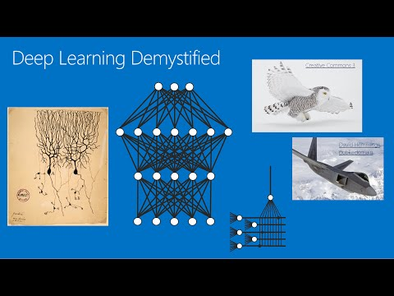
Also check out
Deep Learning Demystified
Notes from Stanford CS 231 course
(Justin Johnson and Andrej Karpathy)
The writings of Christopher Olah

Slide 89
Some ConvNet/DNN toolkits
Caffe (Berkeley Vision and Learning Center)
CNTK (Microsoft)
Deeplearning4j (Skymind)
TensorFlow (Google)
Theano (University of Montreal + broad community)
Torch (Ronan Collobert)
Many others

