Slide 1
Background Most cases of colour vision deficiency are characterised by a red-green deficiency which can be classed into two types; a protan type which may be absolute (protanopia) or partial (protanomalia) a deutan type which may be absolue (deuteranopia) or partial (deuteranomalia) In protanopia the visible range of the spectrum is shorter at the red end compared with that of the normal, and that part of the spectrum that appears blue-green in the normal appears to those with protanopia as grey. In deuteranopia the part of the spectrum that appears to the normal as green appears as grey. Purple-red (the complimentary colour of green) also appears as grey. In protanomalia and deuteranomalia, no part of the spectrum appears as grey, however the part of the spectrum that appears to those with protanopia as grey will appear as a greyish indistinct colour to those with protanomalia and similarily, the part of the spectrum which appears grey to those with deuteranopia will appear as an indistinct greyish colour to those with deuteranomalia. As a result of this red-green colour vision deficiencies show blue and yellow colours clearer than red and green colours. Those who suffer from typical total colour blindness show a complete failure to discriminate any colour variations, usually associated with impairment of central vision with photophobia and nystagmus. With atypical total colour blindness, the sensitivity to red and green, as well as to yellow and blue is so low that only very clear colours may be perceived. There are, however, no further abnormalities in the visual functions. Images obtained from: Tests for Colour Blindness by Dr. Shinobu Ishihara Professor Emeritus of the University of Tokyo Kanehara Shuppan Co., Ltd Tokyo, Kyoto (1962)

Slide 2
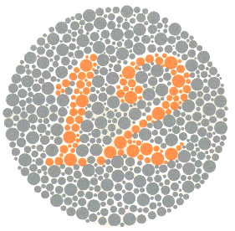
Plate 1 Both normal and those with all colour vision deficiencies should read the number 12.

Slide 3
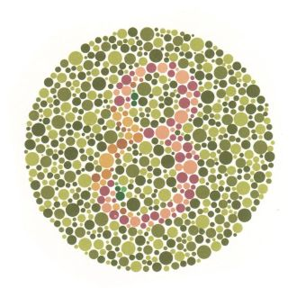
Plate 2
Those with normal colour vision should read the number 8.
Those with red-green colour vision deficiencies should read the number 3.
Total colour blindness should not be able to read any numeral.

Slide 4
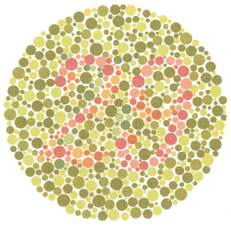
Plate 3 Normal vision should read the number 29. Red-green deficiencies should read the number 70. Total colour blindness should not read any numeral

Slide 5
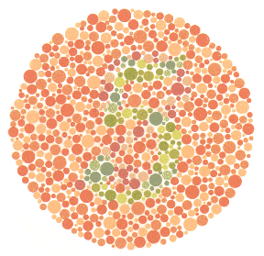
Plate 4 Normal colour vision should read the number 5. Red-Green colour deficiencies should read the number 2. Total colour blindness should not be able toread any numeral.

Slide 6
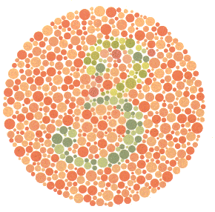
Plate 5 Normal colour vision should read the number 3. Red-Green deficiencies should read the number 5. Total colour blindness should not be able to read any numeral.

Slide 7
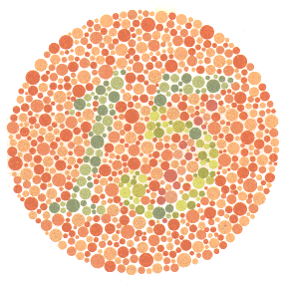
Plate 6 Normal colour vision should read the number 15. Red-Green deficiencies should read the number 17. Total colour blindness should not be able to read any numeral.

Slide 8
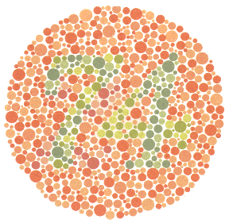
Plate 7 Normal colour vision should read the number 74. Red-Green colour deficiencies should read the number 21. Total colour blindness should not be able to read any numeral.

Slide 9
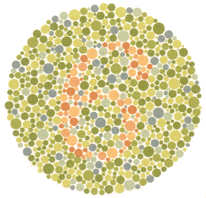
Plate 8 Normal colour vision should read the number 6. The majority of those with colour vision deficiencies cannot read this number or will read it incorrectly.

Slide 10
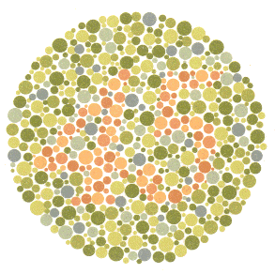
Plate 9 Normal colour vision should read the number 45. The majority of those with colour vision deficiencies cannot read this number or will read it incorrectly.

Slide 11
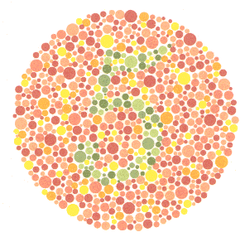
Plate 10 Normal colour vision should read the number 5. Those with colour vision deficiencies will not read the number or read it incorrectly.

Slide 12
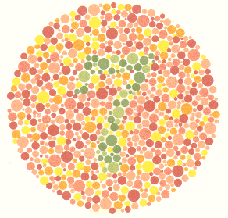
Plate 11 Normal colour vision should read the number 7. Those with colour vision deficiencies will not read this number or read it incorrectly.

Slide 13
Plate 12 Normal colour vision should read the number 16. Those with colour vision deficiencies will not read this number or read it incorrectly.

Slide 14
Plate 13 Normal colour vision will read the number 73. Those with colour vision deficiencies should nor be able to read this number or will read it incorrectly.

Slide 15
Plate 14 Normal colour vision and those with total colour blindness should not be able to read any number. The majority of those with red-green deficiencies should read the number 5.

Slide 16
Plate 15 Normal colour vision and those with total colour blindness should not be able to read any number. The majority of those with red-green deficiencies should read the number 45.

Slide 17
Plate 16 Normal colour vision should read the number 26. In protanopia and strong protanomalia the number 6 is read and in mild protanomalia both numerals are read but the number 6 is clearer than the number 2. In deuteranopia and strong deuteranomalia only the number 2 is read and in mild deuteranomalia both the number 2 is clearer than the number 6.

Slide 18
Plate 17 Normal colour vision should read the number 42. In protanopia and strong protanomalia the number 2 is read and in mild protanomalia both numerals are read but the number 2 is clearer than the number 4. In deuteranopia and strong deuteranomalia only the number 4 is read and in mild deuteranomalia both the number 4 is clearer than the number 2.

Slide 19
Plate 18 The normal should trace along the purple and red lines between the two X's. In protanopia and strong protanomalia only the purple line is traced and in mild protanomalia both lines can be traced but the purple line is easier to follow. In deuteranopia and strong deuteranomalia only the red line is traced and in mild deuteranomalia both lines are traced but the red line is easier to follow.

Slide 20
Plate 19 The majority of those with red-green colour blindness can trace the winding line between the two X's. The majority of those with normal and total colour blindness are unable to follow the line.

Slide 21
Plate 20 Normal will trace the blue-green line between the two X's. The majority of those with colour vision deficiencies will be unable to follow the line or will follow a line different to the normal one.

Slide 22
Plate 21 Normal will trace the orange line between the two X's. The majority of those with colour vision deficiencies will be unable to follow the line or will follow a line different to the normal one.

Slide 23
Plate 22 Normal should trace the line connecting the blue-green and the yellow-green. Those with red-green deficiencies trace the line connecting the blue-green and purple. Those with total colour blindness cannot trace any line.

Slide 24
Plate 23 Normal should trace the line connecting the purple and the orange between the two X's. Red-green deficiencies should trace the line connecting the purple and the blue-green. Total colour blindness and weakness cannot trace any line.

Slide 25
Plate 24 Both normal and those with colour vision deficiencies can trace the winding line between the two X's.

