Slide 1
Services grade 9 lesson 4
By kuchakzadeh
more at t.me/kuchakzadeh
1397

Slide 2
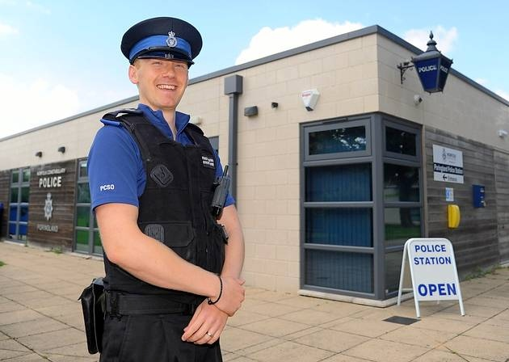
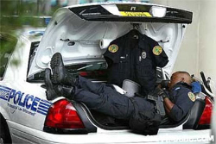
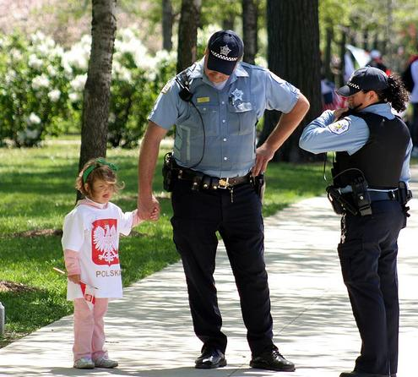
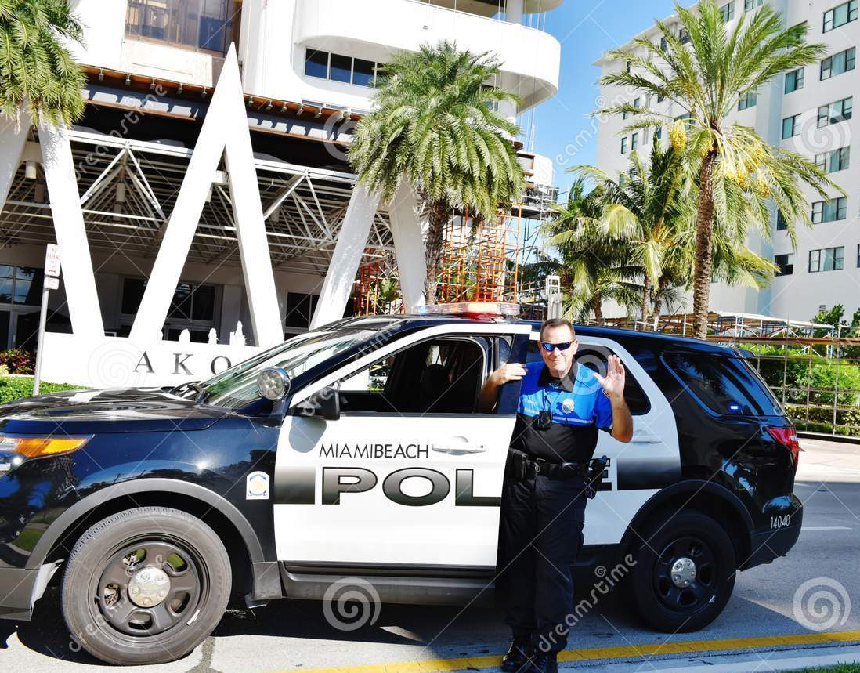
Who is he?
He is a policeman.
When does he go to work?
He usually works on shifts.
Where does he work?
He works at a police station.
What does a policeman do?
How does he go to work?
He sometimes helps lost children.
He often goes by a car.

Slide 3
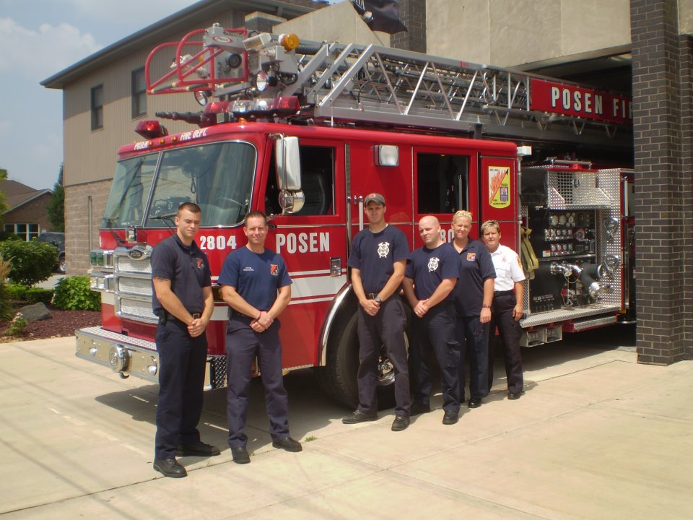
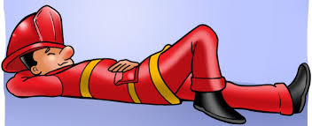
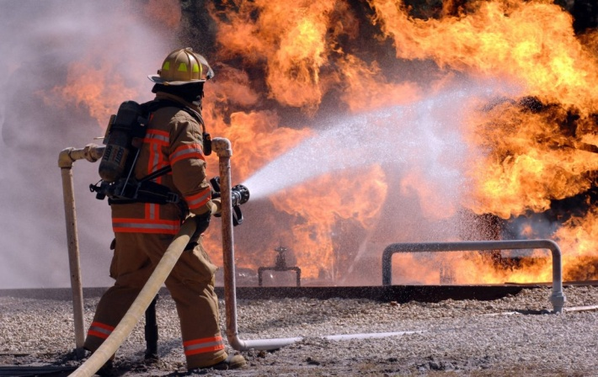
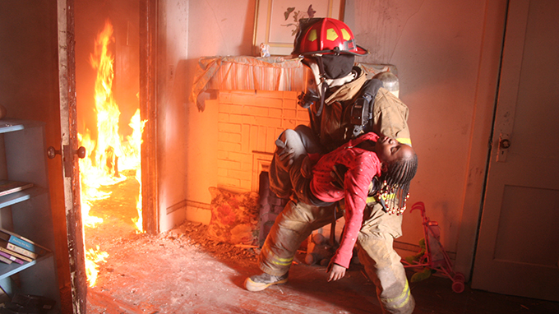
When does he work?
He often works on shifts.
Who are they?
They are firefighters.
Where do they work?
They work at a fire station.
What does a firefighter do?
What does a firefighter do?
He sometimes saves people’s lives.
He usually puts out fire

Slide 4
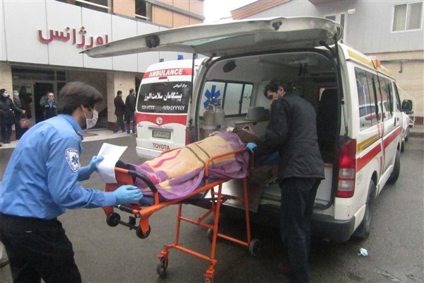
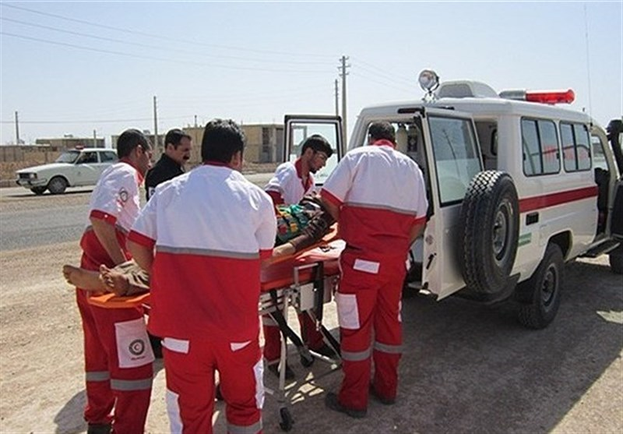
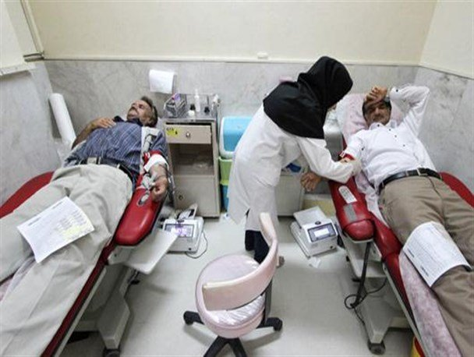
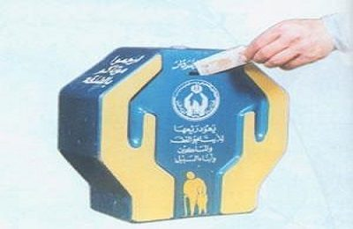
What is his job?
He is a nurse.
Who are they?
What does he do?
They are nurses.
He brings a patient to the ER.
What do they do?
They do voluntary work
How does he help charity?
What do people do here?
He puts money in the box.
They often donate blood

Slide 5
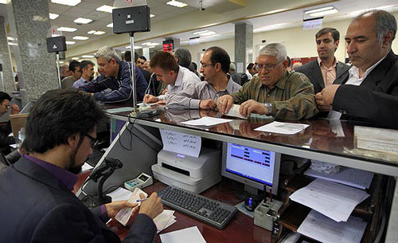
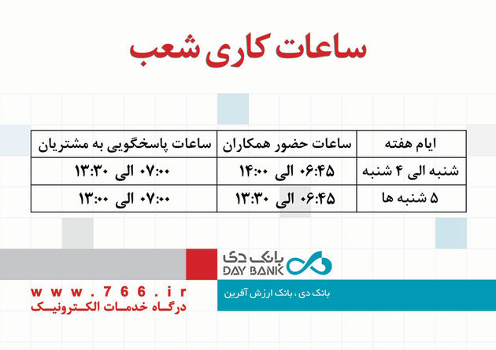
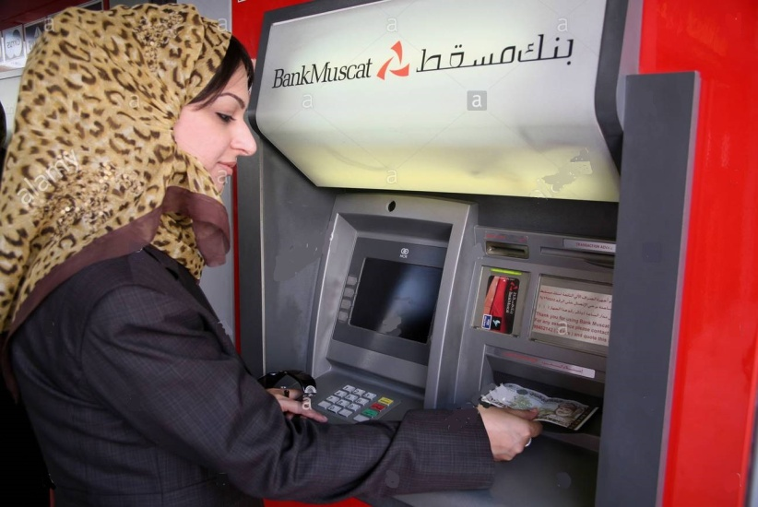
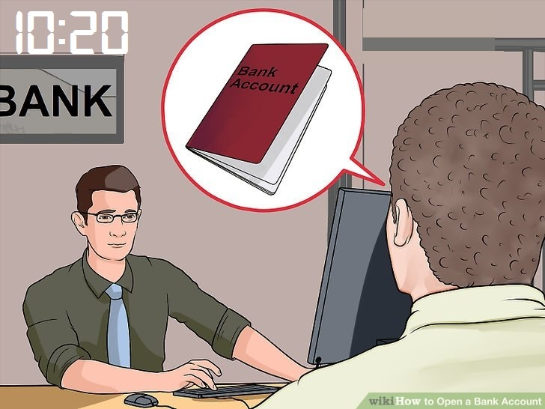
When does it open?
Who is he?
It opens at 7.
He is a bank teller.
What days do they work?
They work from Saturday to Thursday.
What does she do?
What does he do in the bank?
She takes out money from an ATM
He opens an account

Slide 6
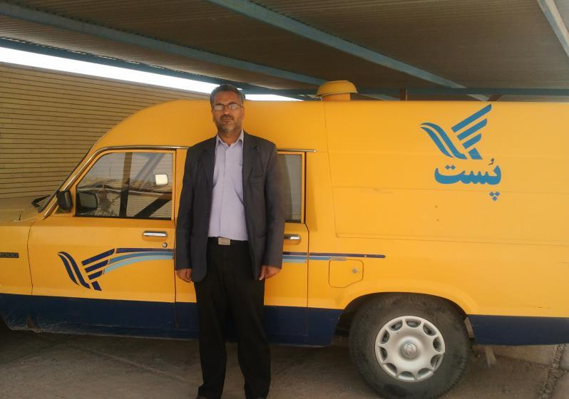
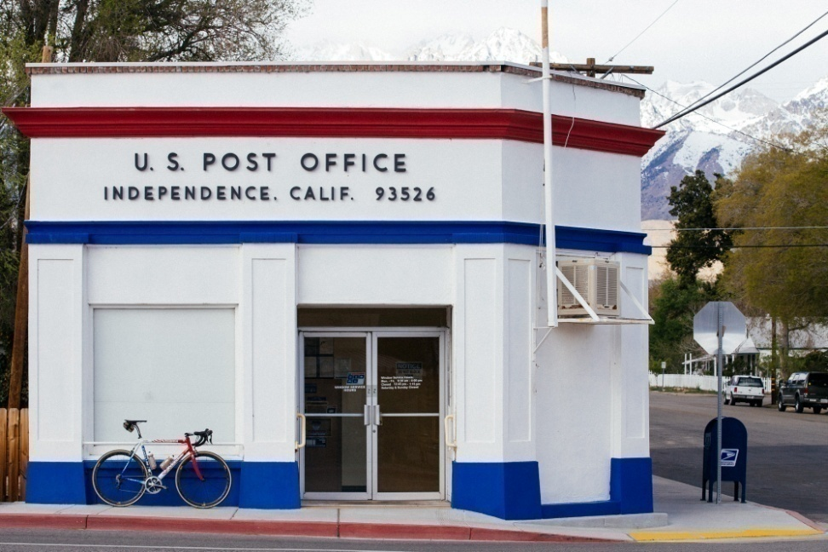
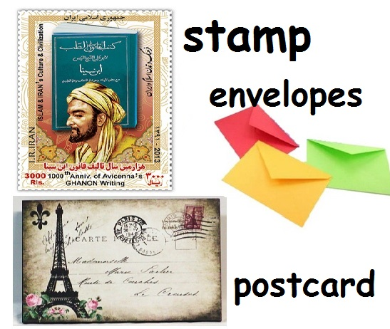
What is his job?
He is a postman.
How does he do his job?
He often does his job by car.
Where is the post office?
It is just round the corner
What do people do in a post office?
They usually send their letters and packs.

Slide 7
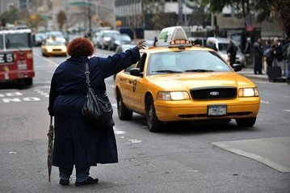
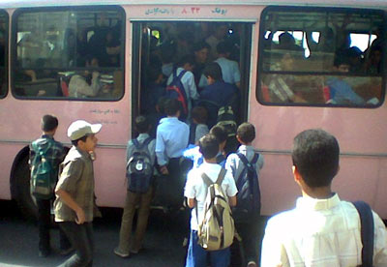
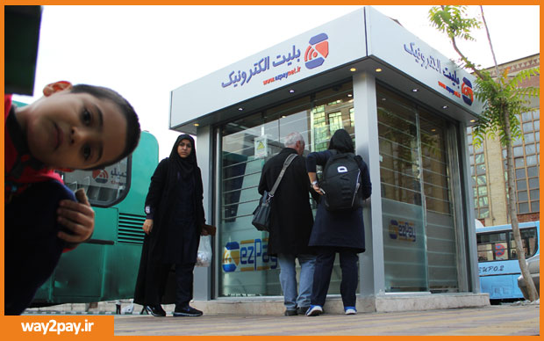
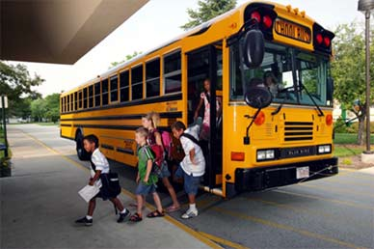
How does she go?
How do they go?
She often hires a taxi.
They go by bus.
Why does she go by taxi?
What do they do now?
Because, it’s fast.
They get on the bus.
What do they do now?
What do they do now?
They get off the bus.
They recharge their E-ticket.
Why do they take a bus?
Because, it’s cheap.

Slide 8
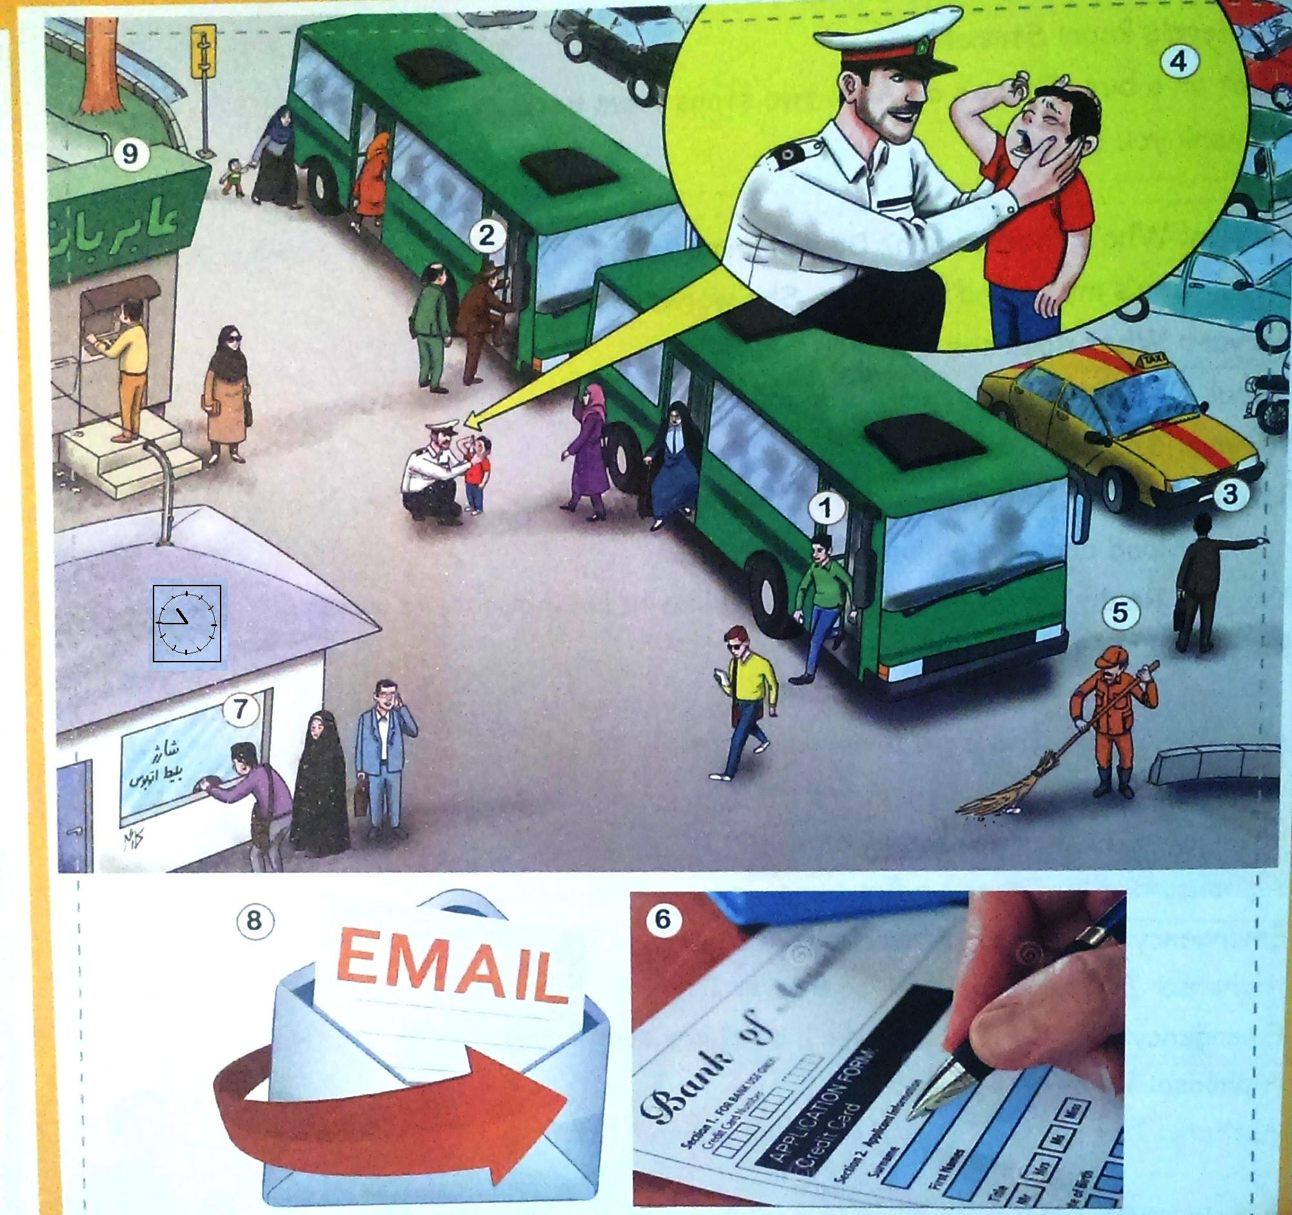
Ask and Answer

Slide 9
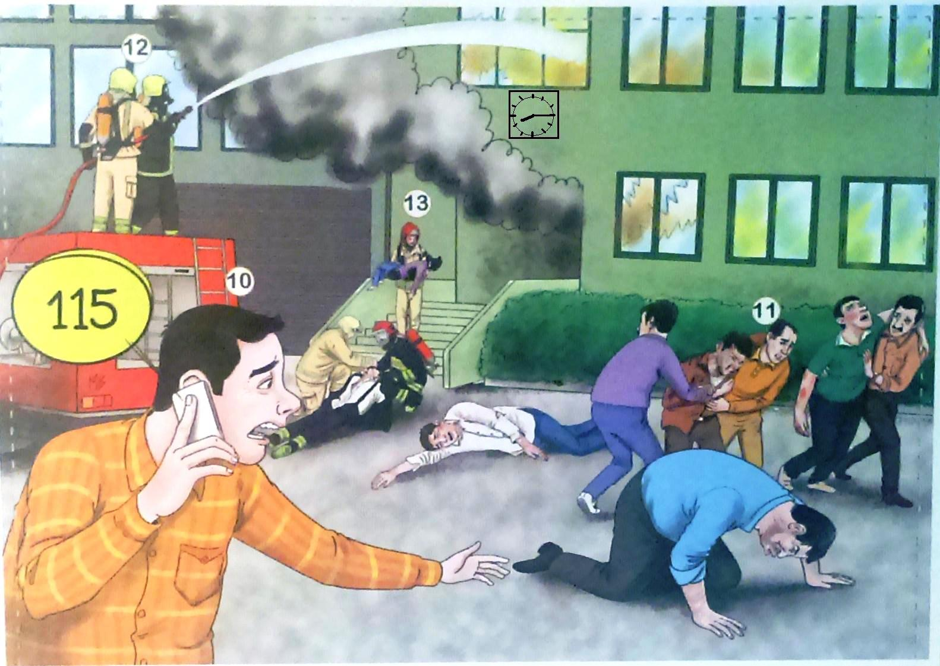
Ask and Answer

Slide 10
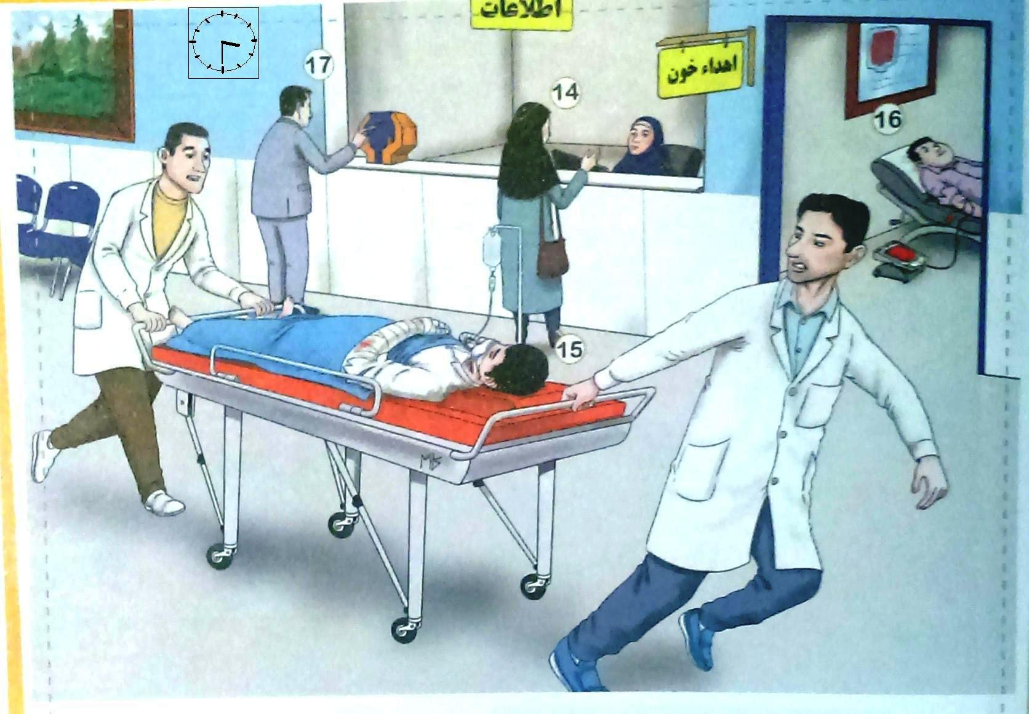
Ask and Answer

Slide 11
Role Plays

Slide 12
Name: Peter Smith
Job: policeman
Duty: help lost children
Work Time: on shifts
Work by: a police car

Slide 13

Name: Jack Richards
Job: firefighter
Duty: Put out fire/save lives
Work Time: on shifts
Work by: a fire engine

Slide 14
Name: Saman Hosseini
Job: bank teller
Duty: open accounts by computer
Work Time: 7:30 am- 2 pm
Go by: a bus

Slide 15
Name: Hassan Mohseni
Job: postman
Duty: drive a post car
Work days: Saturdays to Thursdays
Work by: a post car

Slide 16
Name: Ali Alavi
Job: nurse
Duty: bring patients to the ER
Work Time: on shifts
Work by: an ambulance

Slide 17
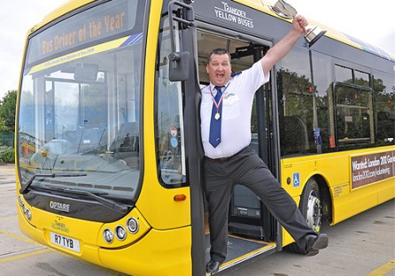
Name: Joe Hamilton
Job: driver
Duty: drive a bus
Work Time: 9 am – 3 pm
Work by: a bus

Slide 18
Monolog

Slide 19
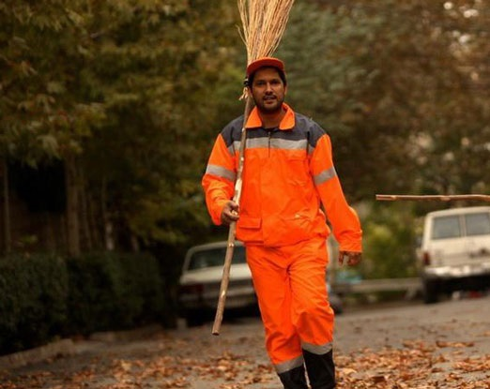
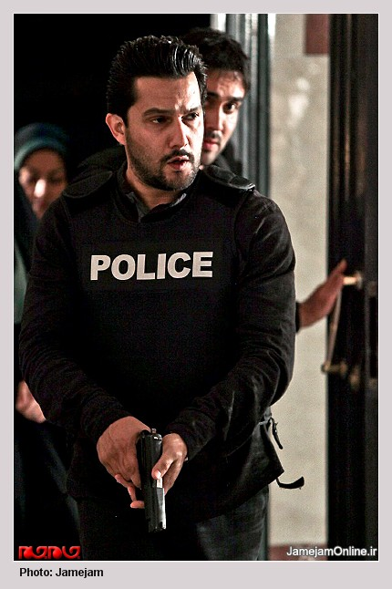
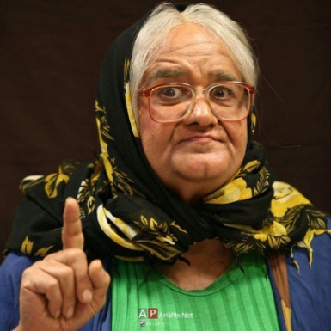
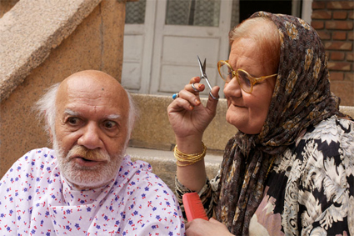
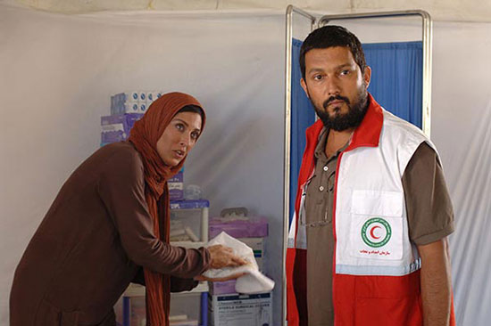
Hello, I am Hamed Behdad. I am an Iranian actor. I usually play a lot of roles. I sometimes play the role of a policeman and arrest the thieves and sometimes I play the role of a sweeper and keep the city clean. In another movie, I play the role of a nurse and help the patients. I never play the role of a woman yet, my colleague Akbar Abdi is very good at it.

