Slide 1
In the Name of God
My Dear Friend

Slide 2
Chapter Two
Learning L2 LANGUAGE
Factors and Processes

Slide 3
I.N.T.A.K.E.
Individual Factors
Negotiation Factors
Tactical Factors
Affective Factors
Knowledge Factors
Environmental Factors

Slide 4
Negotiation Factors
Meaning :> Ways in which participants in a communicative event structure their social relationships through interaction.
There are three dimensions to negotiation:
1)Introspection
2)Interaction
And 3)Interpretation

Slide 5
Negotiation Factors 1)Introspection
Introspection : It is Intra- personal , involving a language learner’s lonely mental
It can sometimes lead to hypothesis formation and testing. It is rarely available for direct observation and analysis.

Slide 6
Negotiation Factors 2)Interaction
It is active involvement in communicative activities such as :
Clarification, confirmation, comprehension checks, requests, repairing, reacting and turn taking.
It has facilitative role in language learning (Long 1981 & 1996)
The more interaction in L2 classroom, The faster rate of learning.
It creates not only learning opportunities but also it is constitutes learning itself.

Slide 7
Negotiation Factors 3)Interpretation
It help learners differentiate between what is said from what is meant.
a)Some utterances may convey more than their literal meaning.
E.g. : It’s cold in here.
b)Some utterances may not convey their literal meaning.
E.G. : How are you?
c) Some utterances may convey meaning only if they are accompanied by certain specifications. Like idioms
E.G. : Drop in sometime(to Visit home or office sometime when Sb. is nearby)
It is required to draw systematic knowledge into the immediate schemata and to relate these schemata to actual instances.
It is largely depends on cultural and subcultural levels of ethnic heritage, class, age and gender.

Slide 8
Tactical factors
Learning Strategies
Communication Strategies
It is the learners’ awareness of, and their ability to use, appropriate tactics or techniques for effective learning of L2 and efficient use of the limited ability developed so far.

Slide 9
Tactical Factors 1) Learning Strategies
Learning Strategies are operations and routines used by the leaner to facilitate the obtaining, storage, retrieval, and use of information. They are specific actions taken by the learner to make learning easier, faster, more enjoyable, more self directed, more effective, and more transferable to new situation.
Metacognitive Strategies Learning Strategies Typology Cognitive Strategies Social / Affective Strategies

Slide 10
Tactical Factors 1) Learning Strategies a)Metacognitive strategies
Metacognitive Strategies :
is defined as “cognition about cognition", or "knowing about knowing". It can take many forms; it includes knowledge about when and how to use particular strategies for learning or for problem solving. There are generally two components of metacognition: knowledge about cognition, and regulation of cognition.
Refer to higher order executive strategies such as thinking about the learning process, planning for and monitoring learning as it takes place, and self- evaluation of learning after the learning activity.

Slide 11
Tactical Factors 1) Learning Strategies B)cognitive strategies
Cognitive Strategies:
A strategy or group of strategies or procedures that the learner uses to perform academic tasks or to improve social skills.
Refer to conscious ways of tackling learning materials and linguistic input. They include specific steps such as note-taking, summarizing, deducing, transferring, and elaborating.
The use of cognitive strategies can increase the efficiency with which the learner approaches a learning task.

Slide 12
Examples of Cognitive Strategies :
Concept Mapping
Dump and Clump
Visualization
Making Associations
Chunking
Questioning
Scanning
Underlining
Accessing Cues
Using Mnemonics
Sounding out words
Self-checking and Monitoring.

Slide 13
Tactical Factors 1) Learning Strategies C)Social/ affective strategies
Social/ affective strategies:
Affective strategies are learning strategies concerned with managing emotions, both negative and positive.
Refer to inter personal strategies that are consistent with learners’ psychological and emotional conditions and experiences.
They include co- operating learning, peer group discussion, and interacting with competent speakers.
Lowering anxiety levels with relaxation techniques is one kind of affective strategy.
Example

Slide 14
Tactical Factors 2) communication Strategies
Communication Strategies:
Refer to potentially conscious plans for solving what to an individual presents itself as a problem in reaching a particular communicative goal.
Paraphrase
Communication Strategies : Borrowing
Avoidance

Slide 15
Tactical Factors 2) communication Strategies a) Paraphrase
Paraphrase:
is a restatement of the meaning of a text or passage using other words. paraphrase typically explains or clarifies the text that is being paraphrased.

Slide 16
Tactical Factors 2) communication Strategies B) Borrowing
Borrowing:
Involves word-for-word literal translation from native language. The most common way that languages influence each other is the exchange of words. Much is made about the contemporary borrowing of English words into other languages, but this phenomenon is not new, nor it is very large by historical standards.

Slide 17
Tactical Factors 2) communication Strategies C) Avoidance
Avoidance:
When speaking or writing an L2, the learner is often found to try to avoid using difficult words or structures, and use some simpler words or structures instead. It is Involving the attempt to avoid using a required expression or just to give up the effort to communicate.

Slide 18
Affective Factors
Affective factors :
Are emotional factors which influence learning. They can have a negative or positive effect. Negative affective factors are called affective filters and are an important idea in theories about second language acquisition.
Teachers can reduce negative factors and develop positive ones by doing activities to build a positive group dynamic, by including students in deciding aspects of the course and choosing activities that are motivating for the age and interests of the learners.
Attitude Affective Factors: Motivation

Slide 19
Affective Factors: 1)Attitude
Attitude:
It is one’s evaluative response to a person, place, thing or an event. Attitudes are individually driven, means that they are one’s personal thoughts or feelings based on one’s beliefs or opinions.
Attitudes are also socially grounded, that is they must be experienced as related to subjects or events in the external world.
Environmental Attitude : Pedagogic

Slide 20
Affective Factors: 1)Attitude a) Environmental
Environmental Factor:
Includes social, cultural, political and economic imperatives that shape the L2 educational social environment.

Slide 21
Affective Factors: 1)Attitude B) Pedagogic
Pedagogic Factor:
It shapes how teachers, learners and learning situation interact with each other to trigger positive or negative attitudes in the learner.

Slide 25
Affective Factors: 2)Motivation
Motivation :
The word "motivation" is typically defined as the forces that account for the arousal, selection, direction, and continuation of behavior. A student who studies hard and tries for top grades may be described as being "highly motivated", while his/her friend may say that he is "finding it hard to get motivated".
Motivation can be defined as a concept used to describe the factors within an individual which arouse, maintain and channel behavior towards a goal. Another way to say this is that motivation is goal-directed behavior.
It provides the driving force to sustain the long and often boring learning process.

Slide 26
Affective Factors: 2)Motivation A)Social psychologist view
According to Social Psychologists motivation has two broad branch:
I) Integrative motivation
II)Instrumental motivation

Slide 27
Affective Factors: 2)Motivation A)Social psychologist view I) Integrative motivation
Integrative motivation :
Refers to an interest in learning an L2 in order to socioculturally integrate with members of the TL community.
People who immigrate to new countries are some examples of people who may want to identify with the community around them. An important aspect of this form of language learning is using language for social interaction. This form of motivation is thought to produce success in language learners.

Slide 28
Affective Factors: 2)Motivation A)Social psychologist view II) Instrumental motivation
Instrumental Motivation :
It is Wanting to learn a language for the purpose of obtaining some concrete goals such as a job, graduation, or the ability to read academic. Instrumental motivation is often characteristic of second language acquisition, where little or no social integration of the learner into a community using the target language takes place, or in some instances is even desired.

Slide 29
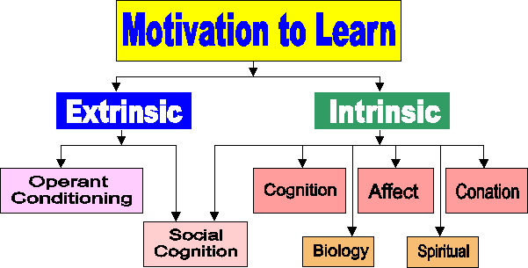
Affective Factors: 2)Motivation B)Cognitive psychologist view
According to Cognitive Psychologists view of motivation it has three major types:
I)Intrinsic motivation
II)Extrinsic motivation
III)Achievement motivation

Slide 30
Affective Factors: 2)Motivation B)Cognitive psychologist view I)Intrinsic motivation
Intrinsic motivation :
Is the desire to engage in activities characterized by enjoyment and there is no apparent reward except the experience of enjoying the activity itself.
E.G. :
*Happiness *Personal goals, values, and morals *Willingness and eagerness to learn *Physiological, social, and self-esteem needs

Slide 31
Affective Factors: 2)Motivation B)Cognitive psychologist view II)extrinsic motivation
Extrinsic motivation:
Motivation in learning that comes from a sense of empowerment in being able to do something. Doing something for the sake of doing it without thought of rewards such as praise, grades, candy, or money.
E.G.:
*Money *People around you *Good grades *Rewards

Slide 32
Affective Factors: 2)Motivation B)Cognitive psychologist view II)Achievement motivation
Achievement motivation:
It refers to the motivation and commitment to excel. It is needs of being excellence.
it includes the expectancy and incentive value of success. Achievement motivation is where the individual assumes control over the learning situation and does what is necessary to get what he / she wants.

Slide 33
FLOW! Flow is a certain kind of intrinsic motivation that someone can feel. It occurs when someone feels an overall, intrinsically motivated feeling when they are totally involved in an activity and are on "auto pilot.“

Slide 34
Certain elements are needed to achieve flow:
* A balance of levels of skills and of level of challenge * Complete absorption in the activity * Merging of action and awareness * Total concentration * Loss of self-consciousness * A sense of control * The absence of certain outward goals or rewards * Effortless movement * A motivation to perform * Achieve optimal arousal before performing * Appropriate focus maintenance. * The use of pre-competitive and competitive plans and preparation * The achievement of optimal physical preparation and readiness * The exhibition of confidence and positive mental attitudes * Positive team interaction * Good feelings about performance

Slide 35
Some things that may prevent flow are:
* Not feeling physically prepared and ready * Injury * Fatigue * Not feeling good * External Stresses * Unwanted crowd response * Uncontrollable influences of the event * A lack of confidence * Negative thinking * Self-doubt * No control of mental state * Thinking too much * Worrying about what others are doing * Frustration with team-mates effort * Poor pre-competitive preparation * Distraction before competition * Interruption to preparation * No goals set

Slide 36
Some things that may prevent flow are: (C’d)
* Lack of challenge * Low arousal or motivation * Not relaxed enough * Too relaxed * Poor team performance * Not feeling part of a team * Negative talk within the team * Errors * Poor techniques * Things not going as planned * Stoppage in play * Oppositions activity * Negative refereeing decisions * Inappropriate, negative, or lack of feedback * Worrying about competition * Daydreaming * Loss of concentration * Self doubt * Putting too much pressure on yourself

Slide 37
How To Motivate ESL Students:
Use as many references to popular culture as you can
Give students a little friendly competition
Cater to their skills and exploit their talents
Use pen pals to motivate writing
Integrate technology into the classroom
Play games
Use real life objects in the classroom

Slide 38
Knowledge factors
Knowledge factors refer to language knowledge and meta language knowledge

Slide 39
Knowledge factors A) Language knowledge
Language knowledge represents knowledge / ability in the native language, in still developing target language and in other languages already known.
L2 learners do not effectively switch off their L1 while processing the L2 , but has it constantly available (V. Cook).It means that L1 has an important effect on L2 learning.
Facilitating Function of language knowledge
Constraining Function of language knowledge

Slide 40
Knowledge factors A) metaLanguage knowledge
Metalanguage knowledge refers to one’s ability to consider language not just as means of expressing ideas or communicating with others, but also as an object of inquiry.
There is a strong relationship between language experience and metalanguage knowledge. The more we use our metalinguistic knowledge the more it impacts on our cognition that results in cognitive processes of L2 dev. and use.

Slide 41
And @ last Environmental Factors
Environmental factors refer to wider social environment in which language learning and teaching take place. These include the global, national, social, cultural, political, economic, educational, and family contexts.
Social Context
Environmental Factors :
Educational Context

Slide 42
Environmental Factor a) Social Context
Social context refers to a range of language learning environment such as home, the neighborhood, the classroom, and the society at large and also recently added like historical, political, and social factors as well.
The learners choice of what input becomes intake is highly affected by social and situational contexts.
Social settings create and shape opportunities for both learners and competent speakers of the L2 to communicate with each other and thereby maximizing learning potential.

Slide 43
Environmental Factor b) Educational Context
Studies on educational contexts grounded in educational psychology emphasize the inseparability and reciprocal influence of educational institutions and setting in which learning and teaching operations are embedded.
Additive bilingualism: Bilingualism in which a second language is acquired without detriment to the first. Used e.g. of the learning of French by English speakers in Canada: that of German and French by speakers of Luxembourgish or of standard German by speakers of Swiss German also seems to fit the definition.
Subtractive bilingualism: When learning a second language interferes with the learning of a first language. The second language replaces the first language. This is commonly found in children who emigrate to a foreign country when they are young, especially in cases of orphans who are deprived of their first language input.

Slide 44
Intake processes
Intake processes are cognitive mechanisms that at once meditate between and interact with input data and intake factors.
Intake processes categories are : 1)Inferencing
2)Structuring
3)restructuring

Slide 45
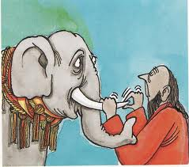
Intake processes 1) Inferencing
Inference: Inference is a mental process by which we reach a conclusion based on specific evidence. It can be inductive or deductive.
E.G.: We infer it is raining when we see someone with an open umbrella. We infer people are thirsty if they ask for a glass of water.
Paraphrase and word coinage are some examples of overgeneralization used by Language learners that is a kind of inference.

Slide 46
Intake processes 2)Structuring
Structuring : Refers to how the L2 system is framed in the mind of the learner. It combines elements of analysis and control.
The intake process of structuring helps learners construct, structure, and organize the symbolic representational system of TL by gradually making explicit the Implicit knowledge that shape their IL performance.
Comparison between Inferencing and structuring process of intake Inferencing > relates to perception and comprehension of forms Structuring > refers to incorporation of the forms in the learners grammar

Slide 47
Intake processes 3) restructuring
Restructuring denotes neither an incremental change in the structure already in place nor a slight modification of it but the addition of a totally new structure to allow for a totally new interpretation.
It makes strategies shift in order to more efficient intake processing.
It is sudden, quick, taking little tome and energy and discontinued process.

Slide 48
Output
Output refers to the corpus of utterances that learners actually produce orally or in writing and is the result of an interplay between intake factors and intake process.
Three Functions of Output: The noticing function
The hypothesis-testing function
The metalinguistic function

Slide 49
Output 1) Noticing Function
The noticing function relates to the possibility that when learners try to communicate in their still developing target language.

Slide 50
Output 2)hypothesis- testing function
Hypothesis-testing function of output relates the possibility that when learners use their still developing TL, they may be experimenting with what works and what does not work.

Slide 51
Output 3)metalinguistic function
Metalinguistic function of output relates to the possibility that learners may be consciously thinking about language and its phonological, grammatical, and semantic rules in order to guide them to produce utterance that are linguistically and communicatively appropriate.

Slide 52
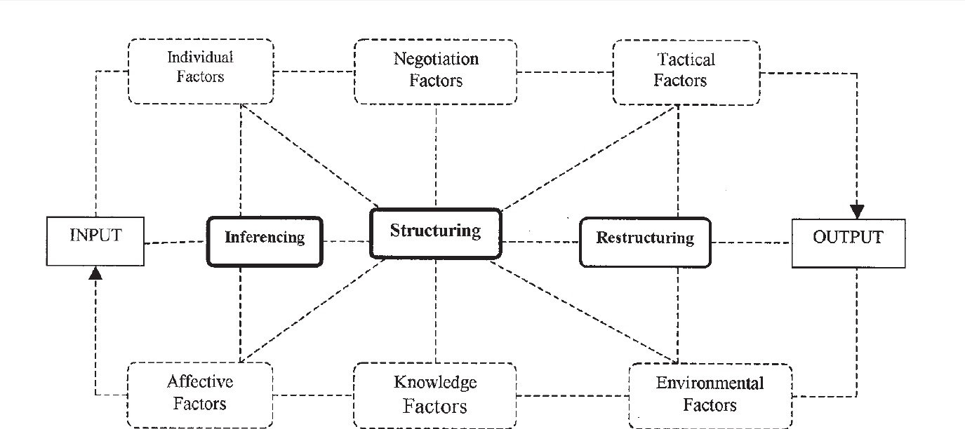
An interactive framework of intake processes

