Slide 1
General Pathology of
Infectious Diseases
In the name of Allah
Chapter 9
B.Shokouhi MD. ACP
B.Shokouhi@yahoo.com

Slide 2
Viruses

Slide 3
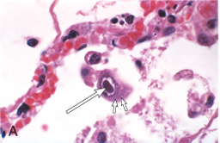
Cytomegalovirus infection in the lung. Infected cells show distinct nuclear (long arrow) and ill-defined cytoplasmic
(short arrows) inclusions

Slide 4
Varicella-zoster virus infection in the skin. Herpes simplex virus and varicella-zoster virus both cause characteristic cytopathologic changes, including fusion of epithelial cells, which produces multinucleate cells with molding of nuclei to one another (long arrow), and eosinophilic haloed nuclear inclusions (short arrow).

Slide 5
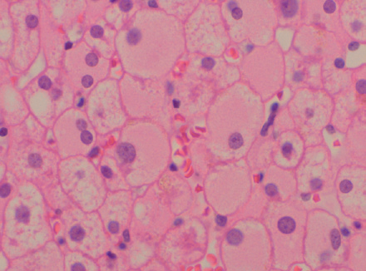
Hepatitis B viral infection in liver. In chronic infections, infected hepatocytes show diffuse granular (“ground-glass”) cytoplasm, reflecting accumulated hepatitis B surface antigen (HBsAg)

Slide 6
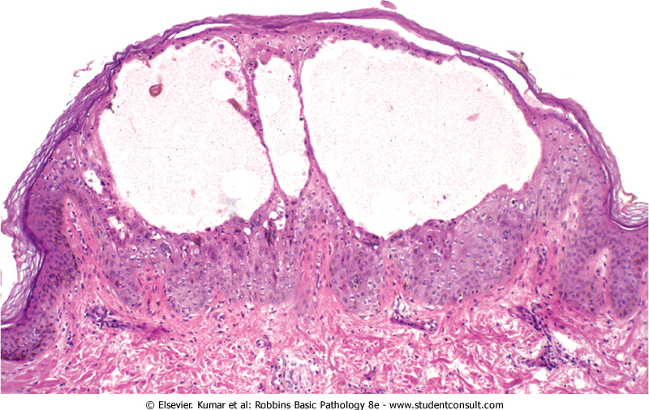
chickenpox (varicella-zoster virus) with intraepithelial vesicle

Slide 7
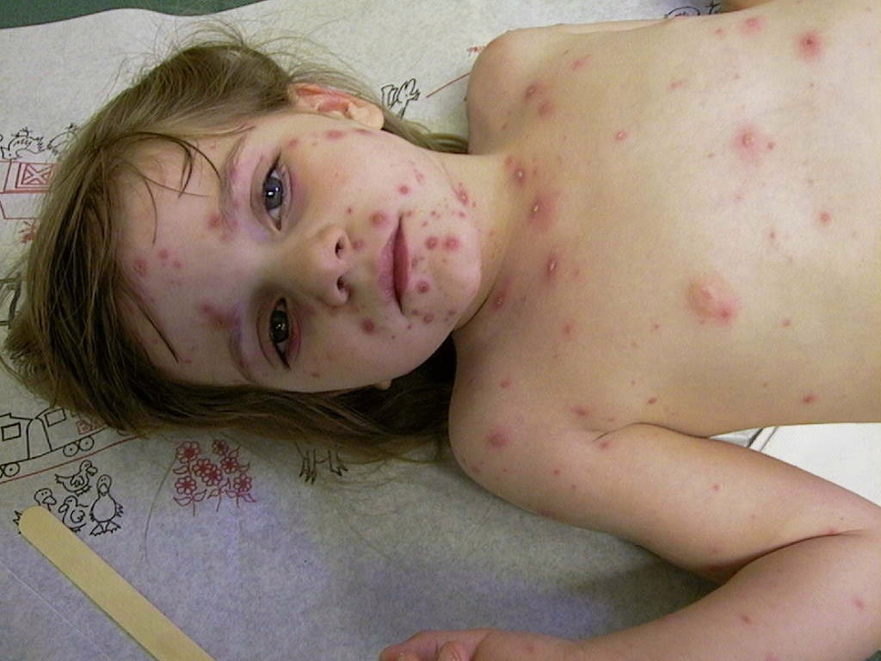

Slide 8
Bacteria
common causes of disease

Slide 9
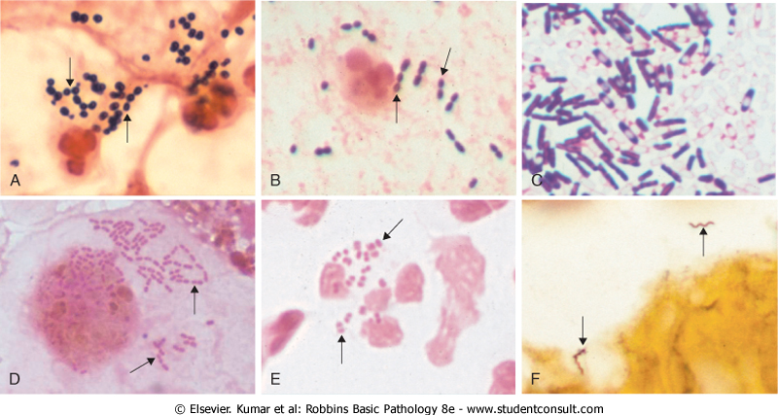
Staphylococcus aureus pneumonia g+ cocci in clusters among degenerating neutrophils

Slide 10
Streptococcus pneumoniae pneumonia g+, elongated cocci in pairs and short chains

Slide 11
bronchoalveolar lavage g- intracellular bacilli of Klebsiella pneumoniae or Escherichia coli

Slide 12
urethral discharge
Neisseria gonorrhoeae showing many g- diplococci

Slide 13
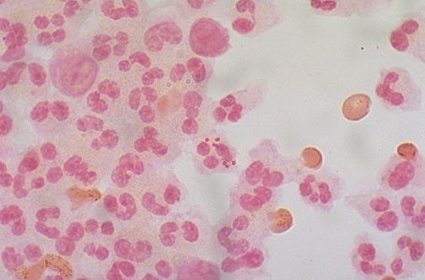
gram negative diplococci within a neutrophil

Slide 14
Silver stain of brain tissue
Lyme disease meningoencephalitis two helical spirochetes (Borrelia burgdorferi)

Slide 15
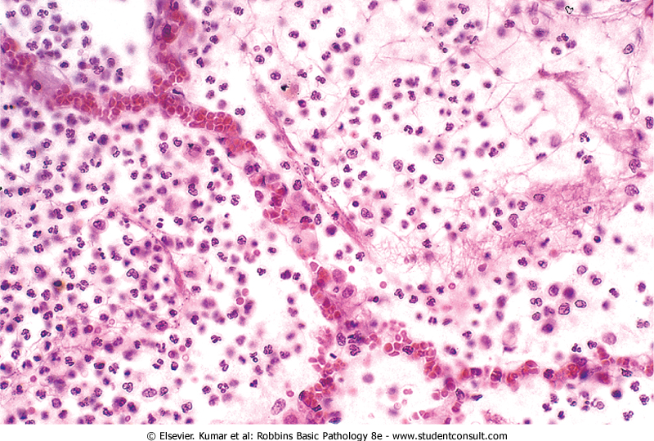
pneumococcal pneumonia. Note the intra-alveolar polymorphonuclear exudate and intact alveolar septa

Slide 16
Fungi

Slide 17
Meningeal blood vessels with angioinvasive Mucor species.
Note the irregular width and near right-angle branching of the hyphae.

Slide 18
Protozoa

Slide 19
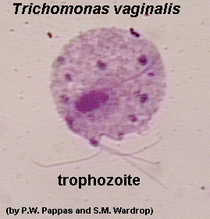

Slide 20
Helminths

Slide 21
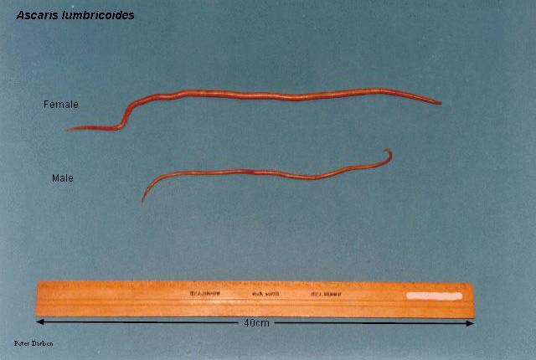

Slide 22
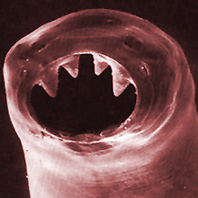
A.duodenalis

Slide 23
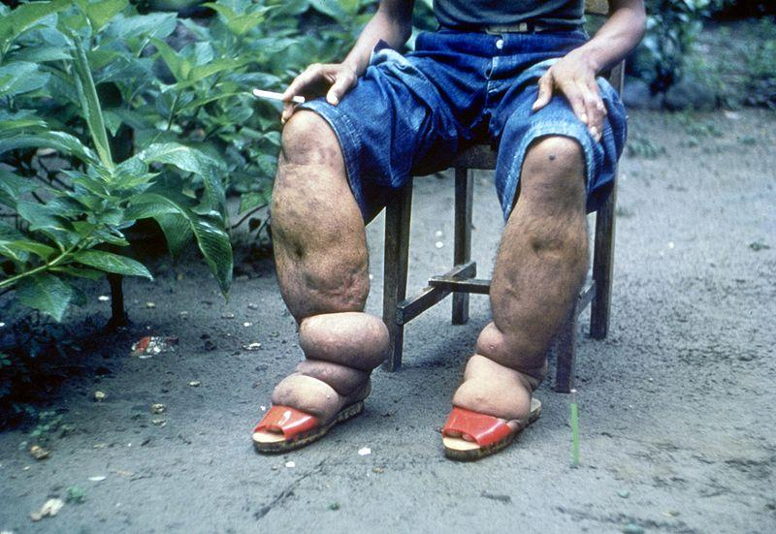
Elephantiasis, Wuchereria bancrofti

Slide 24
Coiled Trichinella spiralis larva within a skeletal muscle cell

Slide 25
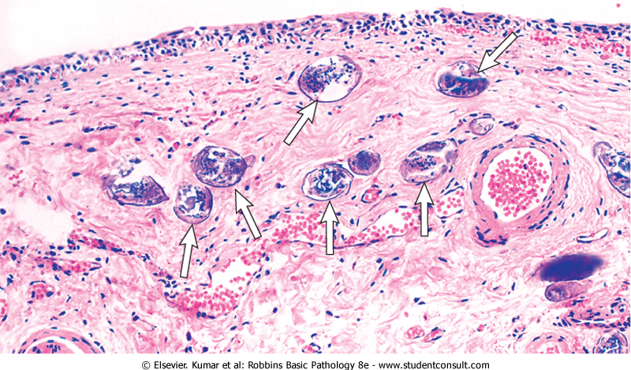
Schistosoma haematobium infection of the bladder with numerous calcified eggs and extensive scarring

Slide 26
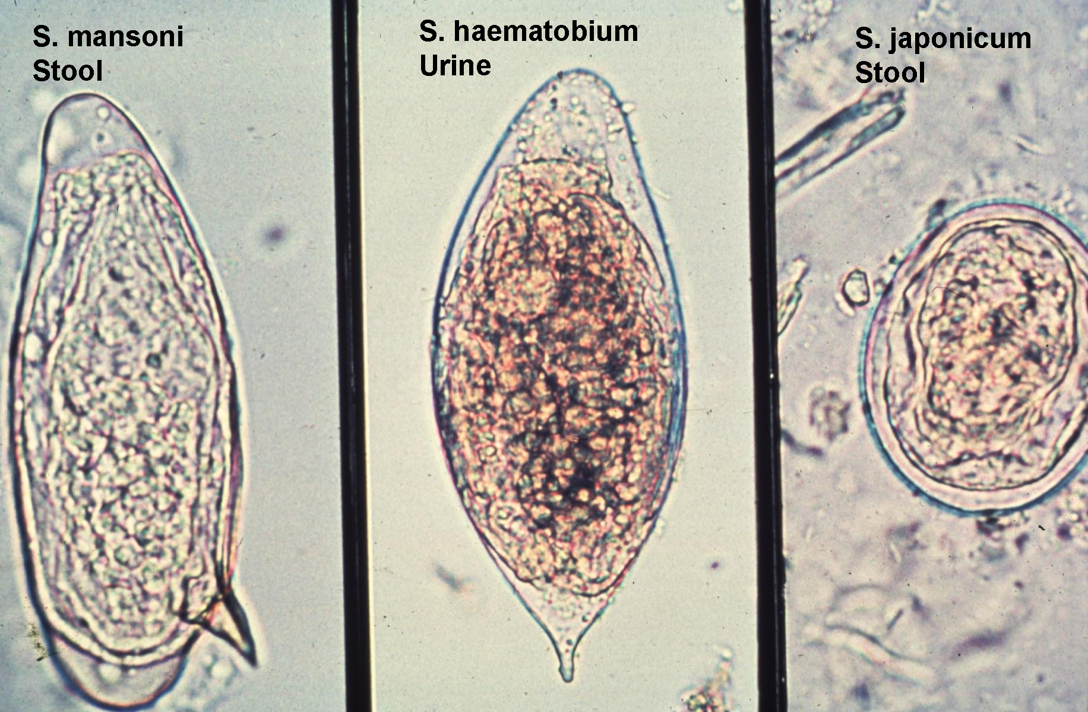

Slide 27
Ectoparasites

Slide 28
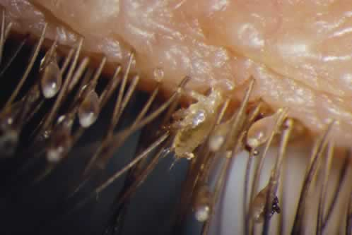
شپش

Slide 29
tuberculosis

Slide 30
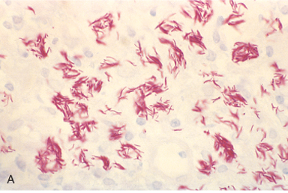
In the absence of appropriate T cell–mediated immunity, granulomatous host response does not occur. Mycobacterium avium infection in a patient with AIDS, showing massive intracellular macrophage infection with acid-fast organisms (filamentous and pink in this acid-fast stain preparation).

