Slide 1
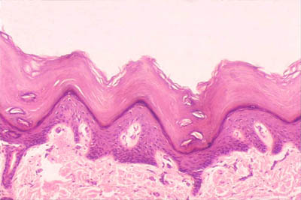
HISTOLOGY OF SKIN

Slide 2
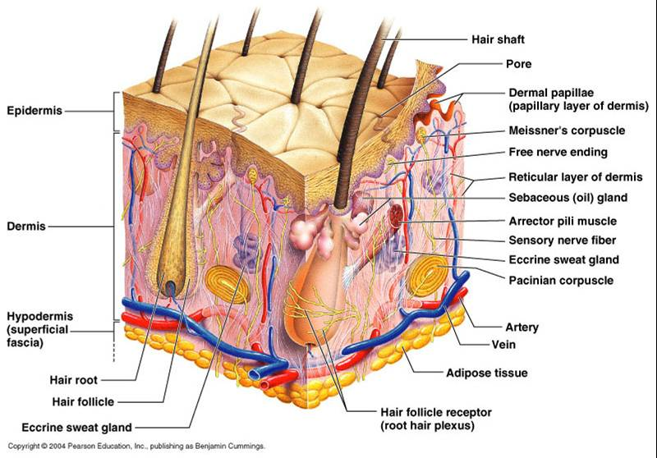
Structure
Structure of skin include:
Epidermis (ectodermal origin)
Dermis (mesodermal origin)
Connection area :
-Papillae of dermal
-Epidermal ridges
There are hypodermal layer (subcutaneous tissue) under dermis layer.

Slide 3
Function
Function :
-Protection :
- UV rays
- Pathogen agents
-Endocrine functions (vitamin D3)
- Immunosurveillance
-Temperature regulation
-Sensation
-Excretion substance
- Prevention of evaporation of water

Slide 4
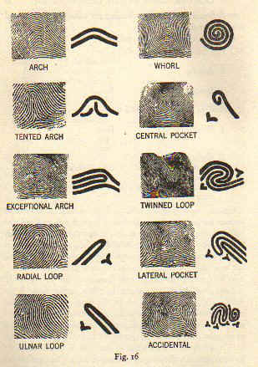
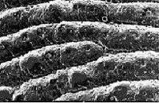
Dermatoglyphics
Licatiopn of Fingerprint:
Palmar
Plantar
Tip of finger

Slide 5
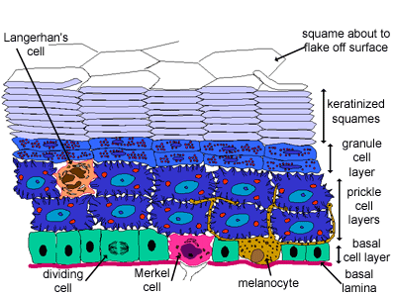
Epidermis
Epidermis consist of 5 Stratum :
Stratum Basale
Stratum spinosum
Stratum granulosum
Stratum lucidum
Stratum corneum

Slide 6
Stratum Basale
Specialization :
-Mitosis dividing
- Basophile cell
- Desmosome junction
-Hemi desmosome junction

Slide 7
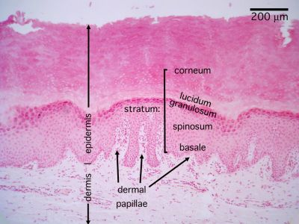
Stratum Spinosum
Specialization :
-Desmosome junction
-Keratin filament

Slide 8
Stratum Granulosum
Specialization :
-Keratohyalin granules
- Formation barrier

Slide 9
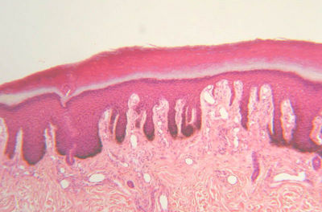
Stratum lucidum
Specialization :
-There are in thick skin .
-Eosinophil color cell

Slide 10
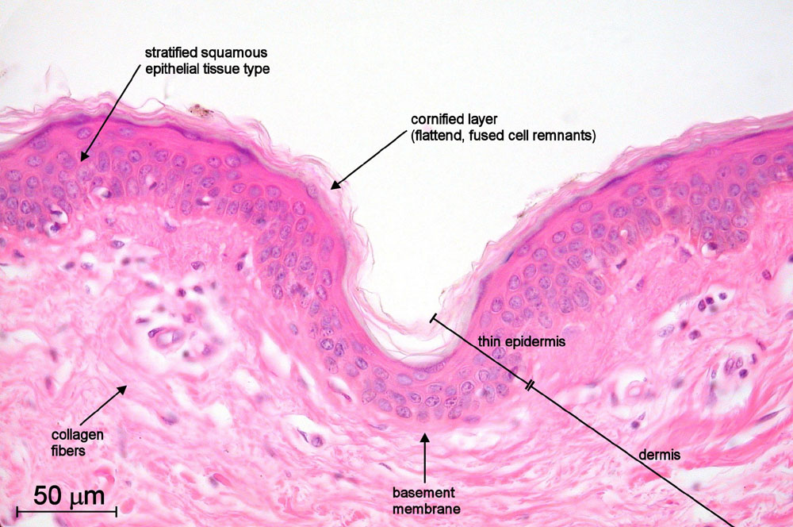
Stratum corneum
Specialization :
-15-20 layers
-Keratin protein
-The keratinocytes without nuclei

Slide 11
Epidermis
Types of cells :
Melanocyte
Langerhans cell
Merkel cell

Slide 12
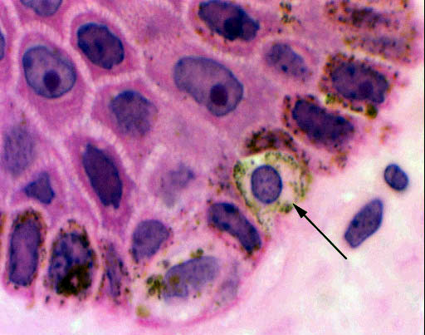
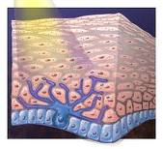
Melanocyte
Specialization :
-Location : Stratum Basale
-Pigmentation: Eumelanin

Slide 13
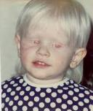
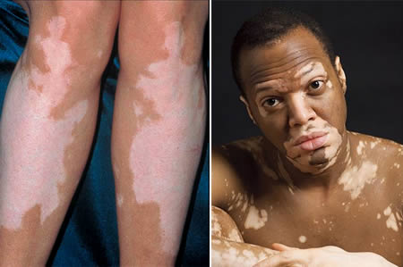
Clinical Note of Melanocyte
Addision disease :
- Adrenal gland defect
Albinisma :
- Tyrosinase enzyme defect
Vitiligo :
-Melanocyte degeneration

Slide 14
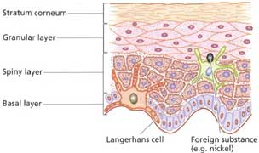
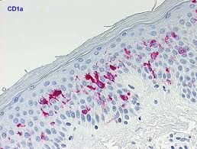
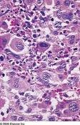
Langerhans Cell
Specialization :
Location : Stratum Spinosum
Bone marrow origin
Immunity reaction

Slide 15
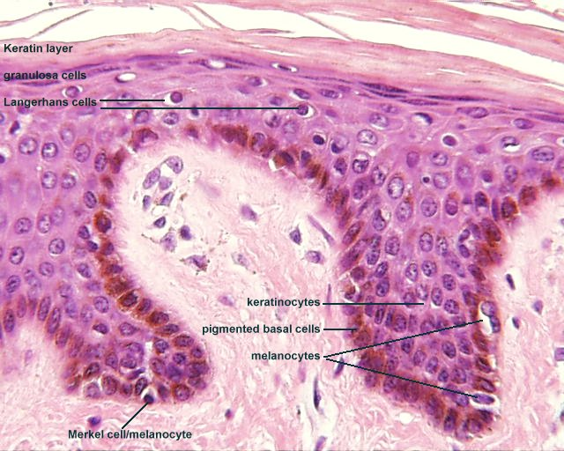
Merkel cell
Specialization :
Mechanoreceptor
Cytoplasmic granule

Slide 16
The Dermal – Epidermal Junction
Function :
-Junction of epidermal cell to dermal
-Migration
-Differentiation
-Barrier and filter
-ECM & Basal lamina signaling
Basal membrane:
-Lamina lucida
-Lamina densa
-Lamina fibroreticularis

Slide 17
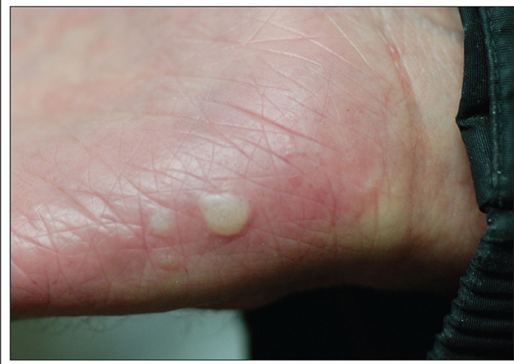
The Dermal – Epidermal Junction & Clinical Note
Bullous Pemphigoid

Slide 18
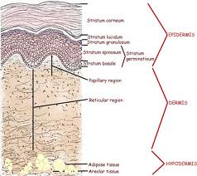
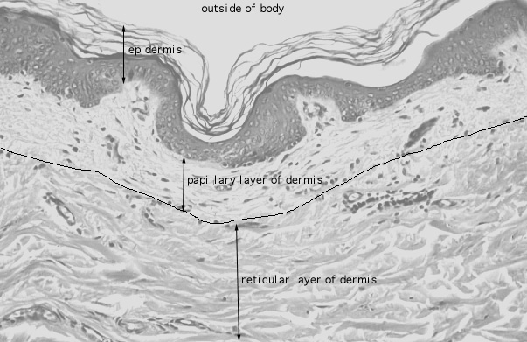
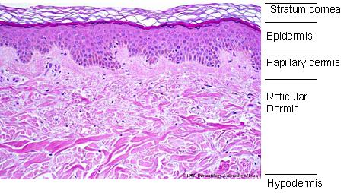
Dermis
Dermis :
-Papillary layer
(Loose connective tissue)
-Reticular layer
(Dense connective tissue)

Slide 19
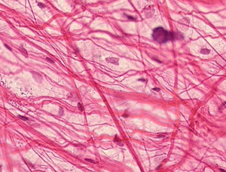
Dermis
Collagen Fibers:
Mostly type : Collagen type I
Papillary layer : Collagen type III
Reticular layer : Collagen type I
Basal membrane: : Collagen type IV
Elastic fibers:
-Oxytalan fibers
Substra substance:
-
-Glycosaminoglycan
The cells of dermis :
- Fibroblast
- Lymphocyte
-Mast cell

Slide 20
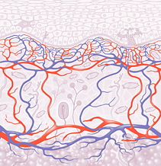
Vascular network
Vascular network :
Between Papillary layer & Reticular layer
Between Dermis & Hypodermis layer

Slide 21
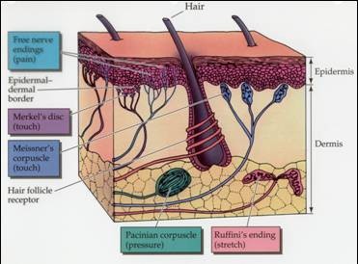
Nerve of Skin
Nerve of Skin :
Sensory nerve (myelin nerve fibres)
Autonomic nerve (non myelinated nerve fibres)
Terminal nerve ending :
- Encapsulate nerve ending
- Free nerve ending
-Peritrichial nerve ending
-mercle

Slide 22
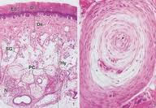
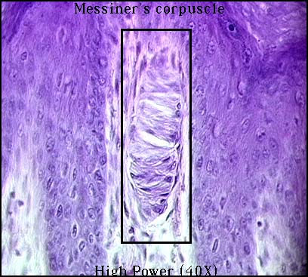
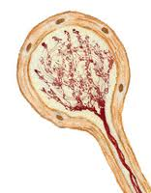
Encapsulate Nerve Ending
Encapsulate Nerve Ending :
-Pacinian corpuscle
-Krause end bulb
-Meissnerss tactile corpuscle

Slide 23
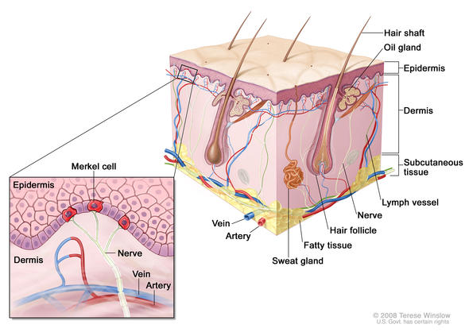
Nerve of Skin
Free nerve ending
Peritrichial nerve
ending
Merkel nerve ending

Slide 24
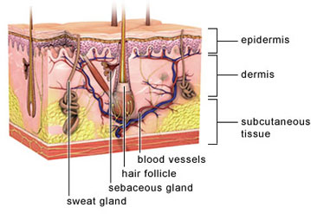
Appendage of Skin
Appendage of Skin :
Hair
Nails
Sweat gland
Sebaceous gland

Slide 25
Hair
Anatomy of hair:
Hair shaft
Hair follicle
-Hair bulb
-Hair papilla

Slide 26
Hair
Histology of hair :
Hair shaft :
- Medulla
- Cortex
- Cuticle
Hair follicle
-Dermal papilla
- matrix cells
- Medulla
- Cortex
- Cuticle
-Internal root sheath
-External root sheath
-Glassy membrance

Slide 27
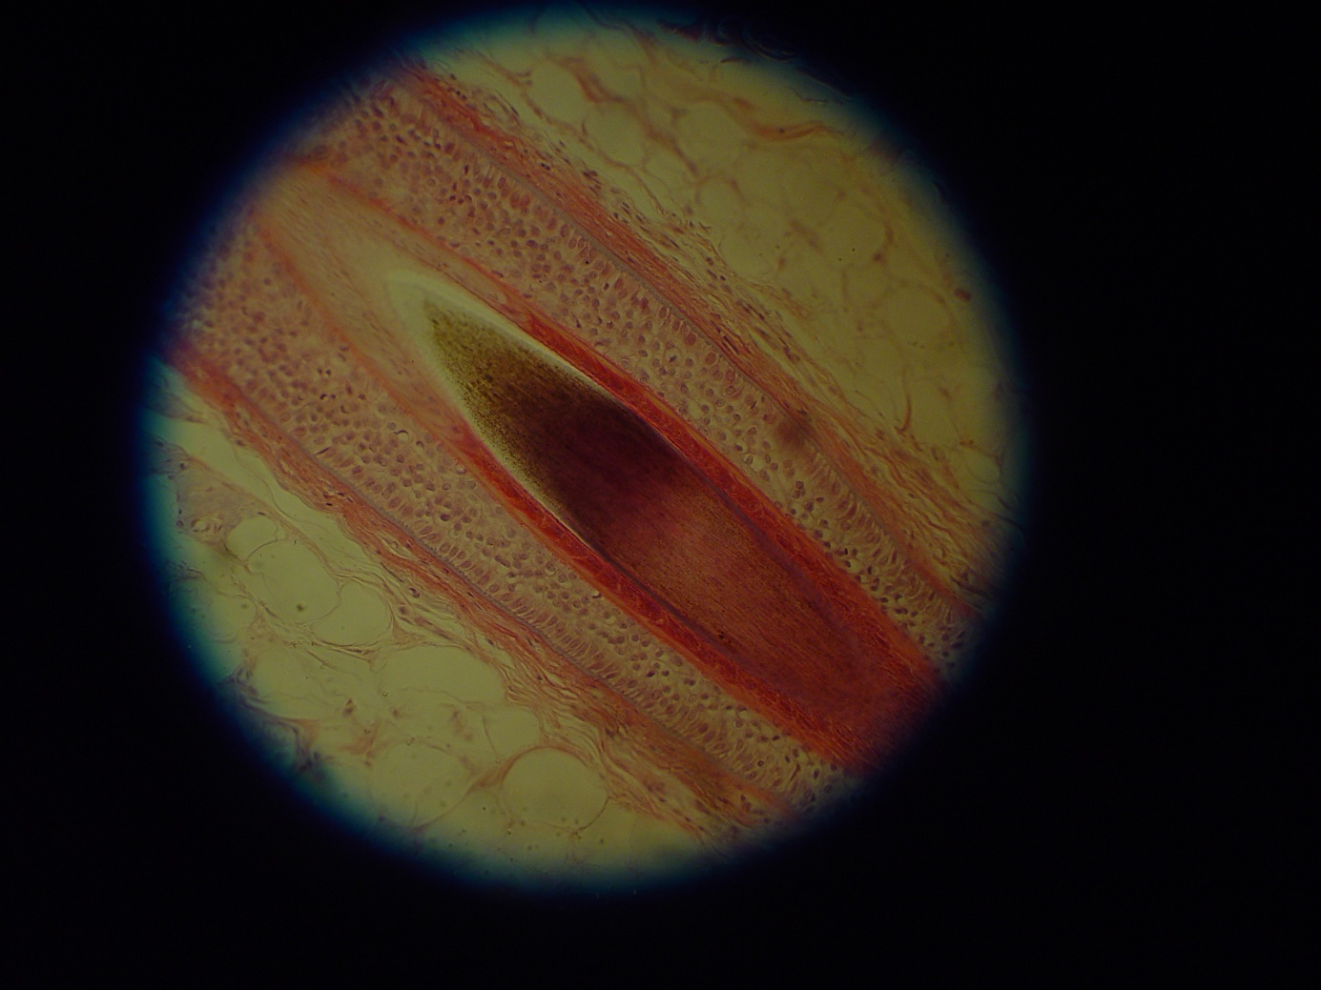
Histology of hair
Cuticle
Cortex
External Root Sheath
Inner Root Sheath
Glassy Membrane

Slide 28
Hair grow cycle
Hair grow cycle :
-Anagen
-Catagen
-Telogen

Slide 29
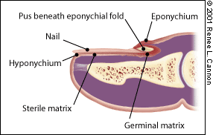
Nail
Nail structure :
Nail root
-Posterior part of Nail root
-Germinal matrix
-Nail bed
Nail plate
Lunula
Eponchium
Hyponnycgium
Lateral nail fold

Slide 30
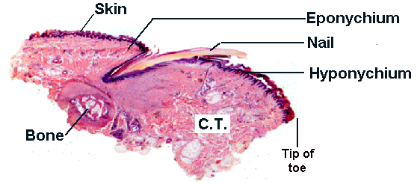
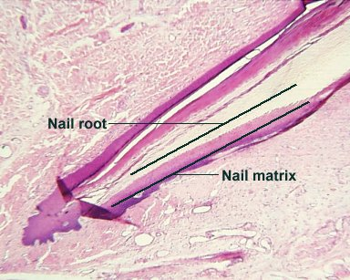
Nail

Slide 31
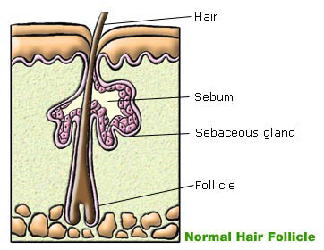
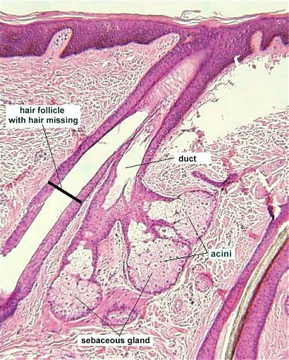
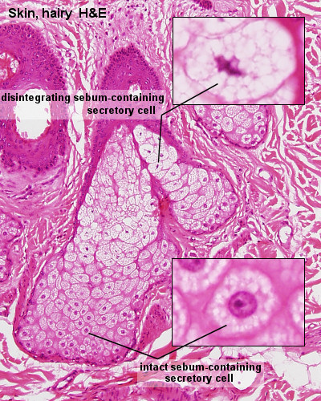
Sebaceous Glands
Sebaceous Glands :
Holocrine gland
Associated hair follicle
Sebum composition :
Triglyceride
Waxes
Squalene
Cholesterol

Slide 32
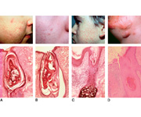
Sebaceous Glands & Clinical Point
Acne:
-Etiology :
-Acne develops as a result of blockages in follicles.
-Hormonal activity, such as menstrual cycles and puberty.

Slide 33
Sweat Gland
Sweat Gland :
Merocrine gland
Apocrine gland

Slide 34
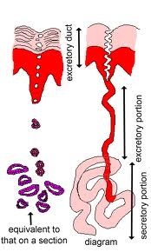
Sweat Gland
Merocrine gland :
Function :
-Decrease body temperature
-Excretory organ
Sweat composition:
-H2O
- Nacl
- Urea
- Urea acid
- Ammonium

Slide 35
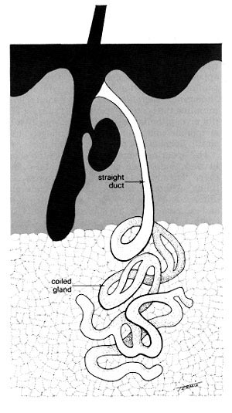
Sweat Gland
Apocrine gland :
Location :
- axilary region
- Breast
- Anal region
Apocrine gland :
-Moll gland in palpebral
-cerumen gland in external ear

Slide 36
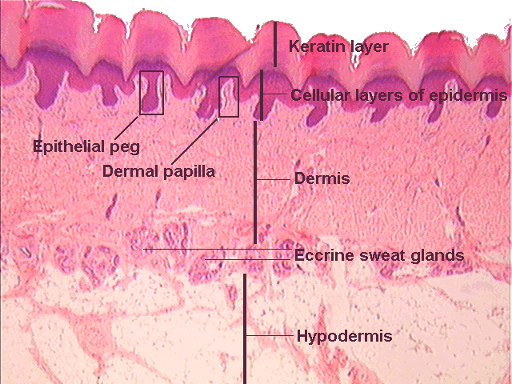
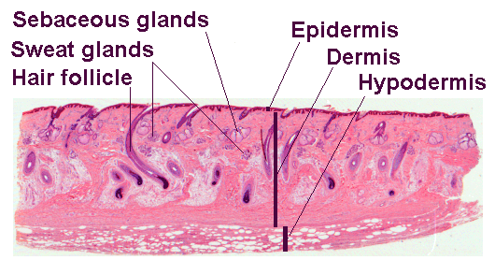
Subcutaneous Tissue
Subcutaneous Tissue contain :
-Adipocyte
-Fibrous lamella

Slide 37
THANK YOU

