Slide 1
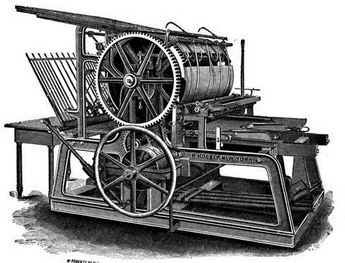
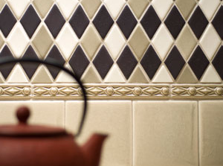
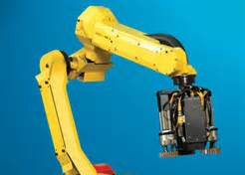
The competitive advantage of nations Michael E. Porter
Chapter 5
Four Studies in National Competitive Advantage

Slide 2
Four Industries
This chapter describes the historical development of four such industries, based in four different nations, that have achieved international leadership.
The German Printing Press Industry
The American Patient Monitoring Equipment Industry
The Italian Ceramic Tile Industry
The Japanese Robotics Industry

Slide 3
The German Printing Press Industry

Slide 4
Introduction
Printing presses were invented in Germany by Johannes Gutenberg around 1440.
German firms account for an estimated 35% of world printing press production.
In 1985, Germany’s world export share was 50.2%, and exports went to some 122 countries.

Slide 5
Koenig pioneer of modern printing press technology
Friedrich Koenig, a German, served an apprenticeship as a printer and typesetter in Leipzig (later part of East Germany) working on Gutenberg-type equipment.
Later, Koenig attended lectures in mathematics and mechanics at Leipzig University, though not as a formal student.
Koenig developed a plan to build an improved printing press without the many weaknesses of the equipment he had used in his apprenticeship.
Unable to find support in Germany, however, he was forced in 1806 to move to England to pursue his idea. England was the world’s most advanced industrial country.

Slide 6
Koenig pioneer of modern printing press technology
The new paper-making machines also reduced the price of paper, leading to higher sales of newspapers and heightened interest in improved printing presses.
In 1809, Koenig signed an agreement with a group of London print shop owners and publishers. In return for a share of future profits from his new machine, they were to finance its construction.
In London, Koenig met Andreas Bauer, another German expatriate, who was an optician and precision mechanic. In 1812, Koenig and Bauer (K&B) developed.
In 1814, a K&B press printed a complete edition of the Times at the rate of 1,100 copies per hour. K&B’s next advances were in “perfecting” (which allowed printing on both sides).

Slide 7
Returning to Germany
K&B began to prosper, but the company soon ran into a dispute with its financial backers. They did not want K&B to sell presses to competitors either within or outside of England. Koenig and Bauer decided to leave England in 1818.
After searching for a new location, the company settled in Oberzell. An unlikely place to locate (there was little industry there).
The king of Bavaria was actively trying to attract industry to the region and helped K&B in locating and purchasing an abandoned monastery for use as a factory. Other incentives provided to locate in the region included: financial assistance in the early years; a tax exemption for the first ten years; ten years’ protection on all inventions and trades; no obligatory military service for company workers during the early years; and no tariffs on imports of machinery and other necessary raw materials.

Slide 8
Returning to Germany
Advantages & Disadvantages of the Oberzell location:
production costs were only one-third of English costs due to lower wages and other costs.
raw materials were difficult to obtain
most local labor was unskilled and unfamiliar with industrial production
In 1819, K&B completed its first machine built in Germany.
Over the next several years, K&B built presses for print shops in Augsburg and Hamburg (Germany), Copenhagen (Denmark), and several locations in France.
In 1827, the company founded a paper manufacturing firm. It used an English machine bought from Donkin.

Slide 9
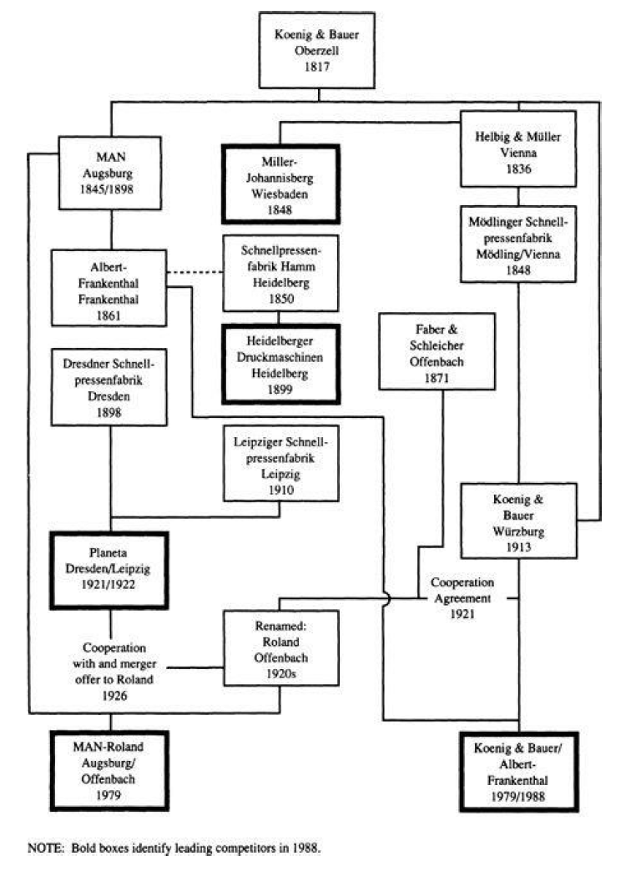
The emergence of domestic rivalry
A number of other German competitors (and one Austrian) entered the industry, starting in the 1830s.
All their founders had either worked at K&B or had some other connection with the firm.
A gradual process of consolidation began during the world economic downturn following World War I. In 1921, K&B acquired Mödlinger Schnellpressenfabrik and signed a cooperation agreement with Faber & Schleicher, an Offenbach-based firm that had been established in 1871. About the same time, Dresdner Schnellpressenfabrik merged with Leipziger Schnellpressenfabrik to become Planeta.

Slide 10
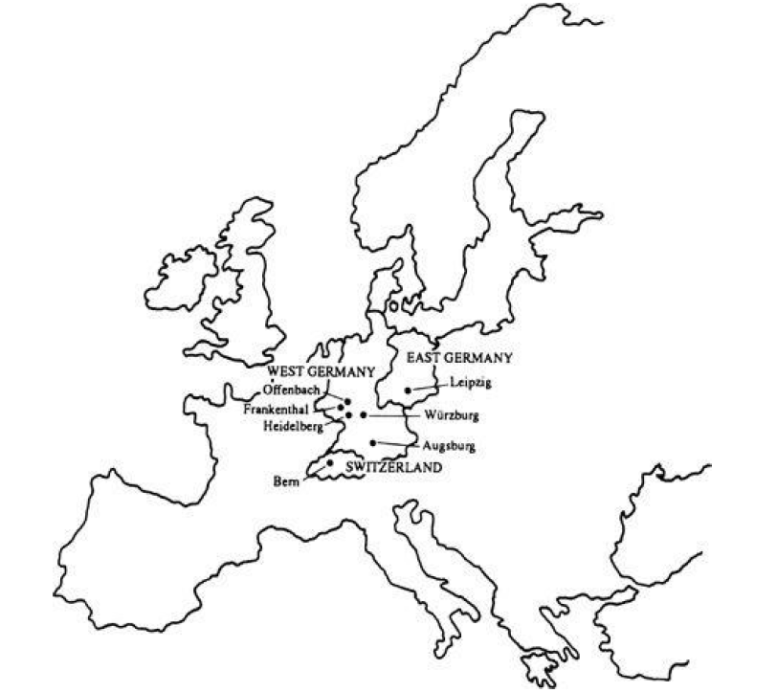
The emergence of domestic rivalry
By the 1930s, the six leading German printing press producers were Heidelberg, MAN, Roland, K&B, Albert-Frankenthal, and Planeta. They were all located in a radius of about 150 miles.

Slide 11
The strategies of German competitors
German printing press firms competed with differentiation strategies, based on high quality and reliability, high performance, and punctual delivery.
German presses often sold at premium prices compared with those from other nations.
The early entry and international focus of the German firms allowed them to create extensive worldwide service networks and to develop premier international reputations.

Slide 12
The strategies of German competitors
German printing press firms conducted research and development activities in Germany.
Most production took place in Germany, but both K&B and MAN had production facilities in the United States where they had assembled machines since the early 1980s.
K&B had an alliance with Sumitomo Heavy Industries of Japan because of the difficulty of penetrating the Japanese market independently. Other firms had similar arrangements.
Competition was based more on performance than price.

Slide 13
Specialized factor creation
German printing press firms all had active apprenticeship programs for workers and also provided training for newly hired engineers. Every major firm had founded its own vocational school many decades earlier to provide its workers with training specific to the printing machinery.
The printing press industry also drew from a ready supply of well-trained engineers.
German university training was strong in all technical fields, and programs in machinery engineering were uniquely well developed compared with those in other nations. Machinery engineers were recruited from such universities, all located in centers of machinery production.

Slide 14
Specialized factor creation
Direct research links were present between printing press firms and university institutes.
The German Printing Machines Research Association was founded in 1955 by a number of leading German printing press makers.
Its aims were to conduct basic research on the physical, chemical, and cybernetic processes in printing, to provide for trial arrangements for printing machinery, and to contribute to the training of engineers.
Wages and social benefit costs were higher and working hours were shorter than those in competitor nations.
Develop the highest-technology machines.

Slide 15
Sophisticated home demand
The German printing press market was not among the world’s largest; it was estimated to be sixth in size behind the United States, Japan, Britain, and several other nations.
What was more important than size was that the German home market for printing presses had long been one of the world’s most sophisticated.
Sophistication began with the ultimate consumer, the buyer of a newspaper, magazine, or book.
German buyers of printed matter were unusually quality conscious. For example, a German reader …

Slide 16
Sophisticated home demand
Also important was the sophistication of the printers themselves. Education for printers had a long tradition in Germany, and German printers were thought to be the world’s best trained.
German printers had their own research organization: FOGRA
collaborative projects with universities
It proved difficult for American firms to meet higher European standards, while German firms had a much easier time adapting to American standards.

Slide 17
The German printing cluster
The printing press industry had long-standing links with a number of other strong German industries besides printing.
Paper-making machinery.
strong paper producers.
Advancements in presses and printing ink
typesetting systems.

Slide 18
Shifting competitive positions
Wifag AG, based in Berne (Swiss) was the third-leading European producer of web-offset presses for newspaper printing. Wifag, located not far from the German border, was effectively part of the German cluster.
Two other printing press exporting nations, the United States and Britain, were steadily losing position.
Britain’s world export share fell from 9% in 1975 to 5.9% in 1985,
The United States was the second largest exporter of printing presses, holding 20% of the world printing press exports in 1975. By 1985, the U.S. share of world exports had sunk to 4%.

Slide 19
Shifting competitive positions
American-built machines were also said to suffer more breakdowns and to rank lower in quality than German or Swiss machines.
Japan was enjoying a growing position in the industry. Japanese home demand for offset printing was substantial because typing was impractical and thus all formal documents had to be printed.
By 1985, Japan had become the world’s second-largest printing press exporter. Its world export share increased to 19% from 3% in 1975.
Japanese firms concentrated on smaller sheet-fed offset machines.

Slide 20
Danger signals
Germany’s strong international packaging machinery industry had been drawn by evolving technology into the printing cluster.
Since the 1970s, the number of German competitors had decreased substantially through consolidation.
but consolidation in the German printing equipment industry had reached a point where price competition had all but disappeared and domestic rivalry was no longer assured. A more vigorous group of Japanese competitors represented a growing threat,

Slide 21
Summary
Story of competitive advantage sustained for more than 160 years.
The history shows how the international mobility of technology and skilled personnel is far from a new phenomenon.
The initial seed for the industry was planted by a German, Koenig, who became interested in presses because of his training and work as a printer.
To pursue his development, he was forced to go to England, the nation with the most favorable national “diamond” for the industry at that time.
Driven out of England by attempts by his buyers/investors to limit industry growth to protect their interests.

Slide 22
Summary
The particular location he chose was influenced by an early example of government efforts to attract investments.
A large group of German rivals emerged directly or indirectly out of the industry pioneer.
As demand for presses developed in Germany, the high standards and sophistication of German printers and end users spurred innovation, reinforced by pressures from selective factor disadvantages.
All the related and supporting industries essential to innovation (paper, paper machinery, ink, typesetting systems) grew up with the printing press industry and achieved world-class status in their own right.

Slide 23
Summary
The uniquely large group of domestic competitors, located in the southern part of Germany, were each others’ most important rivals.
The successful Swiss firm, Wifag, a part of the German cluster.
Firms from other nations did not challenge Germany because they lacked essential elements of the “diamond.”
America had poor demand quality and less domestic rivalry.
England had no base of competitors, and strong unionism froze innovation for many years among English printers, eroding demand quality.
Japan was a late entrant into the industry because of home demand that diverged sharply from most world demand.

Slide 24
Summary
Germany is the world leader, not only in printing presses but in printing, fine paper, paper machines, typesetting systems, printing inks, and packaging machinery.

Slide 25
The Italian Ceramic Tile Industry

Slide 26
Introduction
A $10 billion industry, in 1987,
30 % of world production,
60 % of world exports.
Concentrated in the Emilia-Romagna region, in and around the small town of Sassuolo.
Hundreds of firms were involved in the ceramic tile industry.
The area was also home to world-leading producers of glazes, enamels, and ceramic tile production equipment.
Superior mechanical and aesthetic qualities.
Yet Italy’s success had been as much, a function of production technology than design.

Slide 27
Products and processes
The main applications were in
flooring (60 to 65 percent of the total market) and
wall covering (35 to 40 percent)
Ceramic tiles competed with wood, vinyl tiles, marble, carpeting, and other building materials in various applications.

Slide 28
Early industry history
The ceramic tile industry in Sassuolo grew out of a related industry, earthenware and crockery, whose history in the area can be traced back to the thirteenth century.
The first ceramic tiles in the area were used as street signs, house numbers, and on cemetery vaults in the 19 century.
Immediately after World War II, there were only a handful of ceramic tile manufacturers in the Sassuolo area.
Demand for ceramic tiles within Italy grew dramatically in the early postwar years.
The reconstruction of Italy after the war created an unprecedented boom in building materials of all kinds, including ceramic tiles.

Slide 29
Early industry history
Italian demand for ceramic tiles was especially high.
The nation’s Mediterranean climate; ceramic tiles were cool in warm weather.
There was also a tradition in Italy of using natural stone materials rather than vinyl or carpeting.
Ceramic tiles fit closely with local taste. Wood was scarce and expensive in Italy, giving tiles a price/performance advantage over wood flooring.
Finally, Italian buildings were generally made of concrete, which made laying tiles relatively easy. Wood buildings sometimes could not take the weight of tiles and required extra base materials.

Slide 30
Early industry history
Sassuolo was in a relatively prosperous area of the country with many well-to-do farmers and well-paid workers from the machinery industries located nearby. Many local citizens were able to put together the modest amount of capital and organizational skills required to operate a tile company at the time.
A running joke was, “With four people you can play cards. With three you can start a tile company.”
New firms flooded into the business, many with the help of local banks.
In 1955, there were 14 tile firms in and around Sassuolo. By 1962, the number was 102.

Slide 31
Early industry history
Outside of Sassuolo, lack of information about the industry led to the emergence of few new competitors.
Assopiastrelle, the Italian ceramic tile industry association, was founded in 1964.
The tile industry benefited from a pool of mechanically trained workers. Emilia-Romagna, and Modena in particular, was home to Ferrari, Maserati, Lamborghini, and other firms with a long tradition of technical sophistication.

Slide 32
Foreign dependence
Italian firms were initially dependent on foreign sources of raw materials and production technology.
The principal raw materials used in making tiles in the 1950s were kaolin (white) clays.
There were no white clay deposits near Sassuolo, so Italian producers had to import white clays from the United Kingdom.
White clays, though much more expensive than more widely available (including around Sassuolo) red clays, were far easier to fire with the prevailing equipment.

Slide 33
Foreign dependence
In the 1950s and 1960s, the production equipment used by Italian tile producers was mostly imported.
Kilns came from Germany, the United States, and France;
presses for forming tiles came from Germany.
Even simple glazing machines had to be imported.
Some of the equipment used in the Italian industry was originally designed for the food industry and modified for use in tile production.
Italian firms developed their own technical know-how as their production experience accumulated. Information diffused rapidly through the Sassuolo area due to worker mobility and the proximity of the tile producers.

Slide 34
The emerging italian tile cluster
Italian tile producers learned how to modify imported equipment for use with locally available red clays and natural gas (as opposed to heavy oil).
By the mid-1960s, Italian tile firms were no longer dependent on foreign equipment producers.
By 1970, Italian firms had emerged as world-class producers of kilns and presses and had begun to export.
Whereas Sassuolo-area tile firms once used machinery optimized for white clays on red clays, now foreigners used Italian equipment optimized for red clays on their white clays.

Slide 35
The emerging italian tile cluster
The relationship between Italian tile and equipment manufacturers was a close one, because they were often located next door to each other.
In the mid-1980s, there were some 200 Italian equipment manufacturers; more than 60% were located in the Sassuolo area.
Italian equipment manufacturers competed fiercely for local business, and Italian tile manufacturers often received better equipment prices than foreign firms.
the latest equipment was often made available to Italian firms a year or so before it was made available to foreign firms.
Get rapid maintenance and service on their equipment.
information flow between suppliers and tile producers also favored Italian firms.

Slide 36
The emerging italian tile cluster
As the industry grew and concentrated around Sassuolo, a pool of specialized workers and technicians developed, including engineers, production specialists, maintenance workers, service technicians, and design personnel.
A Sassuolo manufacturer also had a whole array of knowledgeable specialists in the area on whom he could call to solve production or design problems.

Slide 37
Growing sophistication of Italian demand
By the mid-1960s, the Italian market for ceramic tiles became the single largest in the world.
In 1976, per capita consumption of ceramic tiles was 2.68 square meters in Italy, 1.26 in Spain, 1.06 in Germany, and 1.03 in France. At 3.33 square meters, Italian per capita consumption was still the highest in the world in 1987.
The Italian market was the most sophisticated tile market in the world. Italian customers were generally the first to adopt new designs and features.
The quality of Italian demand rose, therefore it was a pressures to improve manufacturing methods and design that further boosted consumption and market sophistication. In the United Kingdom, in contrast, producers tended to make the same styles and patterns each year, and demand was relatively unsophisticated and stagnant.

Slide 38
Growing sophistication of Italian demand
The uniquely sophisticated and demanding character of Italian home demand extended to retail outlets.
In the formative period of the Italian industry, ceramic tiles were sold like bricks in Italy through building material distributors.
In response to strong demand in the 1960s, specialized tile showrooms began to open in Italy.
By 1985, there were some 7,600 specialized showrooms in Italy that handled approximately 80% of sales in the Italian market.

Slide 39
Sassuolo rivalry
Intensive competition:
To gain an edge on the others in technology, design, and distribution.
News of product and process innovations spread rapidly.
Innovations were usually known in days or weeks and copied in a few months.
Competition among Italian tile producers was intensely personal.
located close together.
Be family
committed to their businesses and the community
knew each other
citizens of the same towns.

Slide 40
Sassuolo rivalry
In 1976, a consortium of the University of Bologna, regional agencies, and various ceramic industry associations founded the Centro ceramico di Bologna. Its functions included research on ceramic raw materials, production processes, and chemical and mechanical analyses of finished products.

Slide 41
Pressures to upgrade advantage
By the early 1970s, Italian tile firms were struggling to reduce labor and gas costs in the face of intense domestic rivalry and pressure from retail customers.
A typical cost structure for a ceramic tile producer was:
raw materials, 35 to 40% of sales
fuel (principally natural gas), 10 to 15%
labor costs, 20 to 30%
depreciation of fixed assets, 15%
Tile manufacture was capital intensive, requiring about 65 cents in assets for each dollar in sales.

Slide 42
Pressures to upgrade advantage
Continued rivalry led to a breakthrough in 1972–1973 with the introduction of the rapid single-firing process by Marazzi.
Roller technology, resulted in a substantial decrease in energy utilization and allowed for the full exploitation of the single-firing technology.
Rapid single-firing greatly reduced natural gas costs and improved productivity.
double-firing method: 225 employees, single-firing 90.
The cycle time dropped from 16-20 hours to 50-55 minutes.
By the early 1980s, exports of Italian equipment manufacturers exceeded their sales to Italian tile companies. Exports represented 75 to 80% of total sales in 1988.

Slide 43
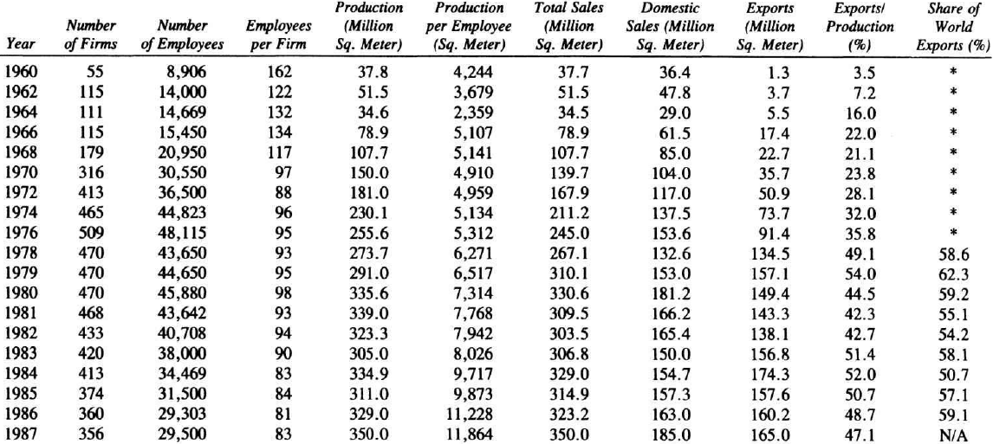
Internationalization

Slide 44
Internationalization
The ceramic tile industry received help in export promotion from ICE, a government agency set up to facilitate trade between Italy and the rest of the world.
A key push in the mid-1980s was an attempt to achieve higher penetration of untapped markets like the United States. Italian producers had to overcome a 19% import duty plus significant transportation costs in order to export to the United States. A few Italian producers moved to offset these disadvantages through direct investment in the United States. For example, Marazzi U.S.A. was founded in 1982 with production facilities in Texas.
The move to greater exports was facilitated by the presence of related and supporting Italian industries.
CERSAIE: exhibition held annually in Bologna: the most important industry event in the world.

Slide 45
Continued innovation
work rules facing Italian manufacturers created strong, and highly visible, pressures to automate the production process.
introduction of designer tiles by Piemme in 1976 (another related Italian industry). By 1987, designer tiles accounted for some 10% of Italian tile sales.
third-firing.

Slide 46
The Italian industry in the 1980s
In 1987, sales of Italian ceramic tile producers amounted to $3.2 billion.
some 47% of which was exported.
58.6% of total production was single-fired tiles,
28.0% was double-fired tiles, and
13.4% was other types of tiles (gres, cotto, etc.).
In 1987, there were 356 Italian companies.

Slide 47
The Italian industry in the 1980s
There were three major groups of Italian firms.
65 Firms (such as Marazzi) were investing heavily in technology to improve productivity or product quality and aesthetics; tended to be larger and more export oriented than average.
A small group of firms (including Piemme) attempted to compete on image and design. These firms advertised heavily and invested substantial amounts in showroom expositions.
A third group included a large number of smaller firms, who competed largely on price. They tended to rapidly imitate successful technological improvements and were also quick to imitate new designs, especially those of the expensive designer tiles.
Cassa integrazione, a program in which the Italian government paid employees dismissed by their companies. Italy did not have a formal unemployment insurance program. USA: unfair subsidy.

Slide 48
The Italian competitive position
Sustained innovation allowed Italian firms to hold and even increase market position in the 1980s.
Spain was the world’s second-largest exporter of ceramic tiles, with a world export share of 11 percent in 1986.
The Spanish market for ceramic tiles was the third largest in the world in volume and the second largest in terms of value.
Increased advertising on television and in magazines that stimulated local demand.
A major constraint facing the Spanish industry was the unavailability of natural gas as an energy source until 1980.
Better-quality clays allowed Spanish firms to be very competitive in the production of large-size tiles, due to fewer production defects and to shorter firing times.

Slide 49
The Italian competitive position
Approximately 90% of Spanish production was concentrated in the Castellan Plain, in the northeastern part of Spain north of Valencia.
The ten largest Spanish companies in the industry accounted for some 40 percent of production, and some of these companies had common shareholders.
Spain had a number of elements of the “diamond” for ceramic tiles, notably demand conditions and some factor advantages, but lacked the base of related and supporting industries and rivalry as intense as in Italy. Its threat to the Italian industry was not yet imminent.
Other competitors: Germany, Brazil and after 1985: Thailand and Korea (that employed Italian equipment).

Slide 50
Summary
Initial growth of the ceramic industry in the Sassuolo area.
A tradition in a closely related industry led to initial interest in the industry.
Unusually high per capita consumption.
A number of factors of production (capital, skilled and unskilled labor) were locally available.
An imitation effect led to a flood of entries.
Vigorous domestic rivalry.
Tile making equipment industry that became the world leader.
The geographic concentration both of firms and suppliers.
Distinctive Italian circumstances made home demand the largest and most sophisticated in the world.

Slide 51
Summary
Powerful and knowledgeable retailers added to the pressure to innovate.
Retail showrooms, linking tiles with other dynamic Italian industries such as furniture, fixtures, and kitchen appliances, led to further innovation.
Intense rivalry powered continuous and important innovation in the industry.
As Italian demand hit a cyclical trough in the early 1960s and leveled off around 1970, Italian ceramic tile producers looked to export markets.
The strength of Italian related and supporting industries (design services, other furnishing-related industries, and related media) led to further innovation as well as advantages in international marketing.

Slide 52
Summary
Many of the advantages which brought about the initial success of the Italian industry were not sustainable.
A tradition of producing ceramic products was not a lasting advantage in the capital intensive, technology-intensive industry that tile production became.
Clay deposits were widely available either from local sources or through trade.
Italy imported most of its natural gas.
Even Italian-developed production technology became widely disseminated by equipment manufacturers and through specialized consultants and trade journals.
Sassuolo’s sustainable competitive advantage in ceramic tiles grew not from any static or historical advantage but from dynamism and change.

Slide 53
Summary
The Sassuolo tile industry represents a system in which each determinant of national competitive advantage is present and self-reinforcing.
The complex interactions among the determinants, taking place in the midst of the world’s largest and most sophisticated tile market, gave Sassuolo area firms unique advantages over their foreign competitors.
Foreign firms must compete not with a single firm, or even a group of firms, but with an entire subculture.
The organic nature of this system is the hardest to duplicate and therefore the most sustainable advantage of Sassuolo firms.

