Slide 3
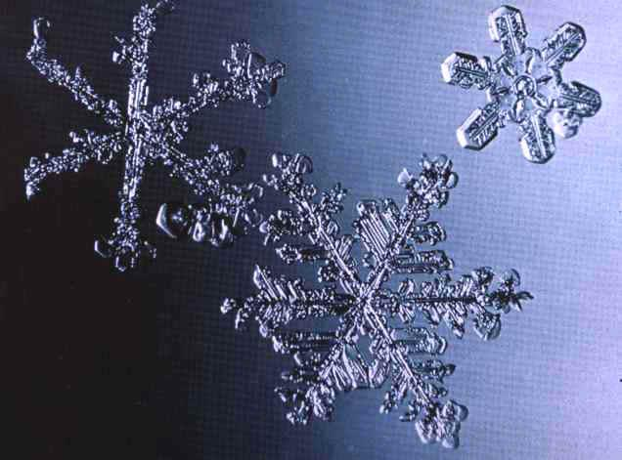
Crystals shape our world
Crystals —familiar to all in gemstones, glittering snowflakes or grains of salt— are everywhere in nature. Throughout history, people have been fascinated by their beauty and mystery. Two thousand years ago, the process of crystallizing sugar and salt was already known to the ancient
Indian and Chinese civilizations.

Slide 4
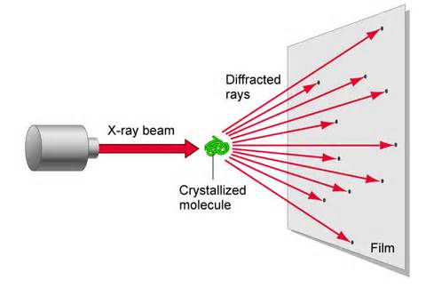
In the early 20th century, it was discovered that X-rays could be used to ‘see’ the structure of matter in a non-intrusive manner, thus beginning the dawn of modern crystallography —the science that examines the arrangement of atoms in solids. X-ray crystallography has allowed us to study the chemical bonds which draw one atom to another.

Slide 5
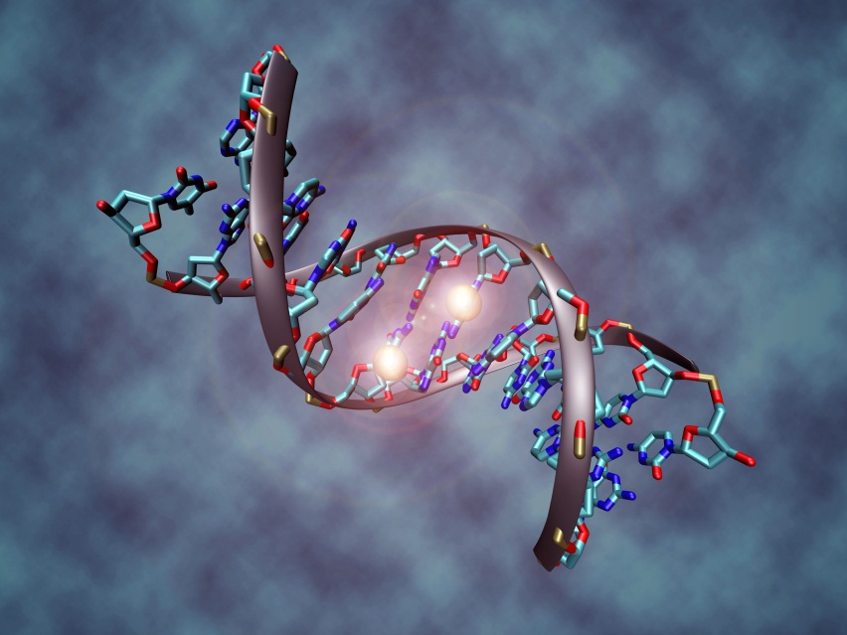
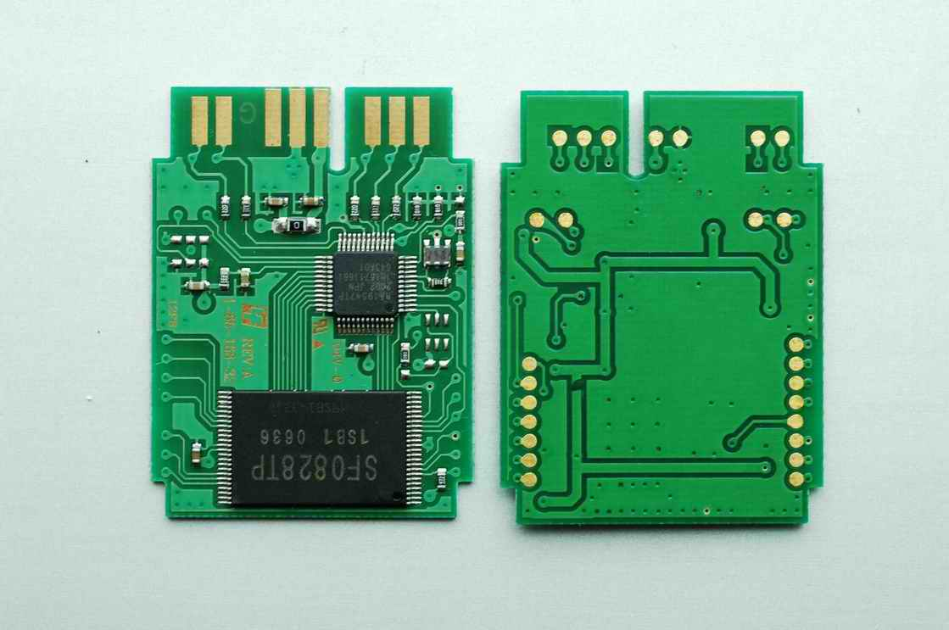
Crystallographers now apply this knowledge to modify a structure and thus change its properties and behavior. Since this discovery, crystallography has become the very core of structural science, revealing the structure of DNA, allowing us to understand and fabricate computer memories, and helping scientists to design powerful new materials and drugs.

Slide 6
Although crystallography underpins all of the sciences today, it remains relatively unknown to the general public. That is one of the reasons why the United Nations General Assembly (UNGA) proclaimed 2014 as the International Year of Crystallography (IYCr2014)*, and requested UNESCO to lead and coordinate, with the International Union of Crystallography (IUCr), the planning and implementation of educational and capacity-building activities during the Year.

Slide 7
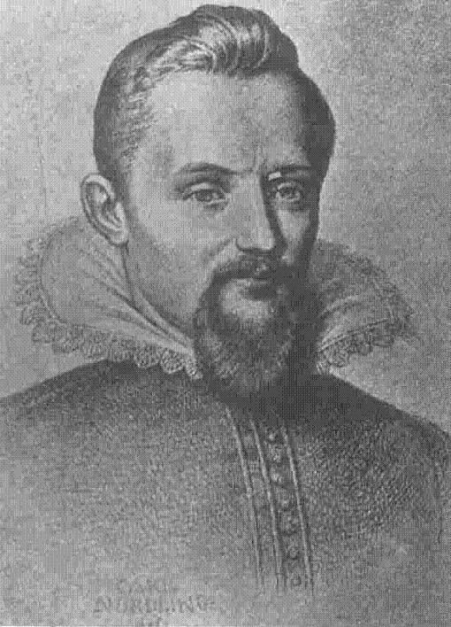
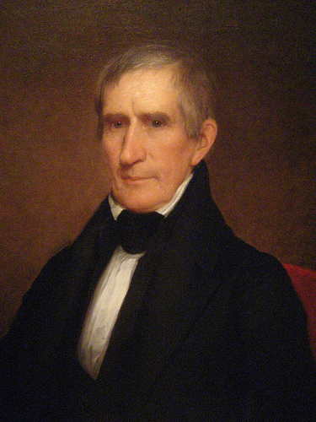
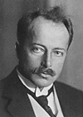
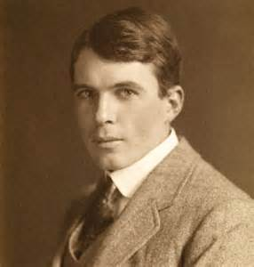
2014 marks the centennial of the birth of X-ray crystallography, thanks to the work of William Henry, William Lawrence Bragg (father and son) and Max von Laue —the later was awarded the 1914 Nobel Prize in Physics for his discovery of the diffraction of X-rays by crystals.
A century later, the International Year of Crystallography 2014 highlights the continuing importance of crystallography

Slide 8
Main objectives
Increasing public awareness of the science of crystallography and how it underpins most technological developments in our modern society
Inspiring young people through public exhibitions, conferences and hands-on demonstrations in schools
Supporting the Africa Initiative on Crystallography and creating similar programmes in Asia and Latin America Promoting education and research in crystallography and its links to other sciences
Promoting education and research in crystallography and its links to other sciences
Involving the large synchrotron and neutron radiation facilities worldwide in the celebrations of IYCr2014, including the SESAME project set up under UNESCO auspices
…

Slide 9
Main activities
Organizing hands-on Crystallography Open Laboratories
Encouraging the organization of Crystal Growth competitions worldwide
Fostering the organization of Crystallography Exhibitions
Launching an open-access crystallography journal
Providing all levels of students, from pre-school to university, with crystallography demonstrations at appropriate levels
Sponsoring poster exhibitions highlighting the usefulness and wonders of crystallography
Organizing problem-solving projects through which students can use their knowledge of crystallography, physics and chemistry
Organizing crystal-growing competitions
…

Slide 10
Key events
Opening Ceremony of the IYCr204, UNESCO Headquarters, 20-21 January 2014
Open Laboratories in Crystallography, in Africa, Asia and Latin America, during the Year
Asian Summit Meeting on Crystallography, Karachi, Pakistan, 28-30 April 2014
Latin America and Caribbean Summit Meeting on Crystallography, Campina, Brazil, September 2014
African Summit Meeting on Crystallography, Bloemfontein, South Africa, 15-17 October 2014.

Slide 11
By:
F. Najjarnia
Leader Teacher:
Dr. Ali Reza Kiani-Rashid

