Slide 1
Media
Grade 9 lesson 5
1398
By Kuchakzadeh
More at t.me/kuchakzadeh or prospectpowerpoints.blog.ir

Slide 2
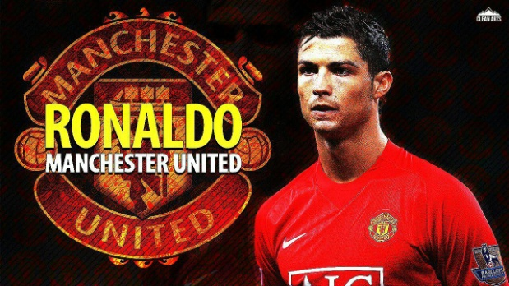
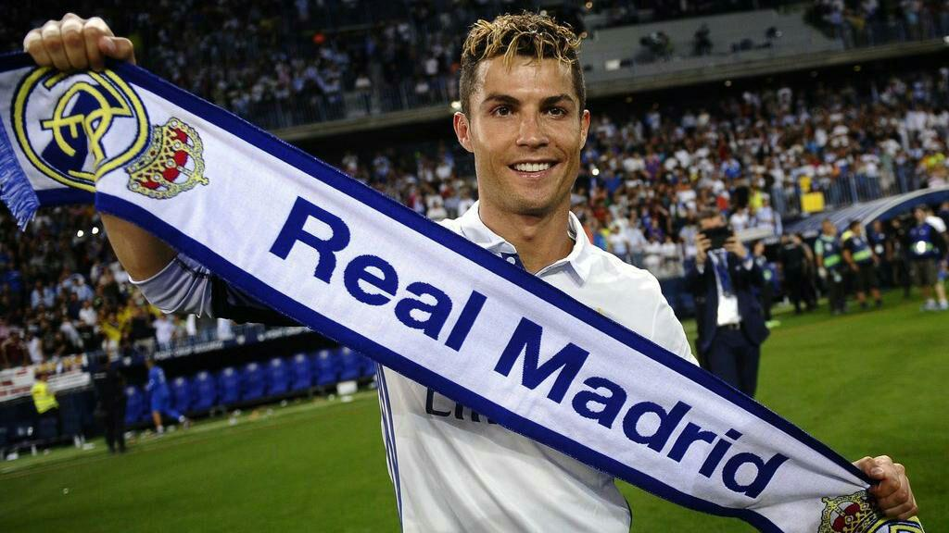
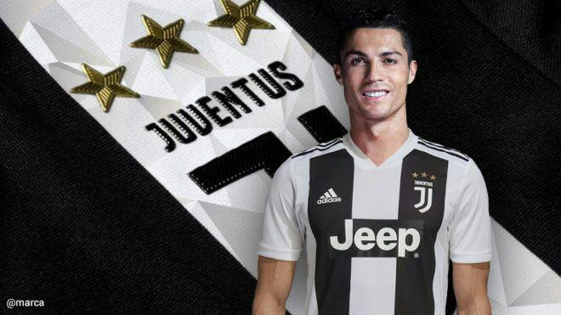
2003–2009
2009–2018
2020
Where does Ronaldo play in 2020?
He plays for Juventus.
Where did Ronaldo play in 2010?
He played for Real Madrid.
Where did Ronaldo play in 2004?
He played for Man Utd.

Slide 3
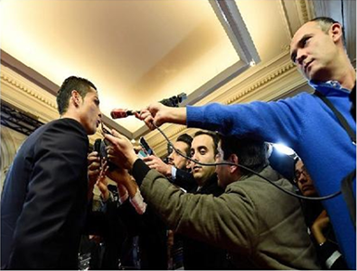
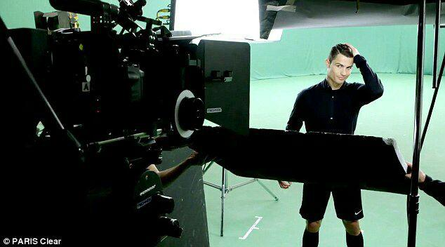
last week
yesterday
Did the journalists interview with Ronaldo last week?
No, they didn’t.
What did he do last week?
He attended a TV show.

Slide 4
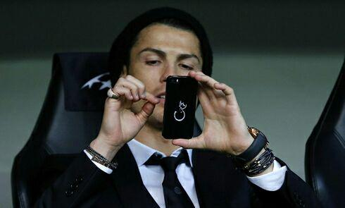
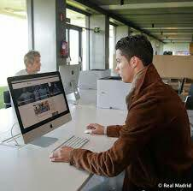
An hour ago
2 hours ago
Did he text a message 2 hours ago?
No, he didn’t.
What did he do 2 hours ago?
He surfed the internet.

Slide 5
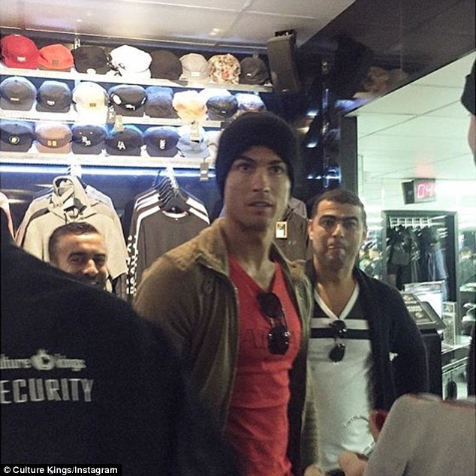
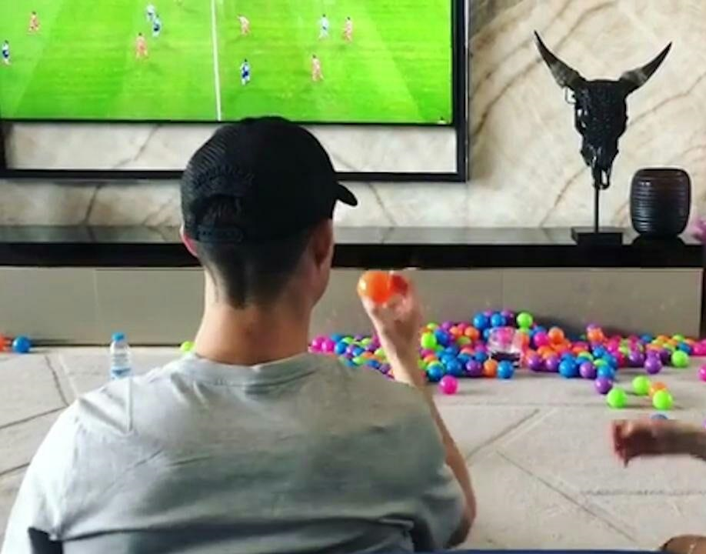
today
Last night
Was he at a shop last night?
No, he wasn’t.
Where was he last night?
He was at home.

Slide 6
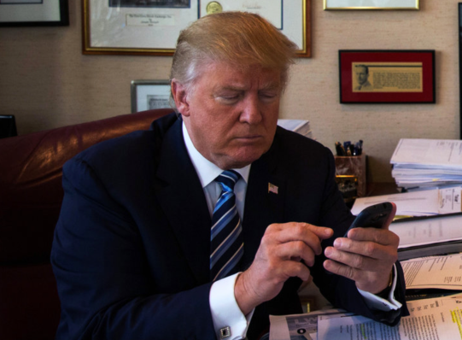
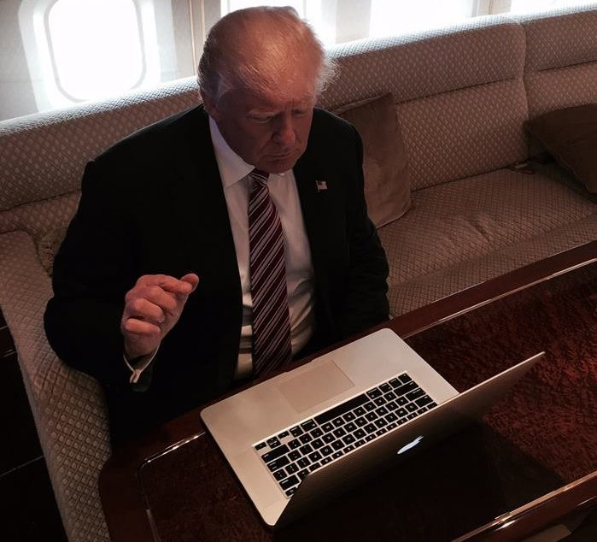
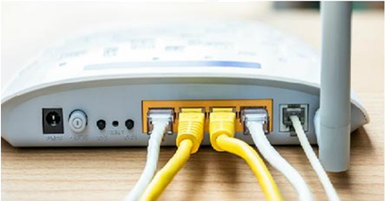
now
8 o’clock
Did he connect to the internet by his mobile at 8?
No, he didn’t.
How did he receive his emails at 8?
He connected by a laptop.

Slide 7
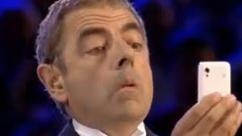
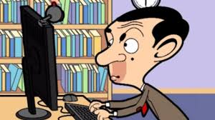
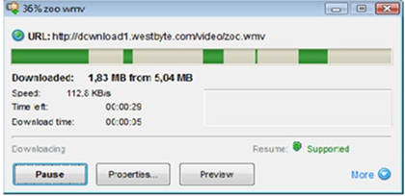
Last month
Last year
Did he participate in an online course last year?
No, he didn’t.
What did he do last year?
He downloaded a movie by his mobile.

Slide 8
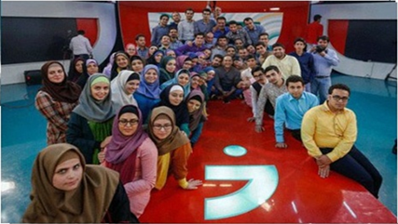
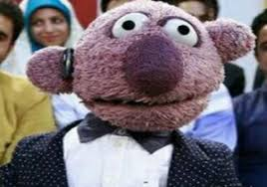
Was Jenab Khan in this quiz show?
No, he wasn’t.
How many people were there in the quiz show?
There were many.

Slide 9
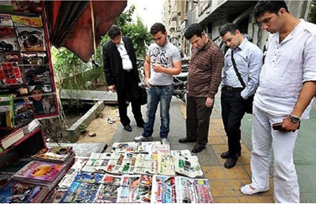
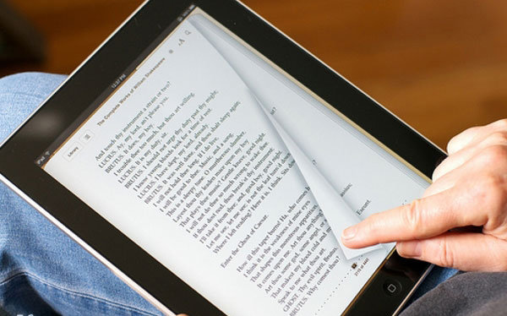
30 years ago
now
Do they look at the newsstands on the streets now?
No, they don’t.
How did they choose newspapers and magazines 30 years ago?
They looked at the newsstands on the streets.

Slide 10
Role Plays

Slide 11
Did you do this?
Who did this?/Who did you do this?
Where did you do this?/Where were you?
When did you do this?/When were you there?
Why did you do this?/Why were you there?
How did you do this?/How were you?
What did you do?

Slide 12
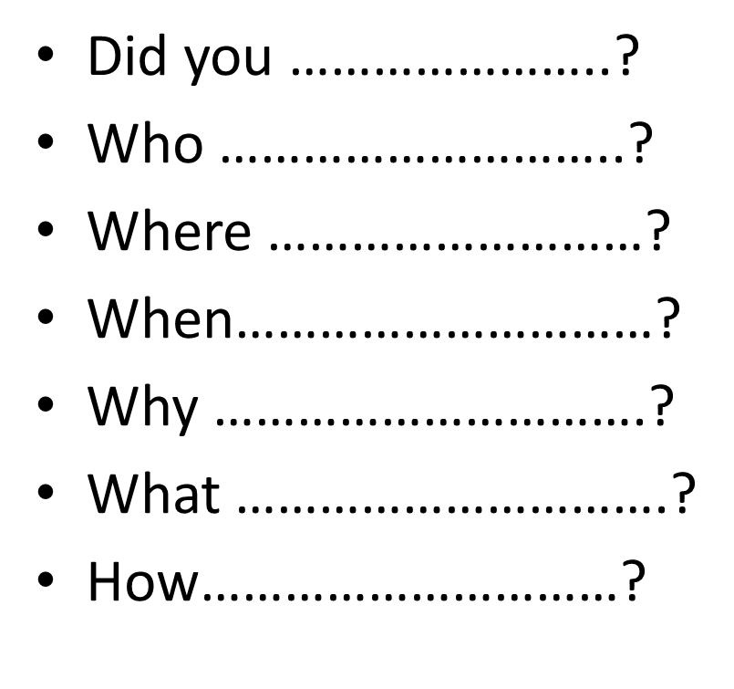
2009–2018
2020
2003–2009
yesterday
last week
2 hours ago
An hour ago

Slide 13
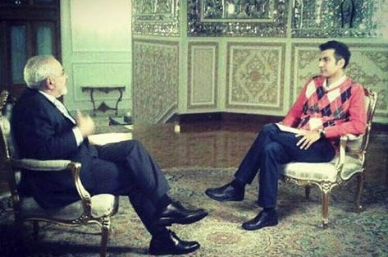
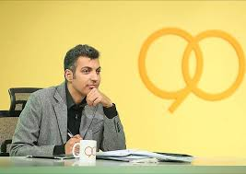
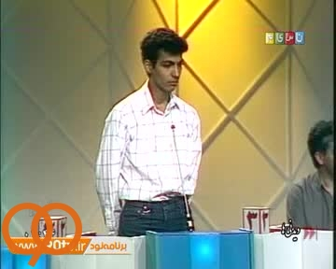
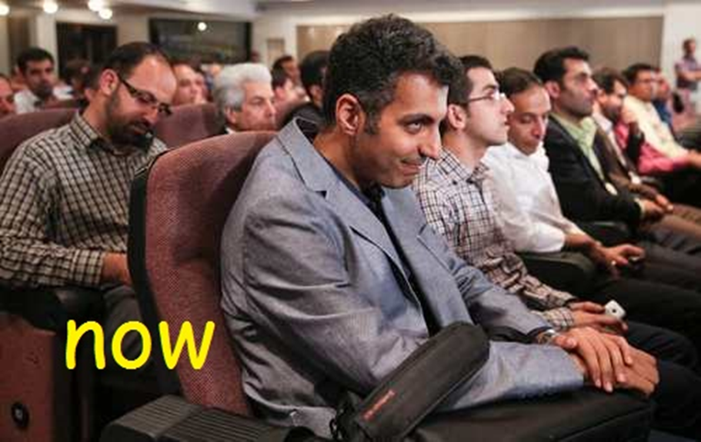
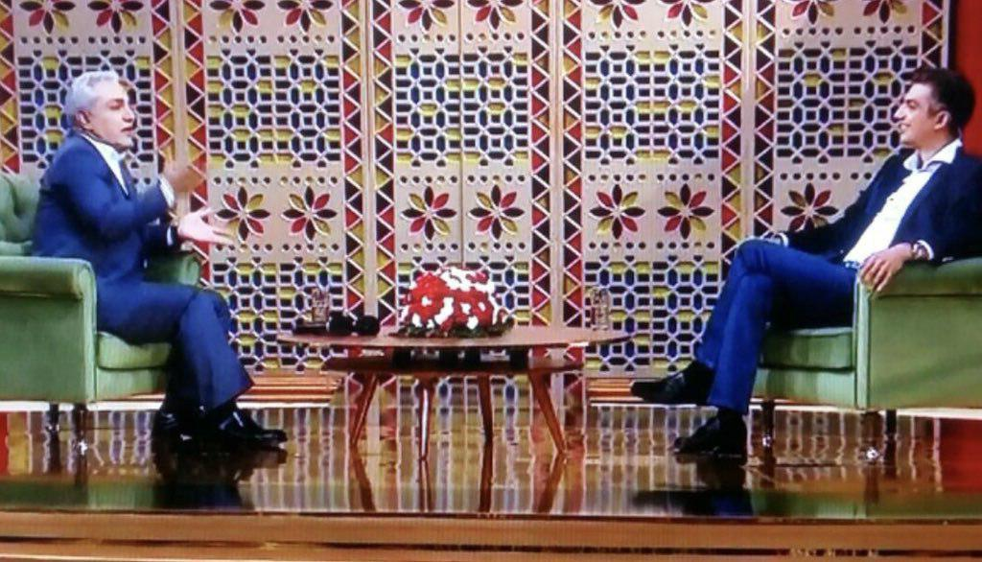
Four years ago
two years ago
20 years ago
3 years ago

Slide 14
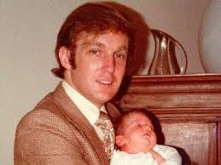
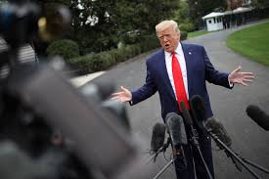
now
Every Sunday
30 years ago
Last weekend

Slide 15
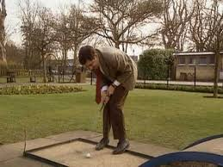
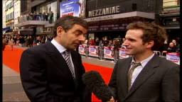
Every day
now
10 years ago
yesterday

Slide 16
Monolog

Slide 17
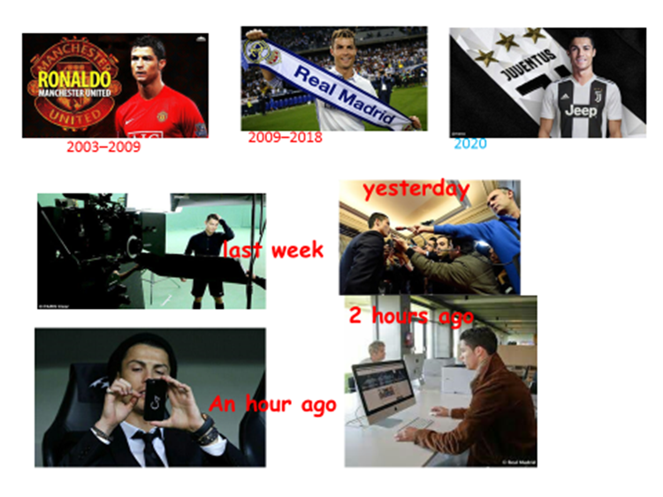
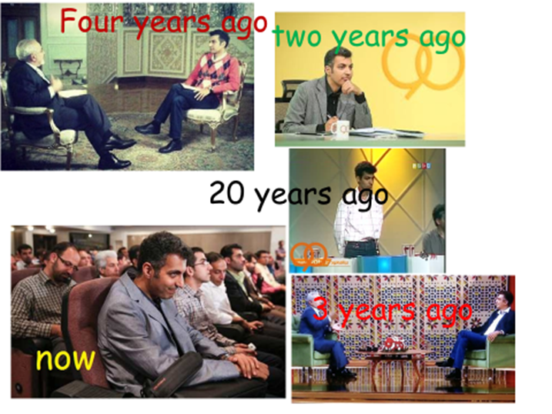
Say about these people

Slide 18
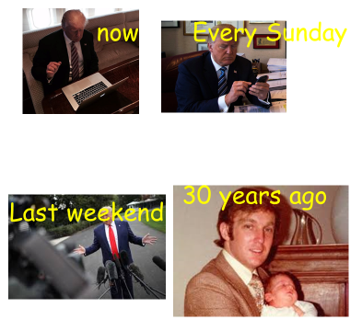
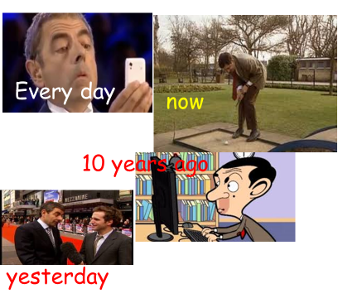
Say about these people

Slide 19
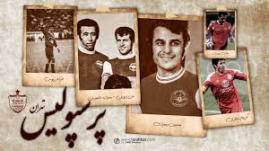
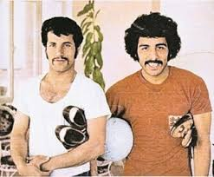
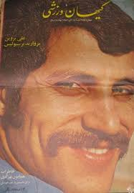
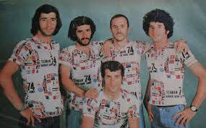
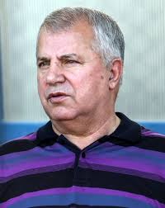
Hello, my name is Ali Parvin. People call me “Soltan”. When I was young, I played for Perpolis team. Yes, my love was, is and will be Perspolis. Those old days, there were no computers, no internet and no mobile. All the week we waited for “Keyhan Varzeshi” to see our photos. I was a handsome player and of course I played football very well. All the journalists wanted to interview with me. I was famous. Now, I am famous too, because a lot of Iranians love me. I love them too!

Slide 20
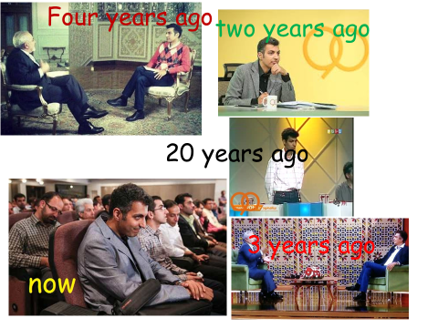
Complete
Cristiano Ronaldo is a Portuguese footballer. He played for Manchester United in 2003. in 2009 he played for Real Madrid and now he is playing for Juventus. Last week, he attended a TV show. He interviewed with journalists yesterday. He surfed the internet by a computer 2 hours ago and he texted a message by his mobile an hour ago.
……………………………………………………………………………………………………………………………………………………………………………………………………………………………………………………………………………………………………………………………………………………………………………………………………………………………………………………………………………………………………………………………………………………………………………………………………..

Slide 21
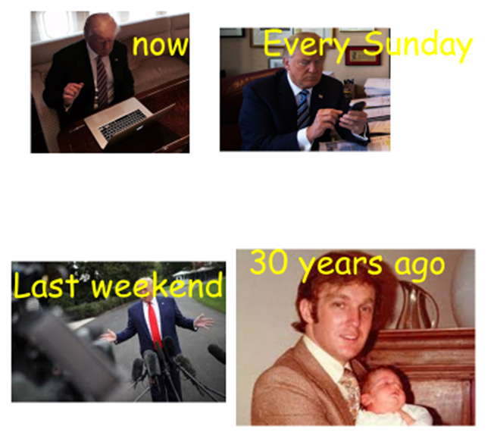
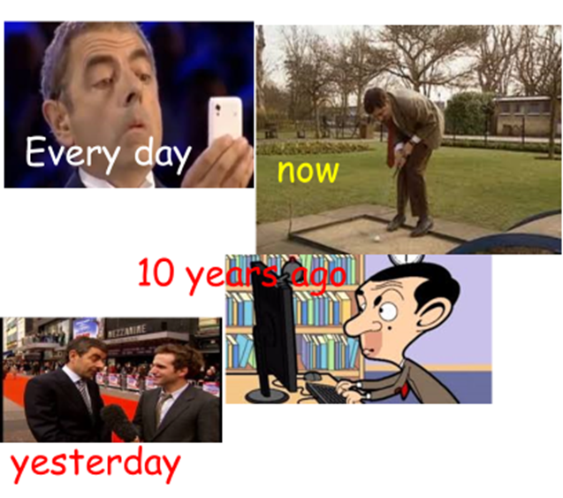

Slide 22
Write about somebody’s life
………………………………………………………………………………………………………………………………………………………………………………………………………………………………………………………………………………………………………………………………………………………………………………………………………………………………………………………………………………………………………………………………………………………………………………………..

