Slide 1
بلورشناسي
ساختارهاي کريستالي، فشردگي
Crystal Structures, Close Packing
عليرضا کياني رشيد
دانشکده مهندسي – دانشگاه فردوسي مشهد
زمستان 1386

Slide 3
Objectives
By the end of this section you should:
understand the concept of close packing
know the difference between hexagonal and cubic close packing
know the different types of interstitial sites in a close packed structure
recognise and demonstrate that cubic close packing is equivalent to a face centred cubic unit cell

Slide 4
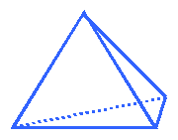
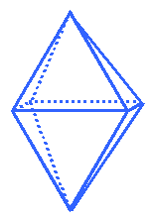
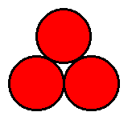
(Inorganic) Crystal Structures
All crystal structures may be described in terms of the unit cell and atomic coordinates of the contents
Many inorganic structures may be described as arrays of space filling polyhedra - tetrahedra, octahedra, etc.
Many structures - ionic, metallic, covalent - may be described as close packed structures

Slide 5
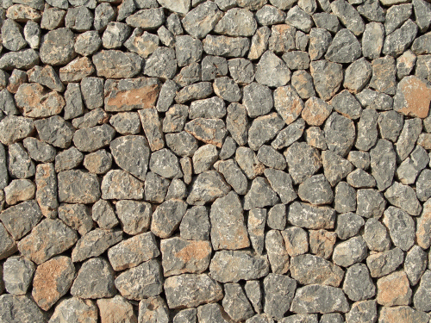
Packing
Can pack with irregular shapes

Slide 6
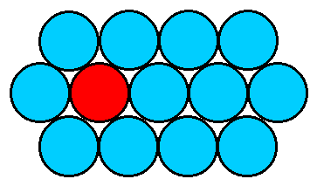
Close packed structures - metals
Most efficient way of packing equal sized spheres.
In 2D, have close packed layers
Coordination number (CN) = 6. This is the maximum possible for 2D packing.
Can stack close packed (c.p.) to give 3D structures.

Slide 7
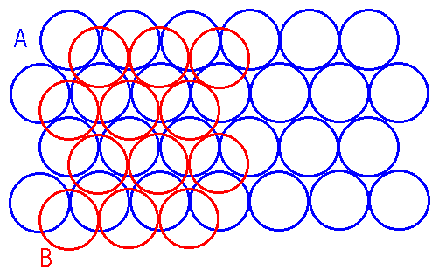
Two main stacking sequences:
If we start with one cp layer, two possible ways of adding a second layer (can have one or other, but not a mixture) :

Slide 8
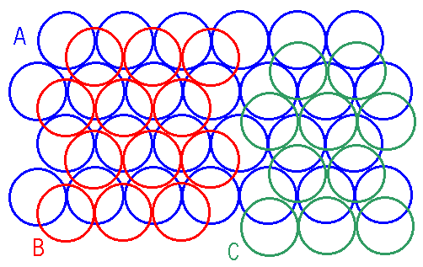
Two main stacking sequences:
If we start with one cp layer, two possible ways of adding a second layer (can have one or other, but not a mixture) :

Slide 9
Let’s assume the second layer is B (red). What about the third layer?
Two possibilities:
(1) Can have A position again (blue). This leads to the regular sequence …ABABABA…..
Hexagonal close packing (hcp)
(2) Can have layer in C position, followed by the same repeat, to give …ABCABCABC…
Cubic close packing (ccp)

Slide 10
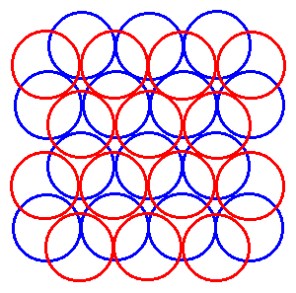
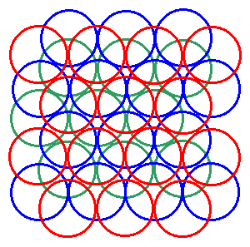
Hexagonal close packed
Cubic close packed

Slide 11
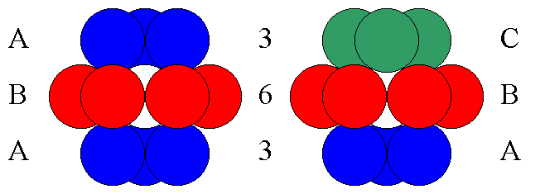
No matter what type of packing, the coordination number of each equal size sphere is always 12
We will see that other coordination numbers are possible for non-equal size spheres

Slide 12
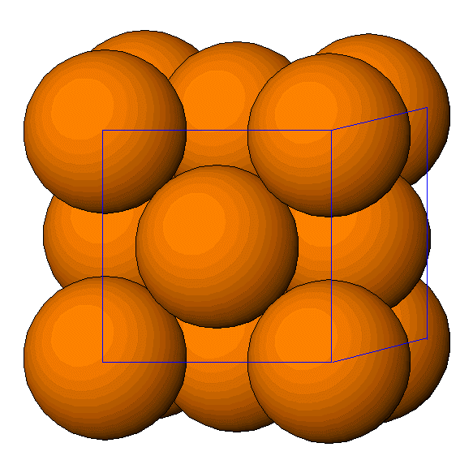
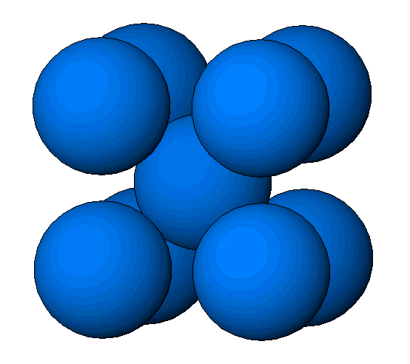
Metals usually have one of three structure types:
ccp (=fcc, see next slide),
hcp or
bcc (body centred cubic)
The reasons why a particular metal prefers a particular structure are still not well understood

Slide 13
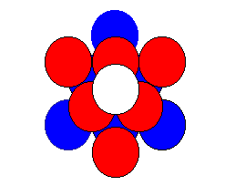
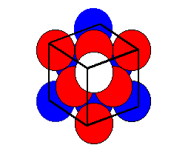
ccp = fcc ?
Build up ccp layers (ABC… packing)
Add construction lines - can see fcc unit cell
c.p layers are oriented perpendicular to the body diagonal of the cube

Slide 14
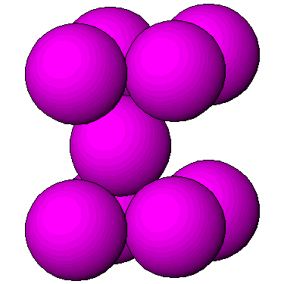
Hexagonal close packed structures (hcp)
hcp
≠
bcc

Slide 15
Close packed ionic structures
Ionic structures - cations (+ve) and anions (-ve)
In many ionic structures, the anions, which are larger than the cations, form a c.p. array and the cations occupy interstitial holes within this anion array.
Two main types of interstitial site:
TETRAHEDRAL : CN = 4
OCTAHEDRAL : CN = 6

Slide 16
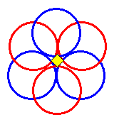
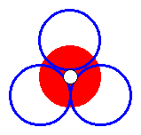
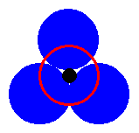
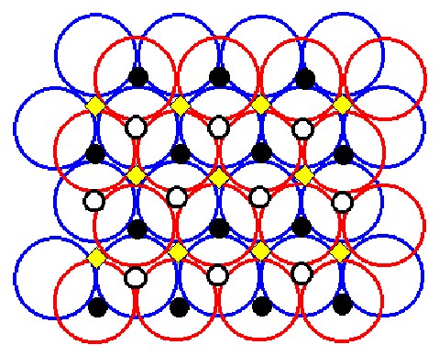
Tetrahedral T₊
Octahedral O
Tetrahedral T₋

Slide 17
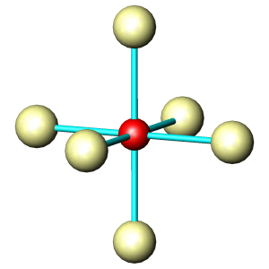
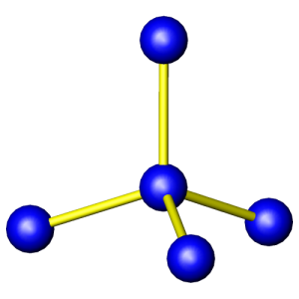
Ball & Stick view of polyhedra
90°
109.5°
Ideal: Positions of maximum repulsion!

Slide 18
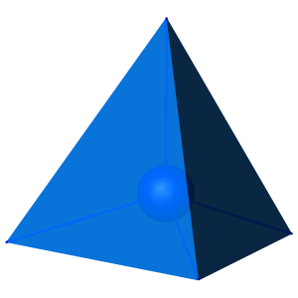
Solid view of polyhedra
Useful to describe: corner-sharing, edge-sharing, face-sharing polyhedra

Slide 19
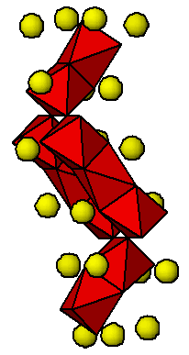
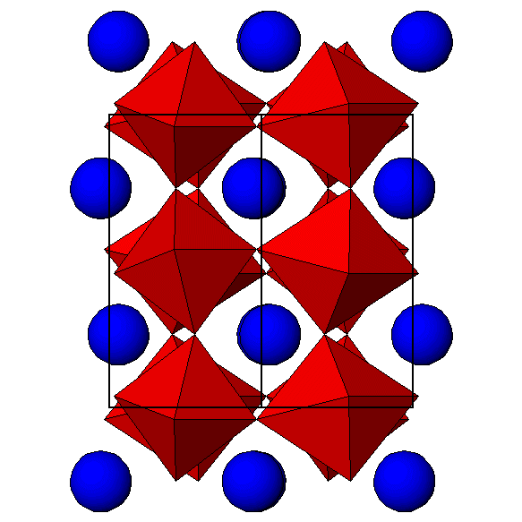
Description
Corner-sharing octahedra form a 3-d framework
Tilted from the vertical
Groups of 3 edge-sharing octahedra
These groups corner- share

Slide 20
Summary
Close packing occurs in a variety of metals
We can envisage layers, positions denoted by A, B and C, so that hexagonal close packing is represented by ABABA… and cubic close packing is represented by ABCABCA…
ccp is equivalent to face-centred cubic
Small ions can occupy interstitial sites in a close packed structure - both tetrahedral (4) and octahedral (6) sites exist
These concepts are useful for description - and...

Slide 21
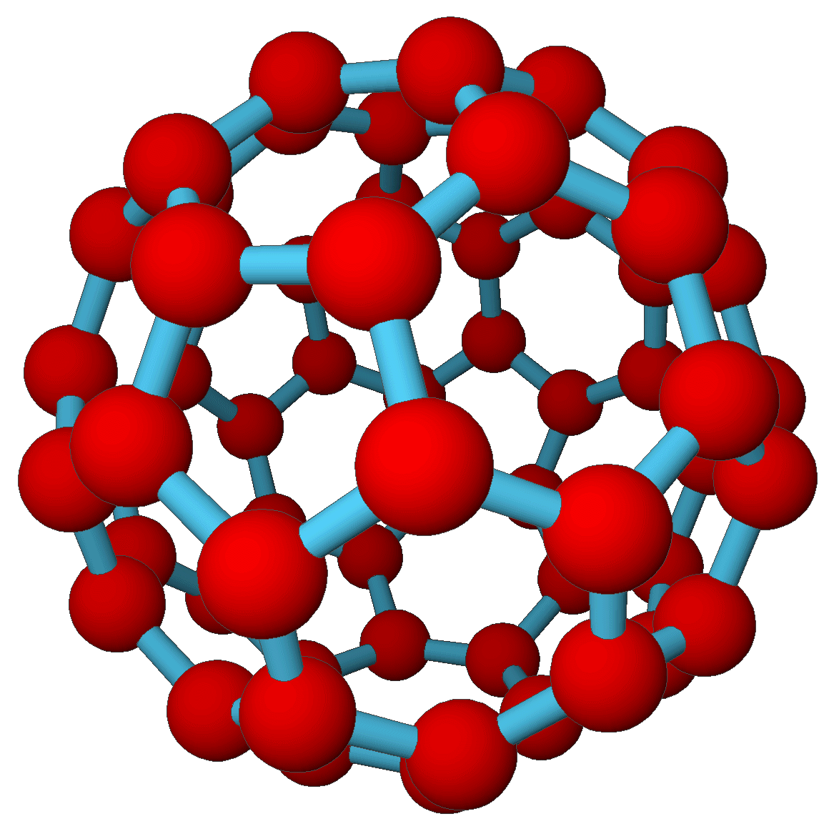
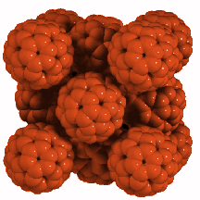
Recurring themes...
C₆₀
Face centred cubic

Slide 22
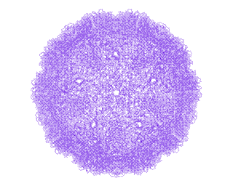
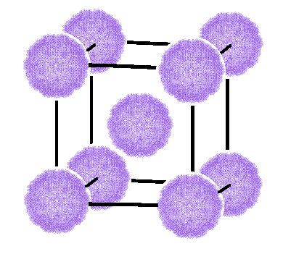
Recurring themes...
Foot and mouth virus
Body centred cubic

