Slide 1
HOW TO TEACH GRAMMAR
MAHABAD ENGLISH LANGUAGE TEACHERS
WORKSHOP
11/05/2018
Awat Shokouhi

Slide 2
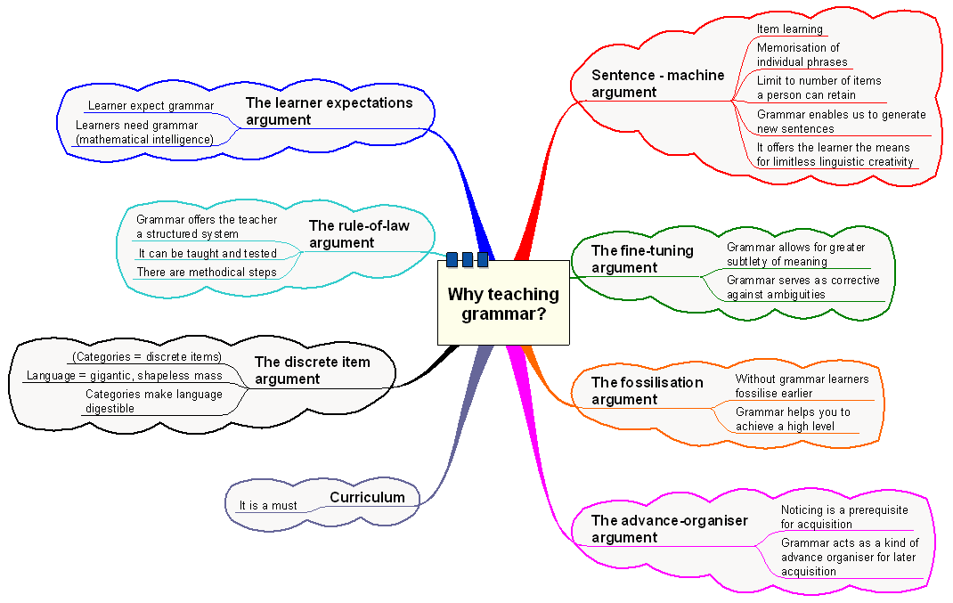

Slide 3
1. The deductive approach – rule-driven learning 2. The inductive approach – the rule-discovery path 3. The functional- notional approach 4. Teaching grammar in situational contexts 5. Teaching grammar through texts
APPROACHES

Slide 4
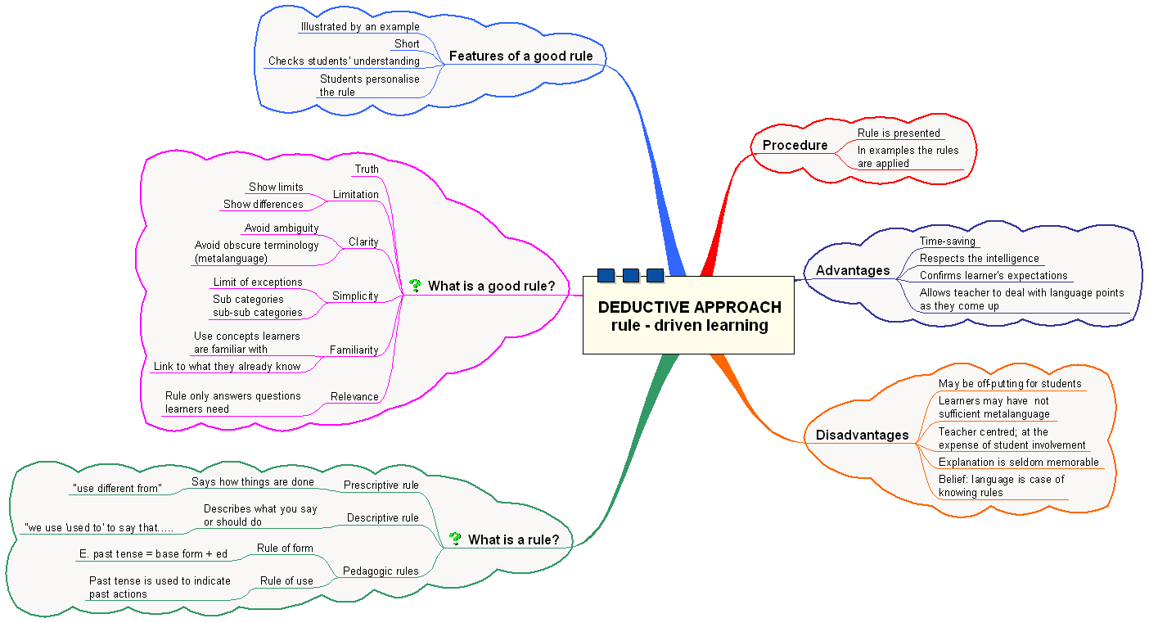

Slide 5
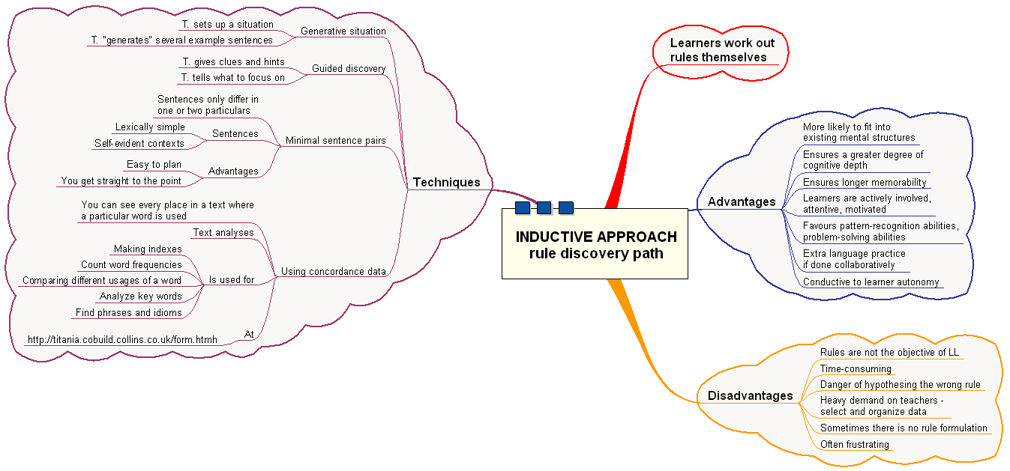

Slide 6
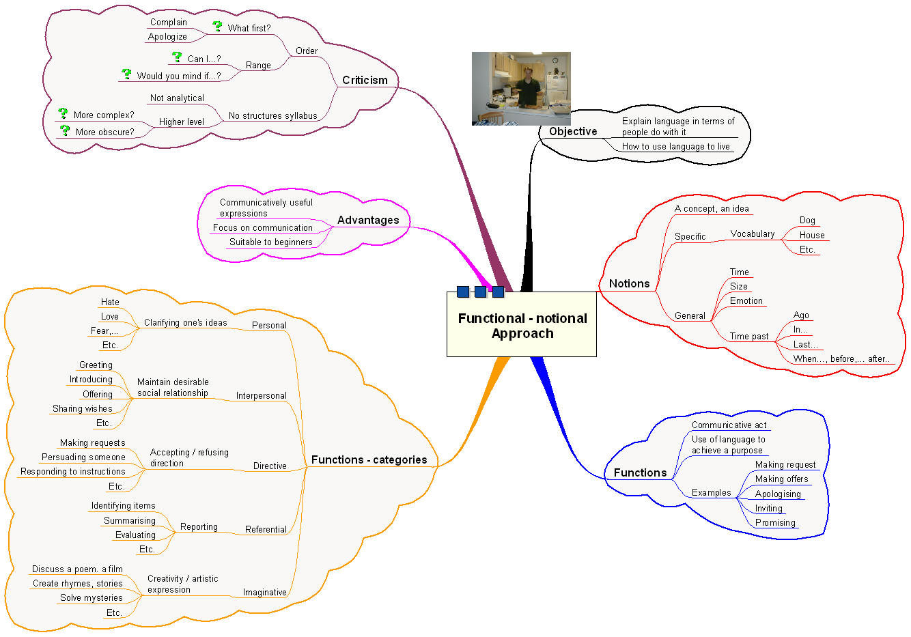

Slide 8
If learners are to achieve a functional command of a second language, they will need to be able to understand and produce not just isolated sentences, but whole texts in that language. A compromise position is to take authentic texts, and to simplify them in ways which retain their genuine flavour. This is the approach generally adopted by coursebook writers nowadays. Another alternative is to write classroom texts, but to make them more engaging.
Teaching grammar through texts

Slide 9
Advantages of using texts: 1. They provide co-textual information, allowing learners to deduce the meaning of unfamiliar grammatical items from the co-text. 2. If the texts are authentic they can show how the item is used in real communication. 3. As well as grammar input, texts provide vocabulary input, skills practice, and exposure to features of text organisation. 4. Their use in the classroom is good preparation for independent study. 5. If the texts come from the students themselves, they may be more engaging and their language features therefore more memorable. Disadvantages 1. The difficulty of the text, especially an authentic one, may mean that some of the above advantages are lost. 2. The alternative - to use simplified texts - may give a misleading impression as to how the language item is naturally used, again defeating the purpose of using texts. 3. Not all texts will be of equal interest to students. 4. Students who want quick answers to simple questions may consider the use of texts to be the 'scenic route' to language awareness, and would prefer a quicker, more direct route instead.

Slide 10
8 Do's for Effective Grammar Instruction 1. Use authentic writing situations every day. 2. Make learning visible with anchor charts and student work around grammar concepts. 3. Provide students with multiple exposures to a variety of grammatical situations. 4. Have students create nonlinguistic representations of grammatical situations (for example, images, gestures, picture stories). 5. Use engaging and relevant writing situations to engage students in grammatical exercises. 6. Encourage students to read a variety of nonfiction, informational, and fiction texts in order to expose them to multiple texts and a variety of writing situations. 7. Harness the power of digital tools for practice and review. 8. Directly teach and model each grammar concept; use your own writing and think-alouds to model grammar instruction
How to Teach Grammar Effectively

Slide 11
Let time constraints be a reason to avoid grammar instruction; instead, find short periods of time during the day to ask grammar questions or oral “grammar quizzes” while waiting in line.
Assess every single grammatical choice a student makes; instead, use a variety of assessment measures to support student learning.
Have students complete only grammar worksheets without purpose for practice.
Teach too many skills at one time; instead, go deep with a few skills and concepts.
Learn skills and abandon them; instead, continue to reinforce skills and concepts throughout the year.
Arbitrarily assign sets of grammatical skills to learn; instead, attach each concept to a purpose for writing.
Forget the power of a print-rich environment. Instead, remember that classroom libraries, books, read-alouds, and discussion allow students a variety of contexts in which to hear different sentence constructions.
Become overwhelmed by the number of grammar skills students need to know; instead, use the Common Core State Standards to guide what students need to know at each grade level.
8 Don'ts for Effective Grammar Instruction

