Slide 1
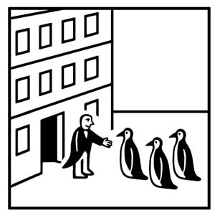
The Identity Approach

Slide 2
Assumptions
Theory
Methods & Data
Managerial implications

Slide 3
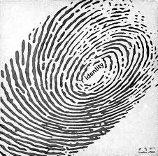
The assumptions of identity approach
The brand should express one unified and coherent identity, internally as well as externally, by using the visual and behavioral identity of the corporations to build the brand.

Slide 4
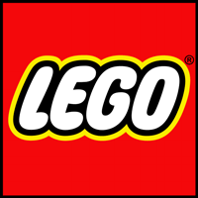
The name 'LEGO' is an abbreviation of the two Danish words "leg godt", meaning "play well". It’s our name and it’s our ideal.
The LEGO Group was founded in 1932 by Ole Kirk Kristiansen.
Timeline 1932 – 1939 (The LEGO Factory has 10 employees)
Timeline 1940 – 1949 (The company produces around 200 different plastic and wooden toys, including Automatic Binding Bricks, a forerunner of the LEGO bricks we know today. They are sold in Denmark exclusively. The first packaging with four colours is introduced. )

Slide 5
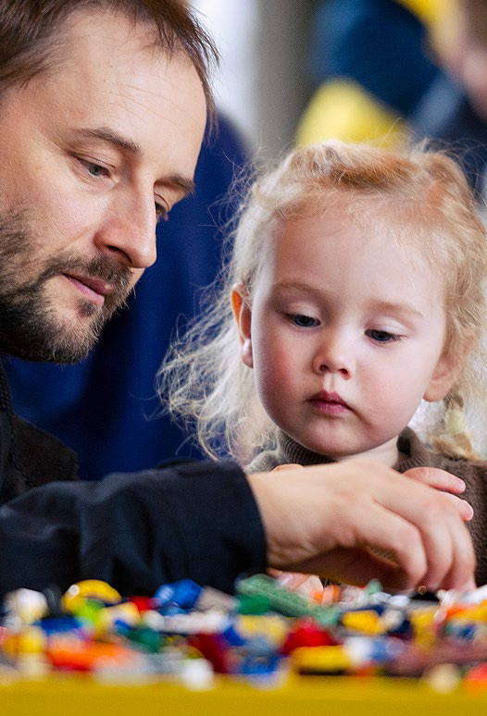
LEGO DNA
hands-on and minds-on,
challenging play,
play that connects,
facilitates creativity,
it is modular,
it is open-ended, and
characteristic and recognizable design
mission statement:
To nurture the child in each of us.

Slide 6
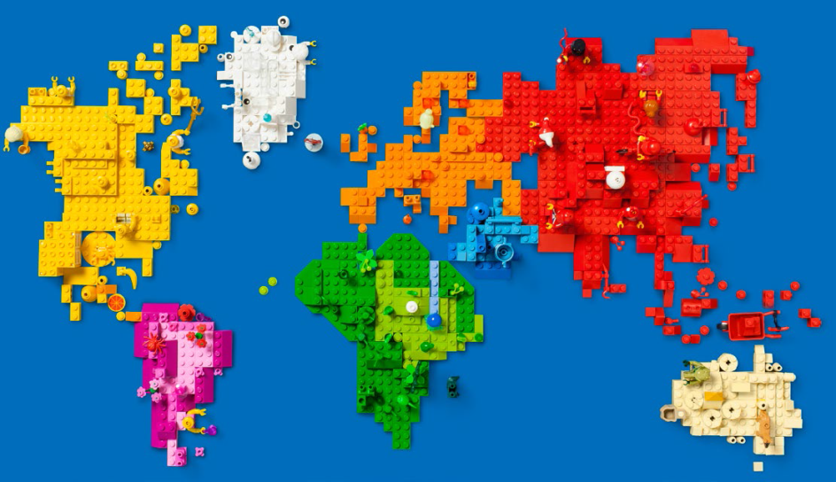
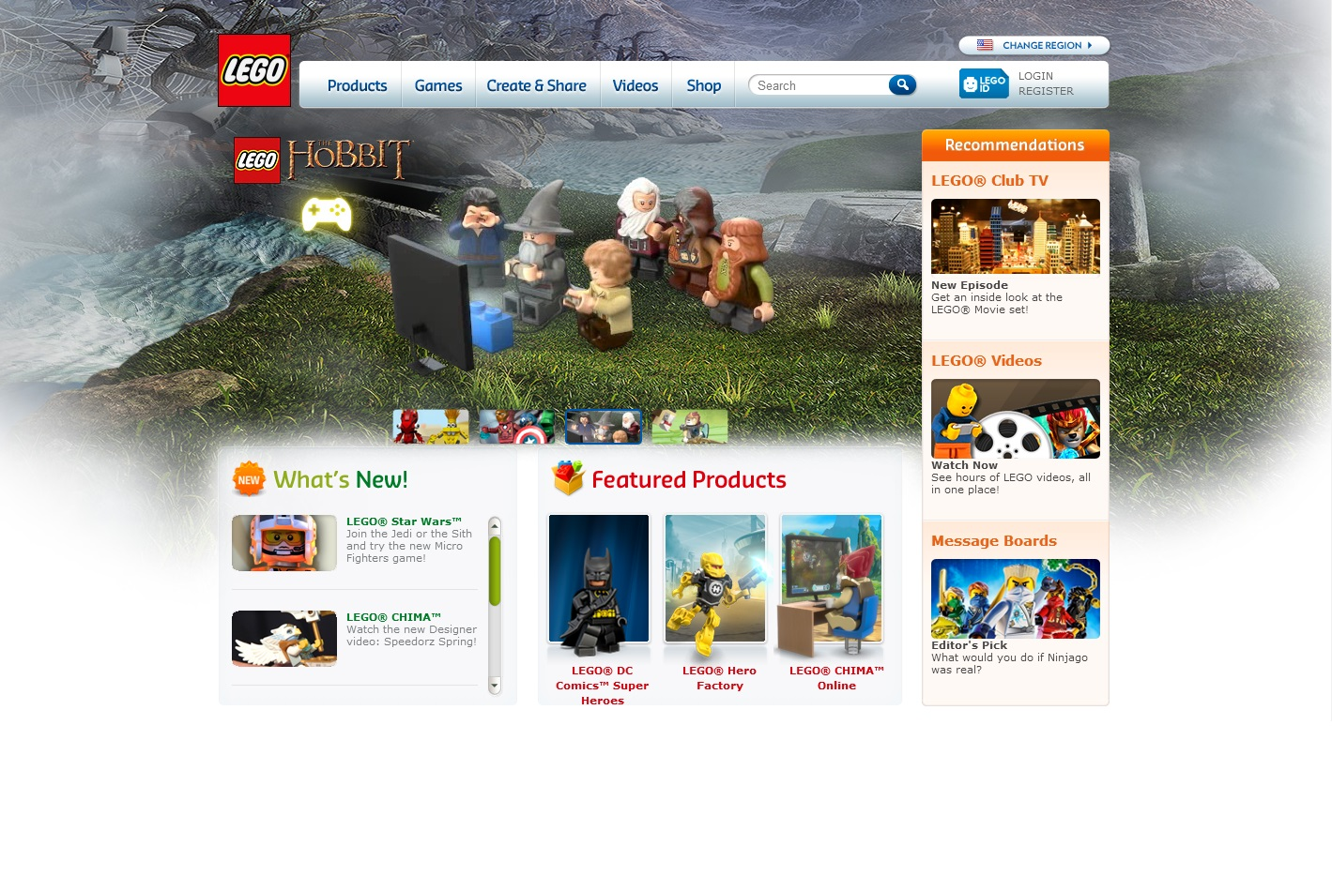
From Product Level to Corporate Branding
It was found that the image of Lego was indeed strong among many stakeholders as a producer of toys enhancing creativity and learning. The strategic vision of the company had to be aligned with this image. Management moved away from defining themselves as producers of Lego bricks to defining themselves as leaders in the business of creativity and learning.

Slide 7
Dimension | From | To
Culture: Focus on core values in LEGO Company | A range of different values including: Creativity Imagination Learning Fun Quality | Company focus on five values: Self Expression Endless Ideas Playful learning Active fun Trusted
Image: Clarification of what LEGO Stands for to consumers | High global awareness and stature for LEGO brand Low awareness on sub-brand High preference in relation to children's development Low preference in relation to coolness and street credibility | Reducing filters between LEGO and consumers by reducing the number of product lines and eliminating sub brands based on building systems and age only Tapping into global perceptions of play experience among children
Vision: Brand positioning | Stimulates creativity Tagline: Just IMAGINE Incoherent implementation | The power to create Tagline: play on Vision for coherent implementation
Brand Architecture | A huge range of disconnected sub brands and endorsed brands , which together form an incoherent brand architecture with no overall guiding principles | The definition of four brand portals based on different play experiences: LEGO EXPLORE, LEGO MAKE & CREATE , LEGO STORIES & ACTION , LEGO NEXT plus an endorsed portal

Slide 8
Internal elements
Supporting theme:
organizational identity
Supporting theme:
Corporate identity
Core theme:
Brand identity
Supporting theme:
Image
Supporting theme:
Reputation
External elements

Slide 9
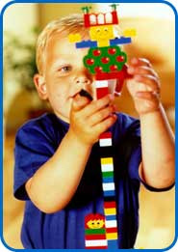
The corporate brand toolkit
• Strategic vision: central idea behind what the company does. The strategic vision expresses future management aspirations.
• Organizational culture: internal values and beliefs. Basic assumptions that embody the heritage of the company, manifested in the ways employees feel
about the company across rank, reflected in behavior.
• Stakeholders’ images: how external stakeholders perceive the company, in other words, it is the outside world’s overall impression of the company.
AC2ID Framework
Actual: the actual identity, organizational behavior and everyday reality of
the corporation.
• Communicated: the brand identity expressed through all sources of
communication.
• Conceived: refers to the image/reputation of the corporation – how do stakeholders
conceive brand identity?
Ideal: represents the optimum positioning of the organization in the market at
any given time.
• Desired: lives in the hearts and minds of the corporate leaders – equivalent of
the strategic vision.

Slide 10
Methods and data of the identity approach
Corporate Identity
Historical Sources:
Semi-structured interviews, story-telling methods ,heuristic analysis
Organizational identity
Anthropology & cultural studies
Image and reputation
Cognitive and social psychology

Slide 11
Council & Task Forces Membership | Brand Analysis | Brand Management Facilitation | Global Implementation
Member of the internal brand task force crafting the overall brand strategy (all of 2001) | Organizational Brand Analysis consisting of 20 interviews with employees, archival research and in depth study of previous attempt in 1997-98 to make new brand strategy (Spring 2001) | Member of small management team recreating the key roles in the future brand organization and leadership set-up | Creating brand foundation for business areas: LEGO® Interactive
Permanent member of internal Brand Council & Culture Council with Executive Office (since 2001) | Brand Strategy Check-In. A follow up on the brand strategy implementation in headquarters: 16 interviews across the company. (Spring 2002) | Ongoing facilitation forming the new Global Brand Communication Unit (since Spring 2002), including process facilitator, involvement in implementation of brand identity | Creating brand foundation for key markets: Involvement with LEGO Americas (since Spring 2002)

Slide 12
Managerial implications
1- Aligning vision and culture in practice
2- Detecting identity gaps
3- Aligning identity gaps
4- Challenges when building brand identity

Slide 13
 | Cycle 1: Stating | Cycle 2: Linking | Cycle 3: Involving | Cycle 4: Integrating
Key Process | Stating the foundation for the corporate brand and linking it to corporate vision | Linking vision to culture and image | Involving stakeholders through culture and image | Integrating vision, culture and image
Key Change Mode | Decentralization | Centralization | Decentralization | Centralization
Key Question | What do we want to stand for? | How can we reorganize behind our corporate brand? | How can we involve internal and external stakeholders in the corporate brand? | How can we integrate vision, culture, and image for the corporate brand?
Key Concerns | Company wide audit of brand expression Revisiting brand heritage Analyzing brand images among key stakeholders | Create a coherent brand organization and provide managerial foundation for implementation processes | Does the company have a shared cultural mindset? Active inclusion of global stakeholder perceptions | Integrate the brand across markets and business areas

