Slide 1
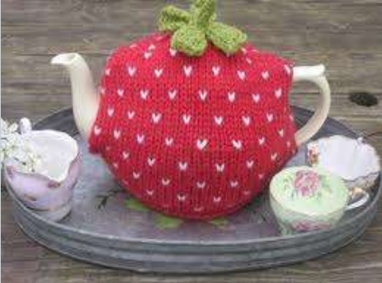
A WORKSHOP ON WARMERS AND FILLERS Seyed Jaafar Rafiee

Slide 2
Warmers and Fillers in ESL Classes
Professor:Gholami,Javad.Ph.D
Urmia University
Sj.Rafiei@yahoo.com
Winter,2019

Slide 3
Introduction
Definition of warmers and fillers
Warmers and fillers are usually short 5-10 minute activities, often in the form of a game, which is introduced at the start of a lesson (warmers) or in between the stages of a lesson (fillers).
They are meant to be fun, motivating and should encourage students to wake up and communicate to each other in English.

Slide 4
In definition of warmers and fillers
Short (5 – 10 mins)
Integrated into lesson plan
Communicative
Fun
Challenging
Non-threatening
Element of surprise
Adaptable
Student-centred
Easy to explain

Slide 5
Why use warmers / fillers / coolers?
Practical reasons:
To delay the start of the class when waiting for late-comers to arrive.
When planned activities finish early before a break or end of class.
When interest / energy levels start to fall and a change of focus or pace is needed.

Slide 6
Why use warmers / fillers / coolers?
To wake up students in early morning classes.
As ice-breakers at the beginning of a new course.
To change class distribution.To calm students down.
For fun.
For a strong finish.
To buy time for the teacher.

Slide 7
Why use warmers / fillers / coolers?
Pedagogical reasons:
Recycling of language
Personalization
Focus on production
Provides a context for content to come
Diagnostic

Slide 8
Let’s watch a video about fillers and warmers

Slide 10
300 New Warmers and Fillers

Slide 12
They include activities like the following:
Unscramble the following anagram with a partner: MRAWRES;
Think of as many words as you can that start with the letter T and end with the letter R;
Find the word that is the odd one out;
Tell a story without using the letter F;
Guess Who I Am/Twenty Questions;
Word Association games, e.g. I say ‘music’ and you say ‘songs’;
What’s the opposite? e.g. I say ‘tall’ and you say ‘short’, I say ‘expensive’ and you say ‘cheap’;
Brainstorm things that share a common property, e.g. things that fly; things that are round; things that are shiny;
Tell a story as a class – one student starts with a sentence, the second student continues with another, etc.;
Running dictation – one student runs to the text, memorises part of it, runs back and dictates it to their partner who then writes it down;
Divide the classroom space into two. Point to one side and say ‘Netflix’ and the other side and say ‘cinema’. Have students stand in the side that they prefer;
Charades, i.e. I act you guess;
Pictionary, i.e. I draw you guess;
And the list goes on…

Slide 13
Vocabulary activties
Anagrams
Hangman
Categories / “Stop”
Taboo
Pictionary
Phonetic transcripts
Pictures
What can you remember? 1 minute to see a picture and remember everything you saw
“Pasapalabra”
“Password”
Call my bluff
Scrabble
Word maps
On line Word games : http://www.wordplays.com/p/index

Slide 14
All-purpose activities
Vocab box / bag
Grammar box / bag
Board game template to adapt
Blockbusters for vocabulary revision
Noughts and crosses for vocab or grammar
Minimal pairs boards – to practise pronunciation and recylce vocabulary

Slide 15
Recommended resources
http://www.developingteachers.com/newsletterplan s/News_warmers_nov1999.htm

