Slide 1
MAGIX MUSIC MAKER LEARN(2013-14 EDITION)
IN THE NAME OF GOD
FIRST STEP
PRODUCED BY: MOHAMMAD RASUL KAZEMY

Slide 2
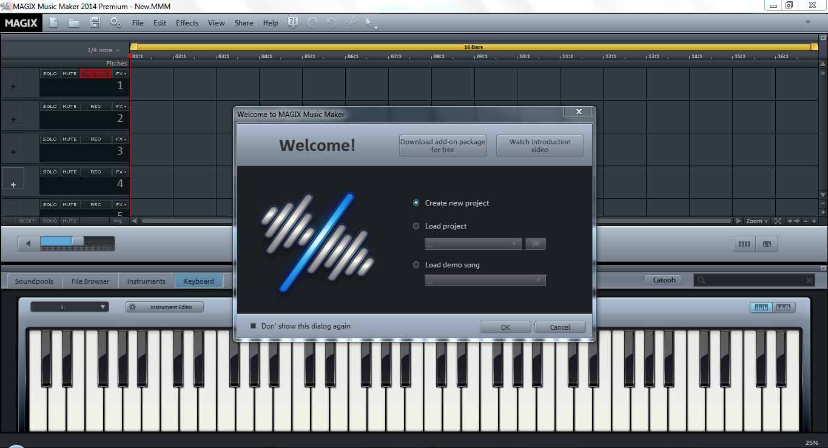
magix music maker(2013-2014) learning
P by:mohammad rasul kazemy

Slide 3
Checking out:
Tabs
Time line-Instruments line
A default project
Menu bar
Song maker

Slide 4
Tabs

Slide 5
Tabs
You can make song with many different ways.
You can choose the skill that you want to make song with on tabs bar

Slide 6
Soundpools

Slide 7
Soundpools
You can make song with combine the samples of many styles and many instruments.

Slide 8
Styles

Slide 9
Styles
You can make your music and song in all styles.
You can choose a style of music’s samples together or all of them

Slide 10
Instruments

Slide 11
Instruments
And again!!!
You can choose.
You can choose the samples of all of instruments.
You see!
Mmm is the mouthpiece of freedom.

Slide 12
Samples

Slide 13
Samples
Its my promise.
The samples
You can see many samples of each instrument in it.
And you can download more samples , instruments and etc.

Slide 14
File browser(next tab)

Slide 15
File browser(next tab)
You can load your files from here

Slide 16
Instruments

Slide 17
Instruments
You can mix and master voices by these tools.

Slide 18
Keyboard

Slide 19
Keyboard
You can record new samples, make new songs and etc. with playing keyboard(piano)

Slide 20
Templates

Slide 21
Templates
Here is more samples

Slide 22
Time line-Instruments line

Slide 23
Time line-Instruments line
You use them to combine the different tracks , samples and a lot of other things
You can mix a lot of sound at the same moment
You can do lot of behaves on samples here

Slide 24
The demo project on time line-instruments line

Slide 25
The demo project on time line-instruments line
You see the default song in the timeline-instruments line
Let’s hear

Slide 26
The demo project on time line-instruments line

Slide 27
Menu bar

Slide 28
New project
if you press it, you can rich to a new page and project, save the current project

Slide 29
Load a file
You can load musics and songs here
Specially the mmm files

Slide 30
Save (as)
If you press it, you can save the file as a mmm file
For example: sample.mmm

Slide 31
Settings
Here is settings.
Here is easy
Here don’t have any guide
Just read the titles
Here is necessary future(when you are professional)

Slide 32
File
The parts:
New project
Load project
Save project
Save as project
My projects(history)
Import(from cd , recording(audio)and(video))
Export (to many different formats)
Backup
Xtreme print studio
Settings
exit

Slide 33
Edit
This tab is for professional uses. May I teach you this part in next present

Slide 34
other
Other menu’s are:
Effects
View
Help
share

Slide 35
Song maker

Slide 36
Song maker
If you press “w” you see a page that where can make song by defined models By marking or unmarking

Slide 37
Please wait for second step…

