Slide 1
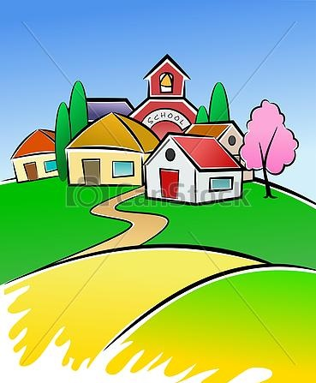
My Village
Grade 8 lesson 6
By Kuchakzadeh
More at t.me/kuchakzadeh
www.prospecpowerpoints.blog.ir
1398

Slide 2
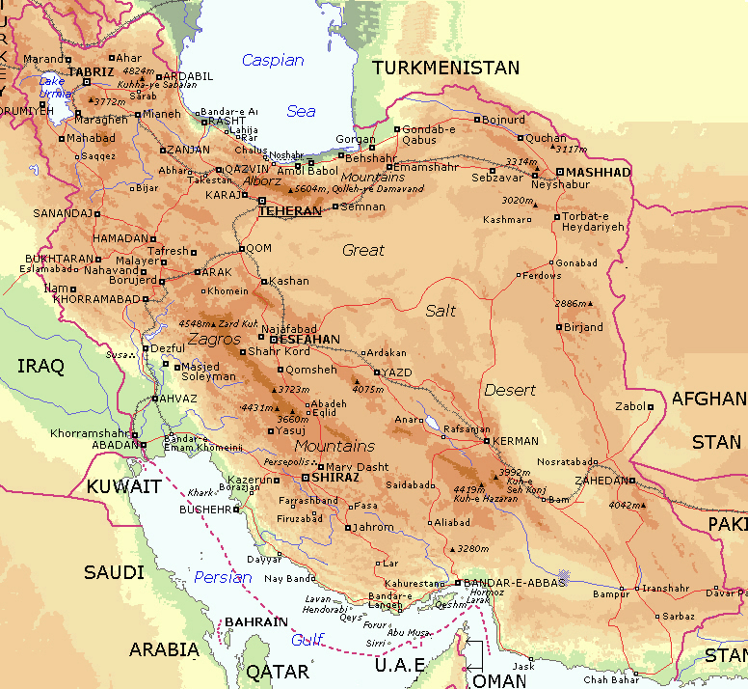
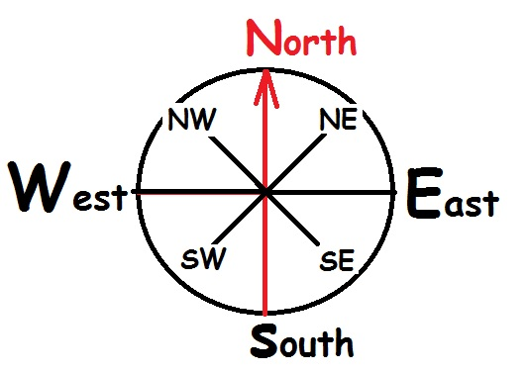
Where is Rudbarak?
It is in the north of Iran near Chalus.

Slide 3
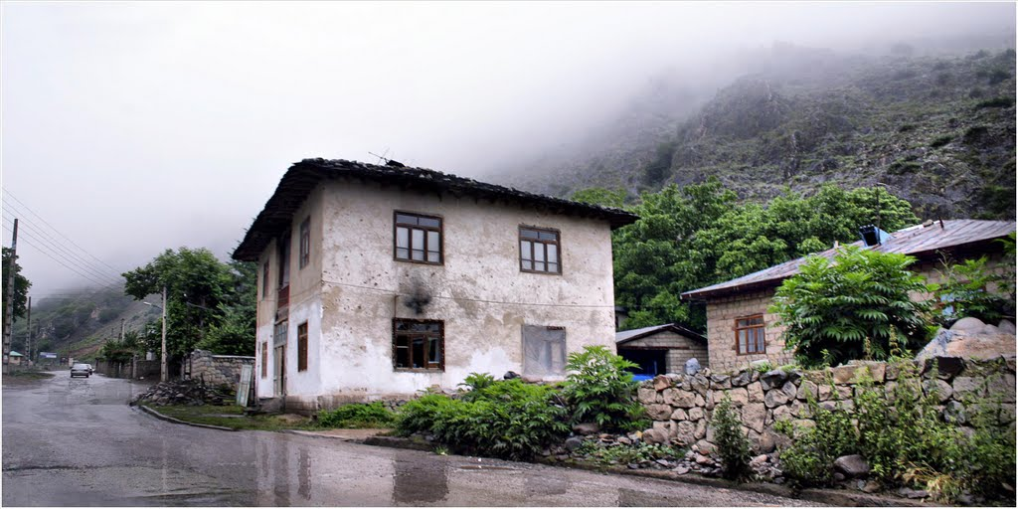
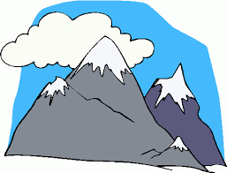
What is Rudbarak like?
It is a beautiful mountain village.
mountain
desert

Slide 4
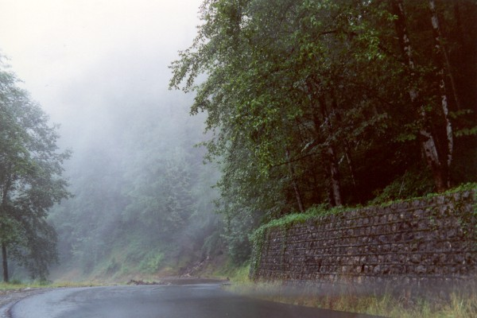
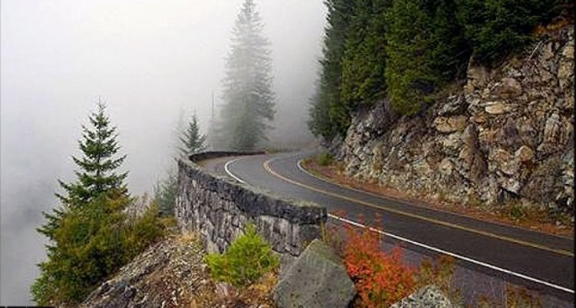
What is Rudbarak famous for?
It is famous for Abbas Abad jungle.

Slide 5
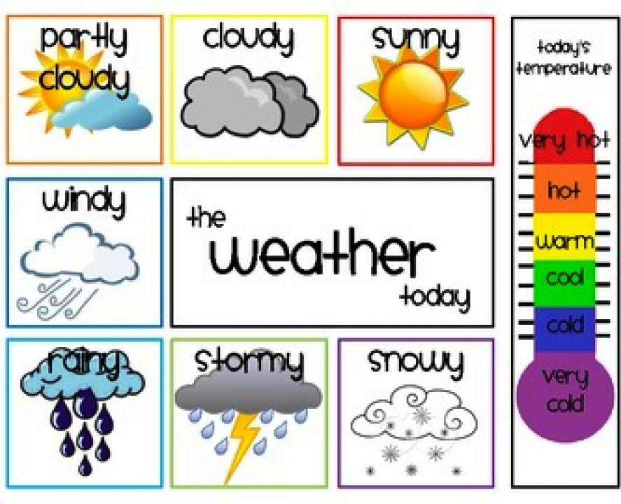
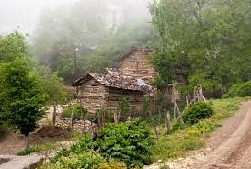
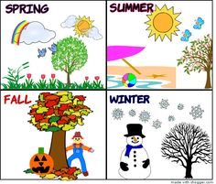
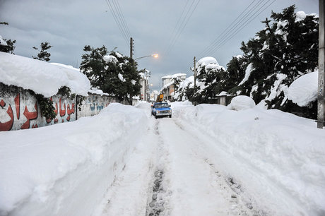
How is the weather?
It’s cool and cloudy in summer,
It’s cold and snowy in winter.

Slide 6
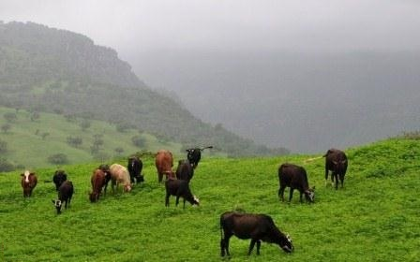
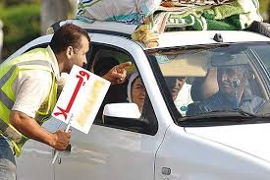
What is the people’s job?
They raise animals.
They rent their villas.

Slide 7
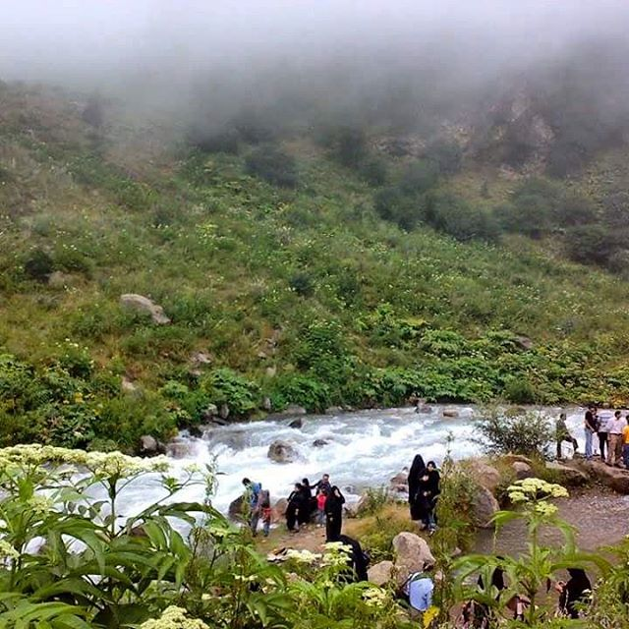
Is there a river in Rudbarak?
Yes, there is.

Slide 8
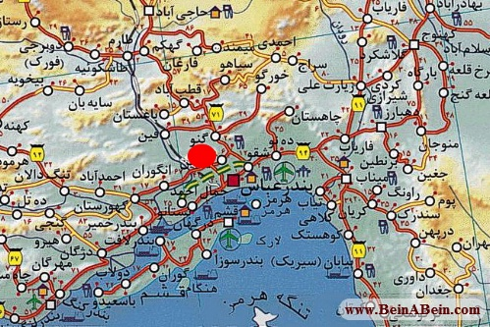
Where is Gennow?
It is in the south of Iran near Bandar Abbass.

Slide 9
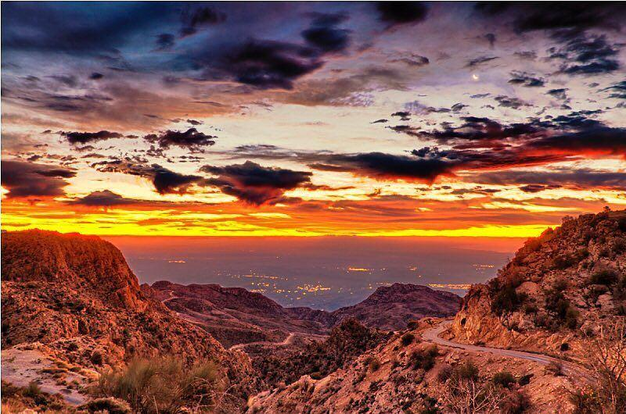
What is Gennow like?
It is a beautiful mountain village.
mountain
desert

Slide 10
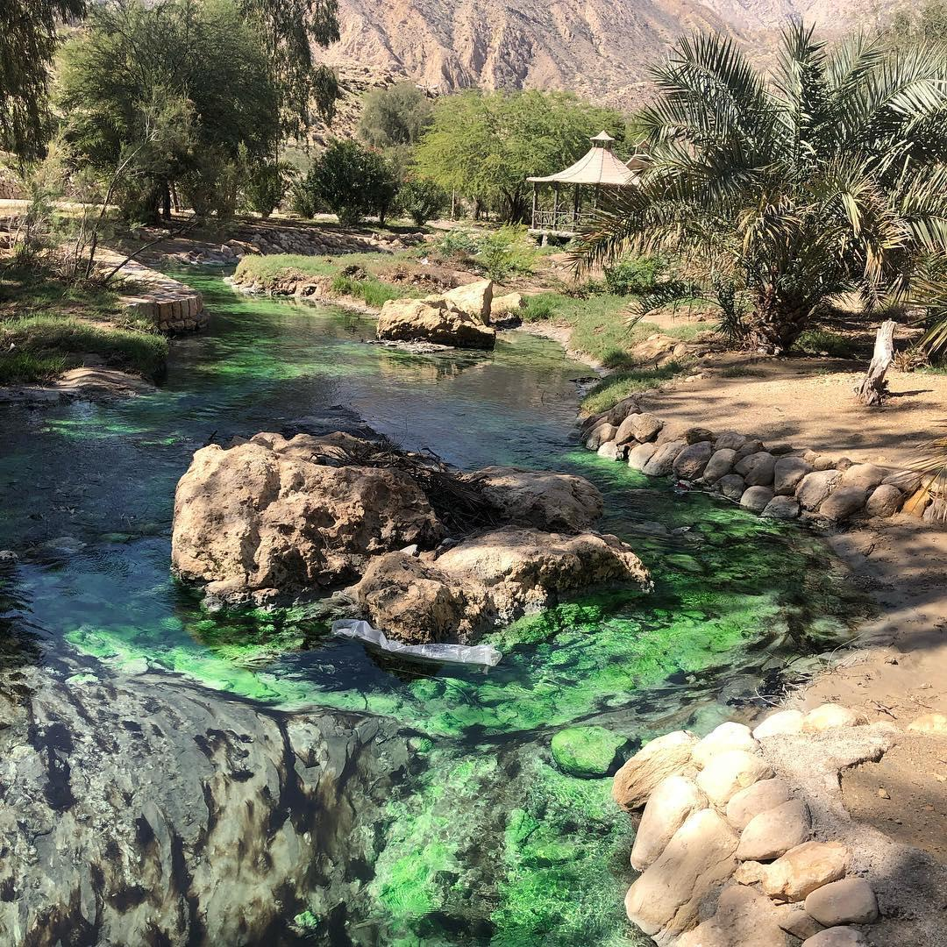
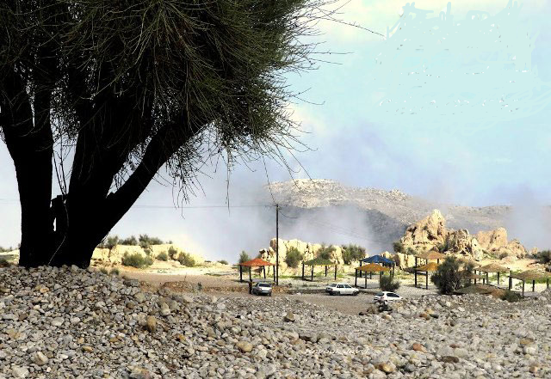
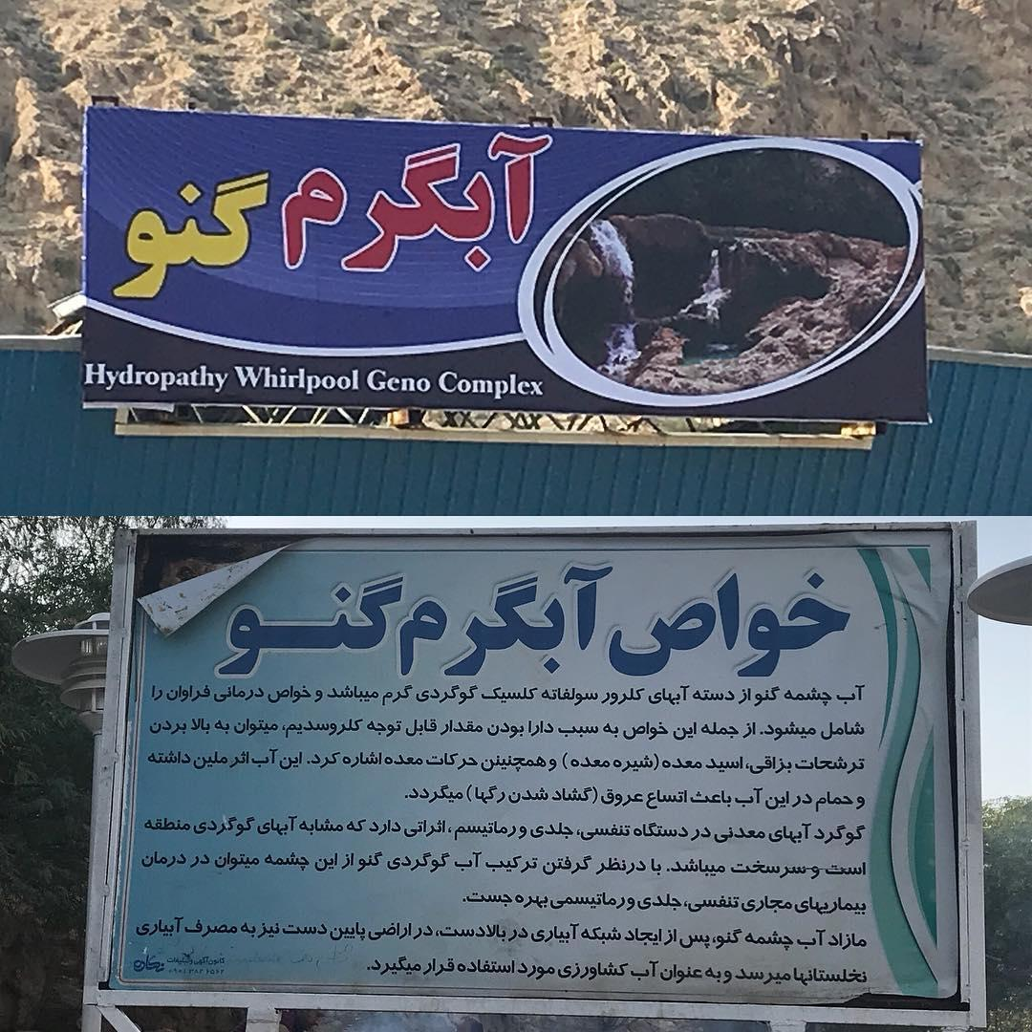
What is Gennow famous for?
It is famous for its hot spring.

Slide 11
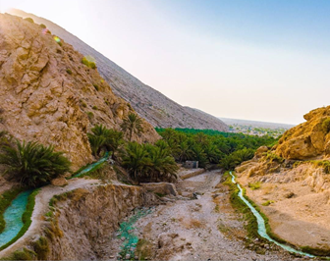
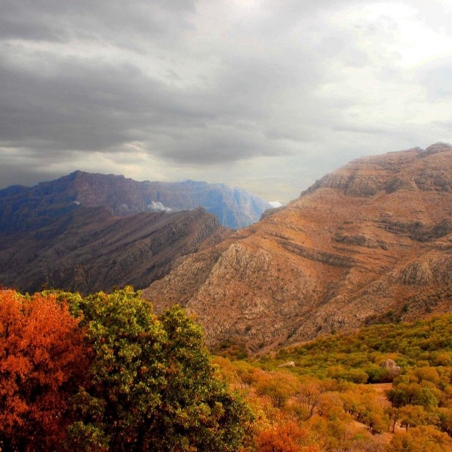
How is the weather?
It’s cool and sunny in spring,
It’s cold and cloudy in fall.

Slide 12
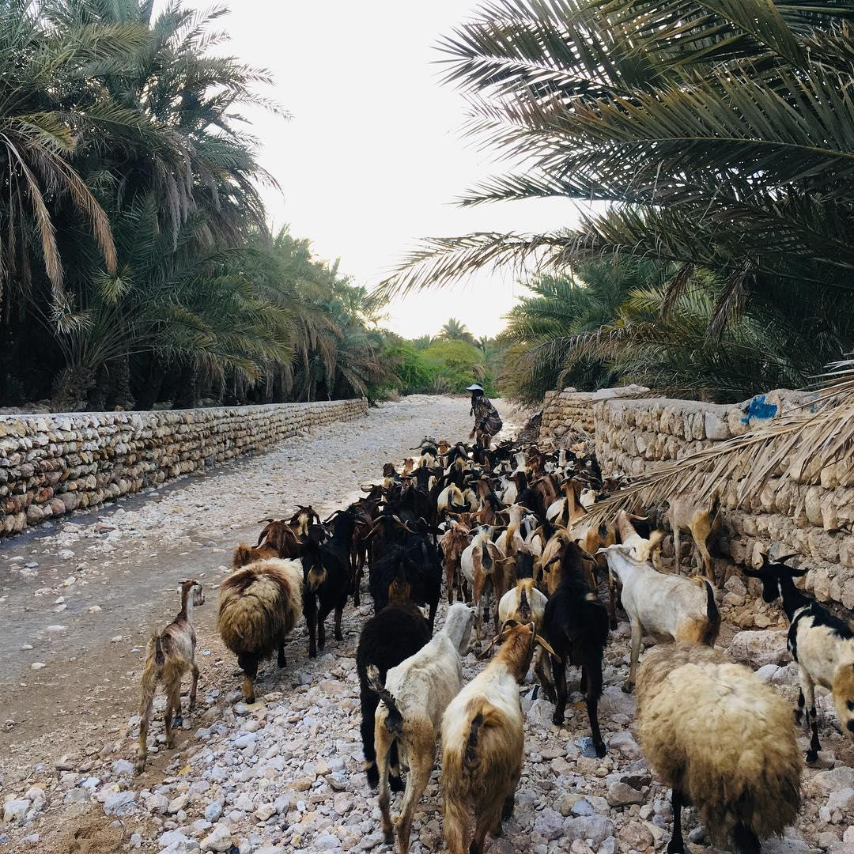
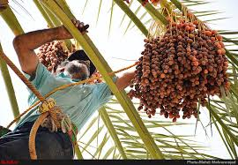
What is the people’s job?
They raise animals like sheep.
They work in palm gardens.

Slide 13
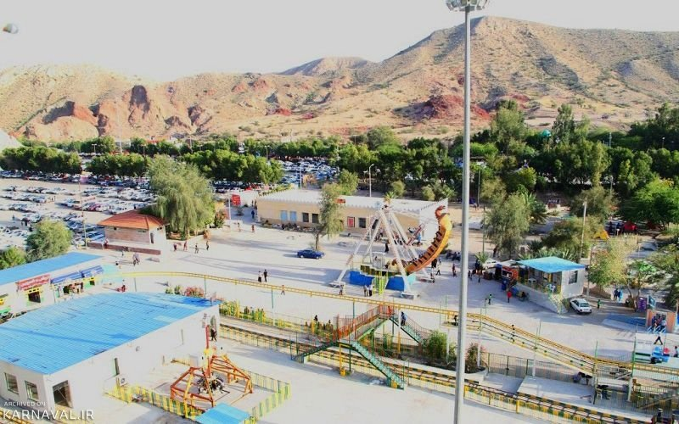
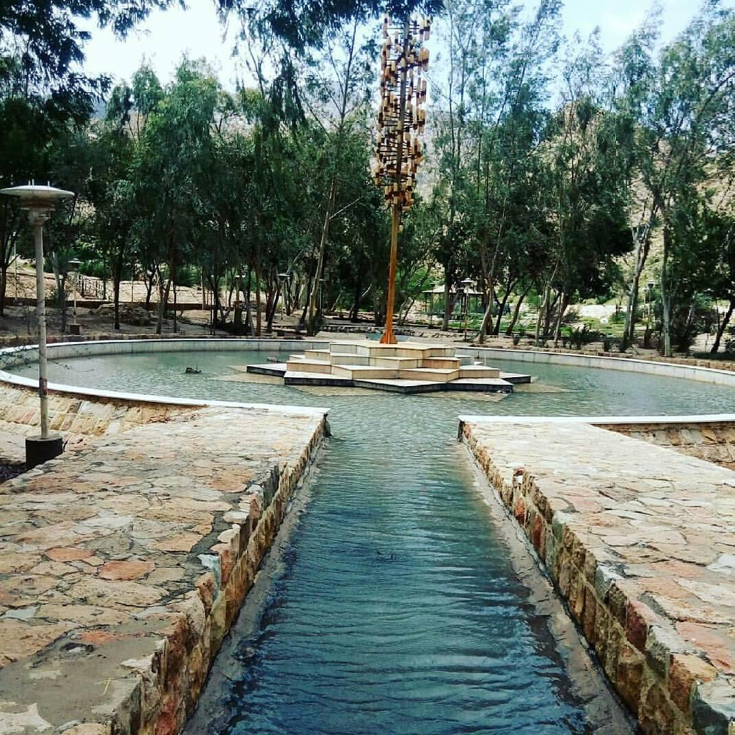
Is there a park in Gennow?
Yes, there is.

Slide 14
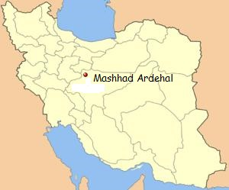
Where is Mashhad Ardehal?
It is in the center of Iran near Kashan.

Slide 15
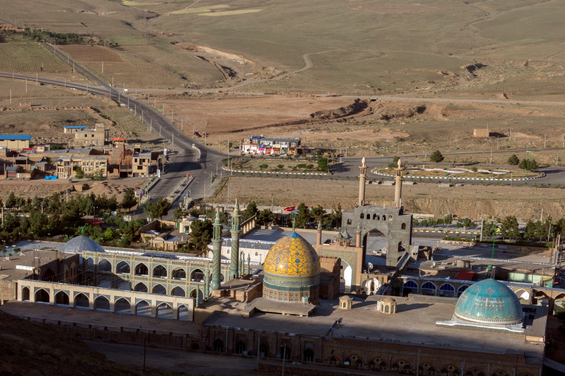
What is it like?
It is an old desert village.
mountain
desert

Slide 16
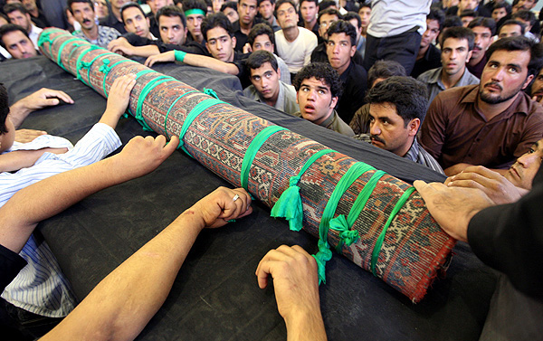
What is Mashhad Ardehal famous for?
It is famous for Qalishuyan.

Slide 17
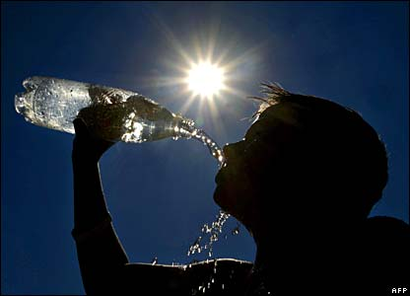
How is the weather?
It’s windy in fall
It’s hot and sunny in summer.

Slide 18
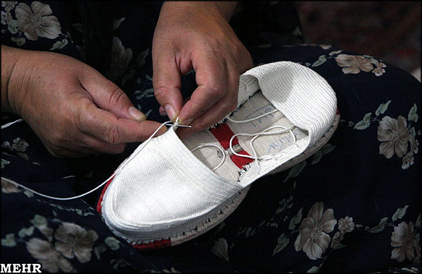
What is the people’s job?
They make handcrafts.

Slide 19
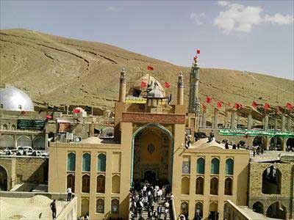
Are there any hills in it?
Yes, there are.

Slide 20
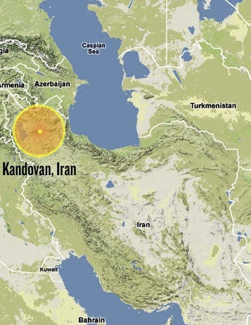
Where is Kandovan?
It is in the North-West of Iran near Tabriz.

Slide 21
What is Kandovan like?
It is a beautiful mountain village.
mountain
desert

Slide 22
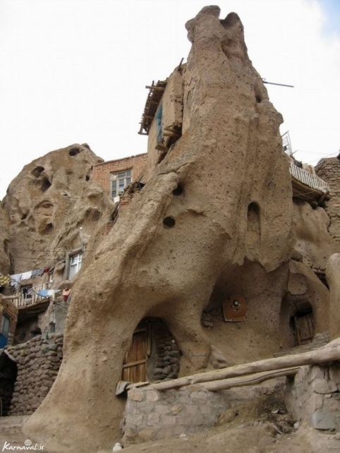
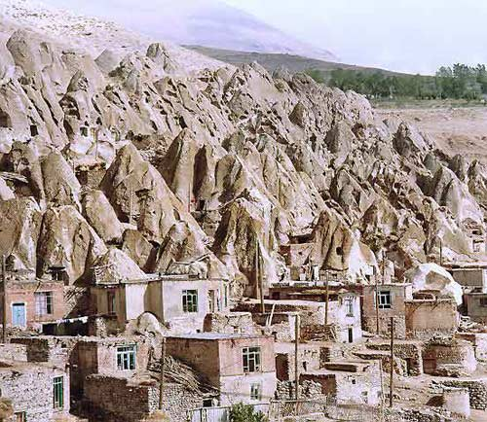
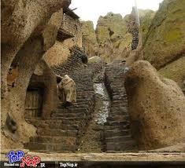
What is Kandovan famous for?
It is famous for its stone houses.

Slide 23
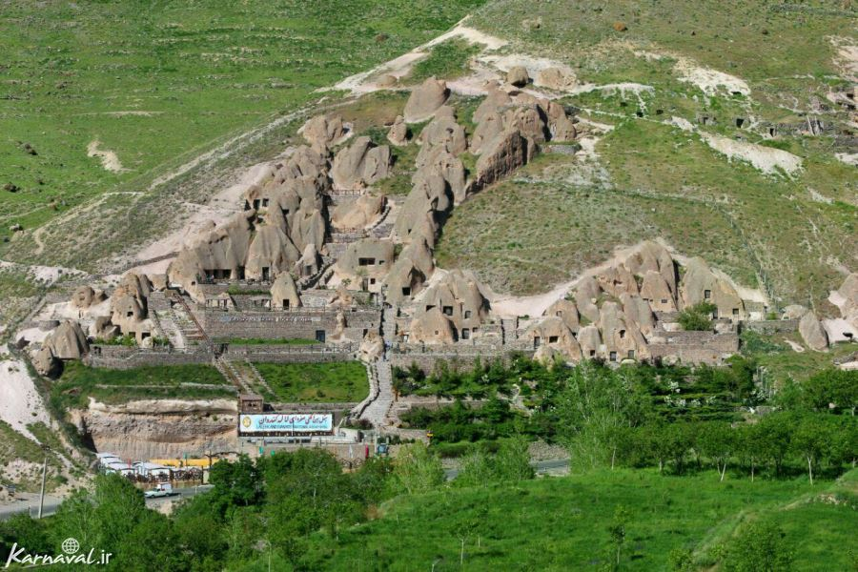
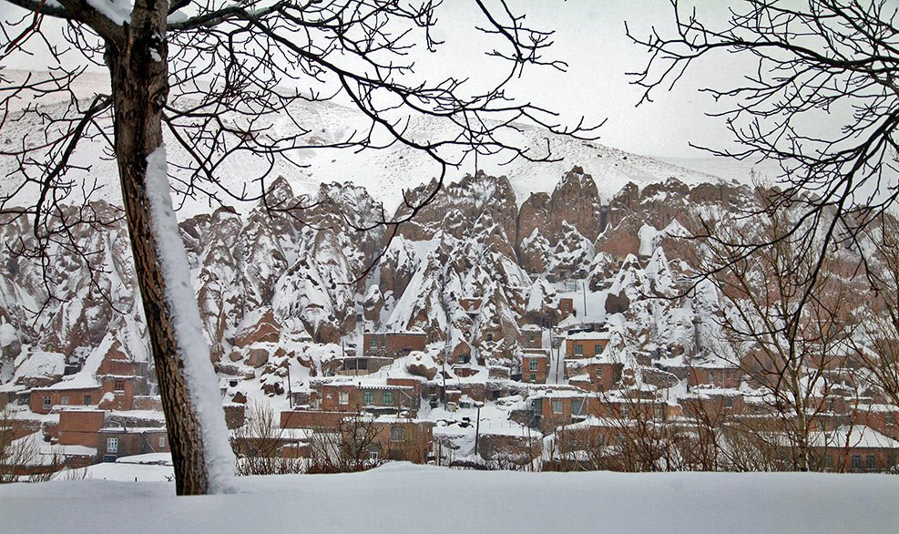
What’s the weather like?
It’s cool in summer,
It’s cold and snowy in winter.

Slide 24
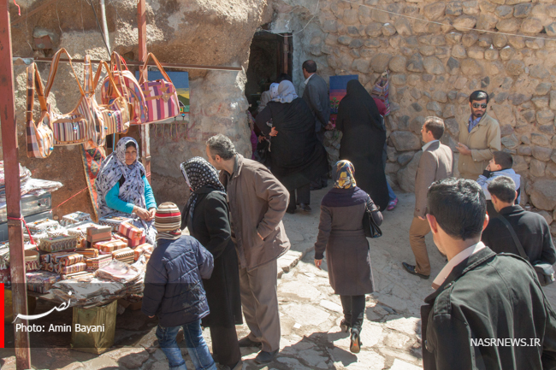
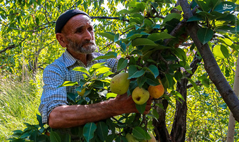
What is the people’s job?
They sell handcrafts.
They work in gardens.

Slide 25
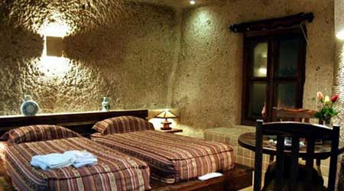
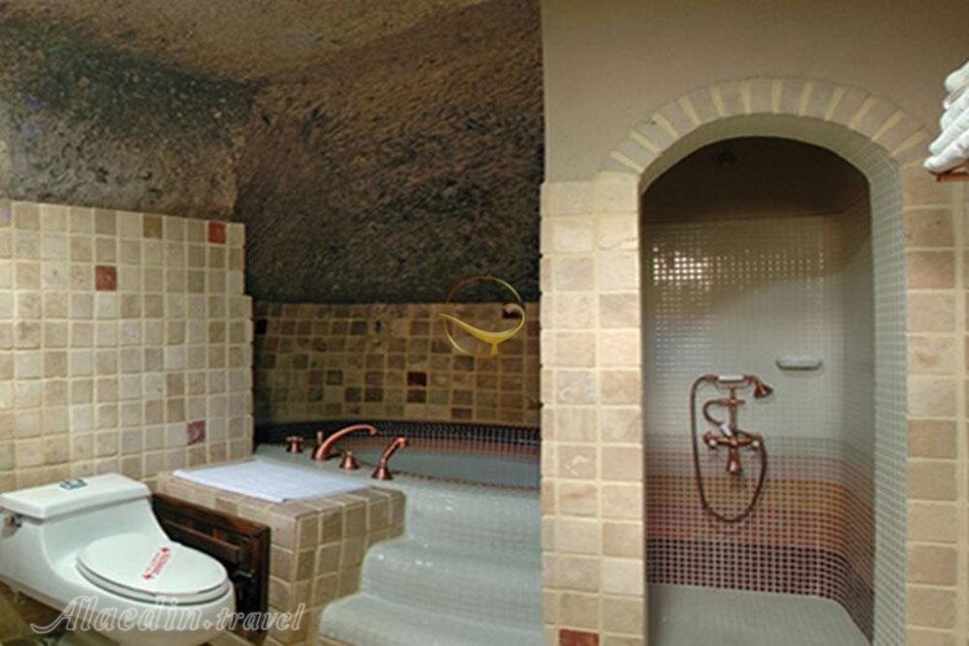
Are there any hotels in Kandovan?
Yes, there are.

Slide 26
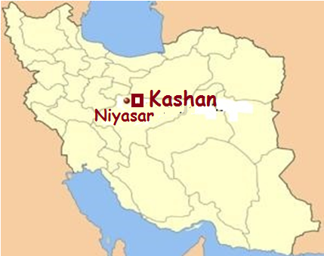
Where is Niyasar?
It is in the west of Kashan.

Slide 27
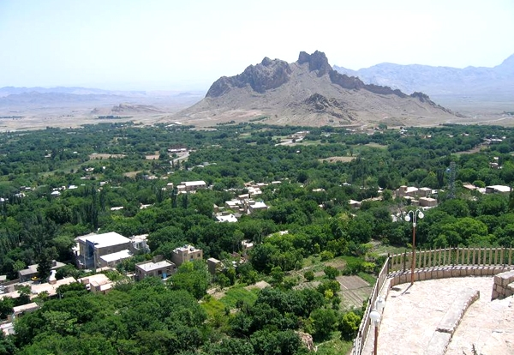
What is Niyasar like?
It is a beautiful green village.

Slide 28
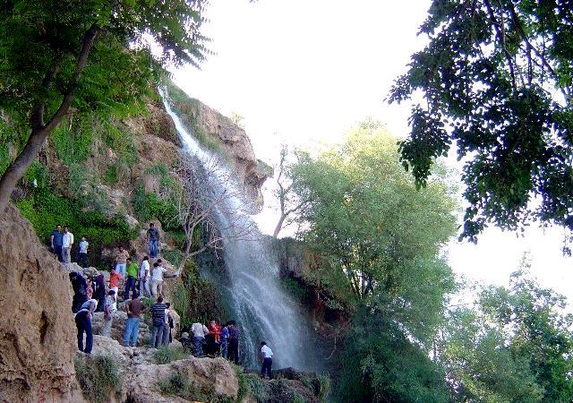
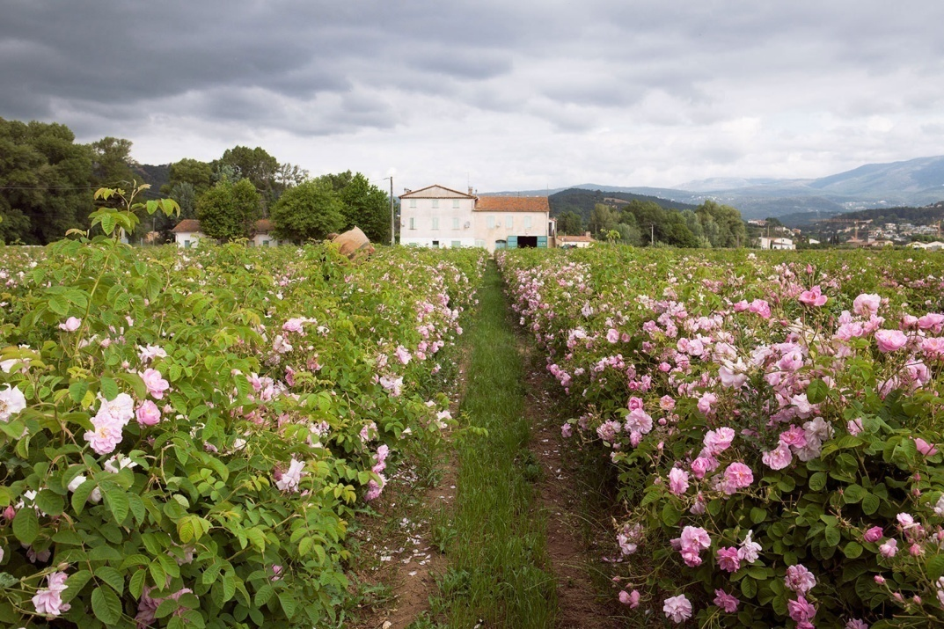
What is Niyasar famous for?
It is famous for its waterfall
and rose fields .

Slide 29
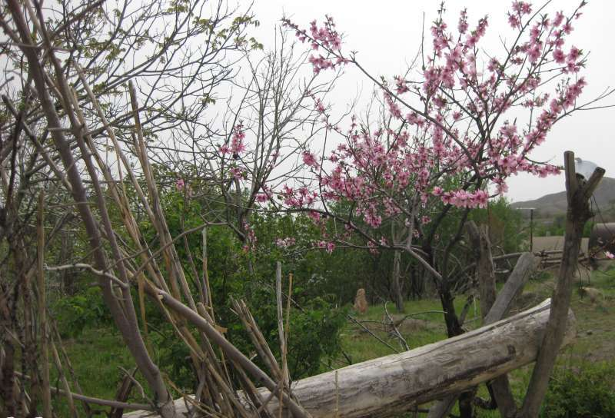
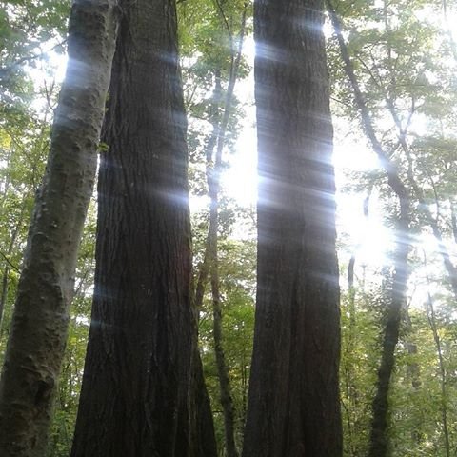
What’s the weather like?
It’s cool in spring,
It’s warm and sunny
in summer.

Slide 30
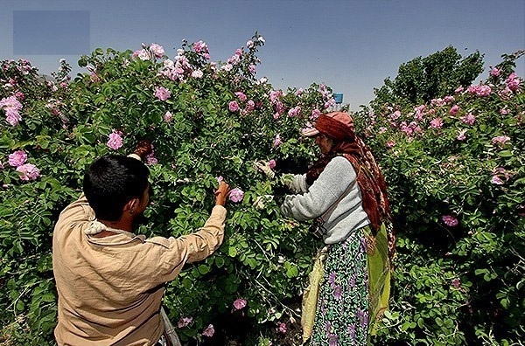
What is the people’s job?
They make rose water.
They work on farms.

Slide 31
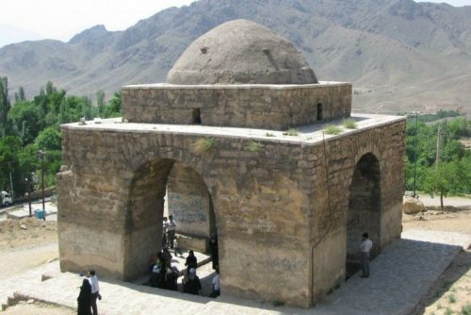
Are there any old buildings in Niyasar?
Yes, there are.

Slide 32
Where is Masuleh?
It is in the north of Iran near Rasht.

Slide 33
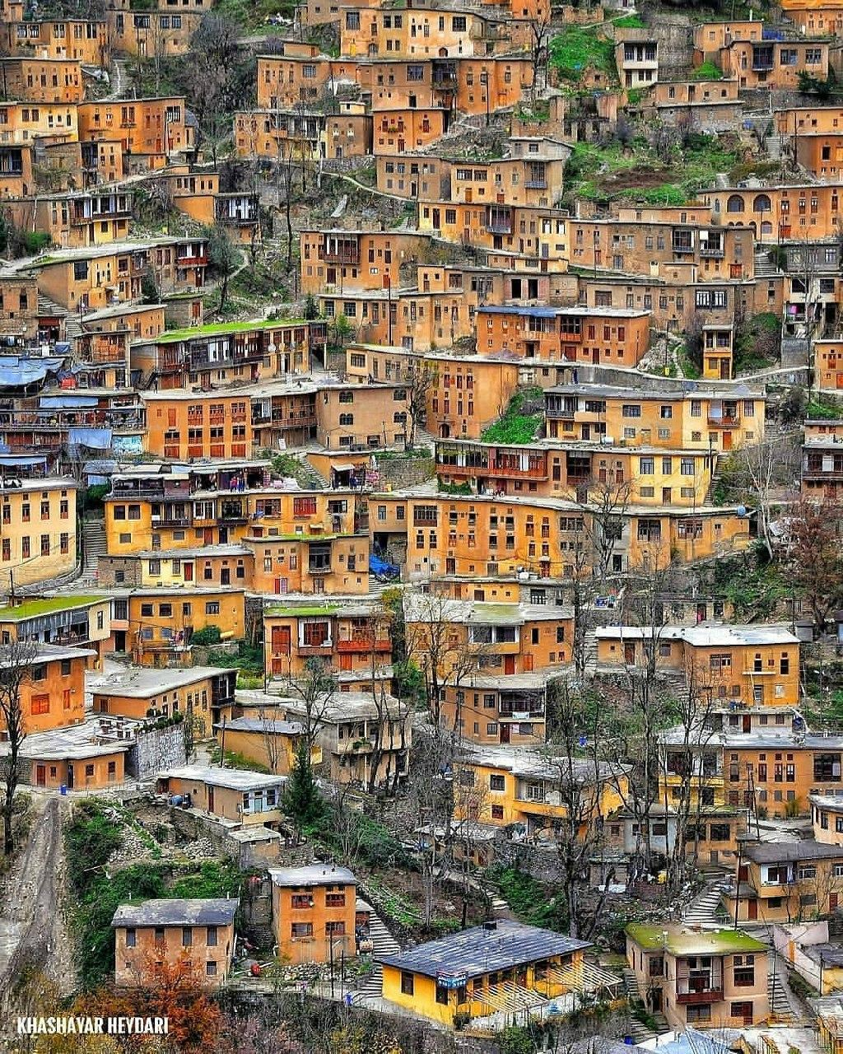
What is Masuleh like?
It is a beautiful mountain village.
mountain
desert

Slide 34
What is Masouleh famous for?
It is famous for its stair houses.

Slide 35
What’s the weather like?
It’s cool and cloudy in summer,
It’s cold and snowy in winter.

Slide 36
What is the people’s job?
They sell their handcrafts.
They rent their rooms.

Slide 37
Is there a mosque in Masuleh?
Yes, there is.

Slide 38
Role Plays or monologs

Slide 46
Masuleh

Slide 47
Monolog

Slide 48
Hello, my name is Rahmatullah. I am very old. I live in Veshnaveh. It is a mountain village near Qom in the center of Iran. Here, it is really cold in winter. It is famous for its weather; Veshnaveh is very cold even in summer! There are many fruit trees like walnut, cherry and plum in my village. People in this village, raise animals like cows and sheep, there are a lot of hens, cats and dogs here, like anywhere else!

Slide 49
complete
This is Mashhad Ardehal. It is near Kashan in the center of Iran. It is an old desert village. It is famous for Qalishuyan. The weather is very hot and dry in summer. People make handcrafts in this village.
This is Gennow. …………………………………………. …………………………………………………………………………………………………………………………………………………………………………………………………………………………………………………………………………………………………………………………………………………..

Slide 50
This is Kandovan. ………………………………………. …………………………………………………………………………………………………………………………………………………………………………………………………………………………………………………………………………………………………………………………………………………..
This is Masuleh. …………………………………………. …………………………………………………………………………………………………………………………………………………………………………………………………………………………………………………………………………………………………………………………………………………..

Slide 51
Write about your favorite village (location, adjectives, famous things, weather, people’s job, facilities)
…………………………………………………………………………………………………………………………………………………………………………………………………………………………………………………………………………………………………………………………………………………………………………………………………………………………………………………………………………………………………………………………………………………………………………………………………………..

