Slide 1
Sintering
Powder Engineering Course

Slide 2
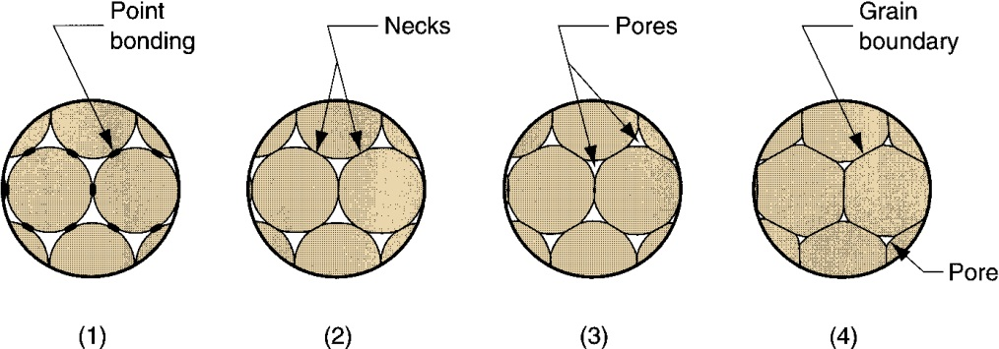
Sintering
Heat treatment to bond the metallic particles, thereby increasing strength and hardness
  Usually carried out at 70% to 90% of the metal's melting point (absolute scale)
  Generally agreed among researchers that the primary driving force for sintering is reduction of surface energy
  Part shrinkage occurs during sintering due to pore size reduction
  Sintering Sequence on a Microscopic Scale
  (1) Particle bonding initiated at contact points; (2) contact points grow into "necks"; (3) pores between particles are reduced in size; (4) grain boundaries develop between particles in place of necked regions
Shrinkage is the reduction in size or volume of a powder metallurgy (PM) component during or after the sintering process. It can affect the dimensional accuracy, mechanical properties, and surface quality of the final product.

Slide 3
Sintering
Sintering refers to the application of heat to the powder compact to increase its strength by bonding together the powder particles. The principal driving force for increasing the density and particle contact area during sintering is the lowering of the surface energy of the powder particles. The reduction of surface energy requires a decrease in the total surface area of the compact, primarily due to the closure of pores between powder particles. Although the lowering of the surface energy is the driving force, diffusion is the mechanism that leads to the increase in density. Surface tension drives atoms to regions where cold welding of adjacent particles has occurred. The atoms are transported by surface diffusion, volume diffusion and/or grain boundary diffusion. As atomic diffusion is a mass transport phenomenon, it is governed by equations of the form presented for the conductive heat flow during solidification. The primary difference between the mass transport phenomenon of atomic diffusion and that of heat conduction is that the thermal diffusivity, αth, is replaced by the diffusion constant, which is determined by an equation of the form:

Slide 4
Sintering
The frequency factor and activation energy are characteristic thermal constants for
each material. The key point in terms of sintering is that diffusion is a thermally activated process. Consequently, increasing the sintering temperature significantly increases the rate at which a powder compact densities. As sintering proceeds, the powder surface area decreases as the contact area increases. Since the powder surface energy is the driving force for the sintering process, as the surface area decreases, so does the driving force. Therefore, the rate of sintering decreases as the process continues. This is illustrated in Fig. 6.10 in terms of the sintered density as a function of the sintering time.

Slide 5
Sintering
The full density of copper is 8.9 g/cm 3, which is not achieved even after long sintering times, as shown in Fig. 6.10. This highlights that sintered compacts will usually have some residual porosity.

Slide 6
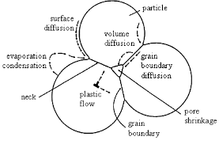
Sintering
The path of the atomic motion occurring during the mass flow in response to the driving force is called the sintering mechanism. For metal powders, the mechanisms are usually diffusion processes with surface, grain boundary or lattice paths. Sintering progresses in different stages; for each stage (i.e. for each driving force type corresponding to a particular particle-pore geometry), different ways of mass flow (i.e. sintering mechanism) are possible.
The knowledge of the relations between the different sintering parameters and each sintering mechanism during the different stages allows modelling and thus optimizing the sintering parameters.
The main sintering parameters are:

Slide 7
Sintering
particle size (reduction of particle size increases the surface energy per unit volume of the powder and so the driving force associated with sintering, thus the sintering rate);
particle size distribution (large difference in curvature of the grains, due to
grain size difference, will promote coalescence, i.e. the growth of the large grain at the expense of the smaller one);
temperature (exponential influence on sintering because it is involved in the activation energy of the sintering mechanisms (e.g. diffusion processes));
time (influences diffusion);
green density (density gradients occurring during compaction will induce differential shrinkage during sintering and maybe distortion of the part because higher green density induces lower shrinkage);
applied external pressure (to obtain fully dense material, HP or HIP processes);
amount of liquid, if any;
sintering aids (favouring diffusion in the solid or liquid state);
atmosphere.

Slide 8
Sintering
A particular sintering atmosphere can be used to protect the metal powder from oxidation (argon, vacuum), to remove the oxidation layer on the powder (reducing atmosphere such as hydrogen, carbon monoxide, dissociated ammonia or natural gas), to control the carbon content of the powder, to remove the lubricants and binders introduced during compaction or even to react with the powder (formation of nitride). Sintering can be classified as solid state, liquid phase, reaction sintering and microwave sintering.

