Slide 1

“Fault Tolerant Clustering Revisited” -- CCCG 2013
Nirman Kumar, Benjamin Raichel
خوشه بندی مقاوم در برابر خرابی
سپیده آقاملائی

Slide 2
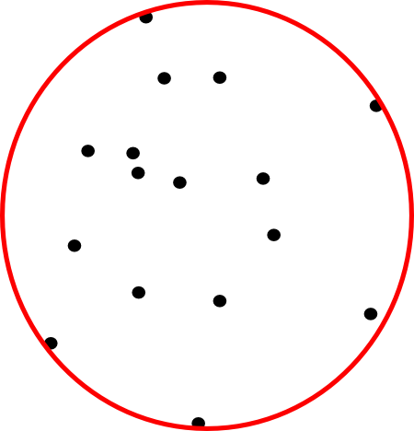
Facility location
Minimax facility location (k-center)
  Given n points
  Find k centers
  Minimize the maximum distance from each point to its nearest site
  K = 1: Minimum enclosing ball
Minisum facility location (k-median)
  Given n points
  Find k centers
  Minimize the (weighted) sum of distances from a given set of point sites to nearest site

Slide 3
Minimax facility location (k-center)
Exact solution: NP hard
Approximation factor=approximation/optimum
Approximation: also NP hard when the error is small.
  Approximation: NP hard when approximation factor is less than 1.822 (dimension = 2) , 2 (dimension >2).

Slide 4
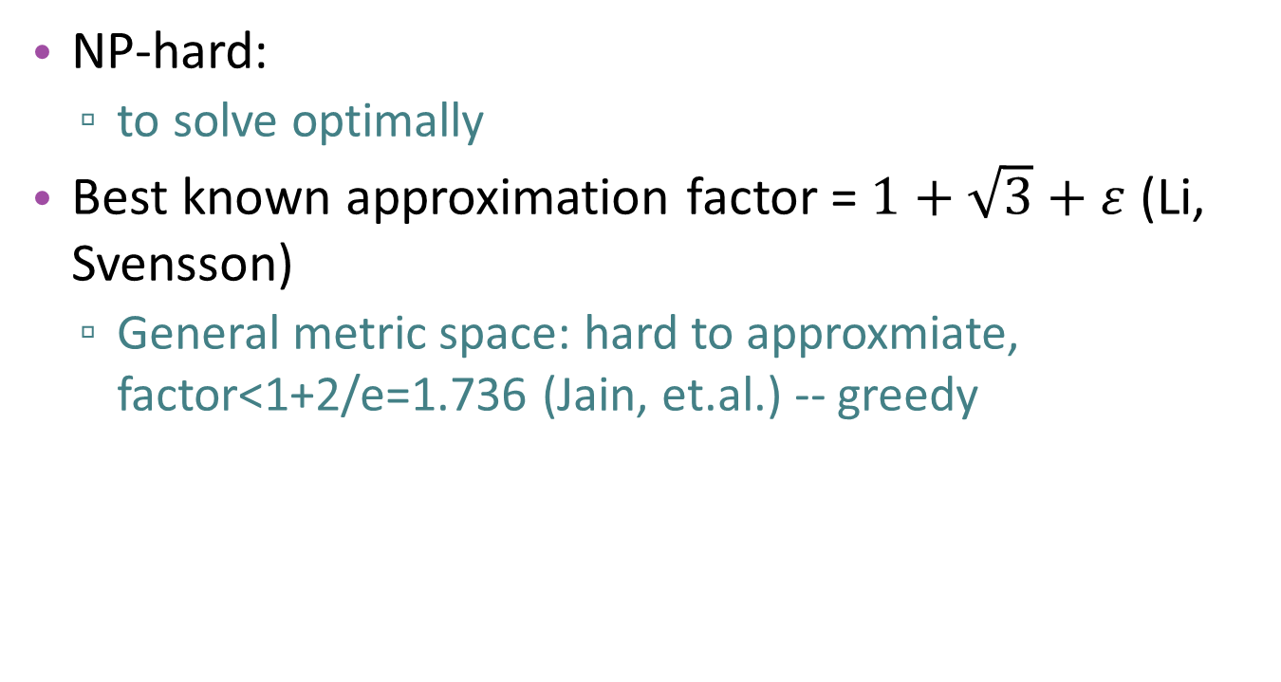
Minisum facility location (k-median)
NP-hard:
  to solve optimally
Best known approximation factor = $1+\sqrt{3}+ε$ (Li, Svensson)
  General metric space: hard to approxmiate, factor<1+2/e=1.736 (Jain, et.al.) -- greedy

Slide 5
Fault Tolerant Clustering
Fault Tolerance
  partial failure
  Redundancy
i fault tolerant
  The system can survive faults in i components and still work.
Fault tolerant clustering
  Keep i centers instead of one

Slide 6
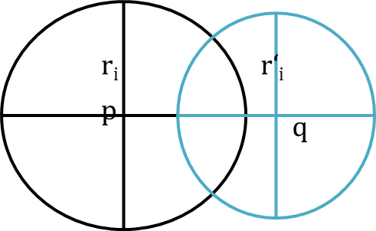
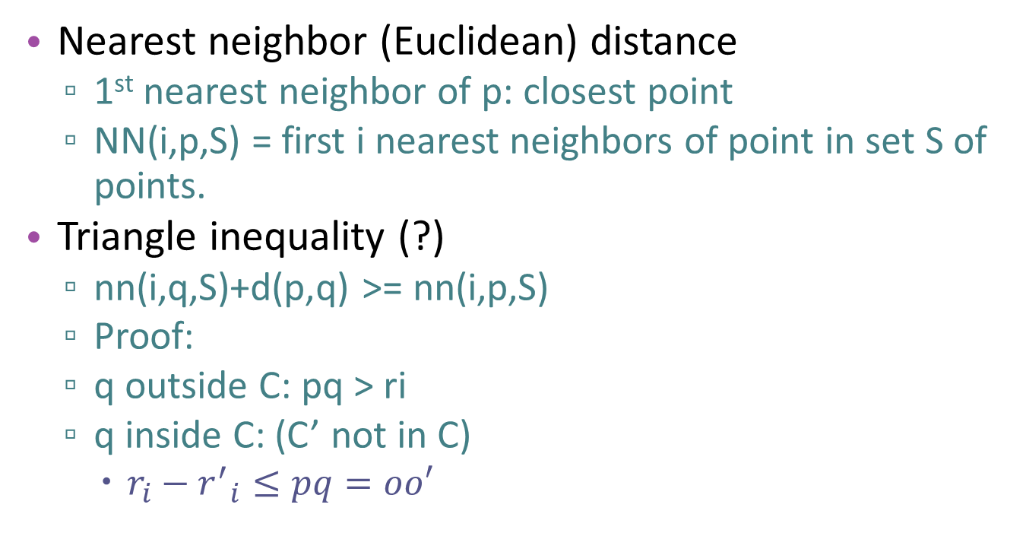
Nearest Neighbor Distance Metric
Nearest neighbor (Euclidean) distance
  1st nearest neighbor of p: closest point
  NN(i,p,S) = first i nearest neighbors of point in set S of points.
Triangle inequality (?)
  nn(i,q,S)+d(p,q) >= nn(i,p,S)
  Proof:
  q outside C: pq > ri
  q inside C: (C’ not in C)
    $r_{i}−{r^{′}}_{i}≤pq=oo′$

Slide 7

Fault Tolerant k-median
A (P,k) = approximation algorithm for k-median
Algorithm:
  Run algorithm A (P,k/i) → output: centers={q₁,…,q_{k/i}}
  $C=\bigcup_{j=1}^{k/i}{{NN}_{i}(q_{j},P)}$

Slide 8
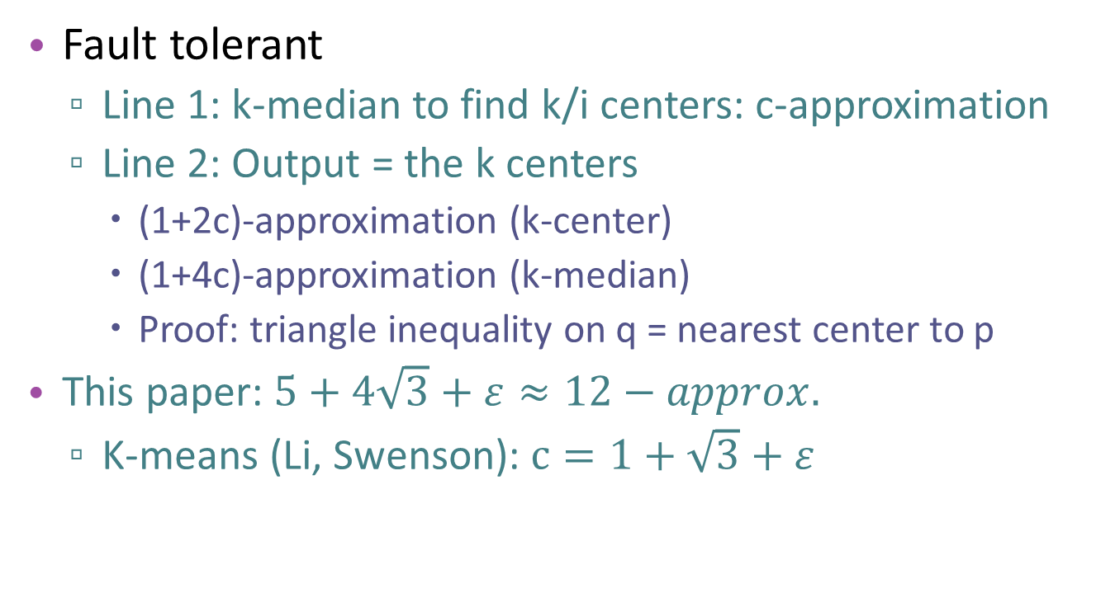
Analysis
Fault tolerant
  Line 1: k-median to find k/i centers: c-approximation
  Line 2: Output = the k centers
    (1+2c)-approximation (k-center)
    (1+4c)-approximation (k-median)
    Proof: triangle inequality on q = nearest center to p
  This paper: $5+4\sqrt{3}+ε≈12−approx.$
  K-means (Li, Swenson): $c=1+\sqrt{3}+ε$

Slide 9
Gonzalez’s Algorithm (k-center)
“Farthest Point Clustering (FPC)”
Best approximation factor for general metric spaces
Total time = O(kn), n=#points, k=#clusters
Algorithm:
  C={p} (arbitrary point)
  Find furthest point in P from C and add it to C
  Repeat until |C|=k
Implementation: keep clusters => each step O(n)
Notes:
Evaluation function: min(max inter-cluster distance)

Slide 10
Analysis
Gonzales k-center
  2-approximation
Fault tolerant k-center + Gonzales
  If i|k : 3-approximation
  else: 4-approximation
  better than 5-approximation (1+2c)
  proof: triangle inequality (Euclidean) on opt center
Best fault tolerant k-center
  2-approximation (Chaudhuri, et.al.) (Khuller, et.al.)

Slide 11
Future work
LP-rounding (k-median) fault tolerant (Swamy, Shmoys)
  Needs all i-nearest servers to work
Fault tolerant k-center(Chaudhuri)
  given a number p, we wish to place k centers so as to minimize the maximum distance of any non-center node to its pth closest center.
Fault tolerant k-center(Khuller)
  each vertex that does not have a center placed on it is required to have at least α centers close to it.
4-approximation → 2-approximation

Slide 12
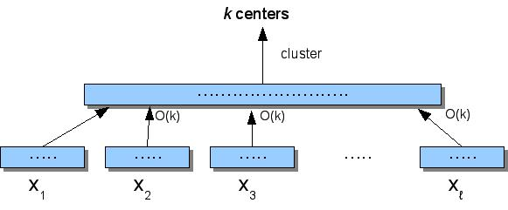

New ideas
Stream clustering
  STREAM (Guha, Mishra, Motwani, O'Callaghan)
    NN metric space
    α-approximation algorithm for threshold t: $cost≤αt$

Slide 13

Based on a true story!
“Fault Tolerant Clustering Revisited”
CCCG 2013
By:
Nirman Kumar
Benjamin Raichel

Slide 14
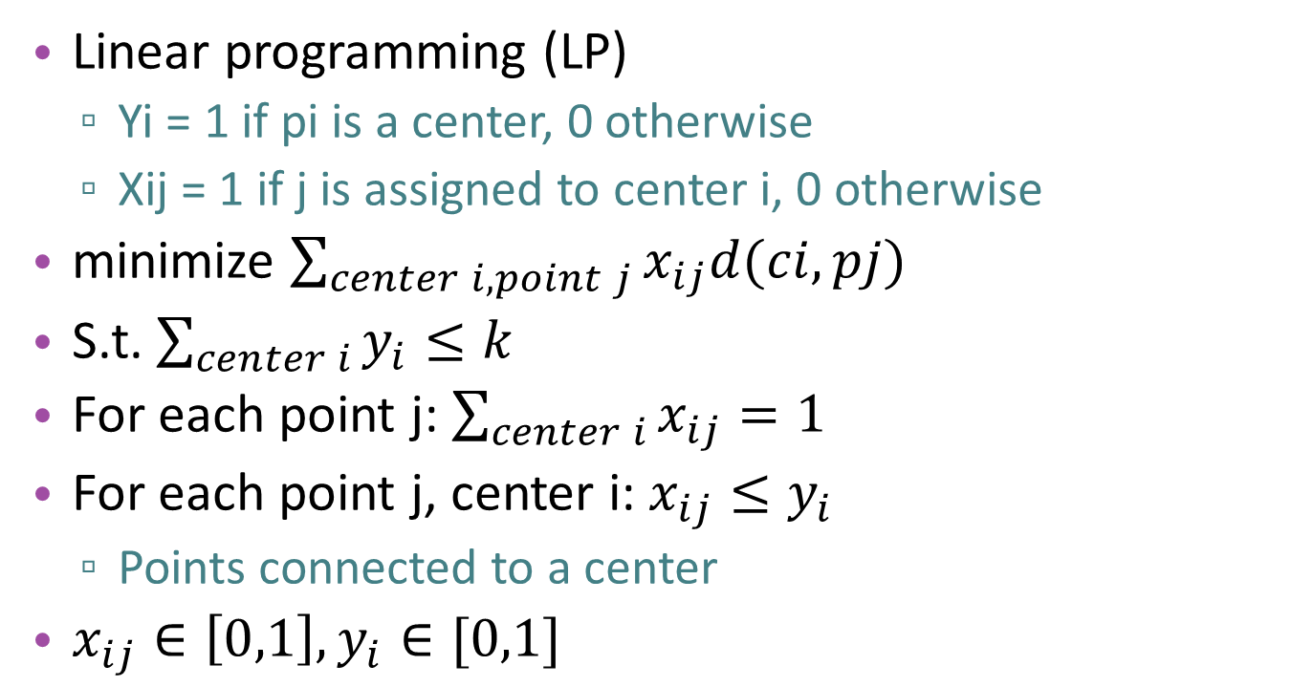
k-median
Linear programming (LP)
  Yi = 1 if pi is a center, 0 otherwise
  Xij = 1 if j is assigned to center i, 0 otherwise
minimize $\sum_{center i, point j}{x_{ij}d(ci,pj)}$
S.t. $\sum_{center i}{y_{i}≤k}$
For each point j: $\sum_{center i}{x_{ij}}=1$
For each point j, center i: $x_{ij}≤y_{i}$
  Points connected to a center
$x_{ij}∈\left[0,1\right],y_{i}∈[0,1]$

Slide 15
Randomized rounding
Yi = probability that pi is a center
Assigning points to closest center: greedy

Slide 17
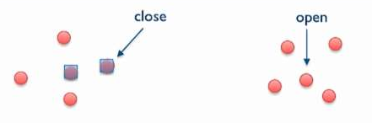
k-median
Local Search Algorithm: (3+ε)-approximation
  S = { k arbitrary points of P} //centers = medians
  Swap: while cost(S+{c_{i}}) > cost(S-{c_{i}}+{p_{j}})
    S = S-{c_{i}}+{p_{j}}

Slide 18
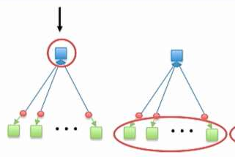
k-median
Star algorithm (Pseudo approximation)
  (1+2/e)-approximation
  Create star graphs (bi-point solution)
    Convex combination of 2 solutions
  For every star do:
    Choose center as median with probability a
    Otherwise choose all leaves as median

Slide 19
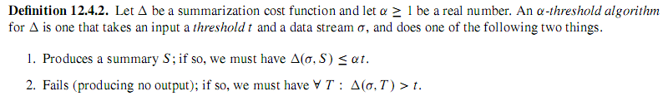

Slide 20
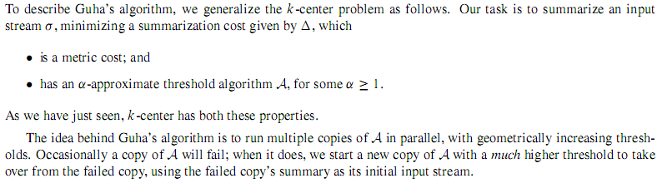
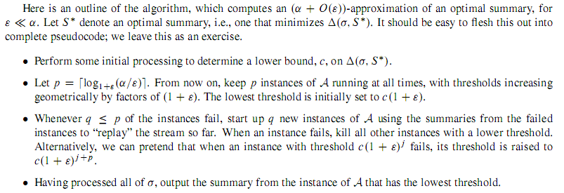

Slide 21
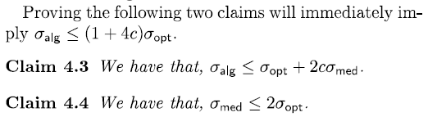

Slide 23
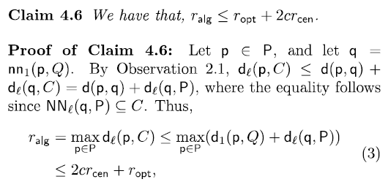


Slide 24
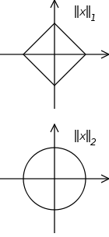
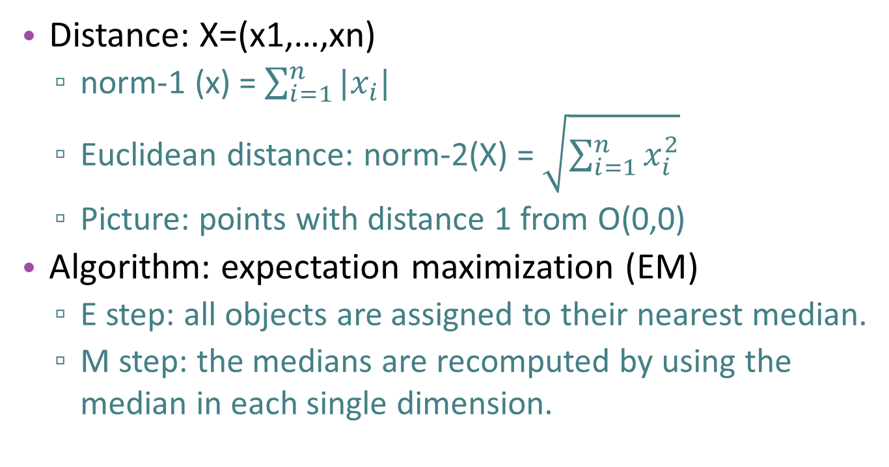
K-median
Distance: X=(x1,…,xn)
  norm-1 (x) = $\sum_{i=1}^{n}{|x_{i}|}$
  Euclidean distance: norm-2(X) = $\sqrt{\sum_{i=1}^{n}{x_{i}^{2}}}$
  Picture: points with distance 1 from O(0,0)
Algorithm: expectation maximization (EM)
  E step: all objects are assigned to their nearest median.
  M step: the medians are recomputed by using the median in each single dimension.

