Slide 1
Introduction
In The Name Of Allah, The Beneficent, The Merciful
C#
www.CSharpSchool.blog.ir

Slide 2
Contents
Visual Studio 2012 IDE
Creating Applications
  Console Application
  Windows Forms Application
  ASP.NET Web Page
C# and the .NET Framework

Slide 3
Setting the Visual C# Settings

Slide 4
Visual C# Keyboard Settings
After installing Visual Studio 2012, select the Visual C# Settings from the Default Collection of Settings window.
This sets the keyboard commands and the user interface for the C# environment.
  Run: Ctrl-F5, Debug: F5, Build: Ctrl-Shift-B, etc.
  New Website command in the Start Page if you select Web Development settings.
If you miss the window, or select another setting, then select the command Import and Export Settings from the Tools menu.

Slide 5
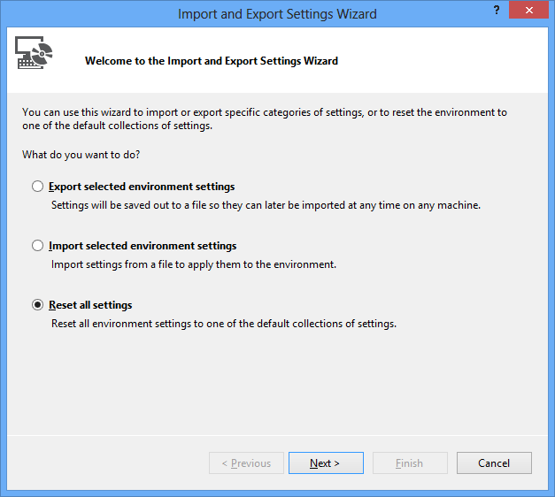

Slide 6
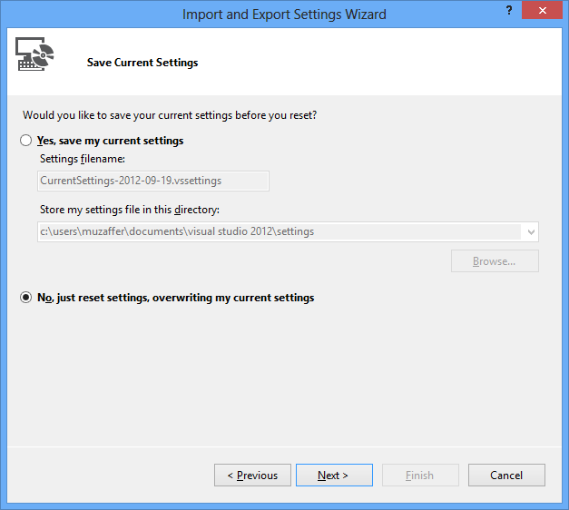

Slide 7
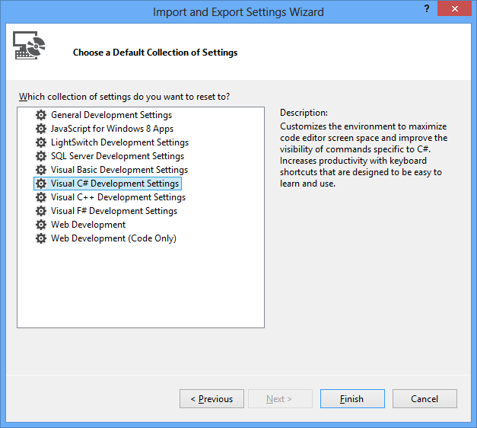

Slide 8
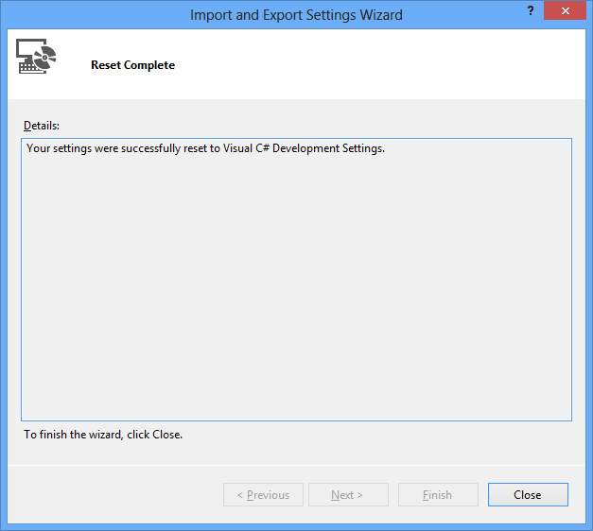

Slide 9
Creating a Console Application

Slide 10
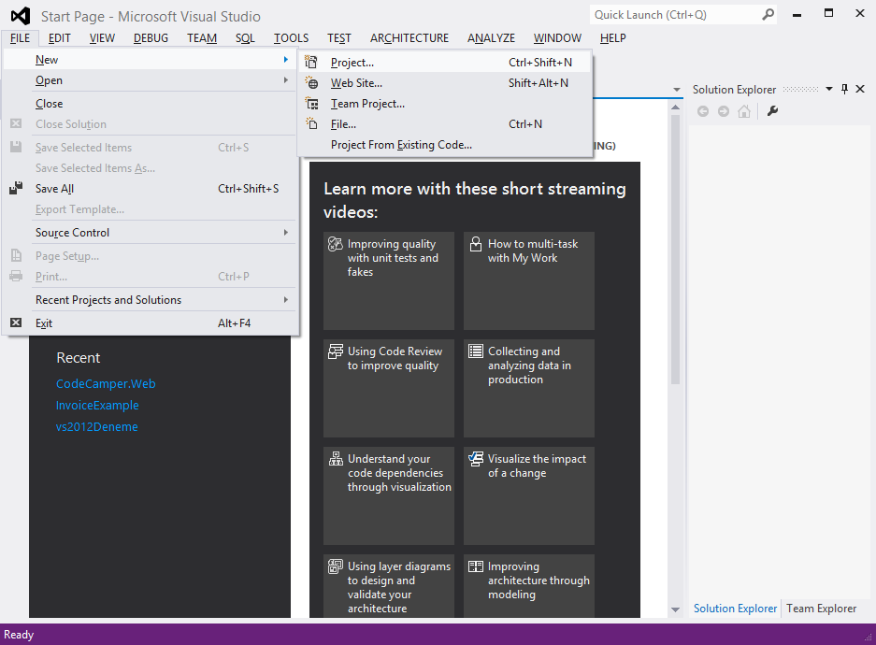

Slide 11
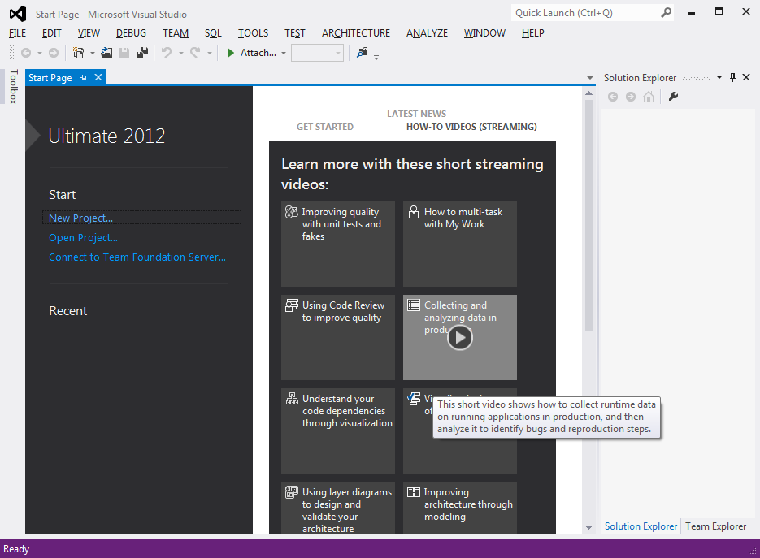

Slide 12
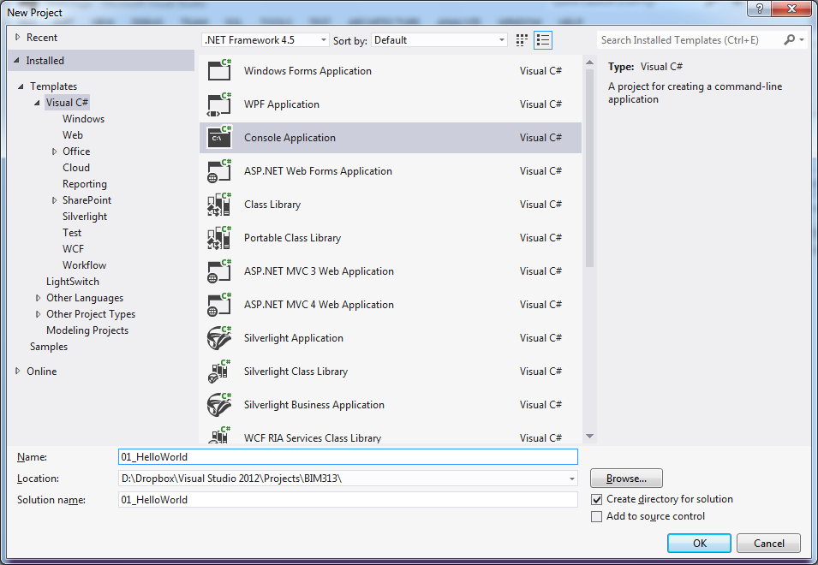

Slide 13
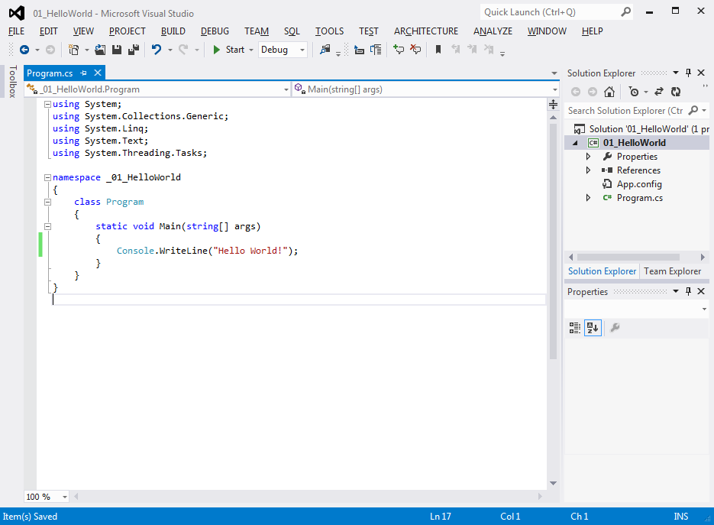
Write the code and press Ctrl-F5

Slide 14
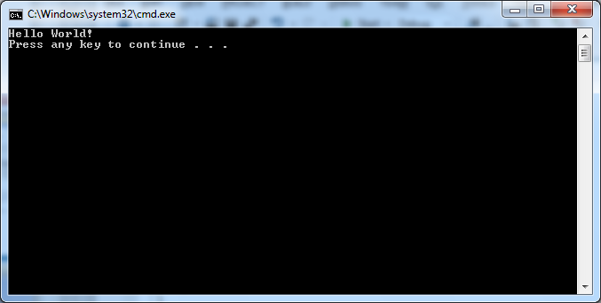

Slide 15
Creating a Windows Forms Application

Slide 17
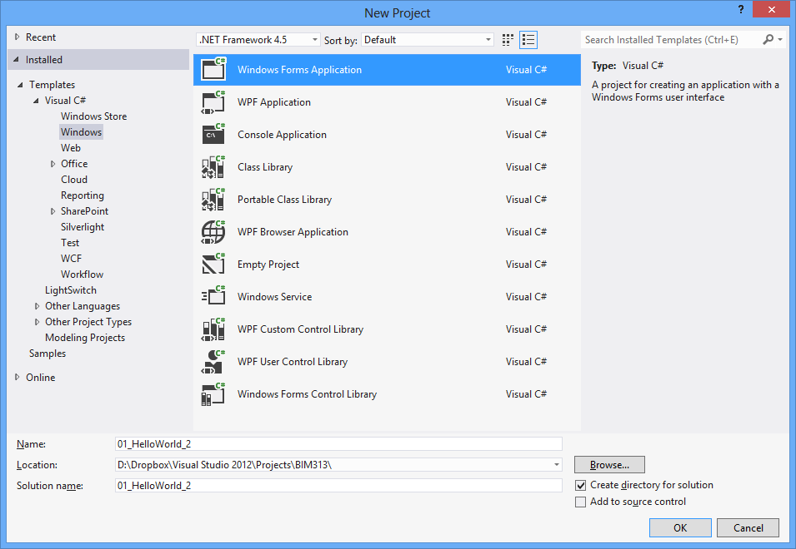

Slide 18
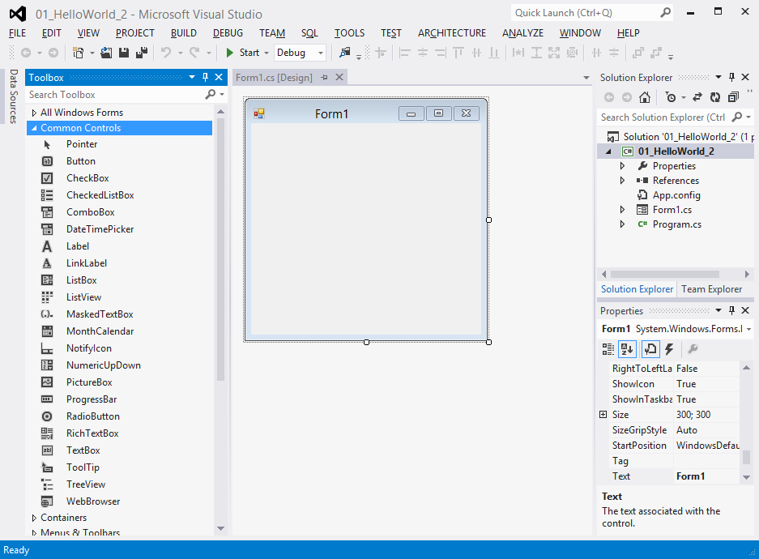
Drag & drop a label and button onto the form

Slide 19
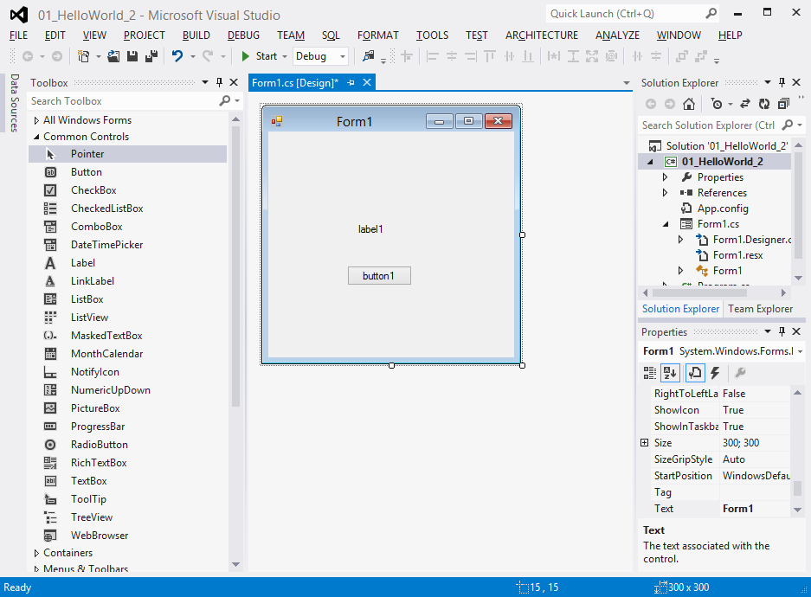
Double-click the button

Slide 20
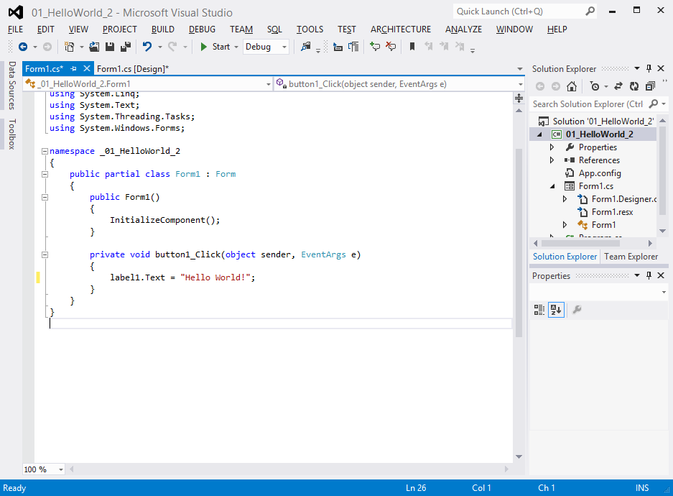
Write the code and press Ctrl-F5

Slide 21
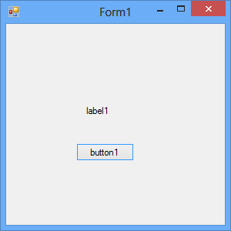
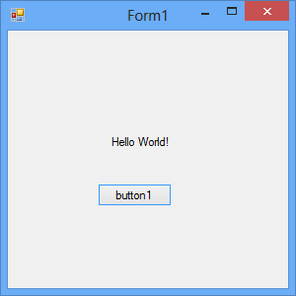
Click the button

Slide 22
Creating an ASP.NET Web Page

Slide 23
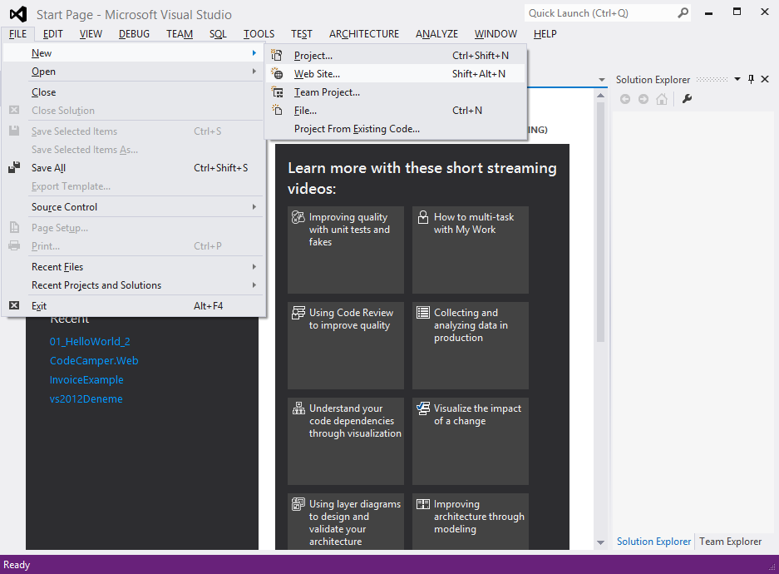
Do NOT select File -> New -> Project -> ASP.NET Web Forms Application

Slide 24
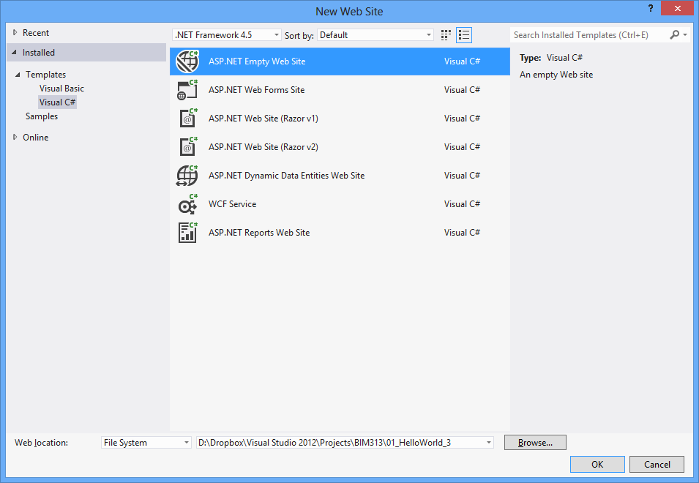

Slide 25
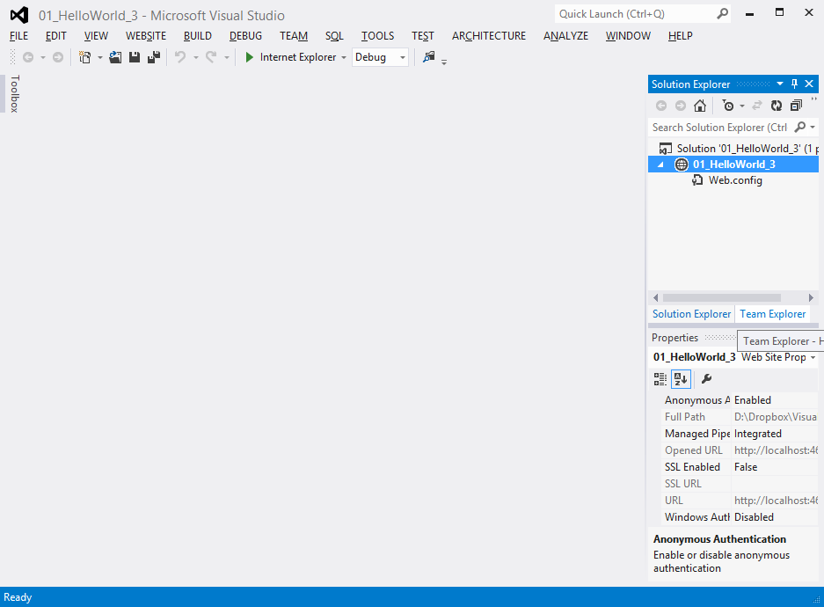
Right-click the project name and select Add -> Add New Item
(equivalently: Add -> Web Form)

Slide 26
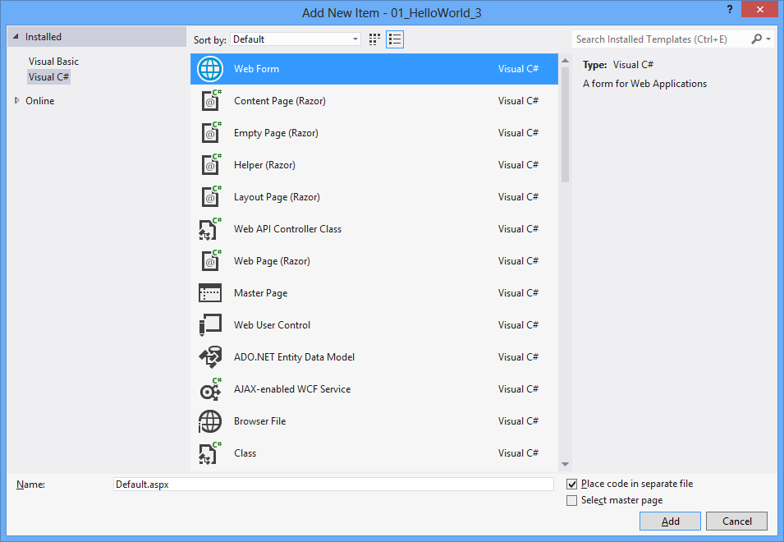

Slide 27
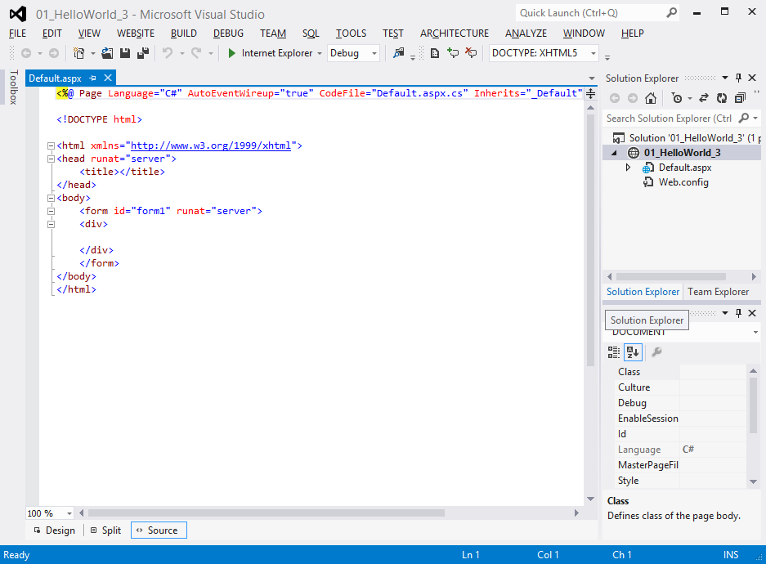
Switch to Design View

Slide 28
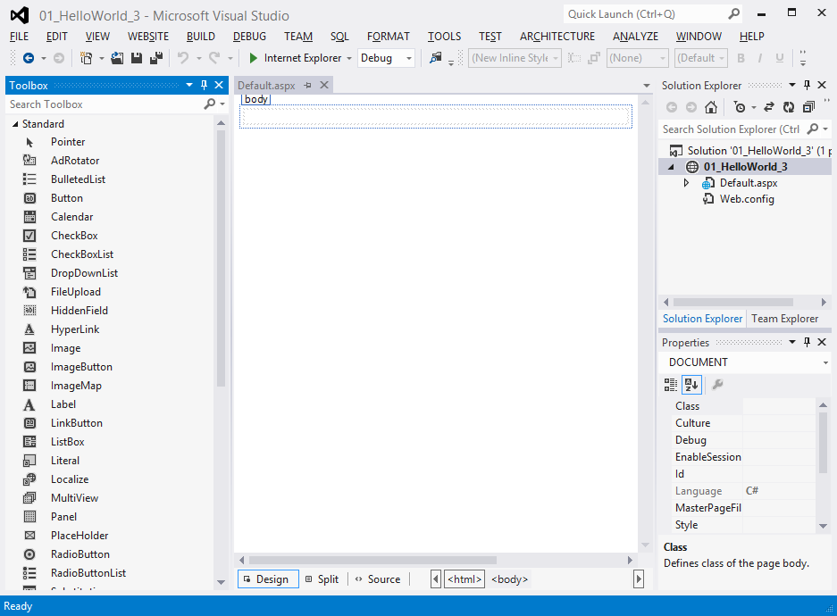
Put a Label, press the Enter key, and put a Button

Slide 29
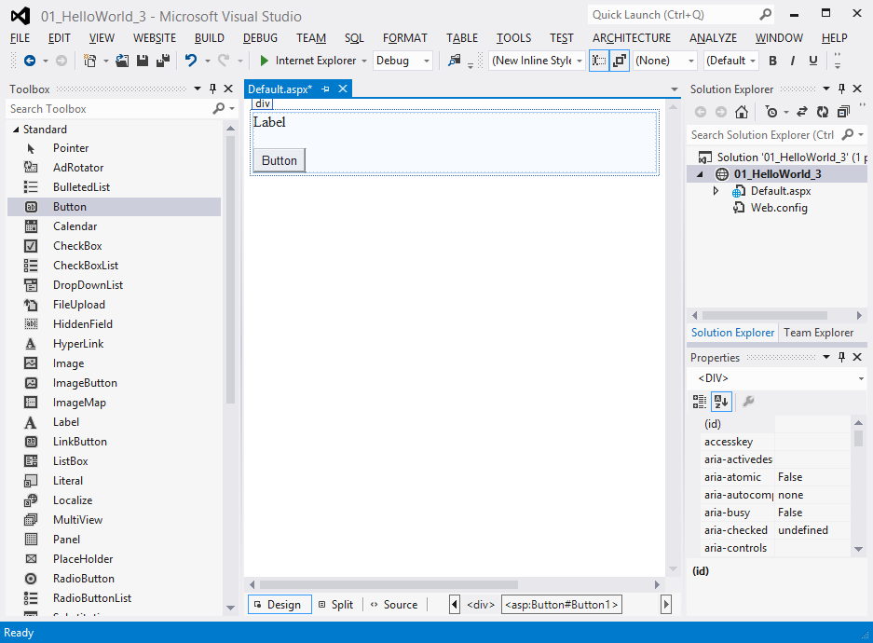
Double-click the button

Slide 30
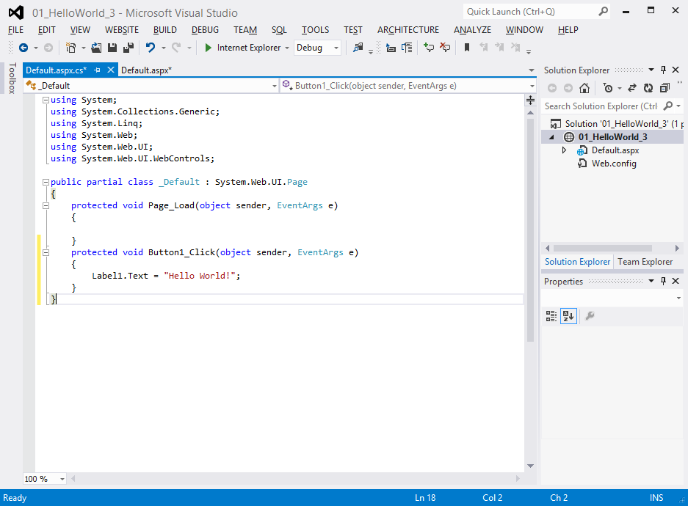
Write the code and press Ctrl-F5

Slide 31
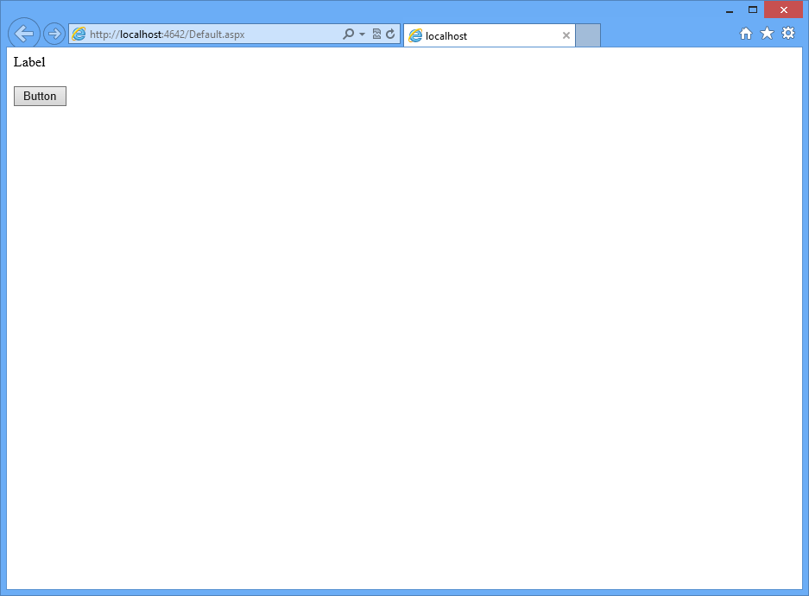
Click the button

Slide 32
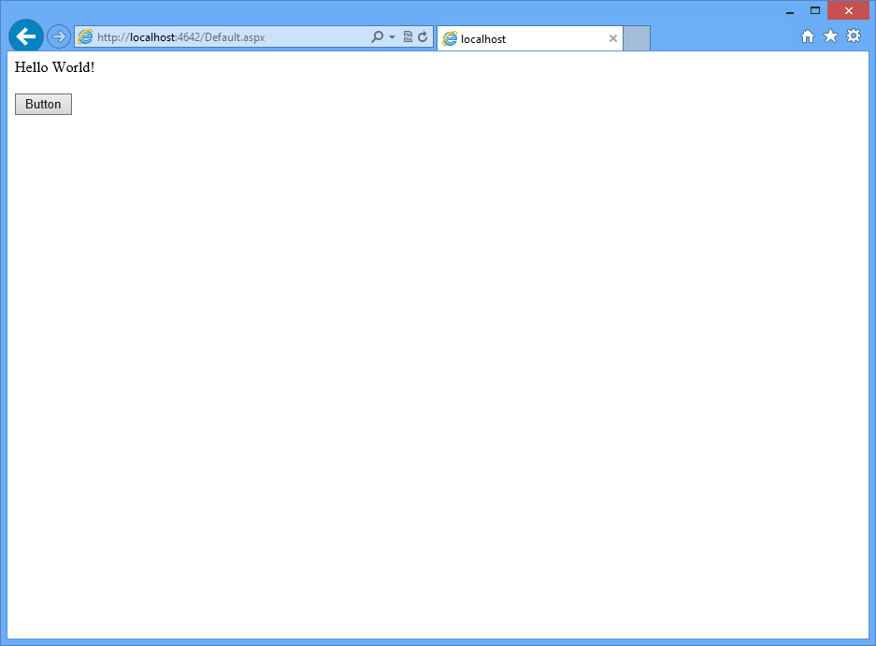

Slide 33
Visual Studio 2012
A powerful integrated development environment (IDE)
Automates the steps required to compile source code
Intelligently detect errors and suggest code where appropriate as you are typing (Intellisense)
Includes designers, enabling simple drag&drop design of UI elements
Includes starter projects
Enables deployment
Enables debugging
etc.

Slide 34
Visual Studio Solutions
You create solutions in Visual Studio
Solutions contain projects
Solutions can contain multiple projects
  This enables you to work on shared code

Slide 35
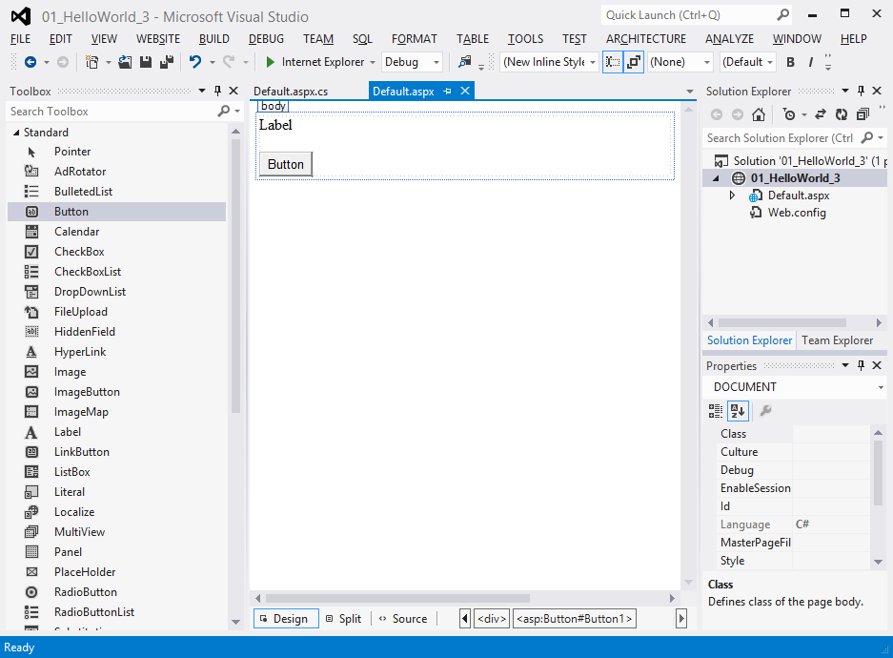
Toolbox
Designer
Solution Explorer
Properties Window

Slide 36
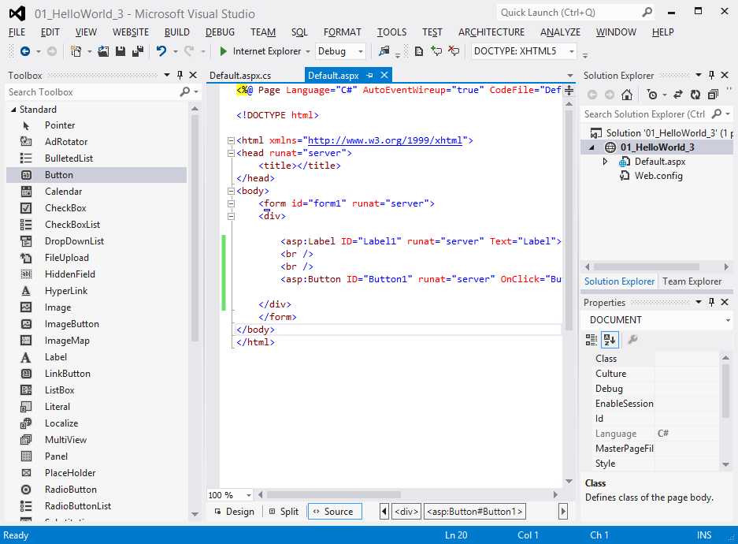
Source Code
Solution
Project
Source Files

Slide 37
با تشکر از توجه شما
پایان
عبداله صارمی نایینی
1393

