Slide 2
FOOD
AND NUTRITIONAL TOXICOLOGY

Slide 3
toxicology is the science of poisons, toxicants, or toxins
Toxins are small poisonous molecules, peptides, or animals, and other organisms like viruses, fungi, bacteria, or protozoa.

Slide 4
The term Toxin usually refers to a poison derived from a protein or conjugated protein produced by some higher plant, animal, or pathogenic bacteria that is highly poisonous for other living organisms, e.g., botulinum toxins

Slide 5
The term Toxicant can be a synonym for Poison , or the term Poison might be more appropriate for the most potent substances, i.e., substances that induce adverse effects at exposure levels of a few milligrams per kilogram of body weight
A toxin is a poison, not all poisons are toxins

Slide 6
Food toxicology deals with substances found in food that might be harmful to those who consume sufficient quantities of the food containing such substances

Slide 7
Nutritional toxicology is the study of the nutritional aspects of toxicology
Nutritional toxicology is related to and might even overlap but is not synonymous with food toxicology

Slide 8
Potential sources of toxicants in food include nutrients, natural food toxicants, contaminants, and chemicals or substances intentionally added to food (food additives).

Slide 9
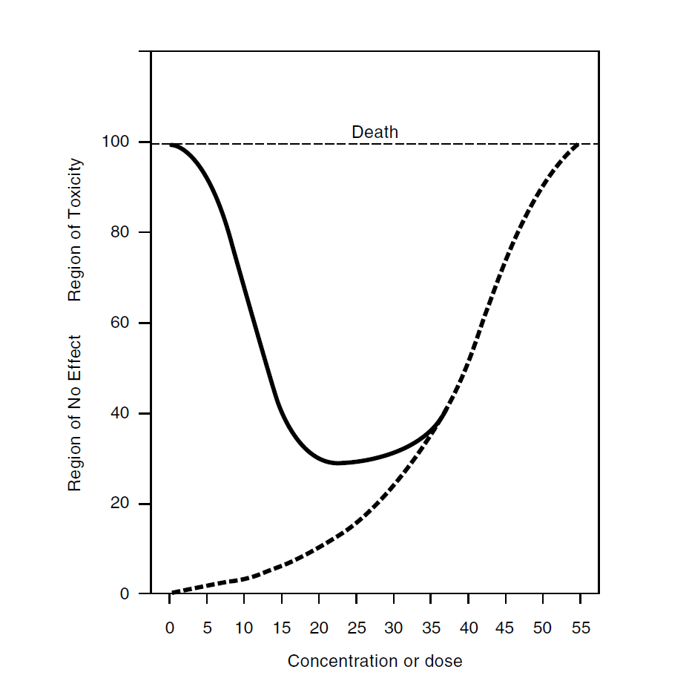

Slide 10
There are some notable examples of natural food toxicants:
toxicant is the toxin produced by the puffer fish
Poisonous Mushroom Amanita muscaria
many phytochemicals are produced as secondary metabolites, have become important defense chemicals used by the plant

Slide 11
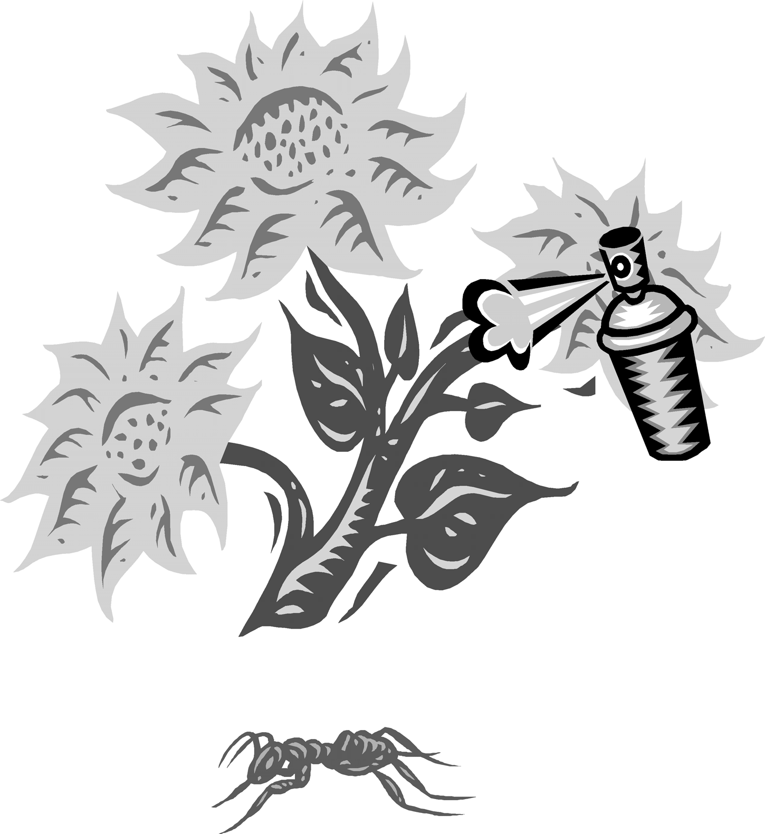

Slide 12
food additives :
Butylated hydroxytoluene (BHT)
nitrite
microbial retardants such as calcium propionate
texturing agents and flavors
residues from fertilizers, pesticides, veterinary pharmaceuticals and drugs
environmental chemicals such as lead or polychlorinated biphenyl (PCB)

Slide 13
Some additives are generally recognized as safe (GRAS) items and require no testing for safety. Others require a battery of tests to ensure their safety for use in consumer foods
No chemical agent is entirely safe and no chemical agent should be considered entirely harmful

Slide 14
The single most important factor determining the potential harmfulness or safeness of a compound is the relationship between the concentration of the chemical and the effect produced on the biological mechanism

Slide 15
the effective dose (ED) and the lethal dose(LD)
ED endpoints are usually therapeutic efficacies, such as the dose to produce anesthesia or analgesia
The calculated LD50 is the statistically estimated dose that when administered to a population will result in the death of 50% of the population

Slide 16
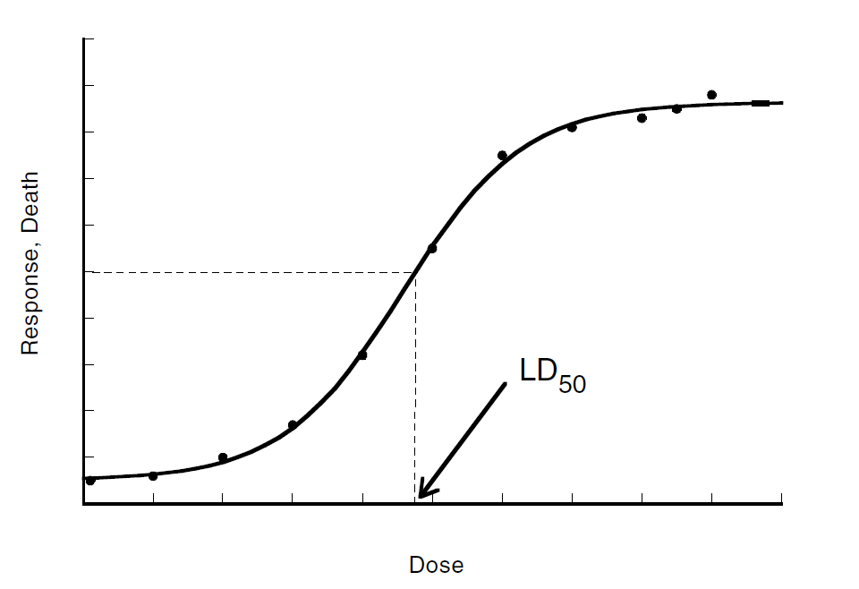

Slide 17

BONE MINERAL MASS
More than 90% of BM is accrued during childhood and adolescence
More than 80% of BM is found in the skeleton
Patients with type 2 diabetes mellitus have more fragility fractures
THE END

