Slide 1

Python basic tutorial
Forward & Condition
Design by : Abdullah Saremi Naeini

Slide 2

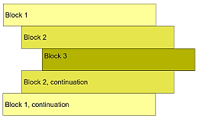
indentation

Slide 3
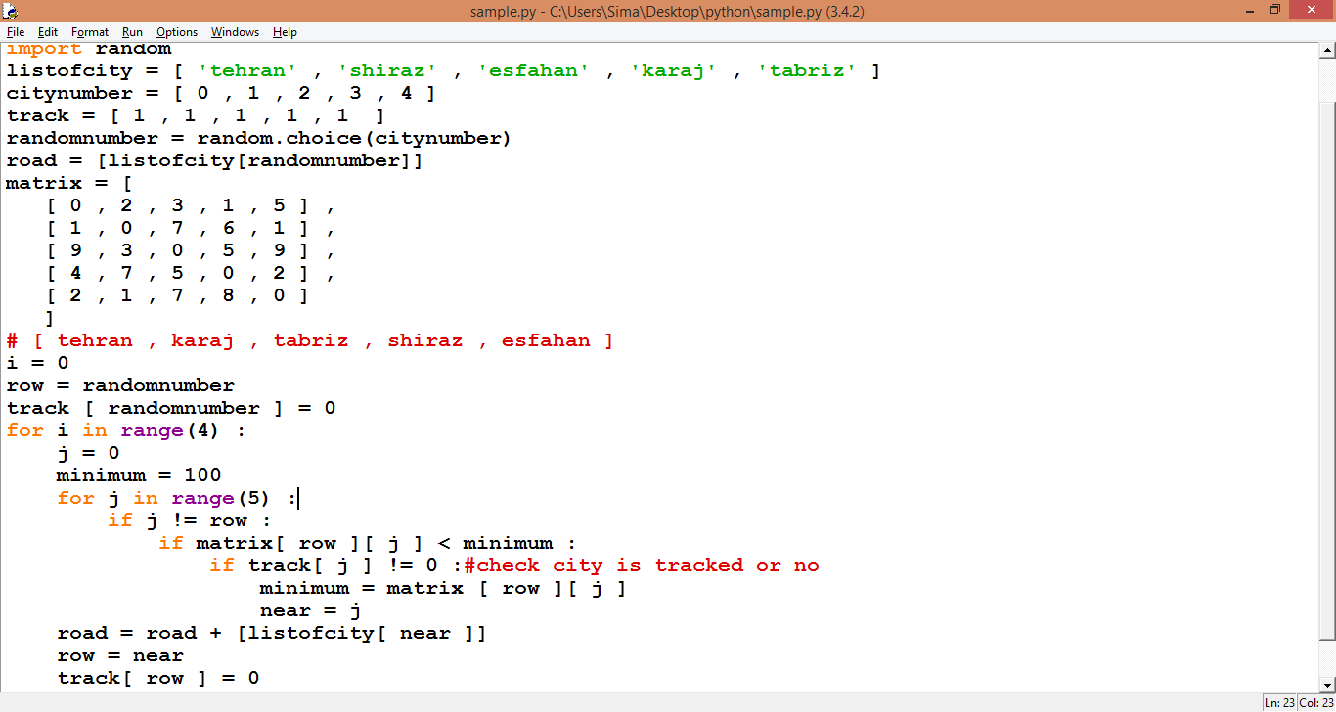
indentation

Slide 4


Slide 5
Swapping Algorithm
X
Y
T
C#
Python
X,Y = « Python« , "C#"
Python
C#
T = X;
Python
C#
X = Y;
Python
C#
Y = T;
Python
C#
Print(X,Y)

Slide 6
Swapping Algorithm
TXXYYT
XAABBX
X=A;
A=B;
B=X;

Slide 7
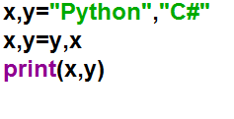
Swapping Algorithm

Slide 8
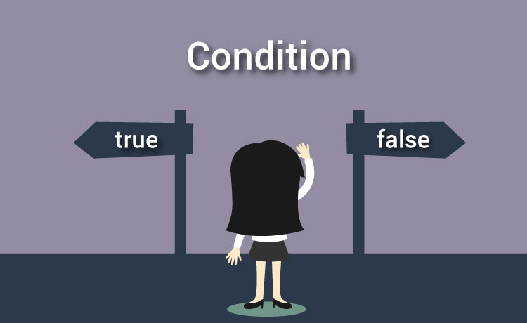

Slide 9
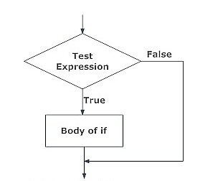
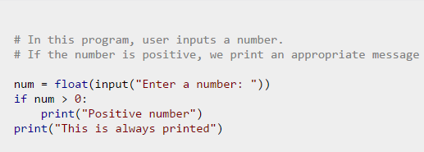
Python if Statement Syntax

Slide 10
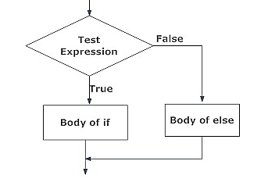
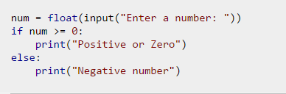
Python if...else

Slide 11
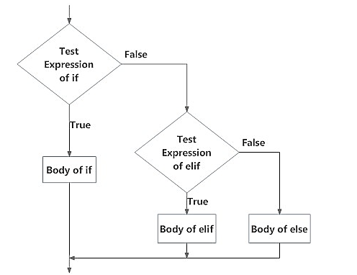
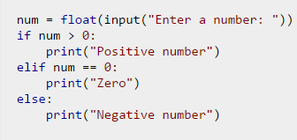
Python if...elif...else

Slide 12
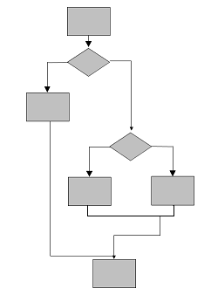
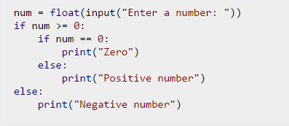
Python Nested if statements

Slide 13
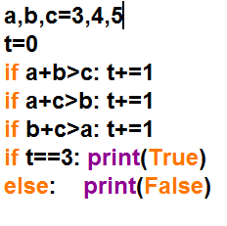
Sample Triangle
1

Slide 14
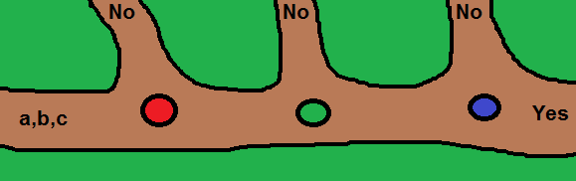
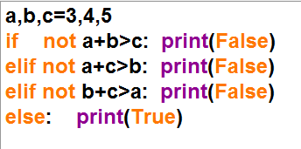
Sample Triangle
2

Slide 15
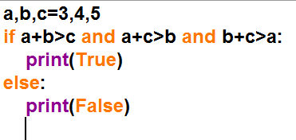
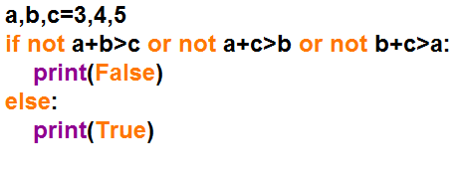
Sample Triangle
3
not (P or Q)=not P and not Q

Slide 16

Sample Triangle
4

Slide 17
پایان
با تشکر از توجه شما
PythonSchool.blog.ir
CsharpSchool.blog.ir
Flowchart.blog.ir
AbuzarArtSchool@yahoo.com

