Slide 1
In The Name Of God Ali Sohrabi
How TO BE A professional Gamer,office worker or programmer

Slide 2
How can we work with the computer without damaging the body for a long time ?

Slide 3
It's so simple. Just by following a few simple tips we can spend hours of pleasure without feel any pain.

Slide 4
Step 1: Sitting correct on the chair.

Slide 5
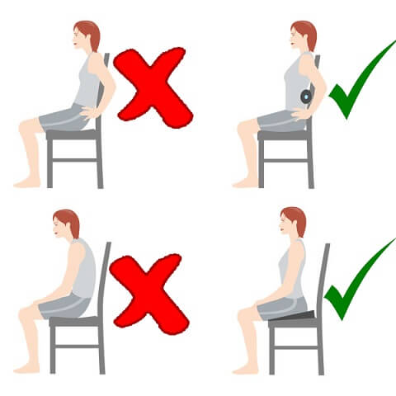

Slide 6
Step 2: Correct use of mouse and keyboard

Slide 7
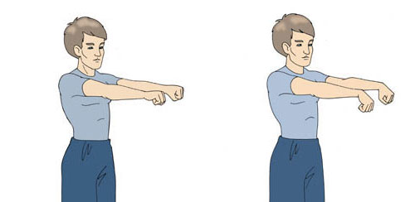
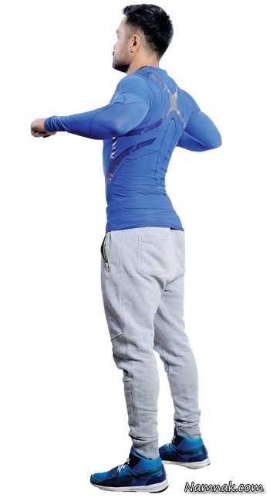
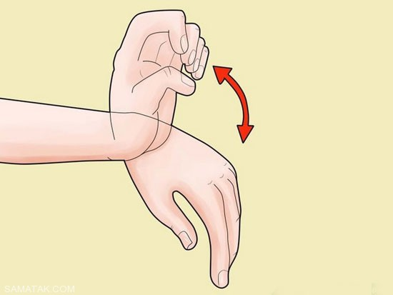
Step 3: For each hour computer work is required at least 5 minutes of exercise

Slide 8
Examples of best ergonomic seats available in the market. And we've got in our country DXracer Dealers. The company's name is Takht-e-Jamshid"

Slide 9
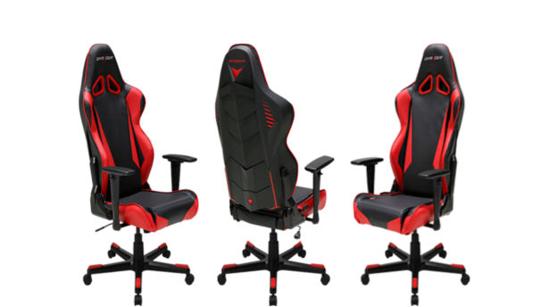

Slide 10
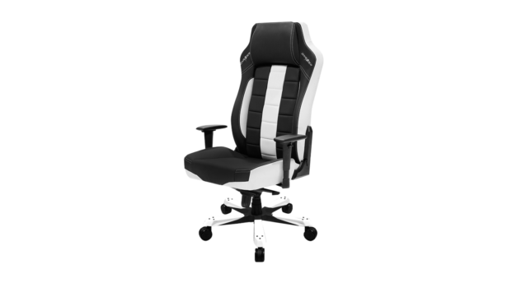
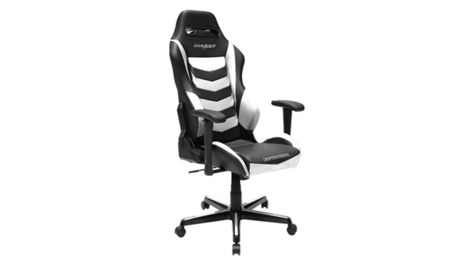
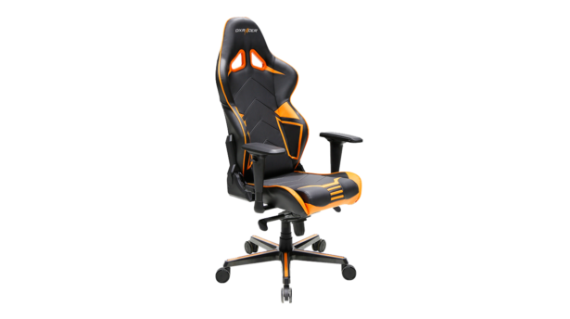
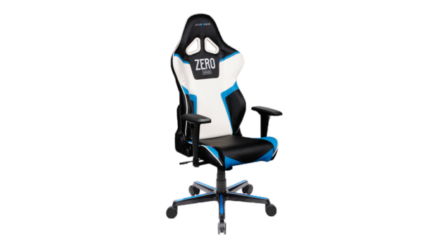

Slide 11
Thanks For Watching .

