Slide 1
My health
In the name of God.
Prospect2 lesson4
By: KUCHAKZADEH

Slide 2
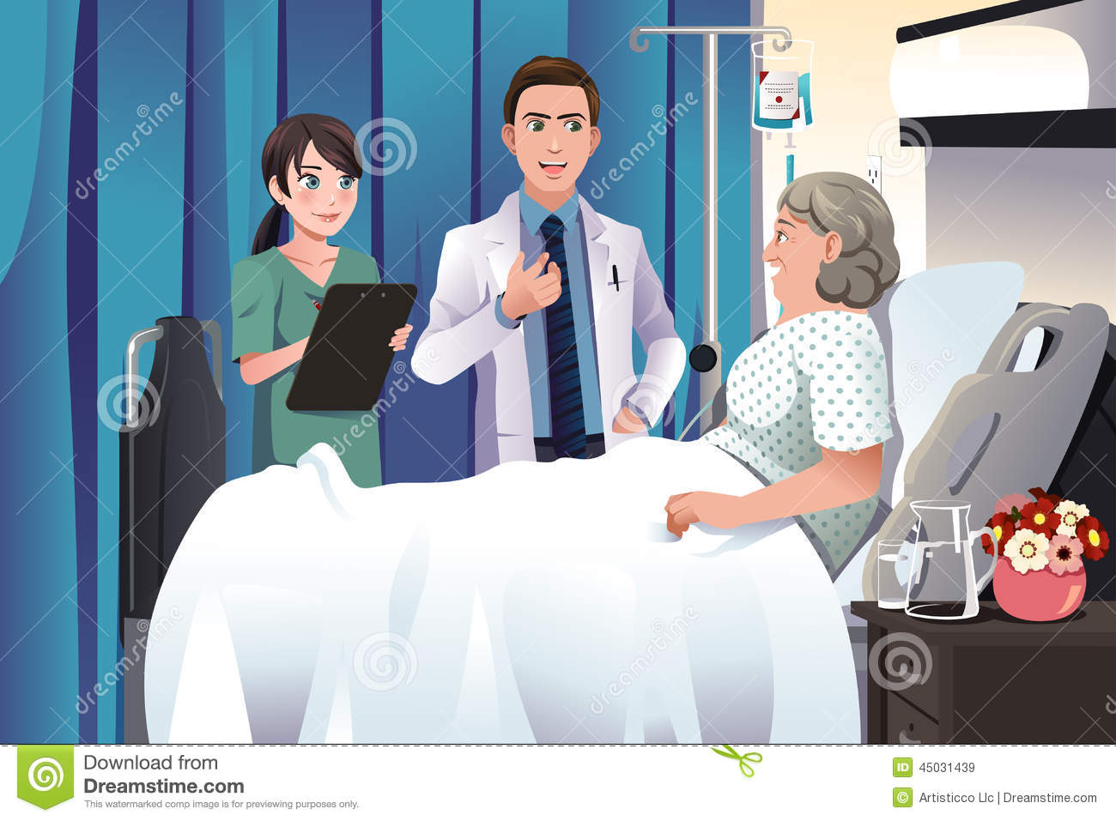
Nurse – Doctor - patient

Slide 3
hospital

Slide 4
drugstore

Slide 5
What’s the matter? What’s wrong? What’s the problem?
Is he OK?
Is she all right?

Slide 6
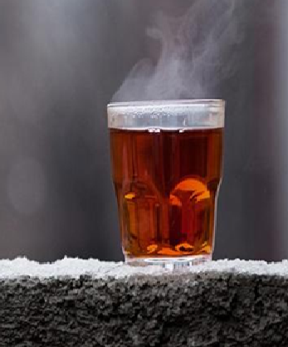
Is he OK?
He should drink hot tea.
No, he isn’t
What’s the matter?
He has a cough.

Slide 7
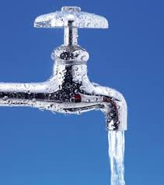
He should wash.
Is he alright?
No, he isn’t.
What’s the matter?
He has a sneeze.

Slide 8
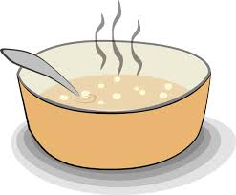
Is he alright?
He should eat soup.
No, he isn’t.
What’s wrong?
He has a running nose.

Slide 9
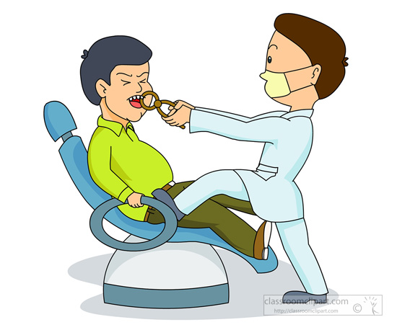
He should go to the dentist.
Is he OK?
No, he isn’t.
What’s the problem?
He has a toothache.

Slide 10
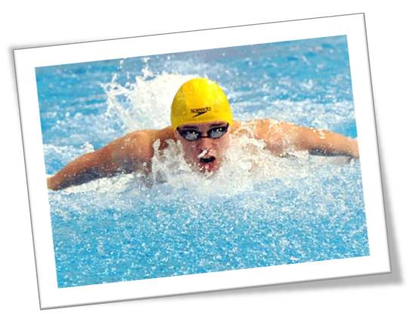
He should go swimming.
Is he OK?
No, he isn’t.
What’s the problem?
He has a backache.

Slide 11
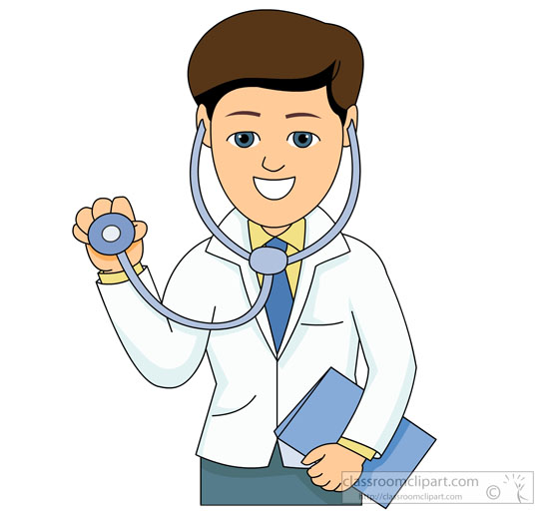
Why doesn’t he see a doctor?
Is he OK?
No, he isn’t.
What’s the problem?
He has a headache.

Slide 12
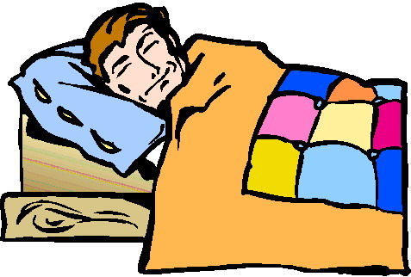
He should rest
Is he alright?
No, he isn’t.
What’s the matter?
He has a fever/cold/temperature.

Slide 13
He should see a doctor.
Is he alright?
No, he isn’t.
What’s wrong?
He has a stomachache.

Slide 14
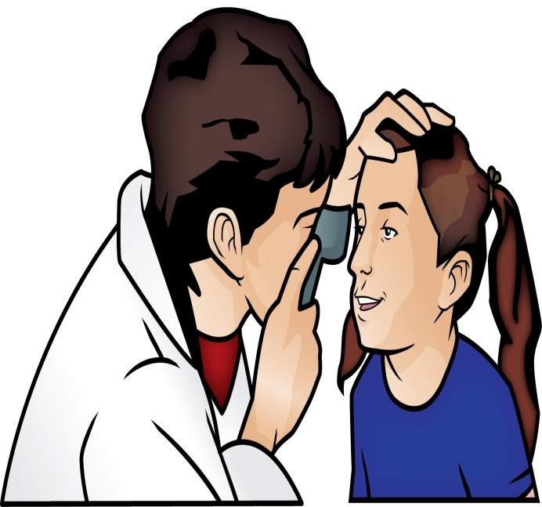
He should see an eye doctor.
Is he OK?
No, he isn’t.
What’s the problem?
He has sore eyes.

Slide 15
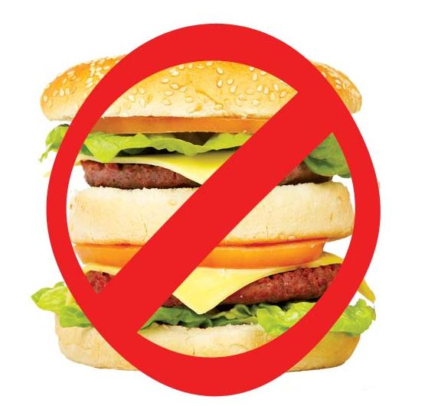
He shouldn’t eat fast food.
Is he OK?
No, he isn’t.
What’s the problem?
He has a sore throat.

Slide 16
He should see a doctor.
Is he alright?
No, he isn’t.
What’s the matter?
He has an earache.

Slide 17
He should stay at home and relax.
Is he alright?
No, he isn’t.
What’s the matter?
He has the flu.

