Slide 1
Adaptive Control
M.Ghorbani

Slide 2
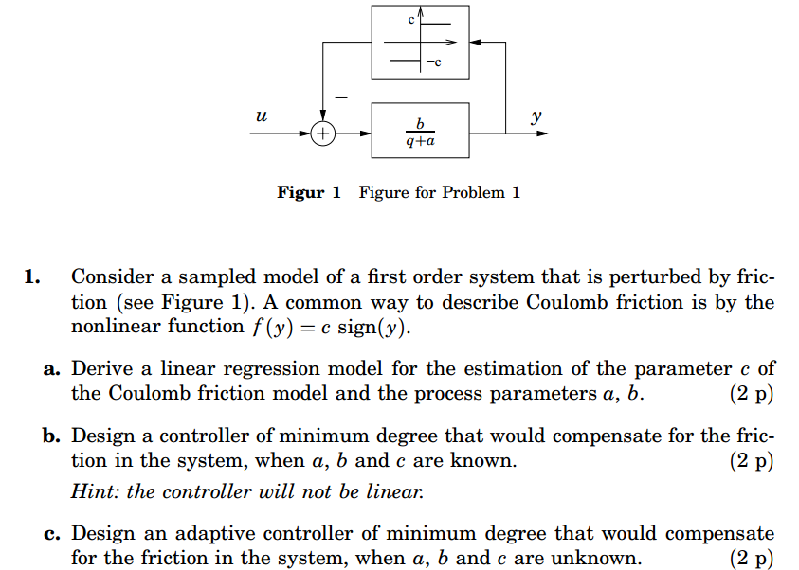
Ex.1

Slide 3
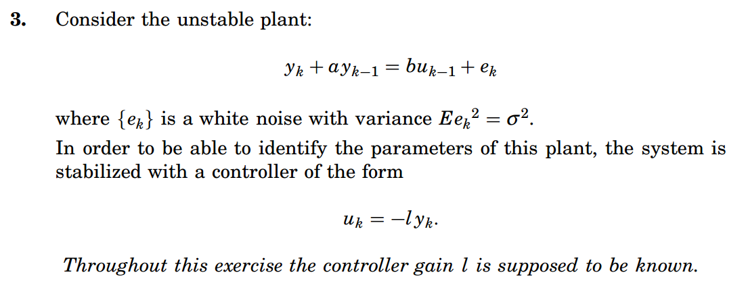
Ex. 2

Slide 4
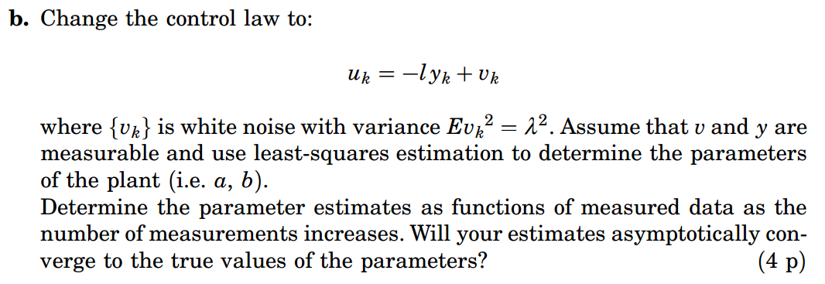
Ex. 2

Slide 5
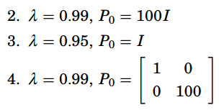
Ex. 3

Slide 6
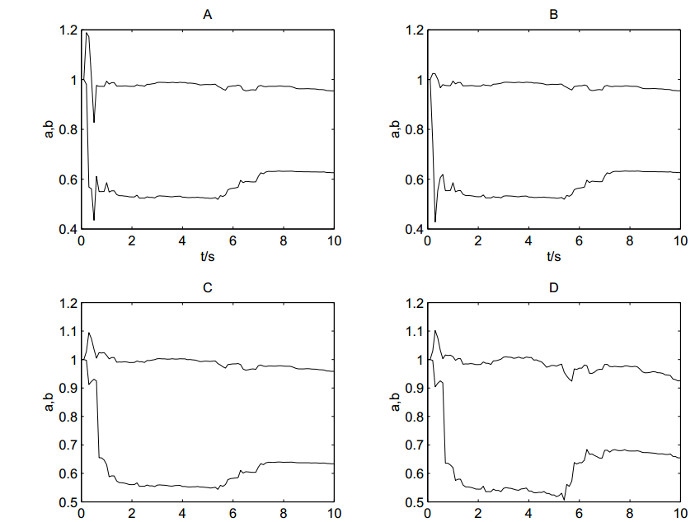
Ex. 3

