Slide 1
In the name of god

Slide 2
Producer: Mohammad Mehnati
Teacher : Mr Amir khah
Salman Parsy school
Closs:803

Slide 3
Lesson 7
My Hobbies
conversation
Lesson to two students and their English teacher talking about their hobbies.
Teacher: Do you have any hobbies, Zahra?
Zahra: Yes, I do. I watch movies as a hobby.
Teacher: Interesting! How about you, Samira?
Samira: Well, I love reading.
Zahra: Really? What sort of things do you read?
Samira: Books, magazines, sports news on the Net, and sometimes poems.
Zahra: And how about you , Mrs. Emami?
Teacher: Actually , I don’t have any hobbies. But I usually go to the gym in
my free time.

Slide 4
Practice 1 talking about Your Hobbies
Do you have any hobbies? Yes , listening to stories on the radio.
When you do as a hobby? I watch movies as a hobby.
Do you like reading? Yes , very much.
What’s your hobby? I enjoy searching the Web.
Practice 2 talking about Your Free Time Activities
What do you do in I go horse riding.
Your free time? I play tennis.
I usually go shopping.
What do you like I walk in the park.
To do in your free time? I like playing computer games.

Slide 5
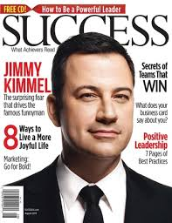
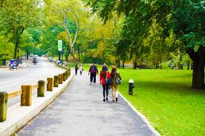
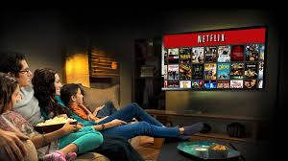
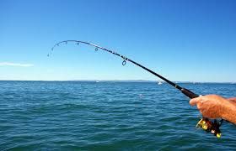
magazine
walking in the park
watching movies
fishing

Slide 6
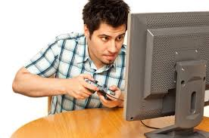
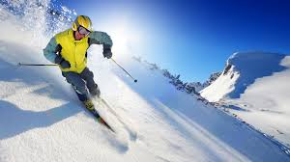
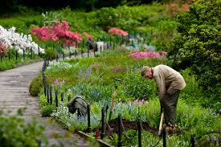
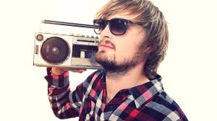
playing computer games
skiing
listening to the radio
working in the garden

Slide 7
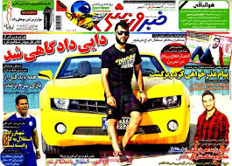
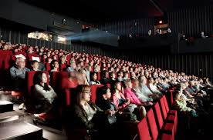
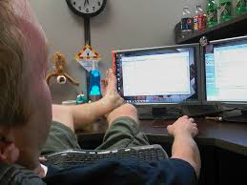
sport news
Going to the movies
browsing the internet

Slide 8
THE END

