Slide 1
Responsive
Bootstrap
Maryam Rabiee
Marzieh Mohammadi

Slide 2
Responsive

Slide 3
History
Definition
Features and Benefits
How to use it?
Responsive Framework

Slide 4
Responsive History

Slide 5
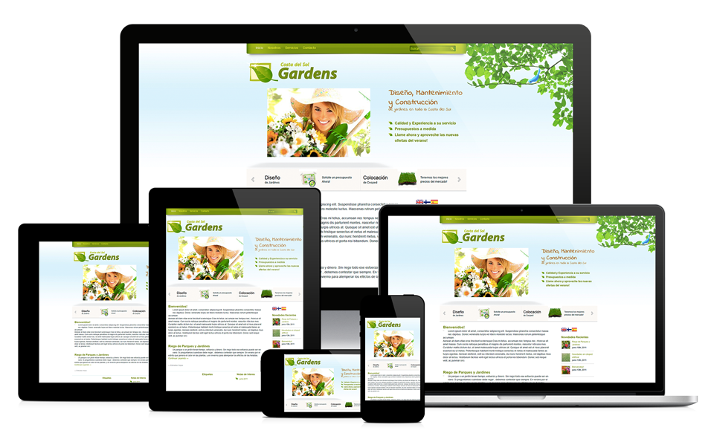
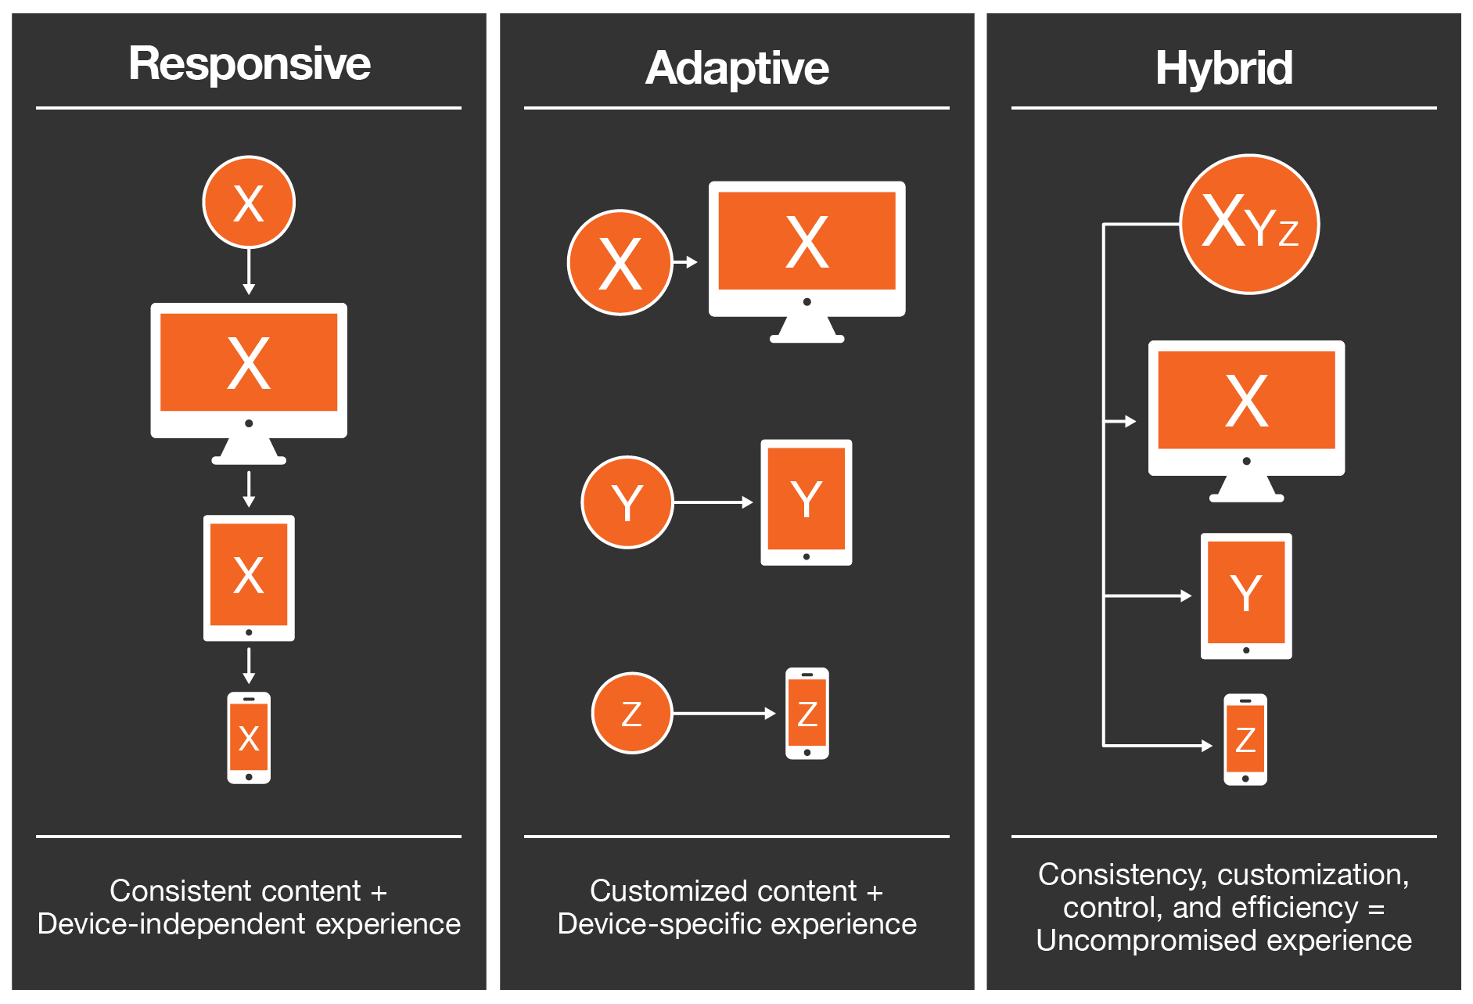
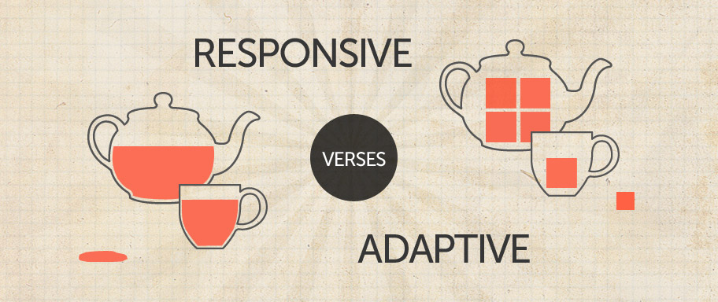
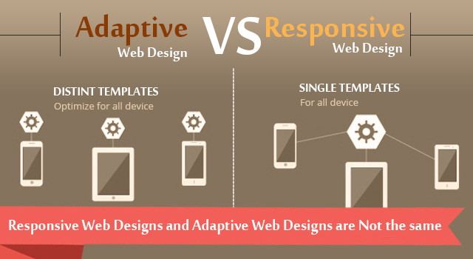
Definition

Slide 8
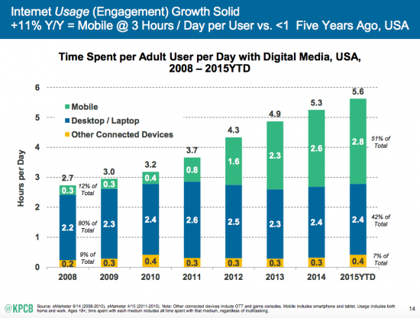
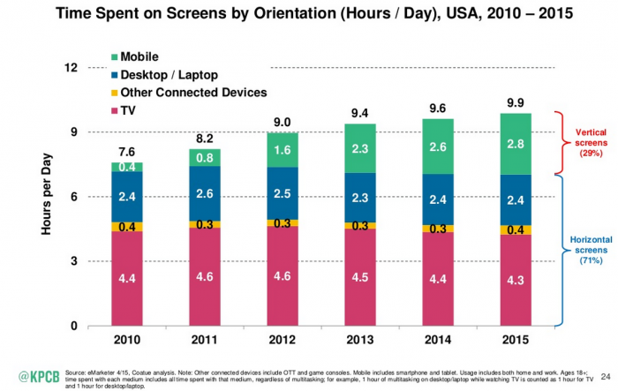

Slide 9
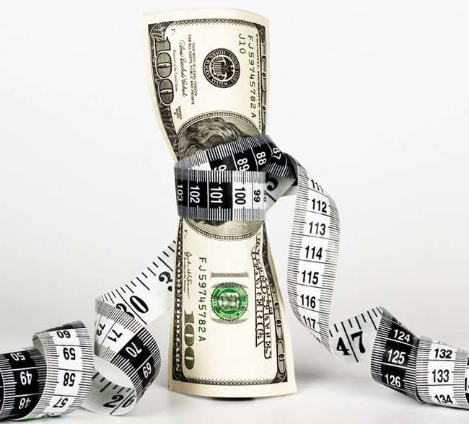
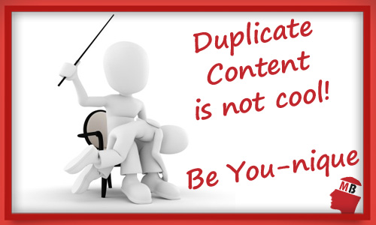
Features and Benefits

Slide 10
How to use it?
Media Queries
@media only screen and (max-width: 500px) { body { background-color: lightblue; } }

Slide 11
Responsive Framework
CSS
Java Script

Slide 12
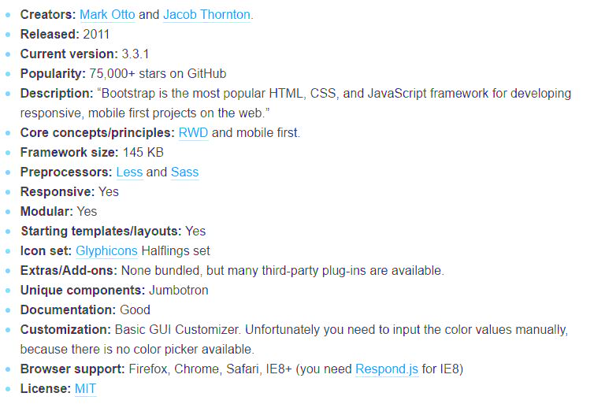
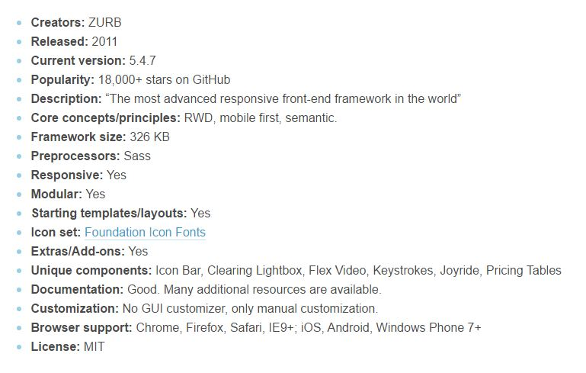
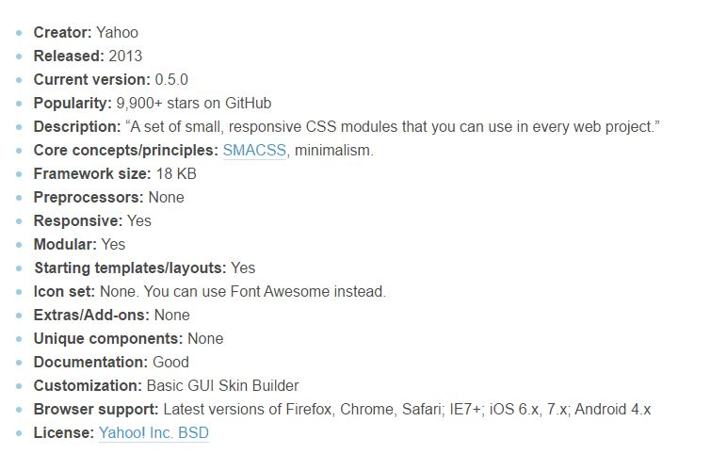
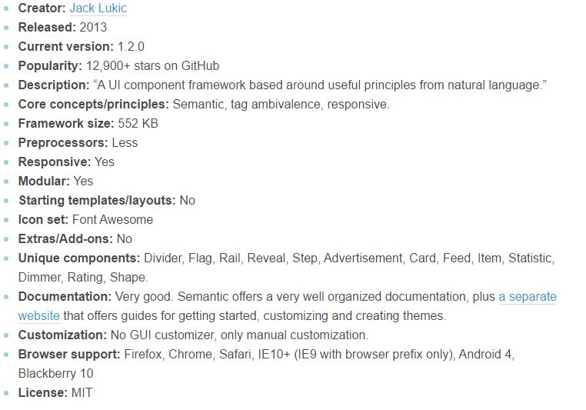
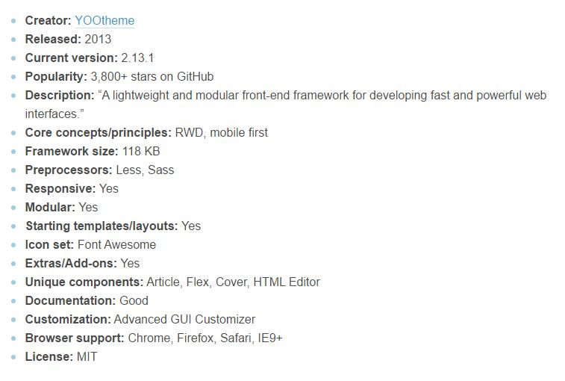
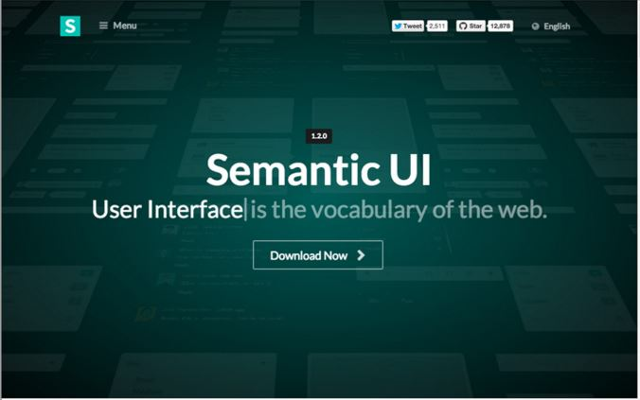
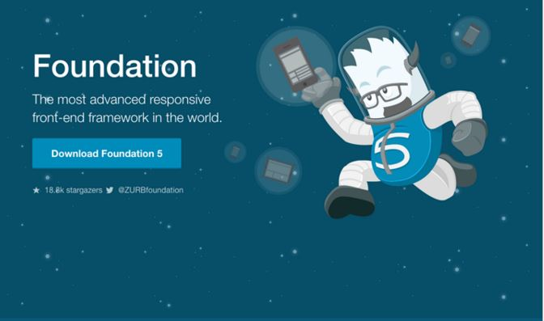
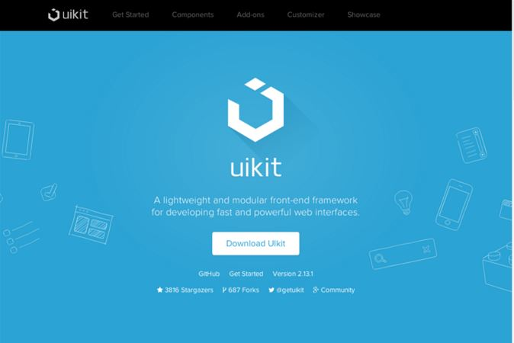
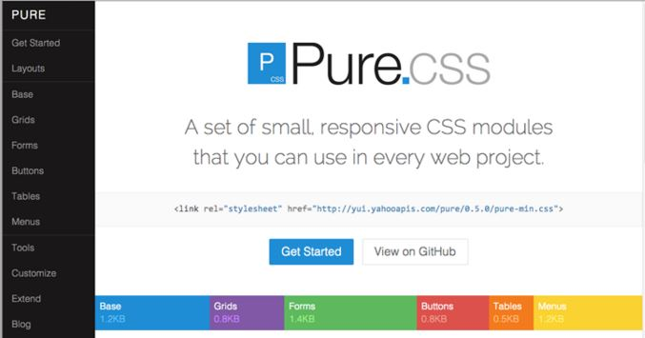
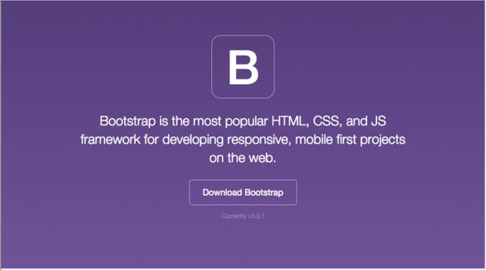
CSS

Slide 13
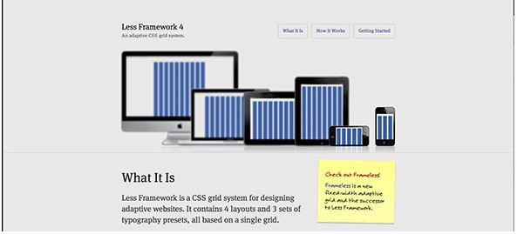
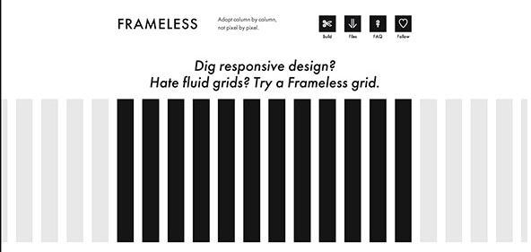
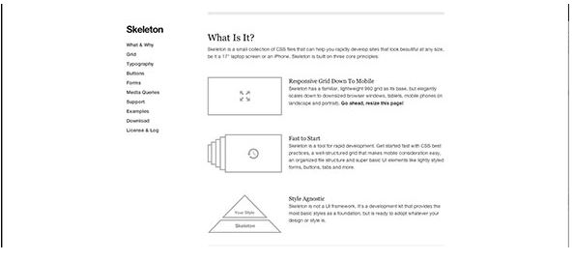
Other

Slide 14
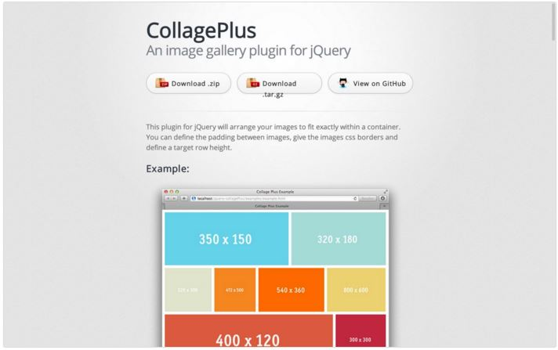
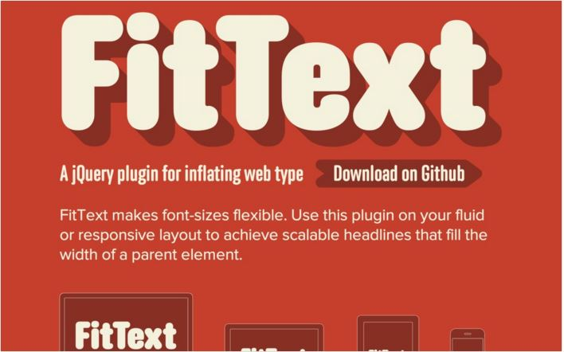
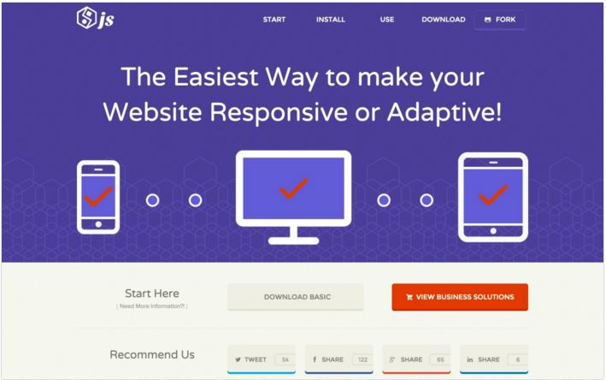
Java Script

Slide 15
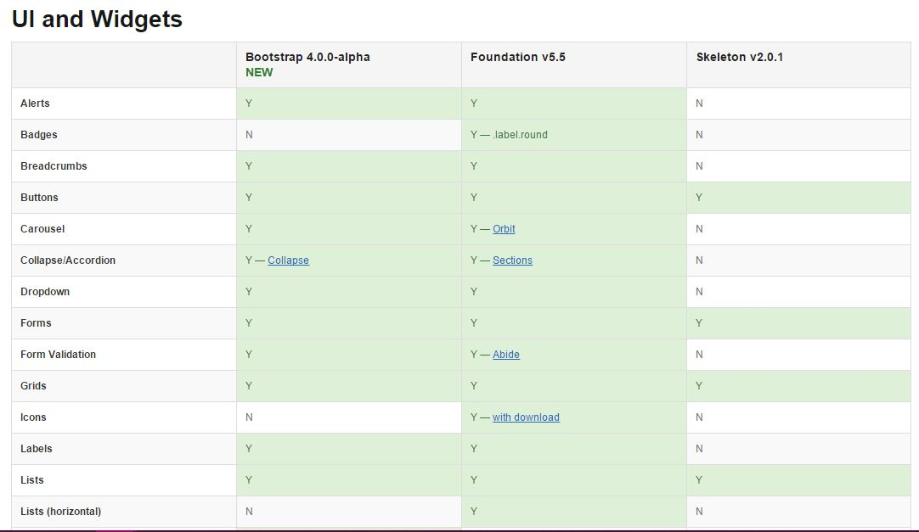
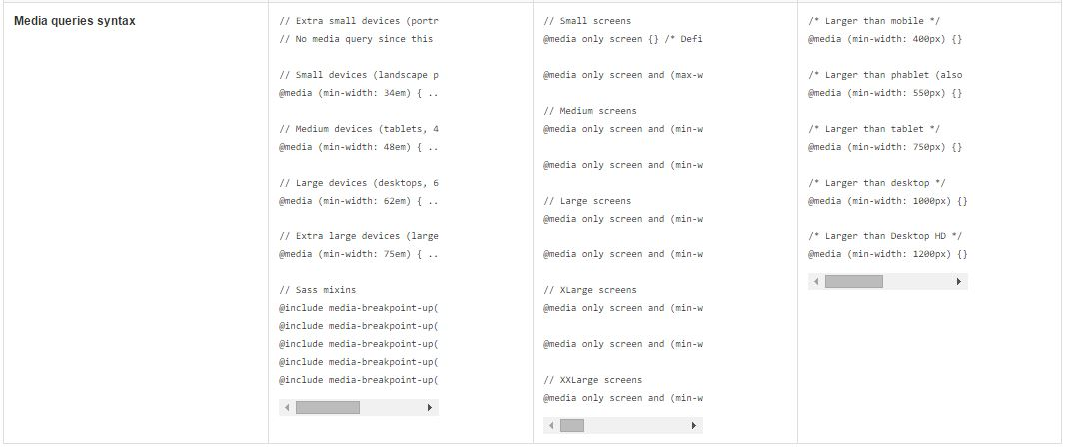
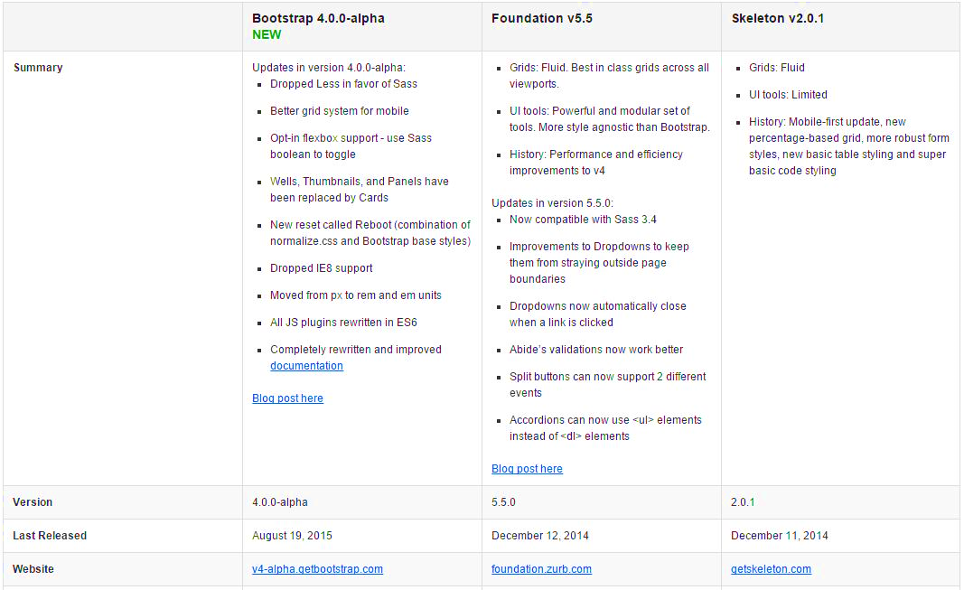
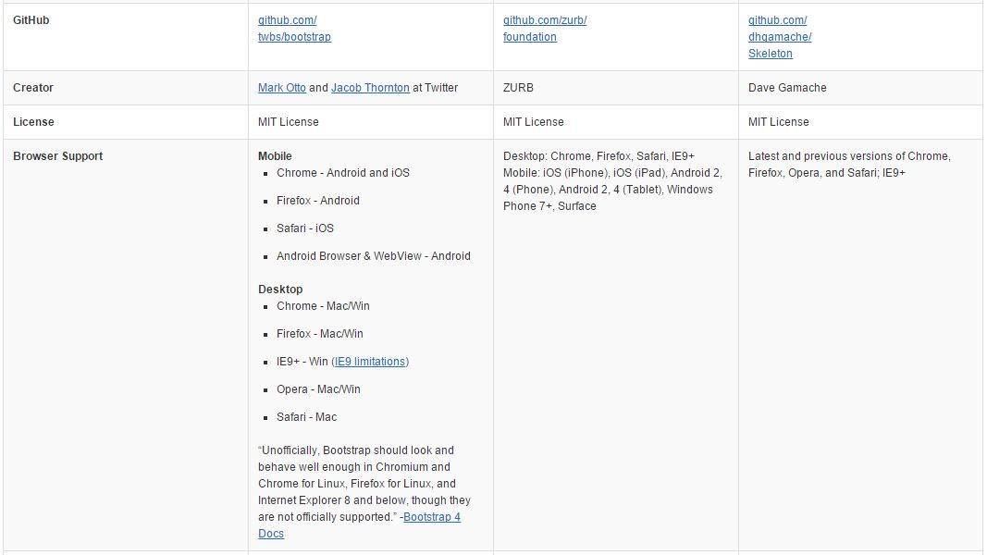
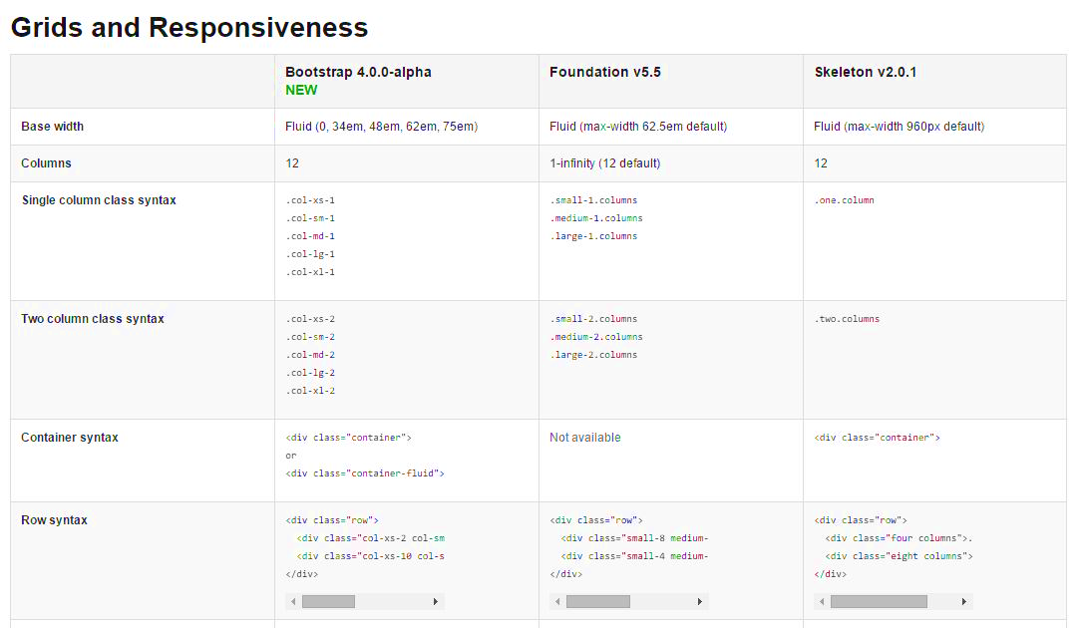
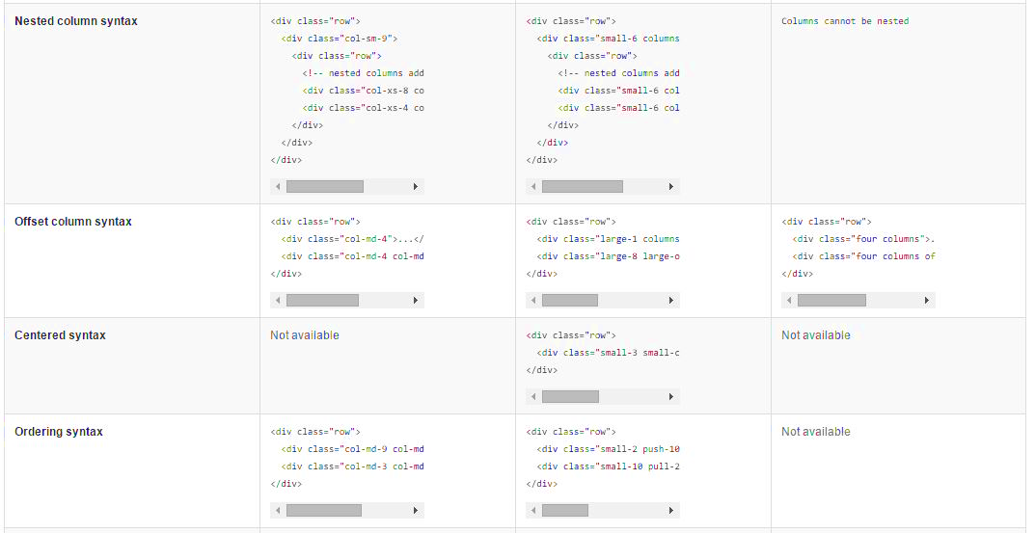
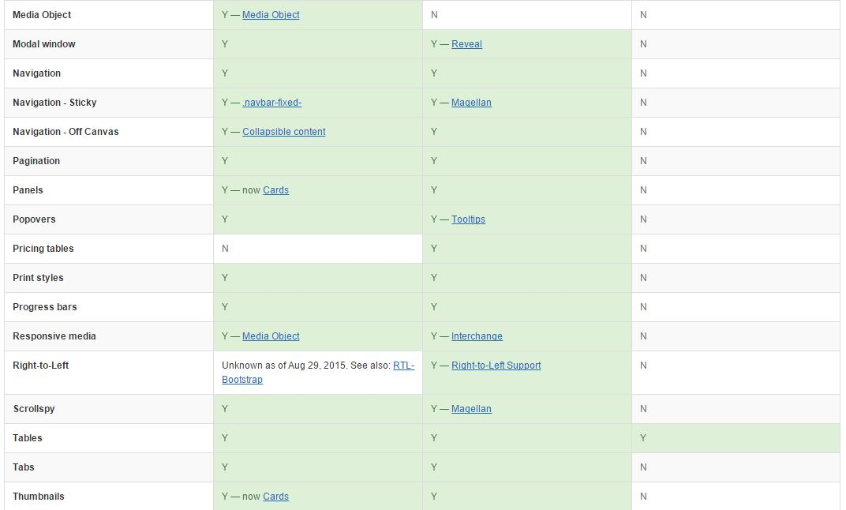

Slide 16
BootStrap

Slide 17
Best Framework

Slide 18
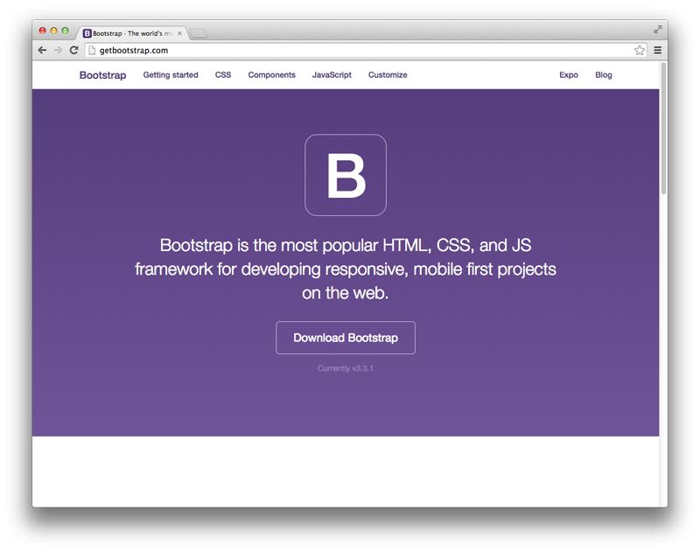

Slide 19
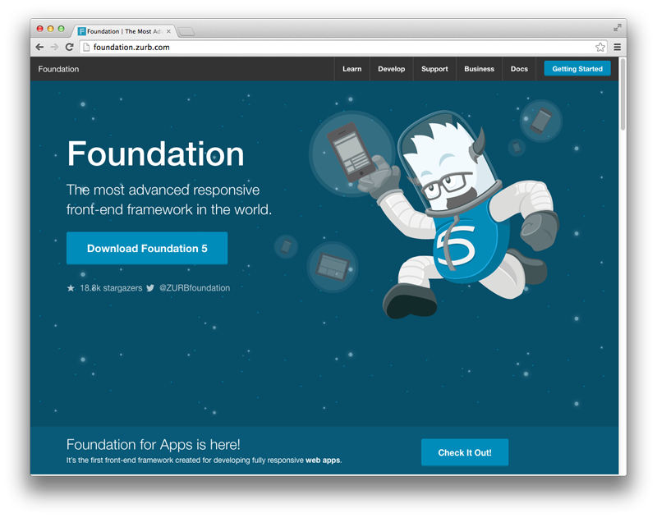

Slide 20
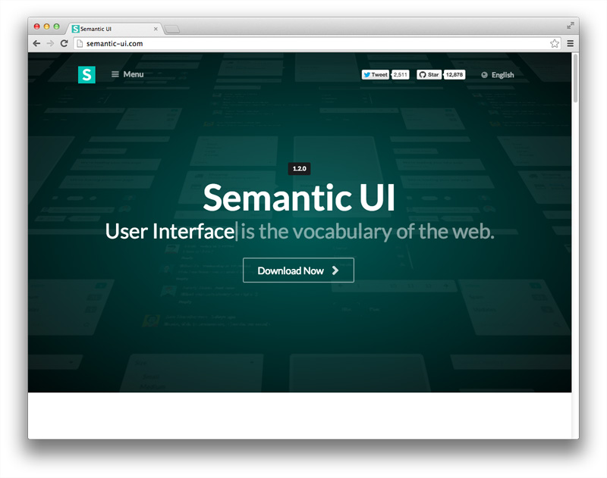

Slide 21
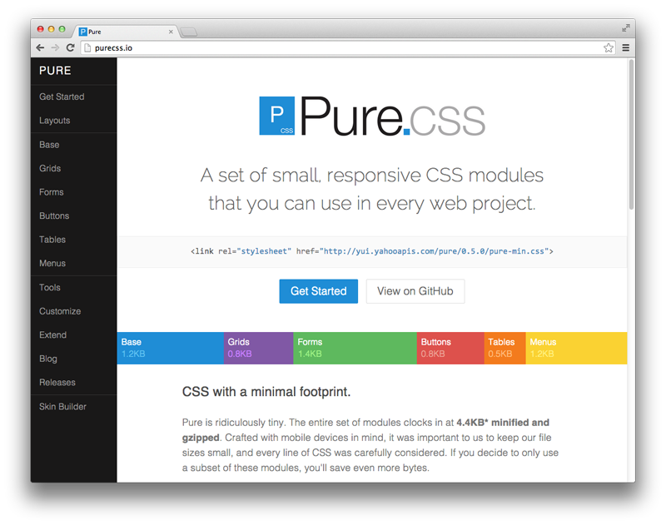

Slide 22
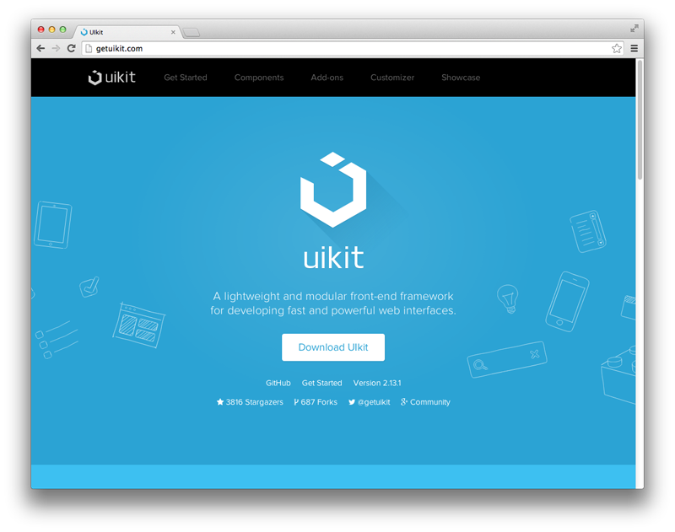

Slide 24
Bootstrap
HTML5 CSS3 jQuery
ASP.NET MVC Yii Framework Joomla

Slide 25
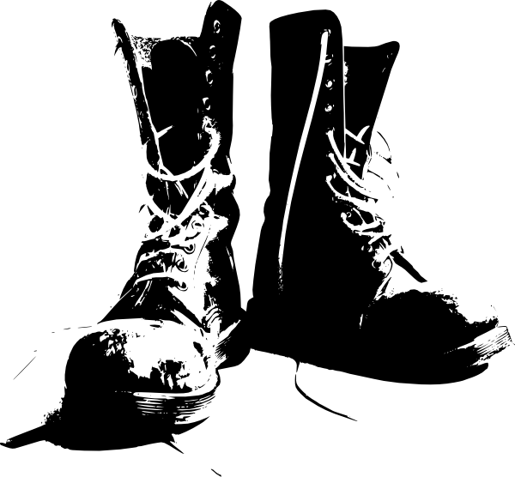
Introduction Bootstrap

Slide 26
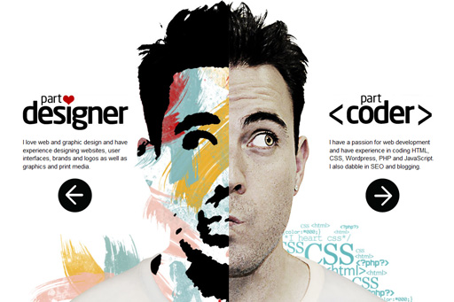

Slide 27
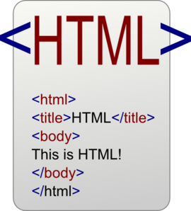

Slide 28
Problems Bootstrap

Slide 29
Benefits Bootstrap

Slide 30
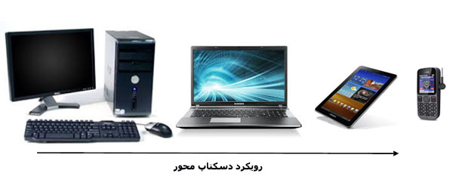
-1 Desktop-based approach

Slide 31
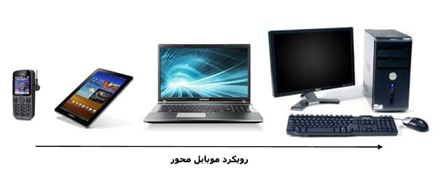
2- Mobil-based approach

Slide 33
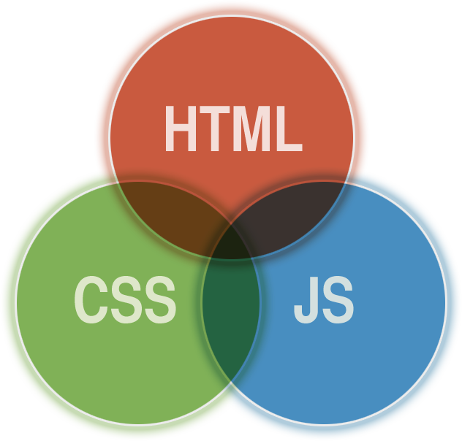

Slide 35
9. Competitiveness
1. Save Time
2. Customizable
10. The Docs Talk!
3. Factor in the Design
11. For the Bosses
4-Consistency
5. Updates
6. Integration
7. Responsiveness
8. Future Compatibility

Slide 36
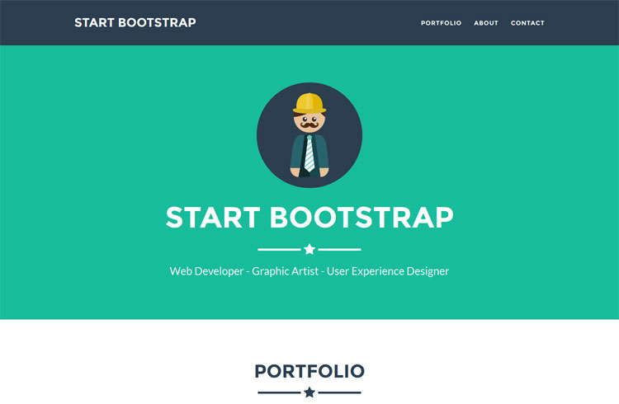

Slide 37
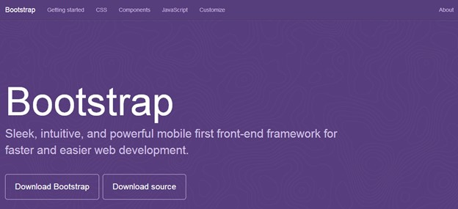
Download Bootstrap

Slide 38
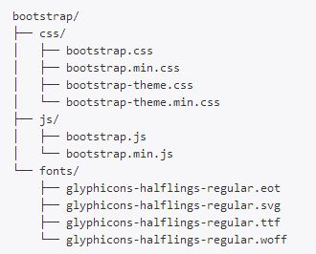
Bootstrap file structure

Slide 39
<span>
<span class="glyphicon glyphicon-search" aria-hidden="true"></span>

Slide 40
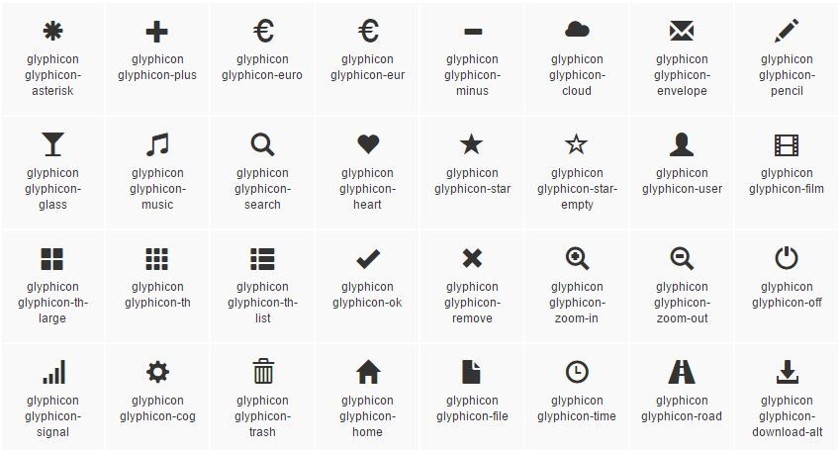

Slide 41
btn-group
<button type="button" class="btn btn-danger dropdown-toggle" data-toggle="dropdown" aria-haspopup="true" aria-expanded="false">

Slide 42
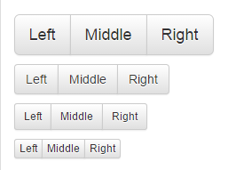
class="btn btn-default btn-lg dropdown-toggle"
class="btn btn-default btn-sm dropdown-toggle"
class="btn btn-default btn-xs dropdown-toggle"

Slide 43
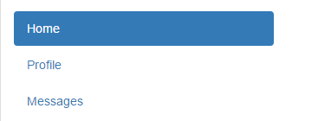
nav
<ul class="nav nav-tabs">
<ul class="nav nav-pills">
<ul class="nav nav-tabs"> ...... </ul>
<ul class="nav nav-pills nav-stacked"> ...</ul>

Slide 44
<ul class="nav nav-tabs">
<ul class="nav nav-pills">

Slide 45
<ul class="nav nav-pills nav-stacked">
<ul class="nav nav-tabs">

Slide 46
Java Script

Slide 47
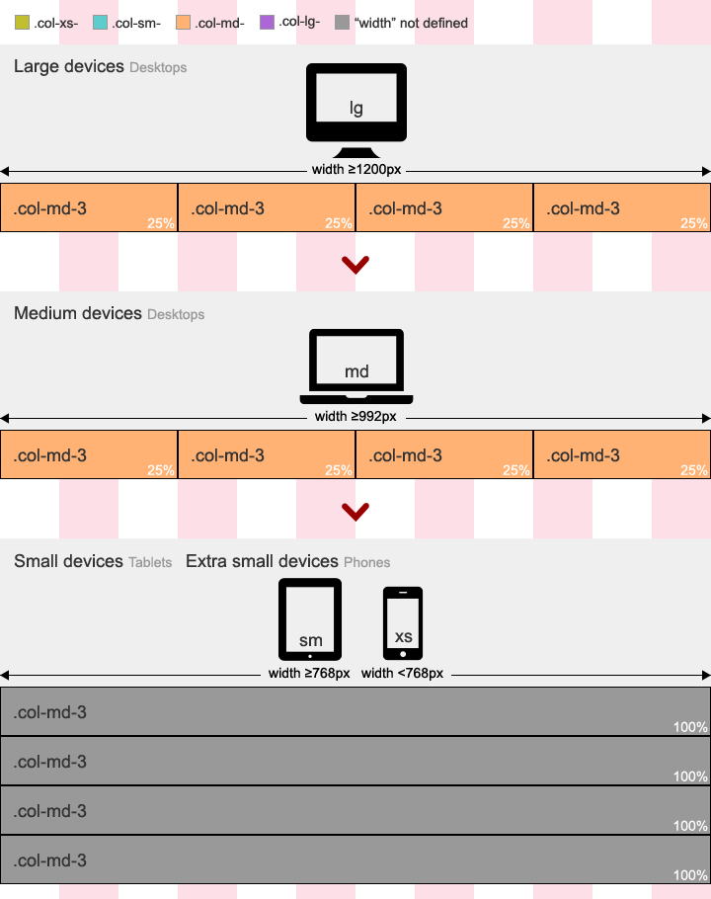
Bootstrap Responsive

Slide 48
What’s New in Bootstrap 4?

Slide 49
Always Design for Mobile First
Mobile First means designing for mobile before designing for desktop or any other device (This will make the page display faster on smaller devices).
This means that we must make some changes in our CSS.
Instead of changing styles when the width gets smaller than 768px, we should change the design when the width gets larger than 768px. This will make our design Mobile First:

Slide 50
Images and Videos
If the width property is set to 100%, the image will be responsive and scale up and down:
If the max-width property is set to 100%, the image will scale down if it has to, but never scale up to be larger than its original size:

Slide 51
img { width: 100%; height: auto; }
img { max-width: 100%; height: auto; }

Slide 52
Responsive Web Design makes your web page look good on all devices (desktops, tablets, and phones).
Responsive Web Design is about using CSS and HTML to resize, hide, shrink, enlarge, or move the content to make it look good on any screen.
Responsive web design uses only HTML and CSS.
Responsive web design is not a program or a JavaScript.
Many web pages are based on a grid-view, which means that the page is divided into columns:
Using a grid-view is very helpful when designing web pages. It makes it easier to place elements on the page.

Slide 53
R
e
s
p
o
n
v
e
s
i

Slide 54
Bootstrap

Slide 55
فهرست مطالب: تعریف کاربرد مزیت نحوه استفاده معرفی سایت های مربوطه

Slide 56
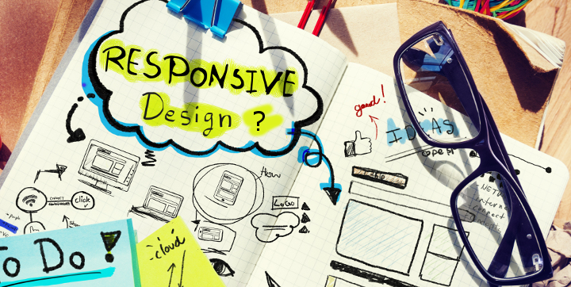
R

Slide 57
R
e
s
p
o
n
s
i
v
e

Slide 58
e
i
d
v
p
o
t
A

Slide 60
Responsive Web Design makes your web page look good on all devices (desktops, tablets, and phones).

Slide 62
The viewport is the user's visible area of a web page.
The viewport varies with the device, and will be smaller on a mobile phone than on a computer screen.
Before tablets and mobile phones, web pages were designed only for computer screens, and it was common for web pages to have a static design and a fixed size.
Then, when we started surfing the internet using tablets and mobile phones, fixed size web pages were too large to fit the viewport. To fix this, browsers on those devices scaled down the entire web page to fit the screen.
This was not perfect, but a quick fix

Slide 63
Many web pages are based on a grid-view, which means that the page is divided into columns:
Using a grid-view is very helpful when designing web pages. It makes it easier to place elements on the page.

Slide 64
Responsive web design uses only HTML and CSS.
Responsive web design is not a program or a JavaScript.
Responsive Web Design is about using CSS and HTML to resize, hide, shrink, enlarge, or move the content to make it look good on any screen.

Slide 65
Media Queries
Media query is a CSS technique introduced in CSS3.
It uses the @media rule to include a block of CSS properties only if a certain condition is true.

