Slide 1
File processing

Slide 2
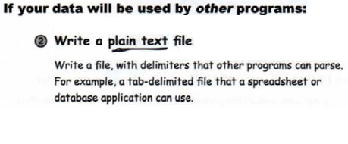
Saving Data

Slide 3
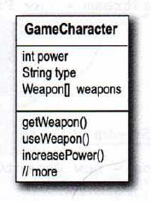
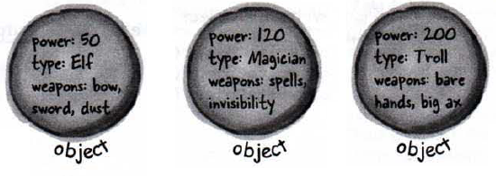
Saving State
A fantasy adventure game
As the game progresses, characters in the game become stronger, weaker, smarter, etc., and gather and use (and lose) weapons.

Slide 4
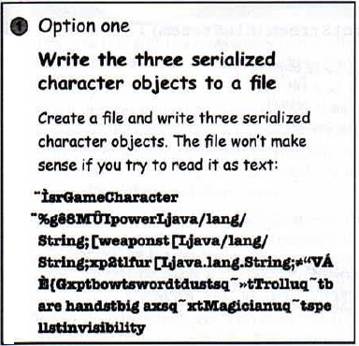
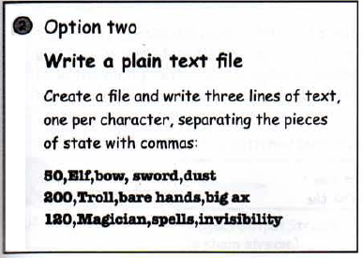
Saving State

Slide 5
Writing a serialized object to a file

Slide 6
Writing a serialized object to a file

Slide 7
Connection Stream vs. Chain Stream
Connection streams represent a connection to a source or destination (file, socket, etc.) while chain stream can't connect on their own and must be chained to a connection stream.

Slide 8
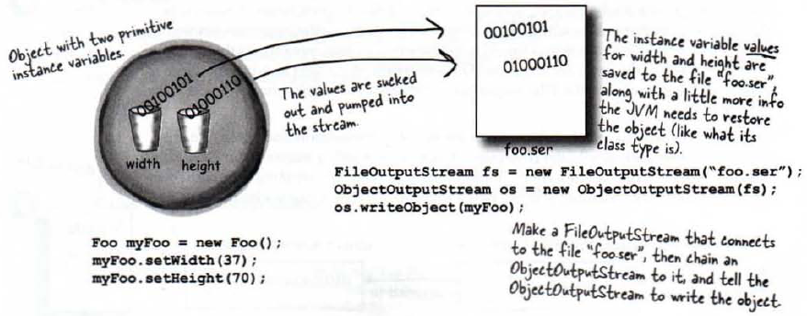
What really happens to an object when it's serialized?

Slide 9
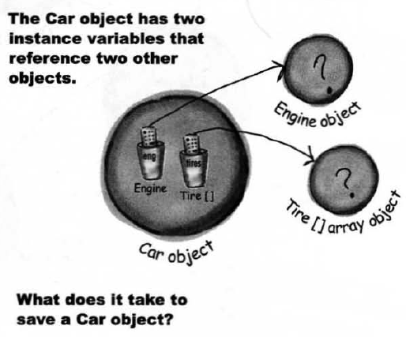
What needs to be saved?
But what exactly IS an object’s state?

Slide 10
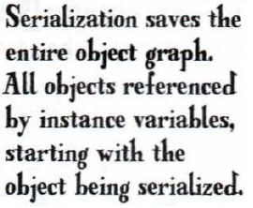
What needs to be saved?

Slide 11
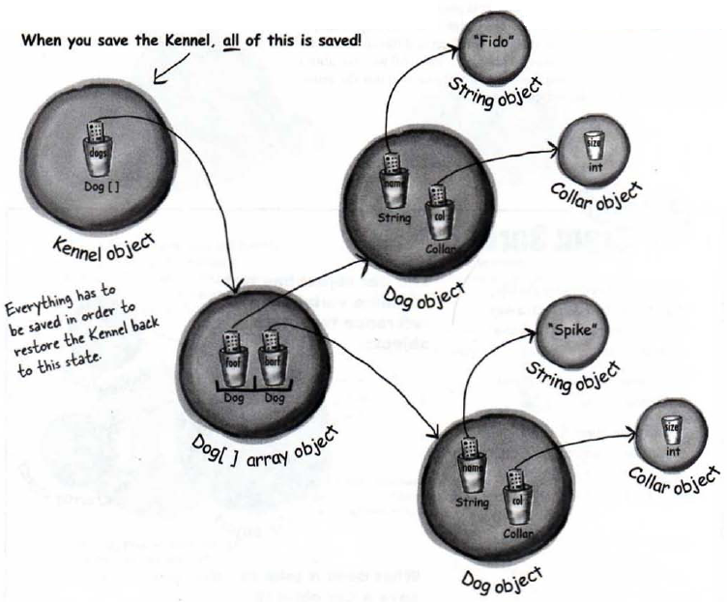

Slide 12
How to serialize?
The Serializable interface is known as a marker or tag interface, because the interface doesn't have any methods to implement.
Its sole purpose is to announce that the class implementing it is Serializable.
If any superclass of a class is serializable, the subclass is automatically serializable even if the subclass doesn't explicitly declare implements Serializable.

Slide 13
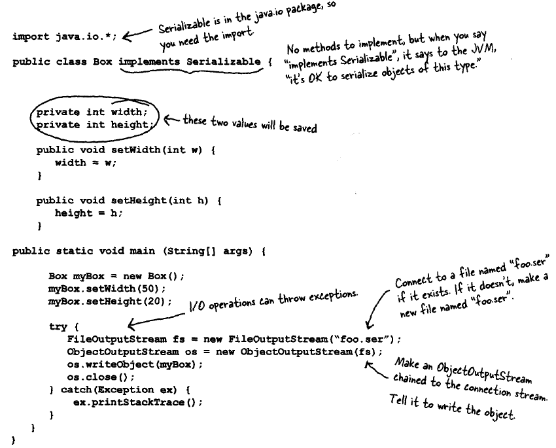

Slide 14
Serialization Is all or nothing.
Either the entire object graph is serialized correctly or serialization fails.
You can't serialize a Pond object if its Duck Instance variable refuses to be serialized (by not Implementing Serializable).

Slide 16
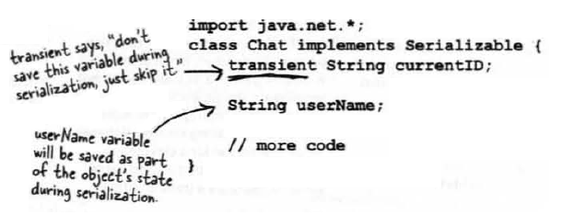
Transient Fields

Slide 17
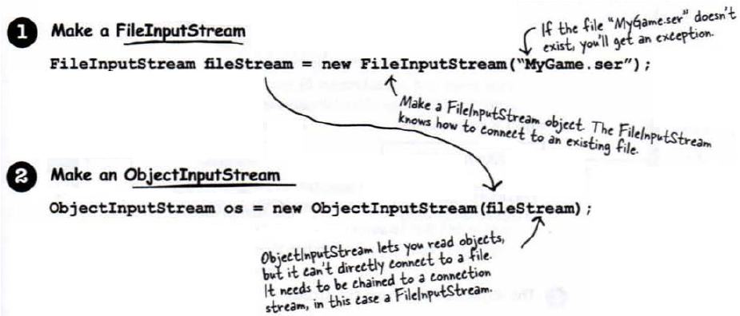
Deserialization
Deserialization: restoring an object

Slide 18
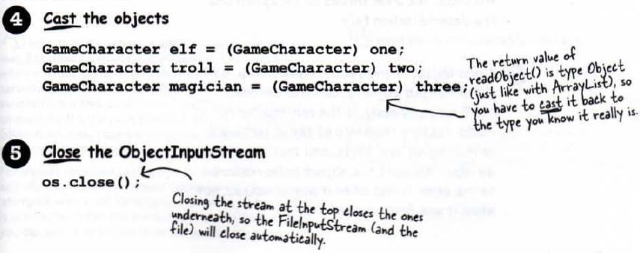
Deserialization

Slide 19
What Happens During Deserializatiotn

Slide 20
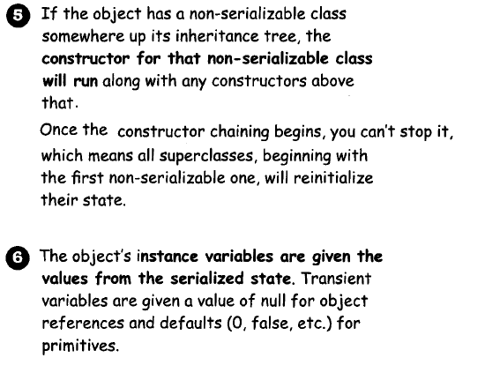
What Happens During Deserializatiotn

Slide 21
Question

Slide 22
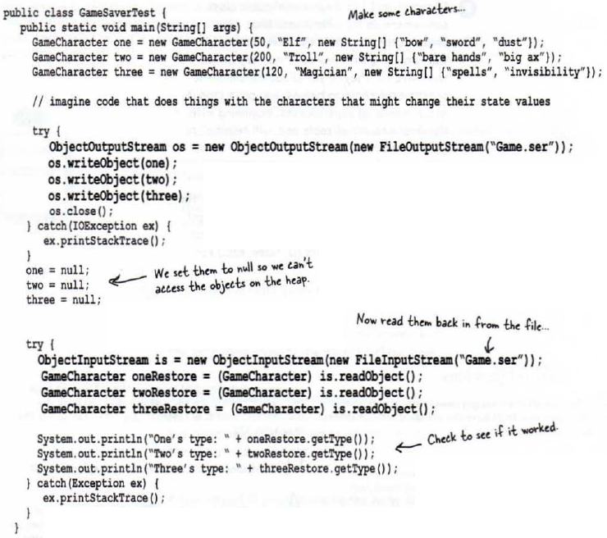

Slide 23
Writing a String to a Text File

Slide 24
Writing a String to a Text File

Slide 25
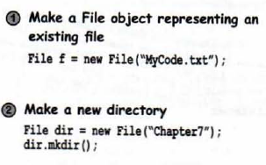
The java.io.File class
The java.io.File class represent a file or directory on disk, but doesn't actually represent the contents of the file.

Slide 26
The java.io.File class

Slide 27
The beauty of buffers

Slide 28
Reading from, a Text File

