Slide 1
LESSON 2 MY classmate Introducing others and asking someone’s name 15O mins in 3 sessions Letters:e, b ,p words and expressions boy , girl , man , woman , friend , classmate)
By: Yahya Kazemi
gahromp4@yahoo.com

Slide 2
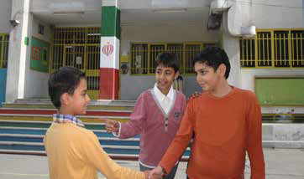
Page 10

Slide 3
Practice 1 Introducing Others page11

Slide 4
Practice 2 Asking Someone’s Name page11

Slide 5
Sounds and Letters Aa , Bb , Cc , Dd , Ee , Ff , Gg , Hh , Ii , Jj , Kk , Ll , Mm , Nn ,Oo ,Pp , Qq , Rr, Ss , Tt , Uu , Vv , Ww , Xx , Yy , Zz

Slide 6
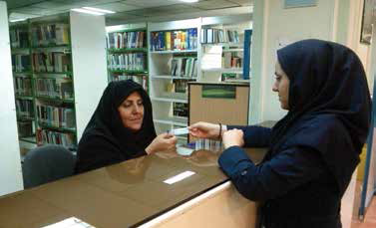
Page 12

Slide 7
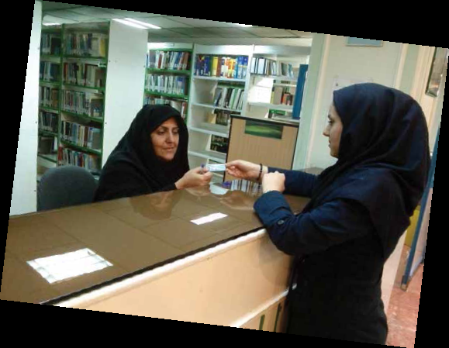
Parisa Behparvar
Parisa Behparvar

Slide 8
E e
Erfan
Nader
-

Slide 9
Example:
Behnaz
, Pedram
, Emad
, Esmat
, eraser
, Sepehr

Slide 10
Parisa Behparvar
Parisa Behparvar

Slide 11
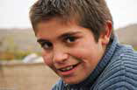
B b
Bahrami
Akbari
-

Slide 12
Example:
, Abbas
, Ziba
, Zaynab
Behrooz
, Mobina

Slide 13
Parisa Behparvar
Parisa Behparvar

Slide 14
P p
Police
pencil
-

Slide 15
Example:
Pedram
, Sepideh
, Parviz
, park

Slide 16
Follow – up Activity
Ebadi , Pakzad , Bahrami ,
Parinaz , Elaheh , Behnaz
, Pedram

Slide 17
Listening and Reading page13

Slide 18
testing
- mami 1)A 2)E 3)e
Ak –ar 1)p 2)b 3)B
My last name is ……….
1)Erfan 2)Parham 3)Alipoor
My first name is …………
1)Miss Pakzad 2) Bahram 3)Ebadi
This is my friend Reza.
Nice to meet you. …………………………
1)Nice to meet you , too.
2)Nice to meet you.

Slide 19
testing
Who is that girl? 1)Miss Karimi 2)Pedram
Who is that man? 1)She ‘s Parisa. 2)He’s my English teacher, Mr Emadi.
This is my classmate Parinaz.
1)I’m Bita. 2)This is my friend Elaheh.
Who is that woman? 1)She’s my teacher Mrs Karimi. 2)He’s my teacher Mr Karimi.
That boy is …………… 1)Elnaz 2)Ehsan

Slide 20
testing
Ebad
Bahmani
Parsa
Kazemi
Alipoor
Mobina
Bahari
Akbari
m,i,m,E,a
- - - - -
(Emami)
k,b,a,a,B
- - - - -
(Babak)

Slide 21
Reading
1)
Nice to meet you ,too ,Amir.
2)
This is my friend Amir.
3)
Amir,this is my classmate Erfan.
4)
Nice to meet you , Erfan.
Ali:
Ali:
Amir:
Erfan:

Slide 22
The End

