Slide 1
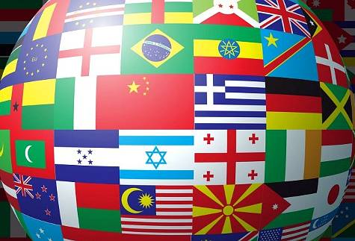
Country Nationality

Slide 2
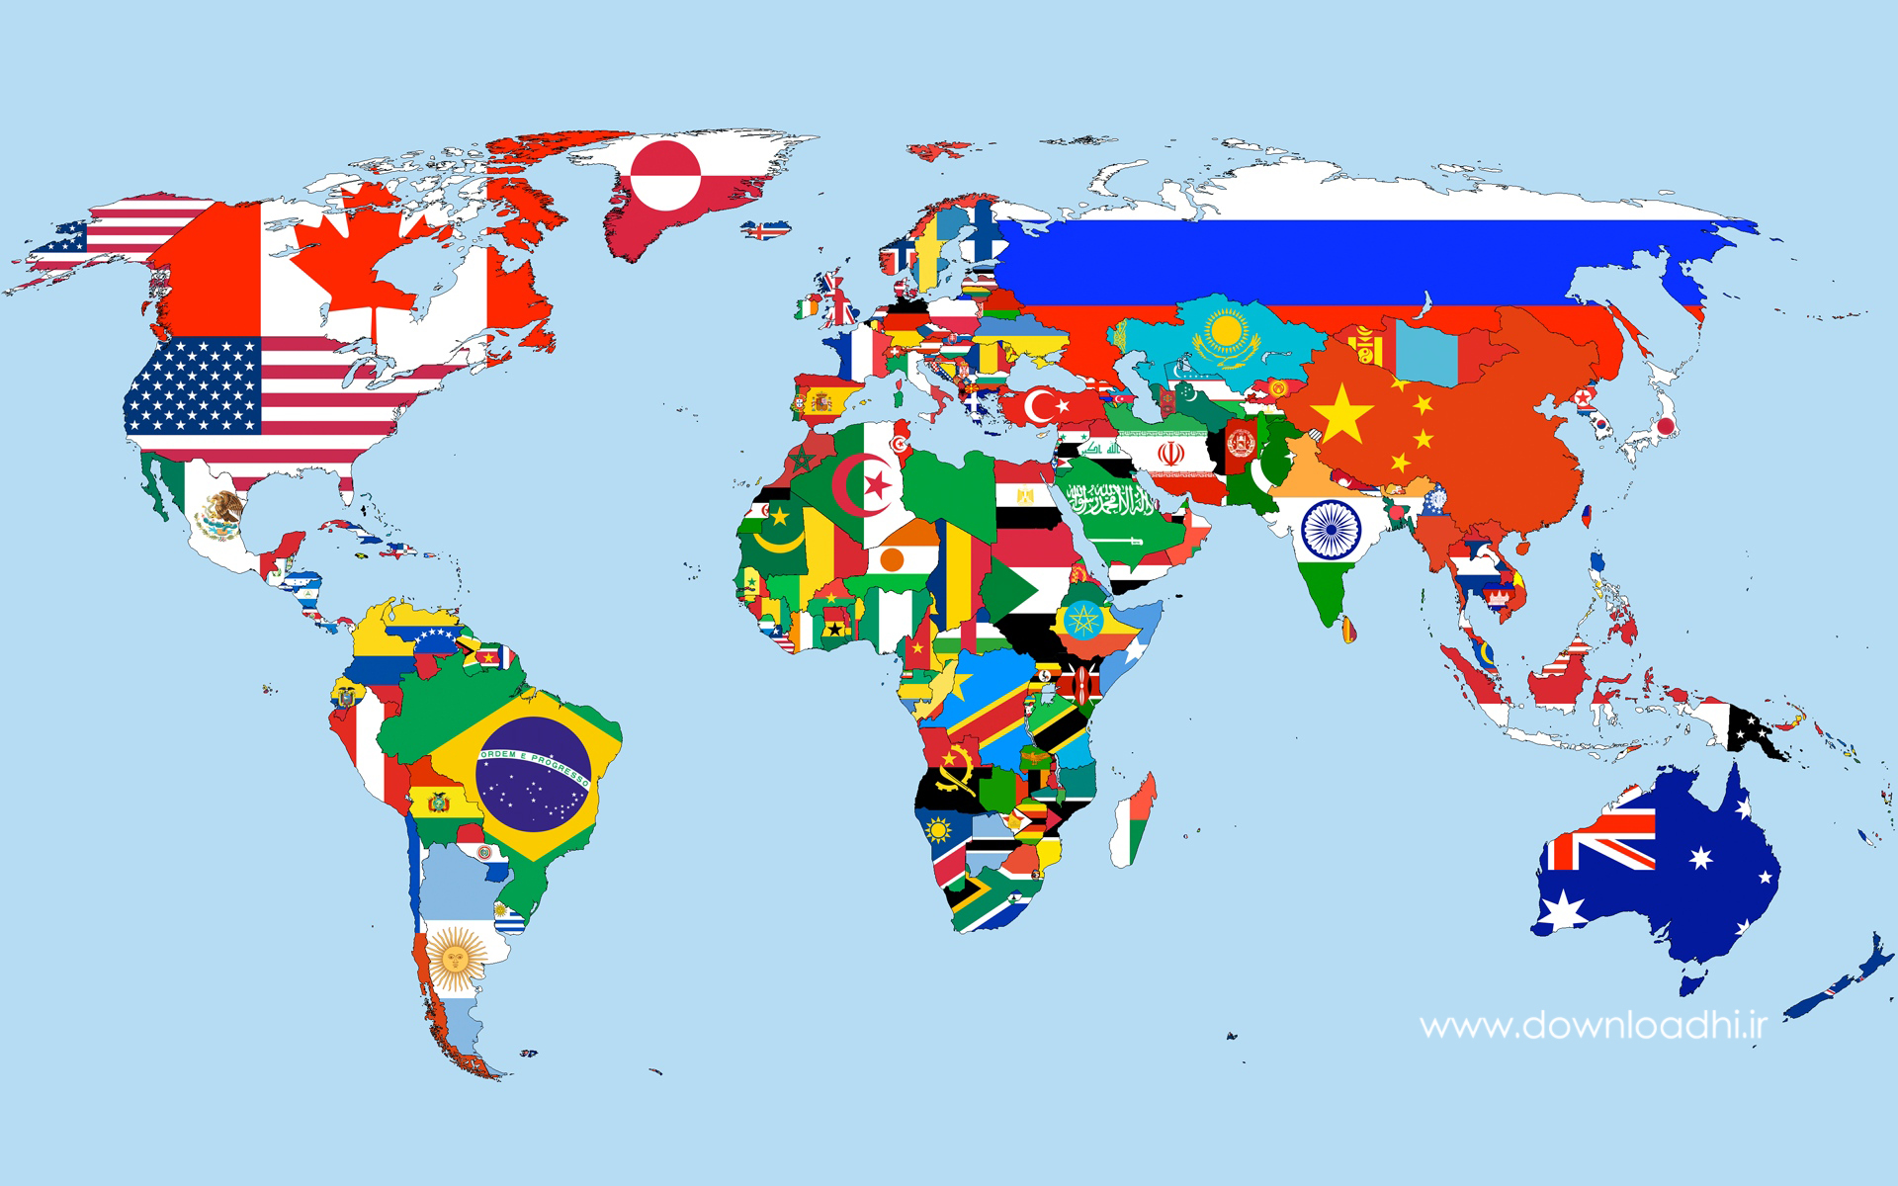
map
world

Slide 3
France
Iran
England
Spain
country
Brazil
China

Slide 4
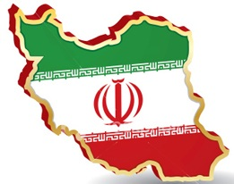
Country
Iran
nationality
Iranian

Slide 5
nationality
French
country
France

Slide 6
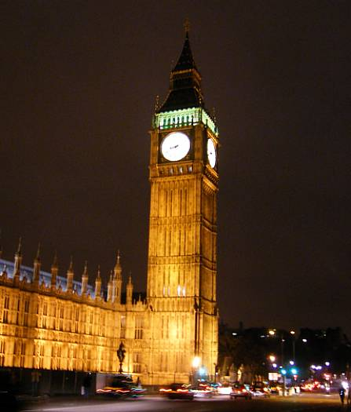
Country
England
nationality
British

Slide 7
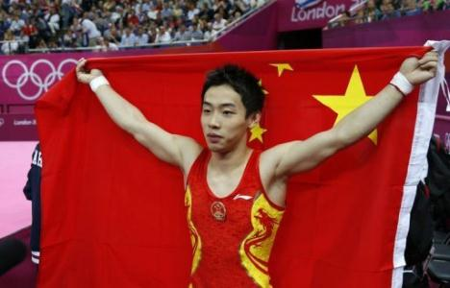
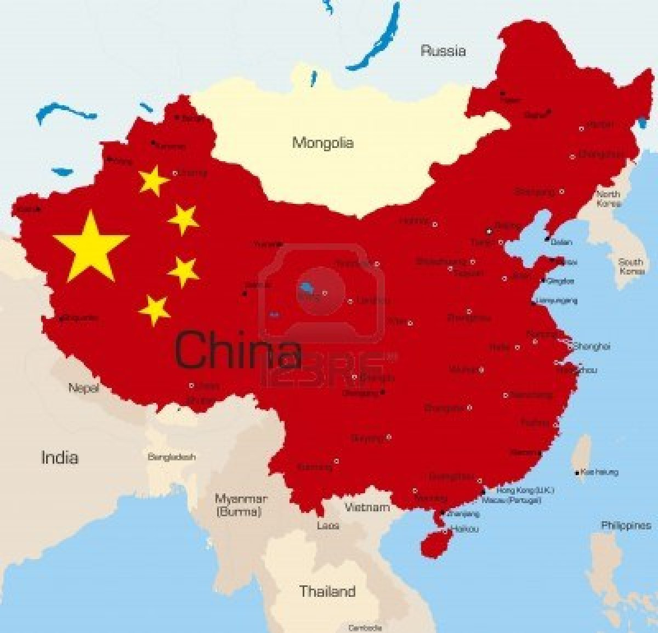
nationality
Chinese
country
China

Slide 8
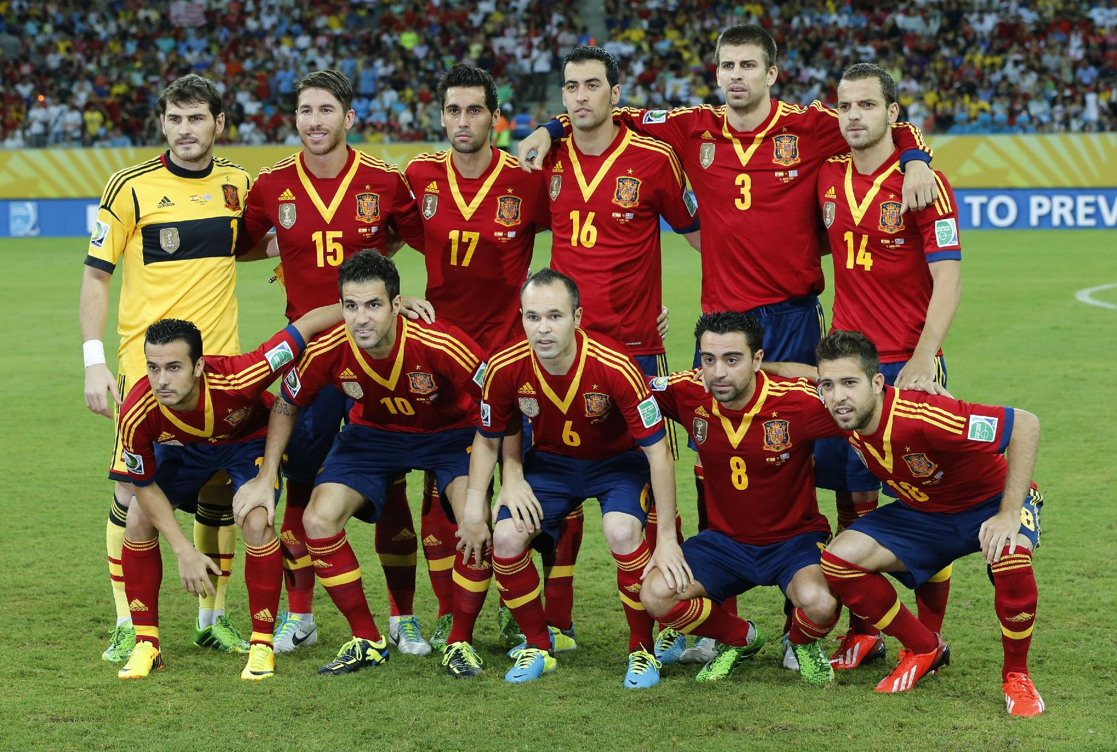
nationality
Spanish
country
Spain

Slide 9
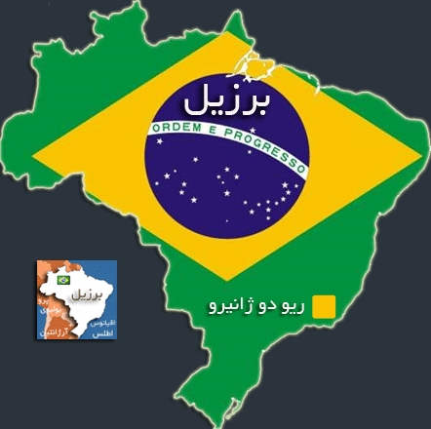
country
Brazil
nationality
Brazilian

Slide 10
Flag | country | nationality
Iran
Iranian
Brazil
Brazilian
England
British
China
Chinese
Spain
Spanish
France
French

Slide 11
(Is he Iranian? Or Is he from Iran?) Where is he from?

