Slide 1
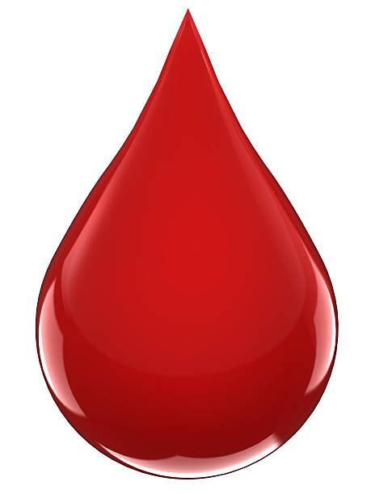
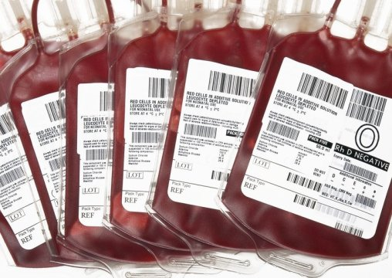
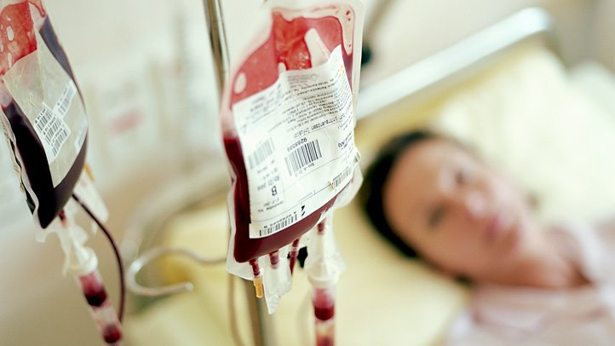
Massive blood Transfusion

Slide 2

Massive transfusion protocol (MTPs)
Established to provide rapid blood replacement in a setting of severe hemorrhage
Early optimal blood transfusion is essential to sustain organ perfusion and oxygenation

Slide 3
What is Massive transfusion?
10 units of red cells in 24 hours
Total blood volume is replaced within 24 hours
Three units over one hour
50% of total blood volume is replaced within 3 hours

Slide 4
Massive Transfusion-Clinical Settings
Trauma
Surgery (e.g. Liver, Cardiovascular)
Less frequent
  abdominal aortic aneurysm
  liver transplant
  obstetric catastrophes
  GI bleeding

Slide 5
Cardiac surgery — Most common cause of massive transfusion
Obstetric hemorrhage — Gravid and parturient women are hypercoagulable with compensatory hyperfibrinolysis.
Liver disease —
  leads to the reduced production of normal coagulation factors
  production of abnormal factors

Slide 6

Types of Shock
SHOCK
Cardiogenic – MI, cardiomyopathy
Obstructive – Tamponade, PE
Distributive – Sepsis, Anaphylaxis
Hypovolemic – Hemorrhage

Slide 7

Challenges
Types of components to be administered
Selection of the appropriate amounts
TIME

Slide 8
Blood Products
RBC
Plasma
Platelets
Cryoprecipitate

Slide 9


Emergency blood issue
Immediate
Minutes
Within an hour
Group O Rh neg Packed RBCs
ABO & Rh D type
ABO & Rh D type
Group specific blood
(5-10 min)
Immediate spin crossmatch
( 15-20) min)
Complete crossmatch
If units are issued without X match – written consent of physician to be taken,
-complete X match protocols followed after issue

Slide 10
Emergency Release Blood - Universal Donor
O, RhD neg/pos RBCs – 5 min
AB or A Plasma/Platelets

Slide 11
Recommendations
“Damage control” approach
Improved survival when the ratio of transfused Fresh Frozen Plasma (FFP, in units) to platelets (in units) to red blood cells (RBCs, in units) approaches 1:1:1
Holcomb JB, Jenkins D, Rhee P, et al. Damage control resuscitation: directly addressing the early coagulopathy of trauma. J Trauma 2007; 62:307.
Notes:
Uptodate

Slide 12

Important
At the onset - aggressive fluid replacement and bleeding control can reduce the tissue injury, inflammation, and hypoperfusion
Untimely or incomplete control of massive bleeding- systemic consumptive coagulopathy with hemodilution and endothelial damage
If uncorrected, concurrent hypothermia and acidosis can further exacerbate coagulopathy and lead to irreversible multiorgan failure (MOF).

Slide 13

Patients who have sustained severe traumatic injuries and/or who are likely to require massive transfusion should receive a
1:1:1 ratio of FFP to platelets to RBCs at the outset of their resuscitation and transfusion therapy
Borgman MA, Spinella PC, Perkins JG, et al. The ratio of blood products transfused affects mortality in patients receiving massive transfusions at a combat support hospital. J Trauma 2007; 63:805.
Holcomb JB, Wade CE, Michalek JE, et al. Increased plasma and platelet to red blood cell ratios improves outcome in 466 massively transfused civilian trauma patients. Ann Surg 2008; 248:447.
Cotton BA, Au BK, Nunez TC, et al. Predefined massive transfusion protocols are associated with a reduction in organ failure and postinjury complications. J Trauma 2009; 66:41.
Shaz BH, Dente CJ, Nicholas J, et al. Increased number of coagulation products in relationship to red blood cell products transfused improves mortality in trauma patients. Transfusion 2010; 50:493.
Inaba K, Lustenberger T, Rhee P, et al. The impact of platelet transfusion in massively transfused trauma patients. J Am Coll Surg 2010; 211:573.
de Biasi AR, Stansbury LG, Dutton RP, et al. Blood product use in trauma resuscitation: plasma deficit versus plasma ratio as predictors of mortality in trauma (CME). Transfusion 2011; 51:1925.

Slide 14
Important!
Uncrossmatched group O Rh D negative RBCs /Whole blood
Residual plasma with both antibodies (Anti A & B) can accumulate when large quantities are transfused
Repeat the blood group and do antibody titres before resuming transfusion of RBCs of the patient’s own blood group.

Slide 15

Fibrinogen concentrate
European guidelines recommend fibrinogen concentrate when the level falls below 1.5g
Cost of fibrinogen concentrate is much more than cryoprecipitate
Availability
Notes:
Availability

Slide 16

Cryoprecipitate
Most common blood product used to replace fibrinogen
Contains approximately 200–250 mg of fibrinogen per unit
Standard dose of two 5-unit pools should be administered early in major obstetric haemorrhage.
Subsequent cryoprecipitate transfusion should be guided by fibrinogen results, aiming to keep levels above 1.5 g/l.

Slide 17
Platelet Transfusion
It becomes necessary after two volumes of blood loss.
10 to 12 units of transfused RBCs- 50 percent fall in the platelet count
Platelet concentrates should be transfused as 1 pack/10 kg body weight.

Slide 18
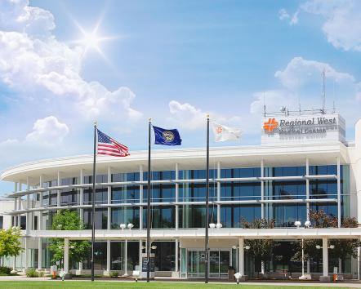
Example
Regional West Medical Center, Nebraska

Slide 19
Massive Transfusion Protocol
Regional West Medical Center
Immediately prepare first transfusion “package” :
Six units RBC’s
Four units FFP
Deliver first “package” within 35 minutes of the initial order.
Have second “package” ready within 35 minutes of issue of first “package”.
Six units RBC’s
Four units FFP
One Single Donor Platelet or one “six-pack” random platelets
Have third “package” ready within 35 minutes of issue of second “package.”
Six units RBC’s
Four units FFP
One “ten-pack” pooled Cryoprecipitate

Slide 20
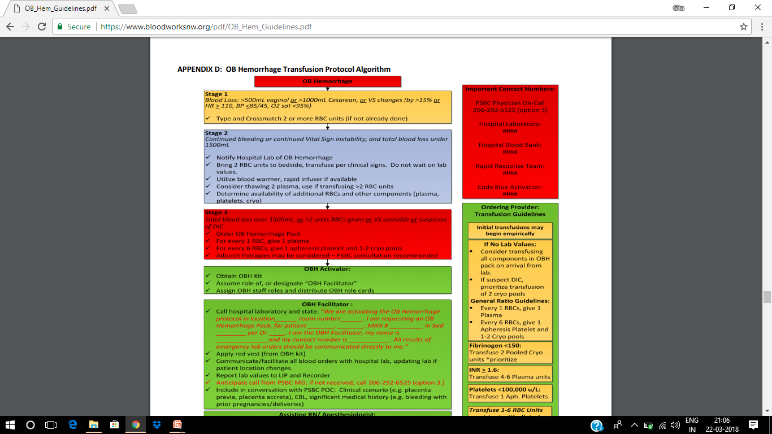
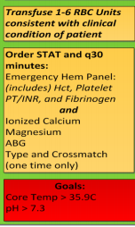

Slide 21
Complications of Massive Transfusion
Hypothermia
Acid/base derangements
Coagulopathy
Citrate toxicity
Electrolyte abnormalities
  hypocalcemia
  hypomagnesemia
  hypokalemia
  hyperkalemia
Transfusion-associated acute lung injury

Slide 22
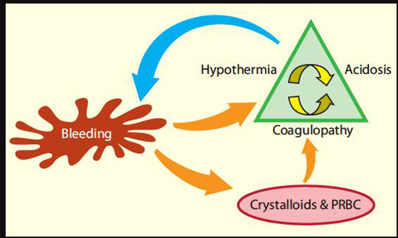

Slide 23
Acidosis and hypothermia
  Acidosis
    Interferes with formation of coagulation factor complexes
  Hypothermia
    Reduces enzymatic activity of coagulation factors
    Prevents activation of platelets

Slide 24
Hypothermia
10 units of cold blood products and an hour of surgery can lead to a 3°C drop in core temperature and hypothermic coagulopathy
RBCs that are stored at 4C are transfused rapidly
Lowers the recipient’s core temperature and further impairs haemostasis.
Reduces the metabolism of citrate and lactate
Increases the likelihood of hypocalcaemia, metabolic acidosis and cardiac arrhythmias.
Shifts the oxyhaemoglobin dissociation curve to the left, reducing tissue oxygen delivery

Slide 25
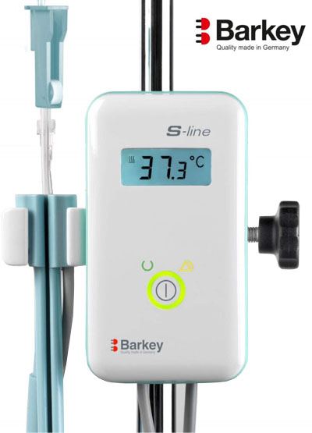
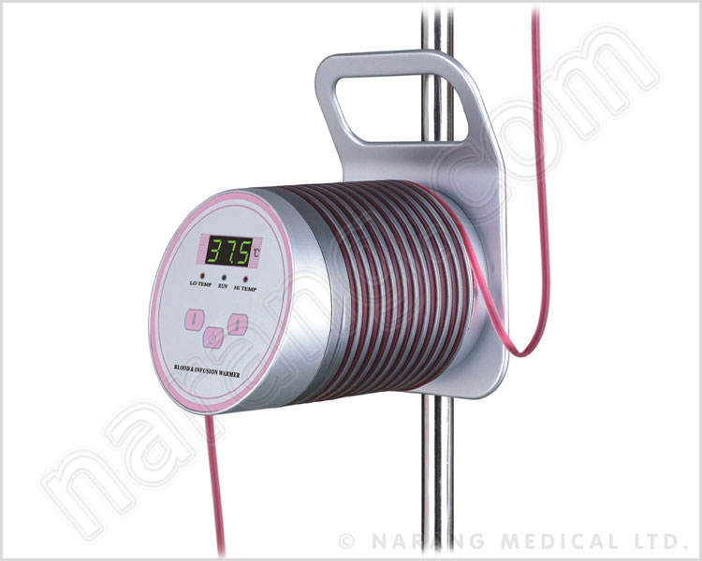
Prevention of hypothermia
A high capacity commercial blood warmer should be used to warm blood components

Slide 26
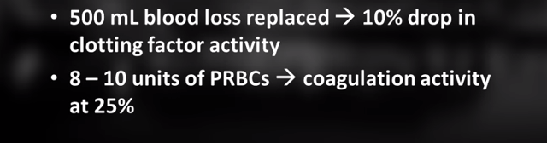
Coagulopathy
Dilutional coagulopathy
Disseminated intravascular coagulation.
Consumption of platelets and coagulation factors

Slide 27
ALTERATIONS IN HEMOSTASIS
Acute DIC
  microvascular oozing
  prolongation of the PT and aPTT in excess of that expected by dilution
  significant thrombocytopenia
  low fibrinogen levels
  increased levels of D-dimer

Slide 28
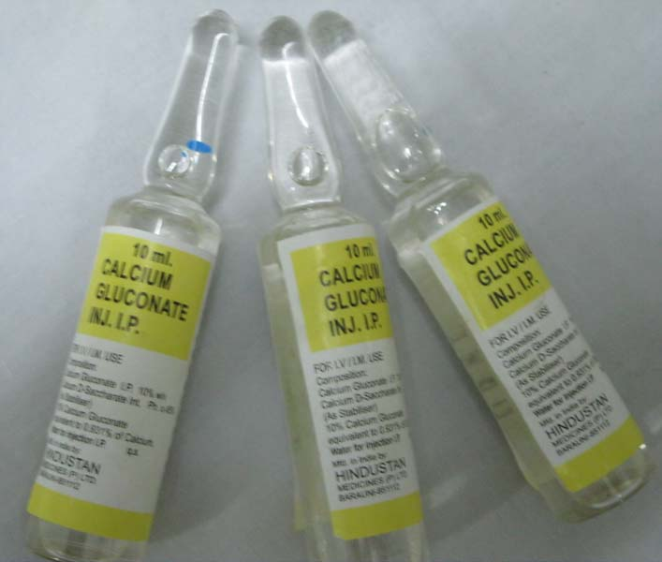
Hypocalcaemia
Citrate binds calcium
Results in hypotension, small pulse pressure, flat ST-segments and prolonged QT intervals on the ECG.
Slow i.v. injection of calcium gluconate 10%

Slide 29
Hyperkalaemia
The potassium concentration of blood increases during storage, by as much as 5–10 mmol u1 .
Hyperkalaemia rarely occurs during massive transfusions unless the patient is also hypothermic and acidotic

Slide 30
Monitoring recommendations
PT, aPTT
Platelet count
Fibrinogen
Electrolytes
Viscoelastic test
  after the administration of every five to seven units of red cells.

Slide 31
Goals
Investigation | Target value
Haemoglobin | 10 gm/dl
Hematocrit | 32%
Platelet count | > 50 x 10 9 /l
PT | < 1.5 x control
PTT | < 1.5 x control
Fibrinogen | > 0.8 g/l

Slide 32
Viscoelastic whole-blood assays
TEG® and ROTEM®
provide information on the coagulation process through the graphic display of clot initiation, propagation and lysis.
used to guide transfusion of blood components

Slide 33
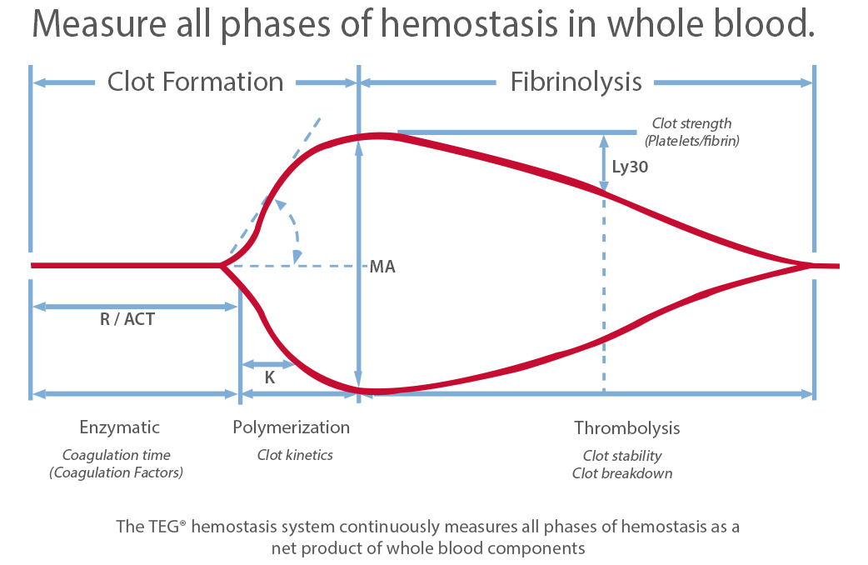

Slide 34
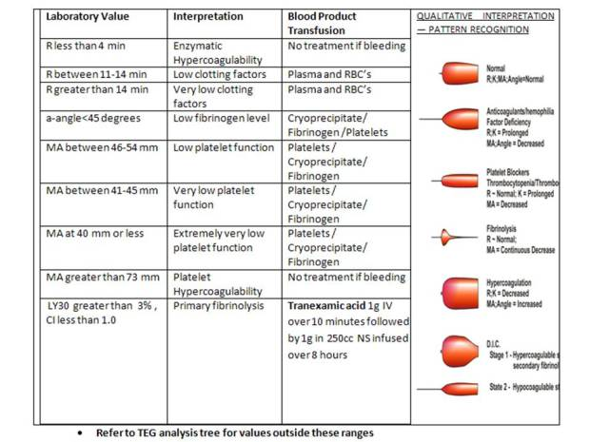
Costeffective -since it reduces inappropriate transfusions, thus improving transfusion management and patients’ clinical outcome

Slide 35
Depletion of fibrinogen and coagulation factors
  PT prolonged – FFP in a dose of 15 ml/kg
  aPTT prolonged – factor VIII/fibrinogen concentrate

Slide 36

Summary and recommendations
Need to define protocol triggers , an algorithm for preparation and delivery of blood products, including continued support
The protocol should be updated annually and practised in ‘skills drills’ to inform and train relevant personnel.

